Slide 1
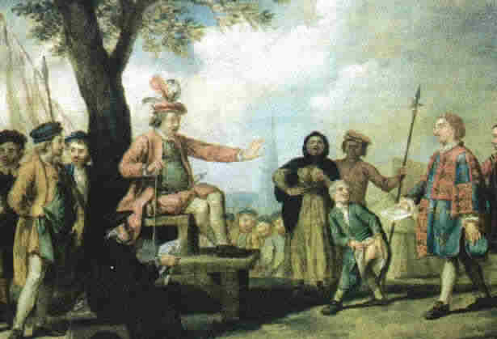
The Tudors - Revision

Slide 2
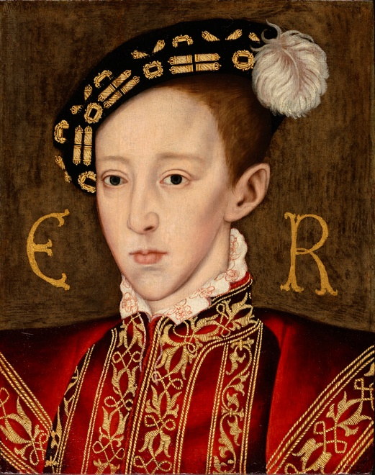
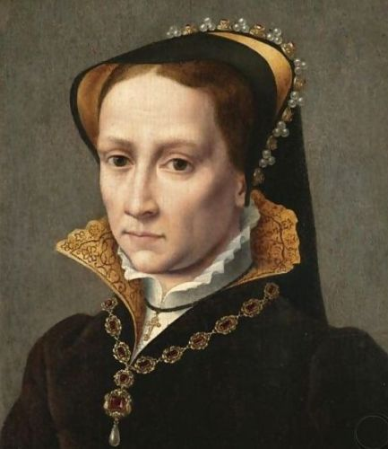
Enquiry topics (sources)
The stability of the monarchy, 1547-58
Religious change, 1547-58
Rebellion and unrest, 1547-58

Slide 3
The stability of the monarchy, 1547-58
How serious were the problems caused by the minority of Edward Vl?
Was Somerset’s attempted coup in 1549 a serious threat to stability?
How seriously did the attempt to alter the succession in 1553 threaten dynastic security?
How serious a threat to the power of the monarchy was a female ruler?
Did the marriage of Mary Tudor to Philip of Spain cause a crisis?
How stable was the monarchy in the period from 1547-1558?

Slide 4
Rebellion and Unrest, 1547-58
How serious were the social and economic problems in the mid-Tudor period?
In what ways did the social and economic problems contribute to unrest?
Why was there so much unrest in 1549?
Why did the rebellions of 1549 fail and did they ever threaten the government?
Why did Mary face challenges to her rule in the first two years of her reign?
To what extent did the challenges to Mary threaten the stability of the monarchy?
Why was the monarchy able to survive the mid-Tudor crises?

Slide 5
How serious were the social and economic problems in the mid-Tudor period?
Population rise Between 1525 and 1551 the population rose form 2.3 million to 3 million. | Poverty and vagrancy
Inflation and rising prices Made worse by debasement of the coinage. | Rising rents
Enclosure | Poor harvests Drove the price of food
Decline in living standards | Influenza and epidemics

Slide 6
In what ways did the social and economic problems contribute to unrest?
Somerset continued the war against Scotland and because of this he continued the policy of debasement which meant that inflation rose faster.
Many thought that enclosure led to inflation.
Somerset established commissions in 1548 and 1549 to investigate illegal enclosures.

Slide 7
Why was there so much unrest in 1549?
Social, economic, religious and political reasons.
Somerset was not king (he was Lord Protector) and so it was easier to challenge unpopular policies.
The late spring and summer of 1549 saw riots and rebellion in 25 counties.
In two cases these required the use of government troops – In Devon and Cornwall and East Anglia (Norfolk).

Slide 8
Why was there a rising in Devon and Cornwall?
Western or Prayer Book Rebellion (?)
Religion dominated the rebels demands but the demands were drawn up by Catholic priests.
Social and economic grievances as well. E.g. the sheep tax.
Class tension. Commoners v gentry.

Slide 9
Why was there unrest in East Anglia?
Kett’s Rebellion in Norfolk.
The unrest started as an enclosure riot.
Agricultural demands e.g. regarding common land
Economic grievances – increasing rents
Religious grievances – rebels were more Protestant
Social grievances – commons attacked the nobles and gentry as landlords and corruption in local government.

Slide 10
Why did the rebellions of 1549 fail and did they ever threaten the government?
The widespread unrest was generally put down by nobility and gentry but in both the West Country and Norfolk a powerful noble family to put down the unrest was not present.
At first the government was unaware of the scale of the problem in the west country.
Government forces were in action in Scotland or defending the south coast from a possible invasion by the French.

Slide 11
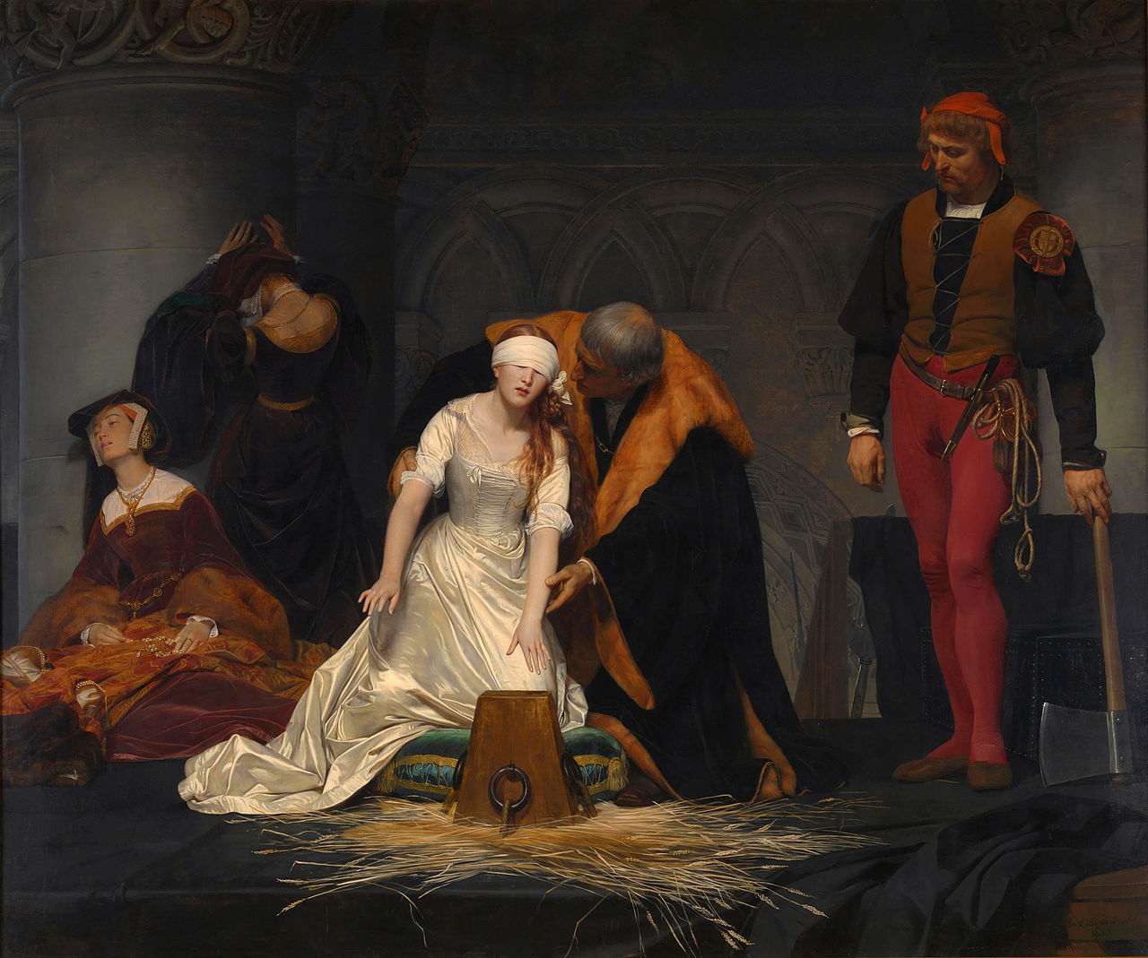
Why did Mary face challenges to her rule in the first two years of her reign?
Lady Jane Grey – How much did Northumberland stand to gain?

Slide 12
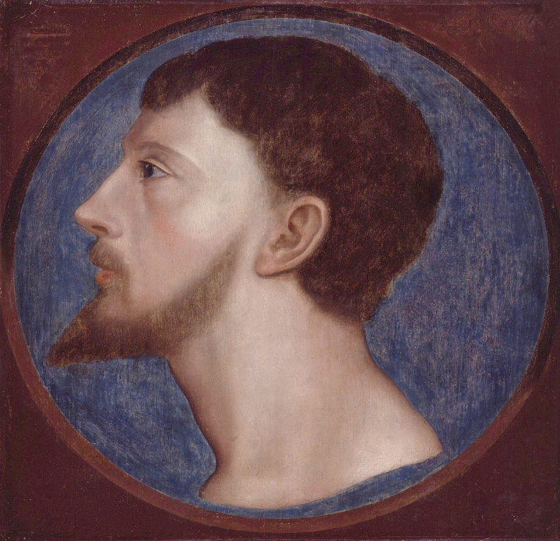
Why did Wyatt rebel in 1554?
Marriage to Philip of Spain
Religious motives?
Loss of status.
Economic motives – decline in the Kent cloth trade.

Slide 13
To what extent did the challenges to Mary threaten the stability of the monarchy?
Lady Jane Grey and Wyatt represented serious threats to the throne.
It was Mary’s actions which probably preserved the throne for the Tudors.
Most of the population supported the Tudors and their right to the throne.
The rebellions of 1549 had turned the ruling classes against rebellion as they feared mob rule and disorder.

Slide 14
Why was the monarchy able to survive the mid-Tudor crises?
The political classes wanted to avoid conflict e.g lack of support for Northumberland in 1553.
The country survived the rule of a minor despite the ambitions of Somerset and Northumberland.
The Tudors were seen as legitimate rulers.
Most people were willing to accept the religion of the monarch.
Most put loyalty to the monarch before their religious beliefs.
Governments tried to deal with social and economic problems.

