Slide 1
REVISION OF the mid-tudor crisis and religious changes 1547 - 1558
How Protestant did England become under Edward (consider Somerset and Northumberland?
What opposition did he face?
How Catholic did England become under Mary?
What difficulties and opposition did she face?
What was the impact of the burnings?

Slide 2
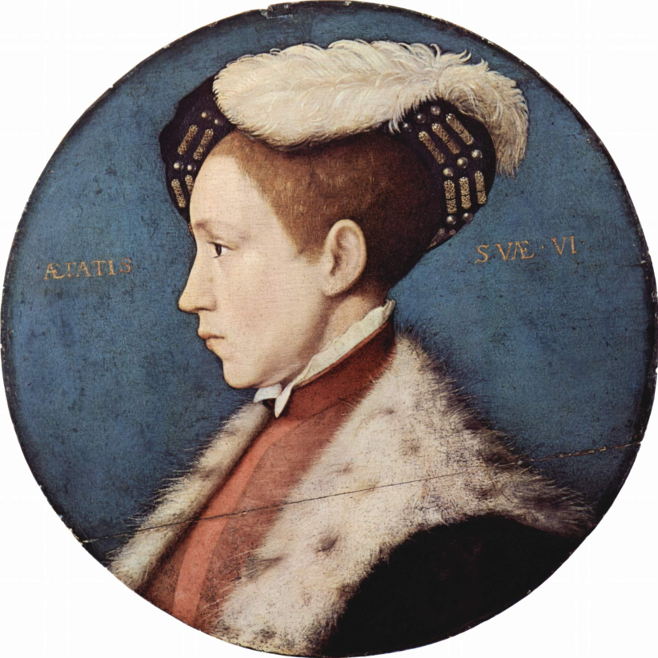
Henry’s legacy
Confusion
Tradition of obeying the king
But what was Henry?
The Regency council was dominated by reformers
Edward had been educated by Cheke (a reformer)

Slide 3
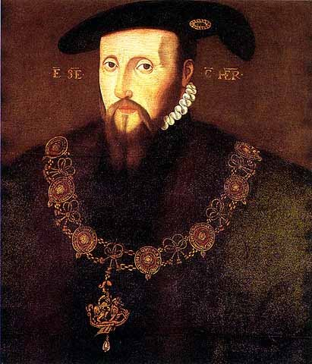
Initial measures under Somerset!
Repeal of Treason law
The Book of Homilies
Royal Injunctions 1547
Dissolution of the Chantries,
repeal of the Six Articles
removal of images,
First Prayer Book,
Act of Uniformity
Replacement of altars

Slide 4
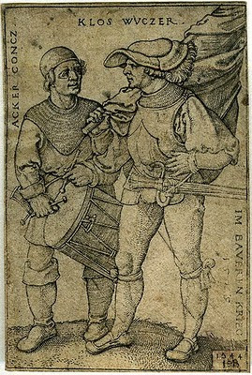
Opposition
Religious unrest at these reforms – mainly in Cornwall and Devon, but also in Yorkshire (Seamer rising) Oxfordshire, Hampshire and Northamptonshire.
Serious concern that changes were being introduced under a minor.
However, after the suppression of the rebellions of 49 – there was no more serious opposition although the changes became much more radical.
They were used to obeying religious orders of the monarch.

Slide 5
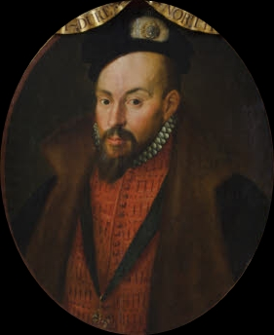
Northumberland
Clerical marriage allowed.
Stone altars replaced by wooden ones.
New treason act
Second book of Common Prayer
Act of Uniformity

Slide 6
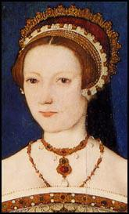
Lady Jane Grey affair
Devise for the Succession
What were the motives?
Northumberland’s ambition or Edward’s desire to protect his Protestant church?
Why did it fail?

Slide 7
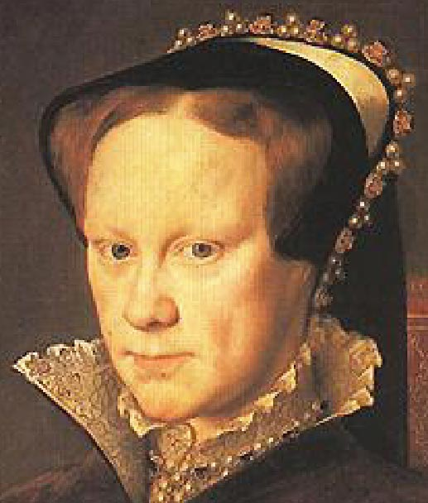
Mary I
The first queen actually crowned and able to rule.
She was welcomed to the throne in 1553.
Daughter of Catherine of Aragon and a devoted Catholic.
1553 Act of Repeal restored England to the religious position of 1547.

Slide 8
Edward wanted Churches to look like this.

Slide 9
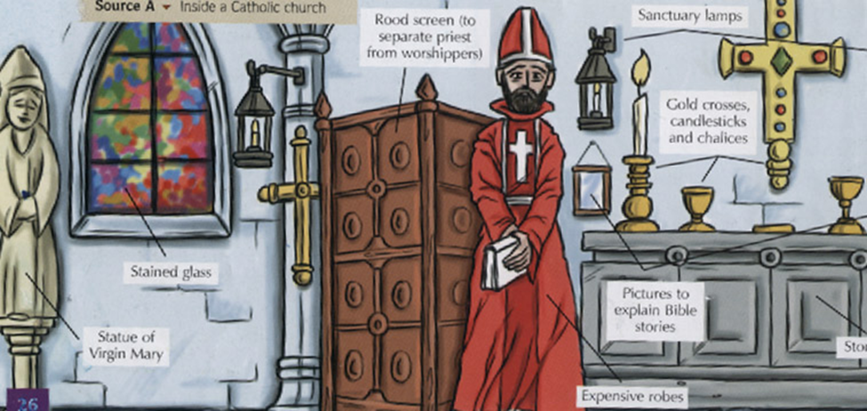
Mary wanted to restore this – but it’s expensive

Slide 10
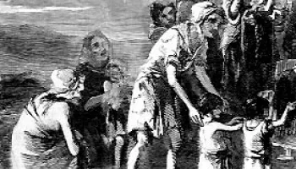
Times were hard
Population rise Between 1525 and 1551 the population rose form 2.3 million to 3 million.
Poverty and vagrancy due to the closing of the monasteries.
Inflation and rising prices made worse by debasement of the coinage.
Enclosure and poor harvests drove up the price of food and caused a decline in living standards
Influenza and epidemics

Slide 11
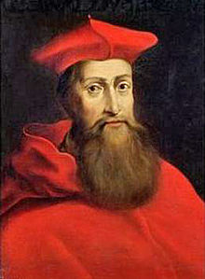
Marian changes
Acts of Repeal 1553
Injunctions
Heresy laws
Appointment of Pole as Archbishop of Canterbury
Church reform
Re-founding of religious houses,
Synod and Twelve Decrees

Slide 12
The Burnings
285 people burnt in the years 1555 – 1558.
There is a debate about its impact.

Slide 13
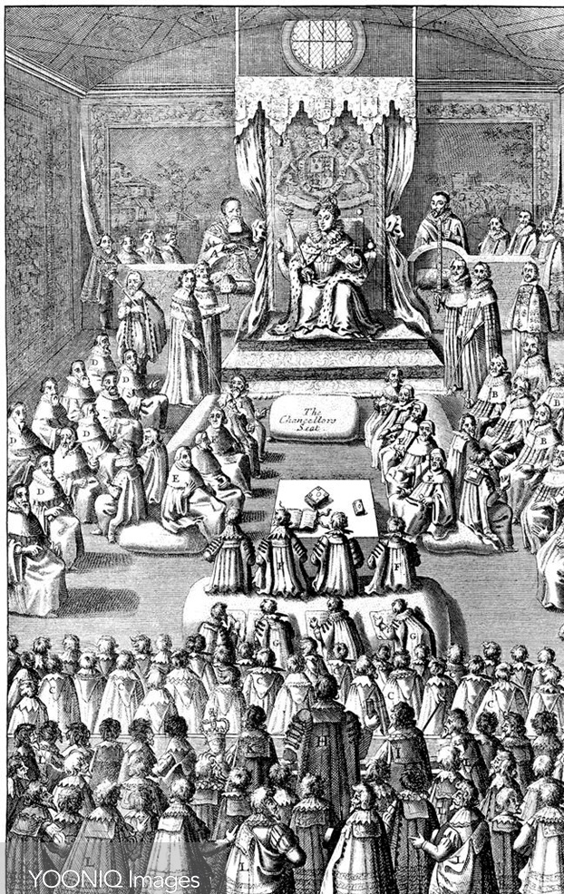
Opposition
Parliament meeting in October 1553 initially refused to repeal the Act of Supremacy.
Wyatt’s Rebellion, 1554
800 committed Protestants went into exile in Germany and Switzerland.
Large numbers of married priests were deprived of their positions.
Opposition to restoration of heresy laws.

Slide 14
How Catholic was England by 1558?
Catholic | Not?
Edward’s reign had been too short for Protestantism to take hold | Mary’s reign was also very short.
Many committed Protestants left for Europe. | Persecution made Protestants martyrs and that gave it a new credibility.
Burning is an effective method of stamping out heresy. You have to be very committed to face such a horrific death. | The burnings were not popular, and we know both Philip and her Spanish ambassador advised her to moderate them. However, Foxe’s book of martyrs was written under Elizabeth so may exaggerate the impact.
Mary and her bishops worked on reforming the Church, improving education and reviving its vitality. | Archbishop Pole could not give reform his full attention as he was involved in foreign policy and his conflict with the new pope.
In Mary’s last year recruitment to the priesthood was better than it had been for thirty years. | Rebuilding Catholic style churches was expensive , images replaced, vestments purchased – and times were hard.
Elizabeth found to her shock and dismay that Mary’s bishops would not just abandon Catholicism and she had a fight on her hands to make the Church Protestant again. | The Church had been stripped of its assets and there were a great many without a priest, or with only an ignorant priest. Mary’s reforms had not had time to take impact.

Slide 15
Sources
Exam questions based on sources test five skills.
Comprehension/understanding. First you must make sure you know what all the words mean as they are used in the source: usually you can deduce the meaning from the context.
Accuracy/Reliability. establish the PROVENANCE – who wrote it, what was their purpose? Could it be propaganda? Does it tell you enough? If you only get part of the picture the missing information may explain things. Consider the context to inform your judgments.
Utility – What are you learning from these sources? How does it help you to form an opinion?
Inference/reading between the lines.
Making Judgements and reaching conclusions.
Purpose
Author
Nature
Date
Audience

