Slide 1
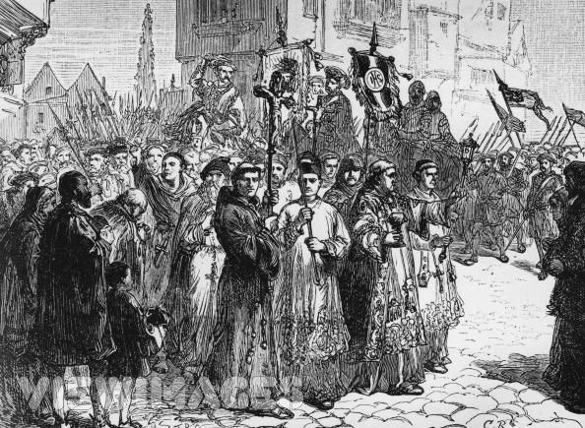
The Pilgrimage of Grace

Slide 2
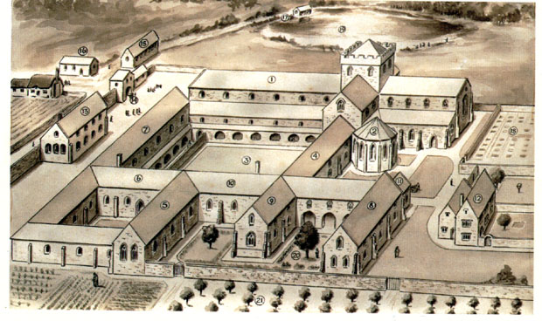
Dissolution of monasteries
11 March 1536 Monasteries A bill was presented to Parliament which would, when passed, authorise the closure of all monasteries with a revenue of less than £200 per year. About 376 monasteries fell into this category.

Slide 3
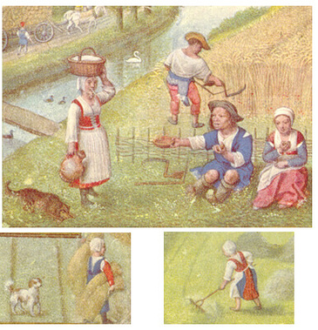
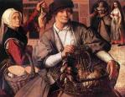
High food prices
Disastrous harvest in 1535.
Disappointing harvest in 1536.
Discontent of tenants at rises in rent.

Slide 4
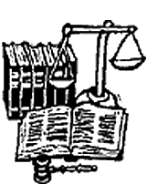
July 1536 - The Ten Articles
These were a series of injunctions introduced by Cromwell to improve the conduct of the clergy and the worship of the people.
Sermons were to be preached at stated periods against the Rome.
Relics were not to be exhibited for gain.
A good home life was deemed preferable to pilgrimage.
Children were to learn the Lord's Prayer, The Holy Creed and The Ten Commandments in English among other things.

Slide 5
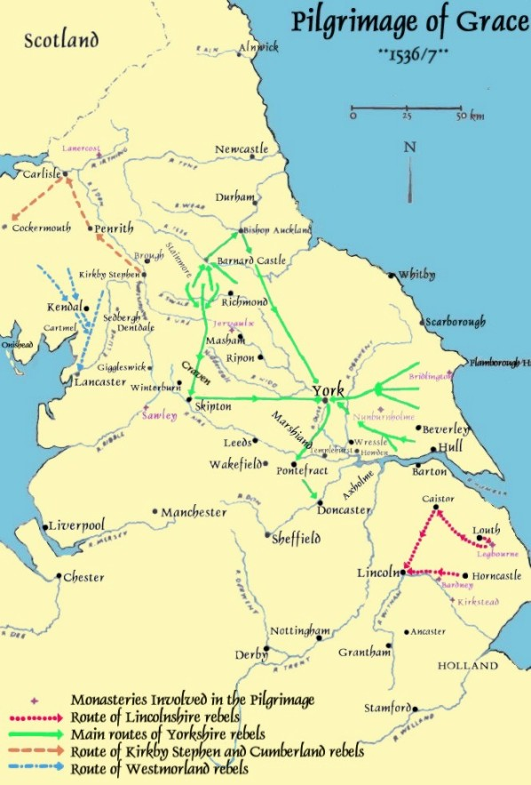
A rising in Lincolnshire began 1 – 11 October 1536.
4 October Yorkshire joined in.
By 10 October there were 30,000 men moving down from York to Pontefract.
A truce was signed on 27 October – Henry tricked them into negotiating.
Meeting at Pontefract 2 – 4 December.
King issued a pardon on 8 December and said he would not dissolve any more monasteries until Parliament met.

Slide 6
Aims
Demands
1. Restoration of the dissolved monasteries and nunneries
2. End to the changes in the inheritance laws (Statute of Uses)
3. Reduced taxes in times of need.
4. Removal of Thomas Cromwell
5. Removal of Protestant Bishops

Slide 7
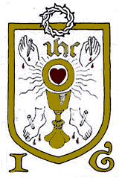
The Five wounds of Christ
The rebels wore badges of the Wounds of Christ and called themselves Christ’s soldiers.

Slide 8
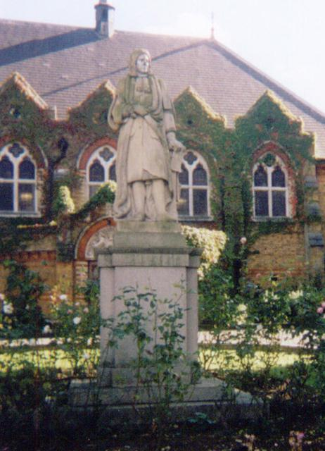
Robert Aske
Robert Aske was a successful lawyer with a London practice. “one of the few men of his age whom we recognise at once to have been utterly frank and single-minded.” (Prof Knowles)
He took command of the rebels and turned it into a “pilgrimage” insisting on good behaviour of the 30,000 men.
He negotiated with the Duke of Norfolk stressing the religious nature of the Rising.
He believed the king would consider his demands and returned home, where he discovered that he’d been tricked and when the small Bigod rising occurred early in 1537 he was arrested. Refusing to name his associates, he was hanged in chains from Clifford’s Tower in Yorkand left to die slowly – an example to his followers.

Slide 9
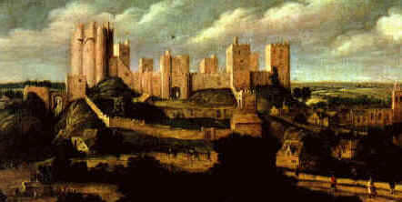
Pontefract Castle
Thomas, Lord Darcy surrendered Pontefract Castle to Aske without resistance and hereafter supported the rebellion. He was one of the leaders who met Norfolk on Doncaster Bridge. He was pardoned along with the others, but following Bigod’s revolt the following January, he was arrested and executed.

Slide 10
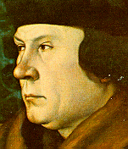
Pontefract Articles
The requests or “articles” are a mixture of economic, political and religious grievances.
Article 8
To have the Lord Cromwell, the Lord Chancellor and Sir Richard Rich knight to have codign punishment as the subverters of the good laws of this realm and maintainer of the false sect of those heretics and the first inventors and bringers in of the same.
Article 5 concerned the 1st fruits and tenths.

Slide 11
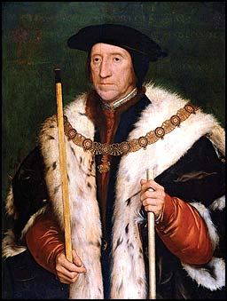
Duke of Norfolk
The Duke of Norfolk, Thomas Howard, master of survival. He had two of his nieces, Ann Boleyn and Catherine Howard, married to Henry, then beheaded to protect his power. His rivalry with Thomas Cromwell would end in success as well!
In the suppression of the rebellion, Norfolk alternately cajoled and threatened the insurgents till their forces melted away, and he could with safety undertake the work of official butchery.
He held the office of Lord President of the Council of the North from April 1537 till October 1538, when he could boast that the rebellion had been avenged by a course of merciless punishment.
He organized Aske’s hideous death.

Slide 12
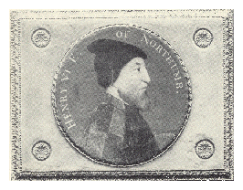
Feudal Reaction
One explanation of the Pilgrimage is to see it as a feudal reaction against the government in London led by the Percies.
Many Pilgrims were Percy tenants or employees including Aske who was the earl’s legal advisor.
The earl was ill throughout the rebellion, but his brothers became prominent leaders: Sir Thomas in Yorkshire and Sir Ingram bringing down men from Northumberland.
It was the end of the Percy family.

Slide 13
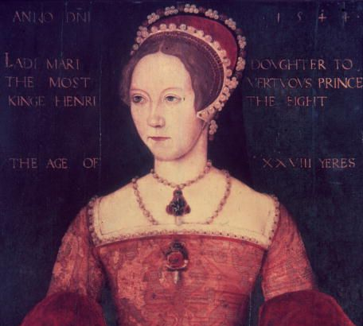
Faction
Some historians maintain that it was a Conservative faction’s last ditch attempt to regain ground lost in fall of Anne Boleyn
‘ …compelling signs exist that the noble and gentry supporters of Princess Mary joined forces with Catholic lawyers ….in revolt against Cromwell’s administration.’
BUT
‘ while court plotting shaped the form of the Pilgrimage to some degree, it does not explain its force and extent.’
John Guy, Tudor England, 1988

Slide 14
Duke of Suffolk
Lincolnshire gentry profoundly disagreed with several of Henry’s policies and very much resented the territorial ambitions of Charles Brandon, Duke of Suffolk, the king’s best friend and brother in law.

Slide 15
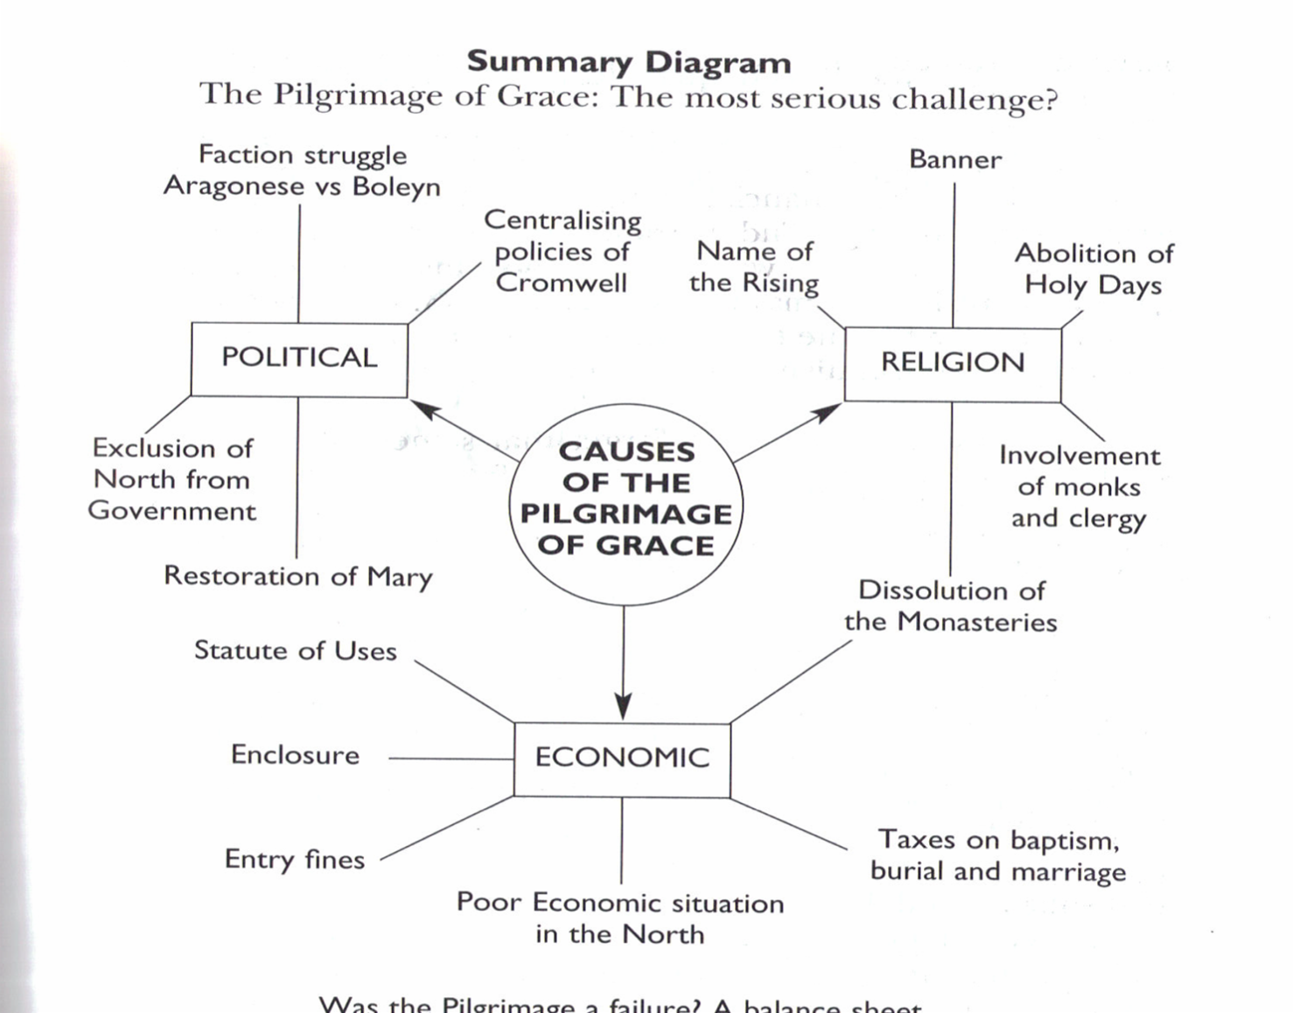
What were the main causes?

