Slide 1
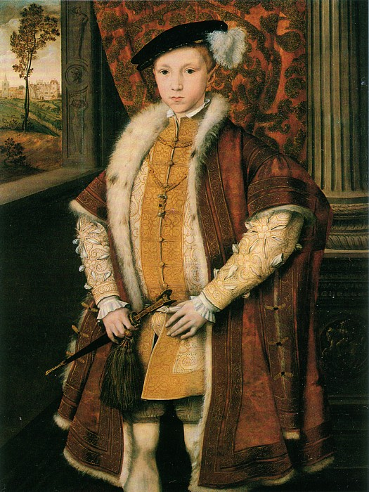
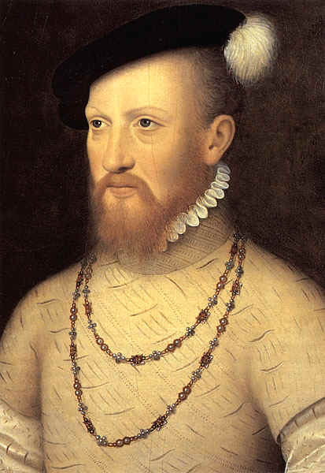
Duke of Somerset
Protector
1547 - 1549

Slide 2
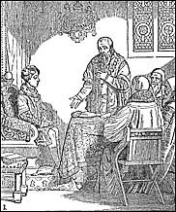
Somerset ruled by proclamation
When Parliament was not sitting acts could be introduced as a result of a royal proclamation as long as they did not infringe on acts already on the statue book. The Proclamation Act stated that such proclamations had to be obeyed. This had been a concern to Parliament as it gave the opportunity for a monarch to rule without it. Henry averaged six a year while each year there were nineteen in Edward’s reign. Over half of these, seventy-seven, were issued by Somerset

Slide 3
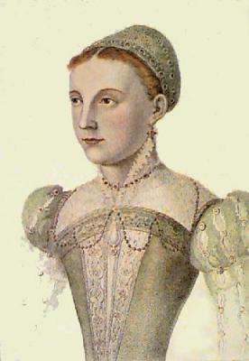
Foreign Policy
With a hostile France and unpredictable Scotland, Henry had left a dangerous situation – for his son.
Somerset thought he should marry Edward to the 5 year old Mary, Queen of Scots.

Slide 4
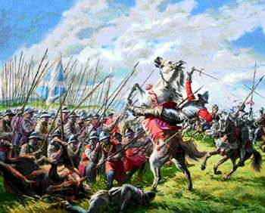
Battle of Pinkie Clough – “rough wooing”
Somerset beat the Scots in battle, but he couldn’t afford to keep the country garrisoned.
His Scottish campaign cost £2.5 million when England was already broke after Henry’s war against France.
France came to Scotland’s aid!!

Slide 5
Somerset stretched the nation’s finances to the limit, so to raise funds, Somerset, authorized the debasement of the coinage as Henry had also done.
Although at first, the resulting inflation meant lower prices for English wool, ultimately debasement hurt English trade and caused rampant inflation.

Slide 6
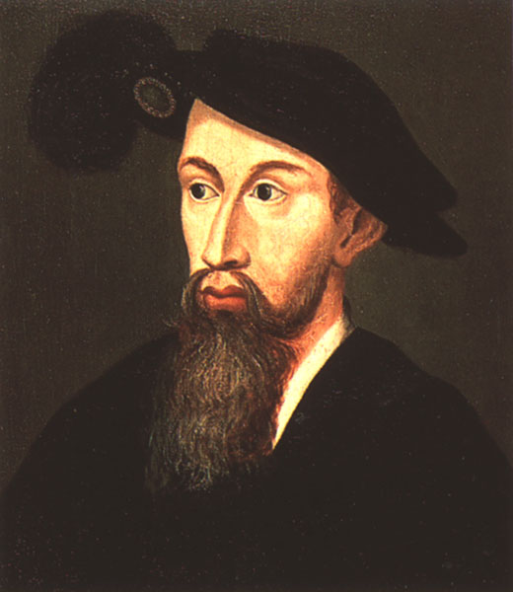
Edward Seymour fostered the introduction of Protestantism by
1. Allowing the free circulation of Protestant ideas.
2. Closing the chantries and insisting that purgatory was a fiction.
3. Allowing the introduction of the first Book of Common Prayer.

Slide 7
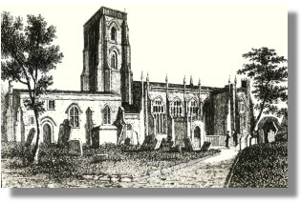
The Chantry Act of 1547 dissolved 2374 chantries, affecting 90 colleges, 110 hospitals and almshouses, and all the religious guilds
The result was to lessen the role of the Church in society--private citizens refound the schools, towns took over the hospitals and almshouses, and the religious guilds, which had promoted the veneration of saints, disappeared.

Slide 8
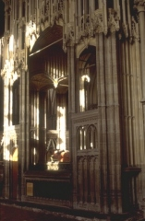
A chantry was an endowment given to a cathedral, a university, a hospital, or a monastery that provided an income to support priests who would say masses for the soul of the deceased donor.
A chantry in Winchester Cathedral

Slide 9
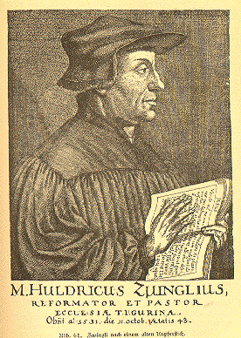
Repeal of the laws against heresy meant that Protestant reformers brought the more extreme Protestant ideas from the Continent into Britain.
Instead of decreasing religious disagreements, repeal of the heresy laws increased religious arguments and chaotic scenes on the streets.
People had been used to order and this worried them.
Swiss theologian Ulrich Zwingli

Slide 10
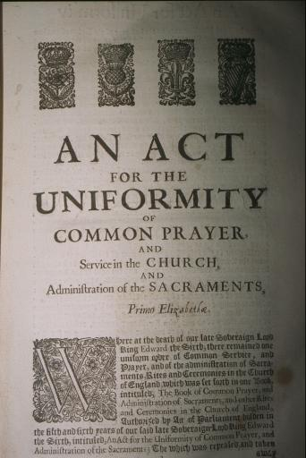
All clergymen were required to use the new Book of Common Prayer.
An Act of Uniformity, 1549

Slide 11
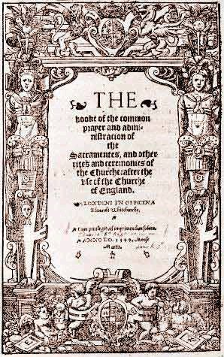
Kept old rites of confession and extreme unction for the dying.
Priests still wore traditional vestments
altar still railed off at the east end of the church.
But, participation by the congregation increased, supporting the Protestant doctrine of the priesthood of all believers.
And the Prayer Book took a Protestant view of the sacrament of the mass.
The Book of Common Prayer, 1548, by Thomas Cranmer

Slide 12
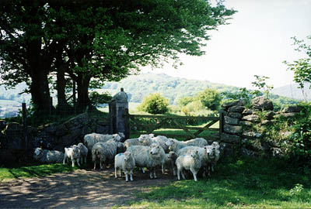
Between 1547-51, the English economy faced both unemployment and inflation.
Rents tripled and enclosures increased.

Slide 13
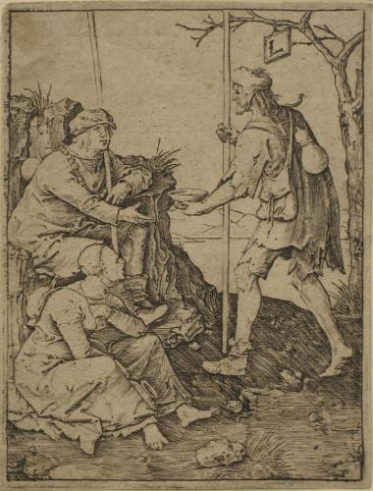
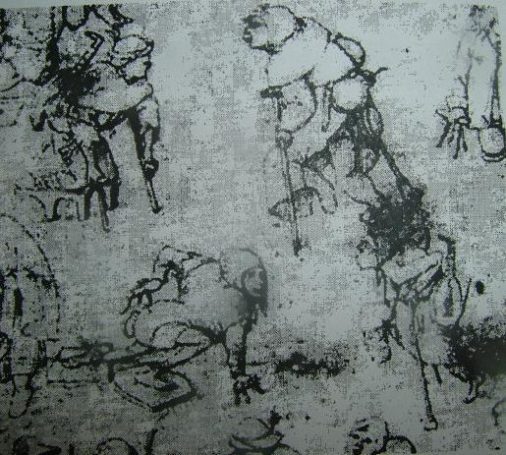
Vagrancy act
Somerset said that beggars should be branded
He also took their childen away and put them in enforced apprenticeship

Slide 14
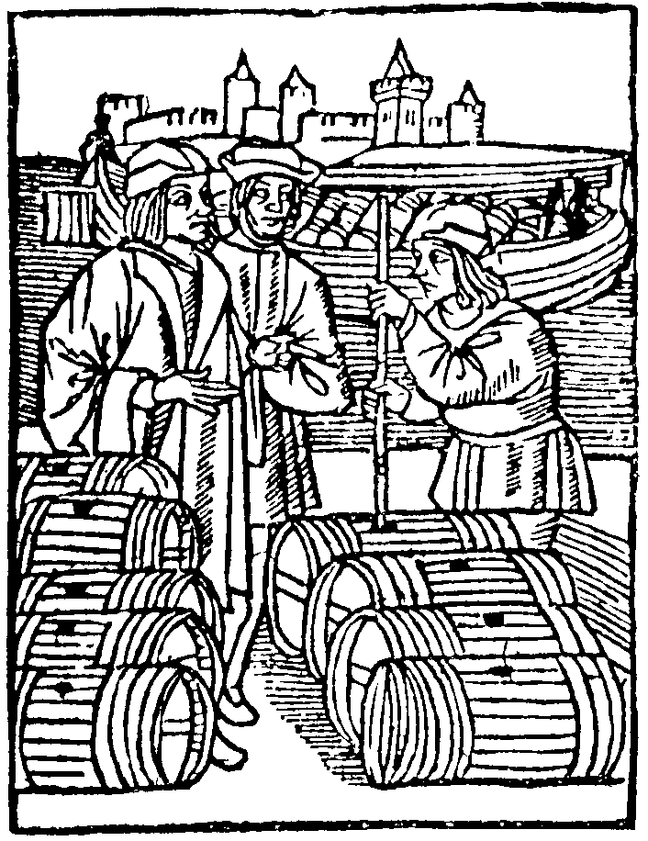
Poor harvest, the plague, and overproduction increased the merchants’ problems.
The solution was to escape dependence on a single market.

Slide 15
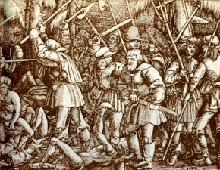
Ket’s Rebellion, July 1549--an economic challenge to the Tudor monarchy
Demanded an end to enclosure of common lands, a reduction in rents, cuts in clerical incomes, and a clergyman in every parish.

Slide 16
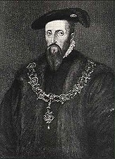
Good Duke?
Formerly historians interpreted Somerset’s apparent indecisiveness as conscience.
But in the 1970’s Bush showed, “the good duke” was in fact an obsessive warlord, who hurt the poor with his taxation and vagrancy laws and ruled without consulting others.

