Slide 1
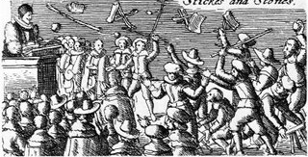
Mary I – 1553 - 1558
The first English queen to rule.
Was she a disaster or has she been unfairly judged?

Slide 2
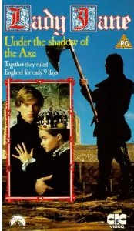
The LBJ affair
Mary’s counter coup against Lady Jane Grey demonstrated that the country was not universally Protestant.

Slide 3
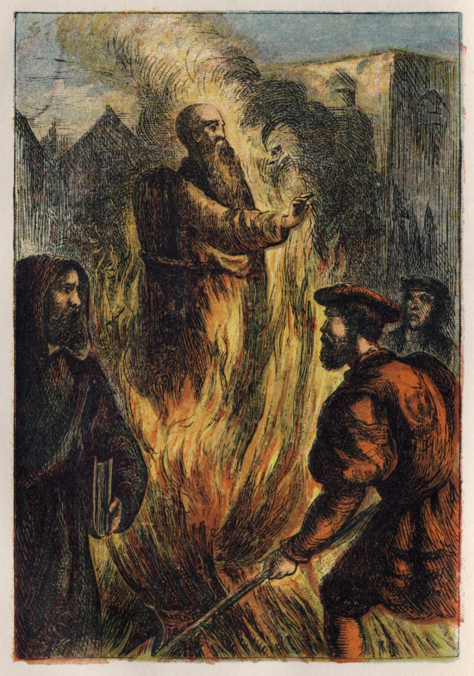
Religion under Mary
Mary is renowned for her 285 burnings. Cruel and unsuccessful this has tarnished her reputation. We must examine this and see if there is anything that can be said for her side?
Notes:
Principally we are looking to see what the impact of changes was on the monarch’s power

Slide 4
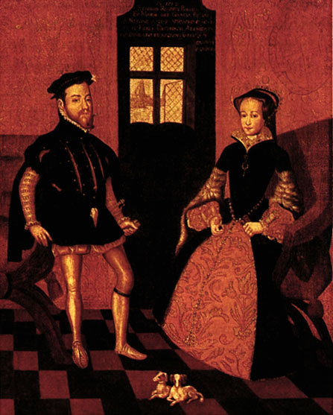
Anglo-Spanish relations, 1553-58.
Mary felt her first job was to marry, but this wasn’t simple for a ruling Queen at time when men dominated women. What was the impact of Mary’s marriage to Philip of Spain?

Slide 5
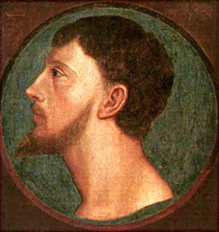
The Wyatt rebellion
How serious was this rebellion and can it be said to be caused by religion or xenophobia?
Mary seems to have done a very inspiring job preventing the rebels from entering London.

Slide 6
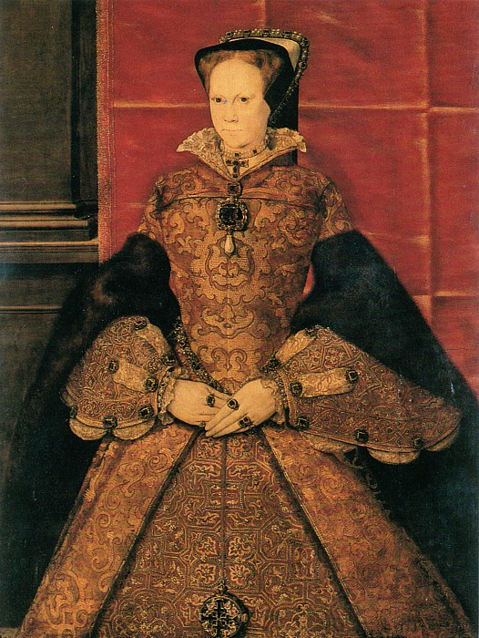
Mary’s capacity to govern
There is a historical debate about how poorly (or not) Mary governed.
Does she deserve the title, ‘bloody Mary’?

