Slide 1
DEFEAT & THE CREATION OF THE WEIMAR REPUBLIC 1918

Slide 2
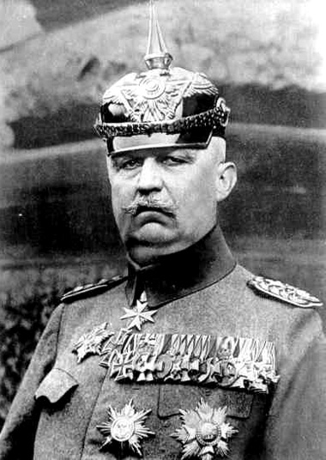
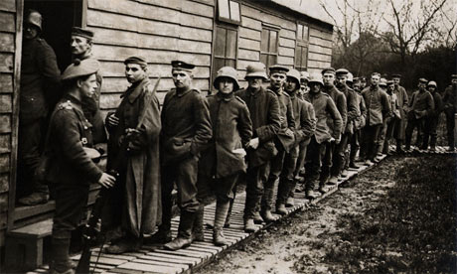
BY OCTOBER 1918 LUDENDORFF WAS ADMITTING THE WAR WAS LOST

Slide 3
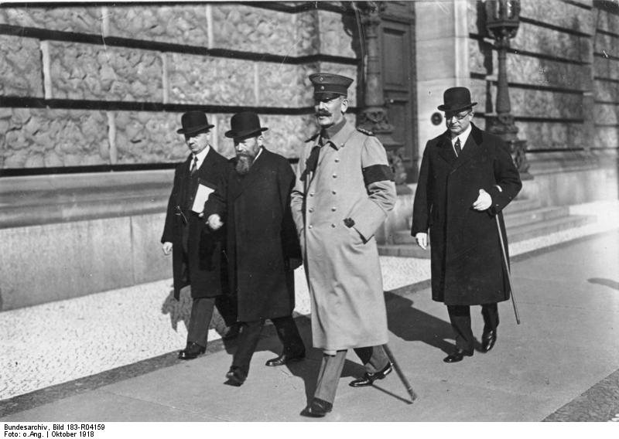
IN OCTOBER 1918 PRINCE MAX OF BADEN BECAME CHANCELLOR …
IN THE HOPE THAT A MORE DEMOCRATIC GOVERNMENT WOULD GET BETTER TERMS
BECAUSE LUDENDORFF WANTED THE DEMOCRATIC POLITICIANS RATHER THAN HIMSELF & THE ARMY TO TAKE THE BLAME FOR GERMANY’S DEFEAT

Slide 4
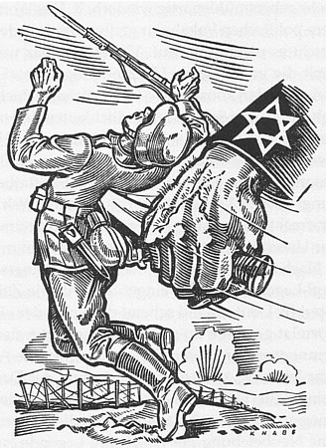
THE DEMOCRATIC POLITICIANS ONLY TOOK POWER AFTER THE MILITARY DEFEAT …
THEREFORE THE “STAB IN THE BACK” WAS A MYTH
THE GERMAN ARMY HAD LOST THE WAR
LUDENDORFF & HINDENBURG WERE TO BLAME, NOT THE DEMOCRATS, BUT THEY DIDN’T HAVE THE COURAGE OR HONESTY TO ADMIT IT

Slide 5
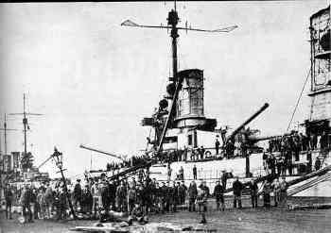
LUDENDORFF’S ORDER TO ATTACK THE BRITISH …
PROVOKED THE GERMAN NAVY TO MUTINY IN OCTOBER 1918

Slide 6
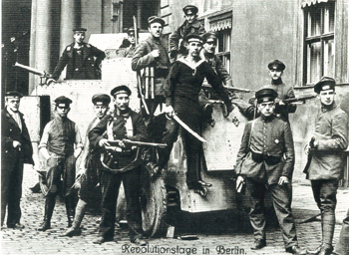
WORKERS & SOLDIERS THEN JOINED THE MUTINY…
TURNING IT INTO A REVOLUTION
THEY DEMANDED BREAD & PEACE, LIKE THE RUSSIAN REVOLUTIONARIES IN 1917

Slide 7
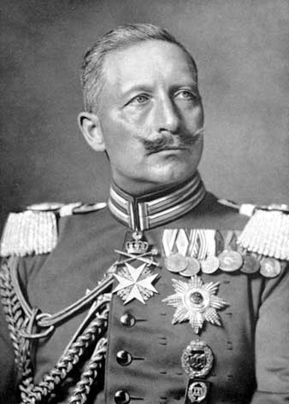
THE ARMY TOLD KAISER WILHELM II THAT THEY COULDN’T KEEP ORDER UNLESS HE ABDICATED
SO HE HAD NO CHOICE BUT TO DO SO ON 9th NOVEMBER

Slide 8
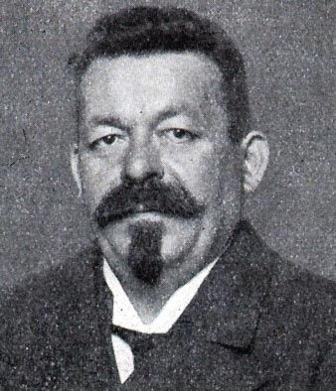
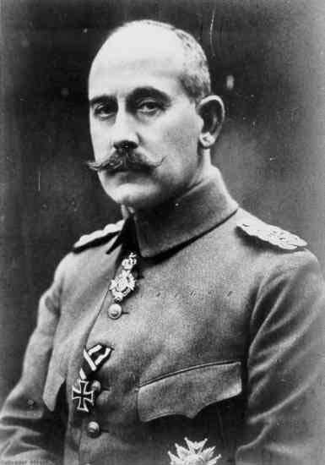
PRINCE MAX RESIGNED AS CHANCELLOR …
& WAS REPLACED BY SPD LEADER FRIEDRICH EBERT

Slide 9
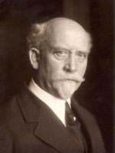
FEAR OF A COMMUNIST REVOLUTION PROVOKED SPD POLITICIAN PHILIPP SCHEIDEMANN TO PROCLAIM THAT GERMANY WAS A DEMOCRATIC REPUBLIC

Slide 10
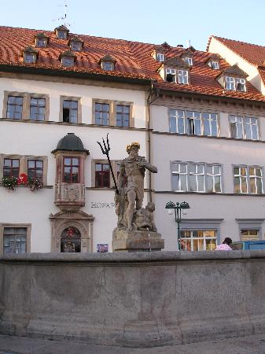
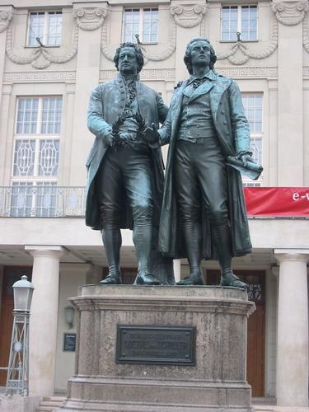
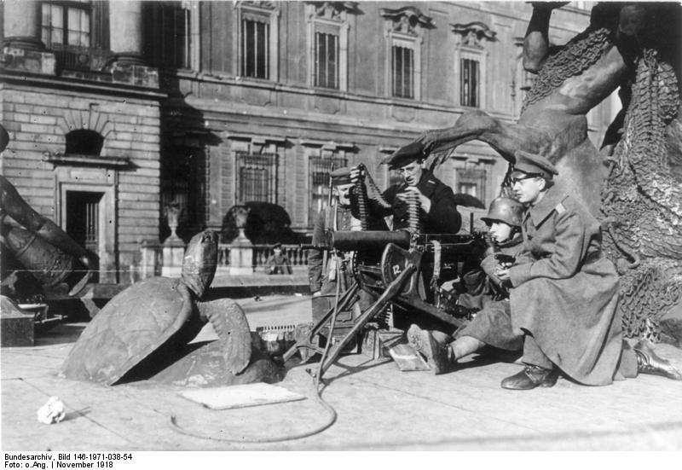
THIS BECAME KNOWN AS THE WEIMAR REPUBLIC B/C ..
THE GOVERNMENT TEMPORARILY MOVED TO THE TOWN OF WEIMAR 1918-19 B/C THERE WAS SO MUCH POLITICAL VIOLENCE IN BERLIN

Slide 11
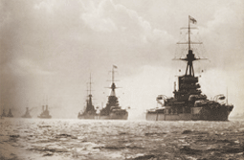
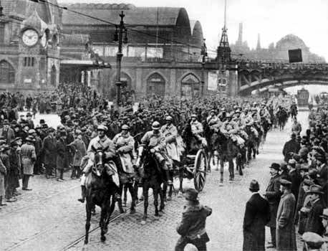
GERMANY’S ENEMIES INSISTED ON HARSH CEASEFIRE TERMS INCLUDING…
THE CONTINUATION OF THE BRITISH NAVAL BLOCKADE
THE OCCUPATION OF THE RHINELAND BY ENEMY TROOPS
UNTIL GERMANY SIGNED A PEACE TREATY
GERMAN NATIONALISTS UNFAIRLY BLAMED THE REPUBLIC FOR THIS

Slide 12
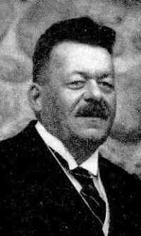
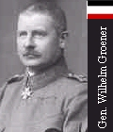
CHANCELLOR EBERT MADE A DEAL WITH GENERAL GROENER OF THE ARMY ...
THAT THE ARMY WOULD SUPPORT HIS GOVERNMENT AGAINST THE COMMUNISTS WHO HAD PROCLAIMED A SOVIET REPUBLIC
EBERT WAS DETERMINED NOT TO BE OVERTHROWN AS THE PROVISIONAL GOVT. HAD BEEN IN RUSSIA

Slide 13
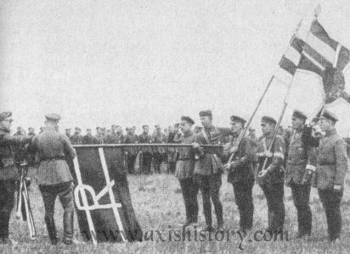
THE ARMY & THE FREIKORPS THEN BRUTALLY CRUSHED THE COMMUNIST UPRISING

Slide 14
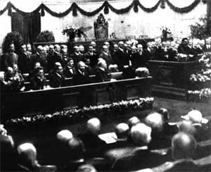
GERMANY THEREFORE UNLIKE RUSSIA BECAME A DEMOCRATIC REPUBLIC

Slide 15
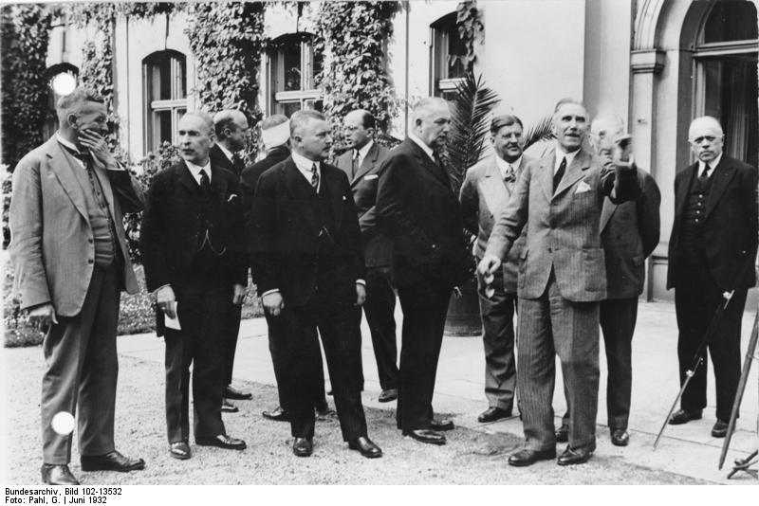
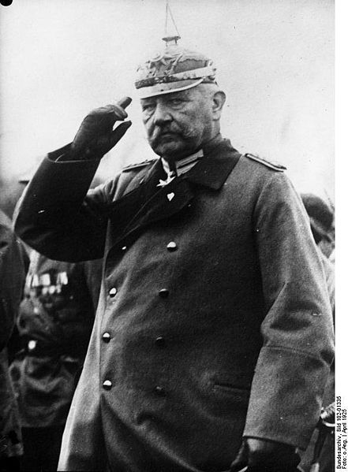
BUT MUCH POWER STILL RESTED WITH CONSERVATIVE JUNKERS, INDUSTRIALISTS & GENERALS …
WHO OPPOSED DEMOCRACY

Slide 16
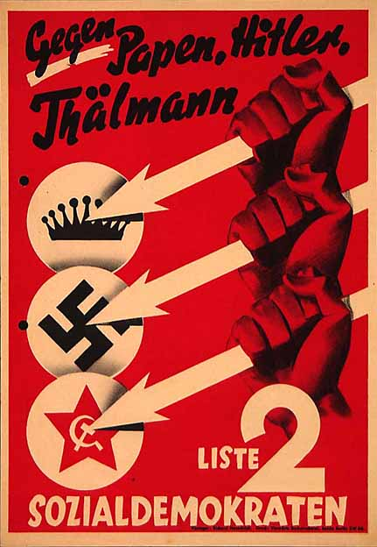
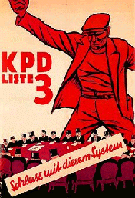
THERE WAS A LASTING SPLIT BETWEEN THE SPD & THE KPD
Because the SPD had supported the crushing of the Communist uprising by the Army

