Slide 1
How effectively did Hitler consolidate his hold on power, 1933-34?
Aims:
Identify the steps Hitler took to consolidate his position in Germany
Evaluate the significance of each step

Slide 2
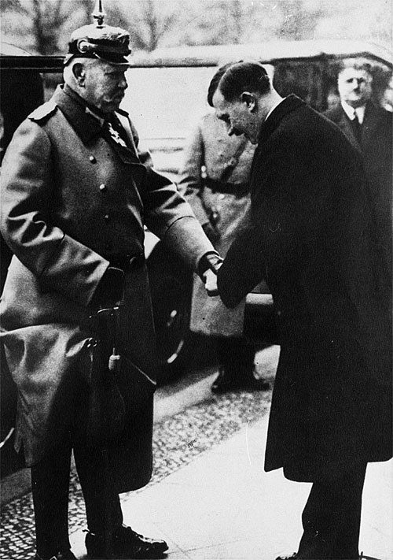
The Nazis’ position in 1933
Largest party in Reichstag
Key positions in Cabinet, including Hitler as Chancellor
However the Party did not have an overall majority and a 2/3 majority was needed to change the Weimar Constitution
There were only 3 Nazis in the Cabinet (of 12)
The President could sack them at any point

Slide 3
Task
How do you think Hitler would try to consolidate his position after his appointment as Chancellor?
Complete the task on p.169.

Slide 4
Stage One: Control at the Centre, Jan-March 1933
In this period Hitler gained the power to bypass the Reichstag and enact laws on the authority of the Cabinet.
Civil liberties were suspended to enable him to arrest and imprison political opponents.
Use Layton p.136-140 to complete the table on p.5-6 of your booklet.

Slide 5
Stage Two: Control beyond the Centre, April-July 1933
Gleichschaltung: ‘bringing into line’
This aimed to extend Party control over the trade unions, the Church, other political parties, the civil service, local government, courts and judges.

Slide 6
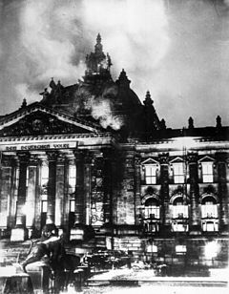
Political parties
The Communists had been outlawed since the Reichstag Fire.
On 22 June 1933 the SPD was outlawed as a ‘party hostile to the nation and state’. The other parties dissolved themselves.
In July a decree was passed making Germany a one-party state.

Slide 7
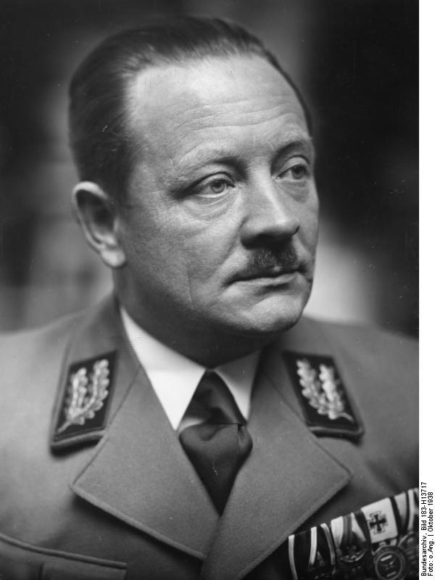
Federated states
State governments were given the power to issue laws without consulting the Landtage (state parliaments)
Nazi Reich governors were appointed – usually the local party Gauleiter.
In January 1934 the Landtage were abolished.

Slide 8
Civil service
Membership of the Nazi Party was not compulsory until 1939.
A Law for the Restoration of the Professional Civil Service (April 1933) enabled those whose political obedience or racial purity was in question to be dismissed.
Most officials of Jewish descent lost their jobs.

Slide 9
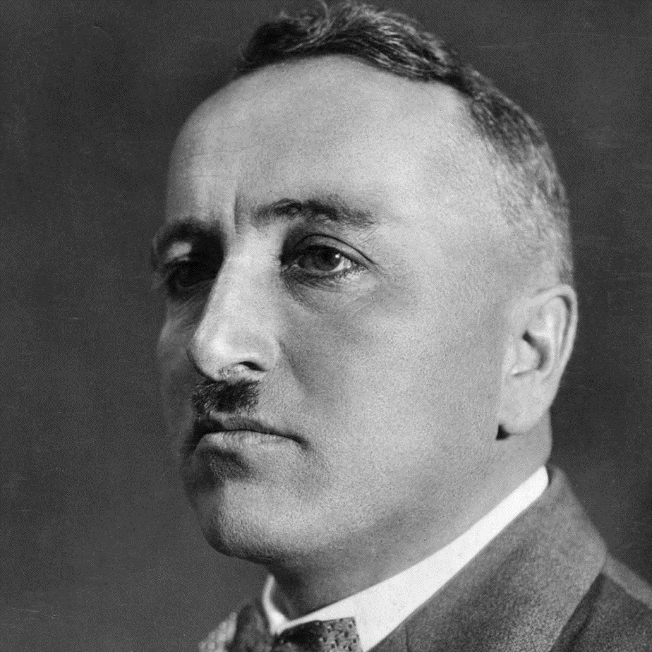
Trade unions
The trade unions were connected with socialism and Catholicism.
2 May 1933 SA & SS occupied trade union offices and abolished all existing trade unions.
New organisation – the German Labour Front (DAF) set up and led by Robert Ley. Membership was compulsory (22 million members) and employees lost the right to negotiate over wages and working conditions.

Slide 10
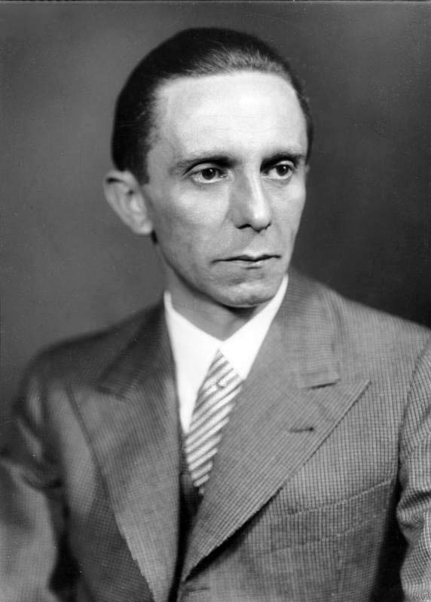
Education, media, culture
On 13 March a New Ministry for Public Enlightenment and Propaganda was established with Goebbels as its head.
In May the Ministry of the Interior compelled the German states to introduce new syllabuses into the schools and in September all ‘intellectual workers’ were forced to join the Reich Chamber of Culture so that a rigorous check could be kept on their activities.

Slide 11
Business and industry
Employers, business associations and agricultural interest groups were all forced into the Reich Chamber of German Industry.
However they were able to manage their own affairs.

Slide 12
2 groups escaped Gleichschaltung: the church and the army.
1. The Catholic Church:
Hitler ‘bought’ the support of the Centre Party for the Enabling Act by promising to protect the Catholic church.
Concordat (14 July 1933) guaranteed the religious freedom of the Catholic church and its right to appoint its own clergy
2. The Protestant Church:
Ludwig Muller, a Nazi, was made Reich bishop; but an alternative church (the ‘Confessing Church’) was set up in 1934 for opponents of this, led by Martin Niemoller
German Protestants remained divided.

Slide 13
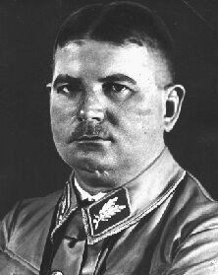
Stage Three: Winning the support of the Army, January-August 1934
Rohm had a different view of the SA to Hitler: Hitler wanted it to be subordinate to the party, whereas Rohm saw it as a key body for sizing and retaining power and thought it should form the basis for a new mass Nazi army.
Hitler needed the support of the traditional elites and in July 1933 promised the end to the ‘legal revolution’. But Rohm wanted a more radical Nazi revolution.
Hindenburg was unwell; the army generals could block Hitler’s ambitions to succeed him if he didn’t bring the SA under control

Slide 14
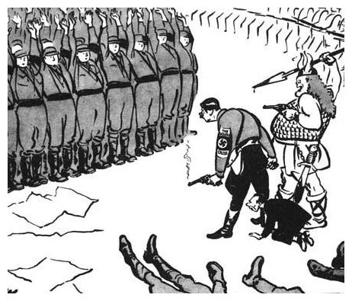
Task
Use p.160-161 of Kitson to analyse the cartoon on p.10, answering the questions on p.10-11.

Slide 15
Homework
Complete the activity on p.12, ranking the factors in order of importance & writing a conclusion to justify this.
Complete the task/grid on p.14-15 of your booklet. You will need to open ‘Task on the traditional power structures- H&H’ on GOL to do this.

