Slide 1
How chaotic was the Nazi system of government?
Aims:
Assess how far the Nazis changed the way in which Germany was governed
Understand the meaning of the term ‘working towards the Fuhrer’

Slide 2
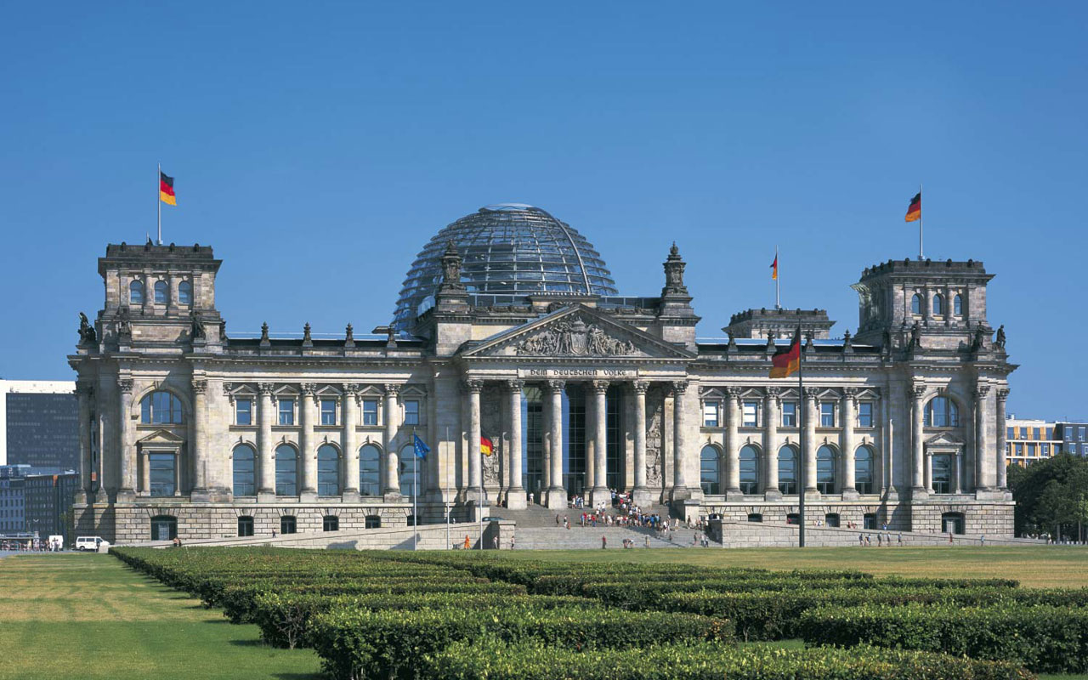
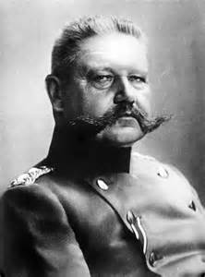
The system of government in 1933
Federal government.
Collective government. policies were discussed amongst Cabinet members and a vote taken to decide on policy.
Laws were passed by the Reichstag or sanctioned by the President in times of emergency.

Slide 3
How Hitler changed this system
The power of individual states was removed.
Collective government ended. The Cabinet rarely met and after 1938 it didn’t meet at all.
Laws could be issued on the authority of the Cabinet alone, which in practice meant Hitler himself.
Hitler gave power to those he trusted and who presented him with good ideas.
Hitler was the single source of authority for everyone, but he was not interested in the day-to-day affairs of government and was frequently disinterested.
What problems can you see with this system of government?

Slide 4
Central government
A ‘dual state’: a mix of old and new. The pre-1933 ministries and civil service operated alongside Nazi party organisations.
The ‘Supreme Reich authorities’ were headed by prominent Nazis who reported directly to Hitler, so they could override other departments. e.g. the Office of the Four-Year Plan, headed by Goering.

Slide 5
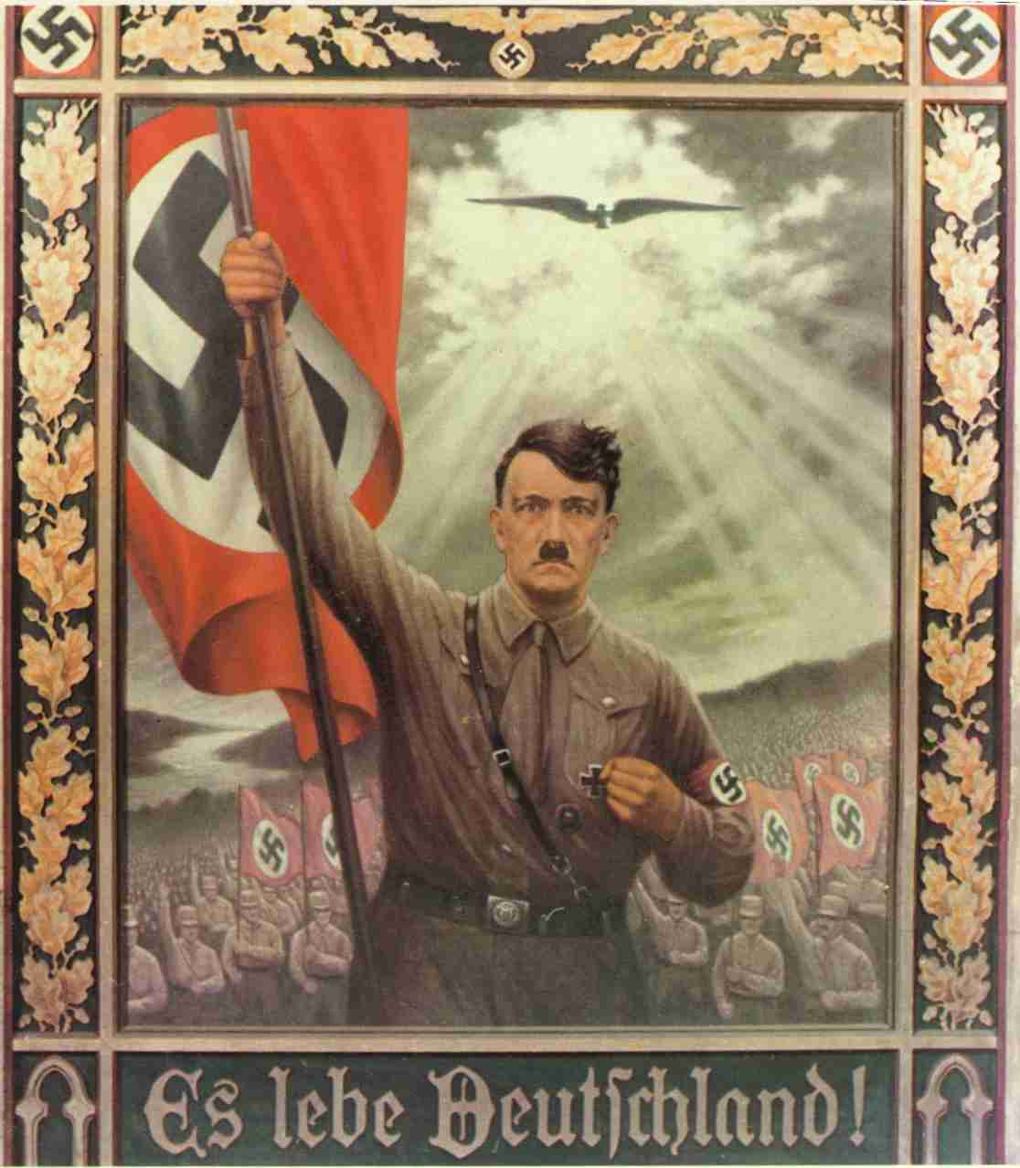
‘Working towards the Fuhrer’
The key to the Hitler dictatorship was the Führerprinzip.
Yet despite this, he played virtually no part in the day-to-day government of the Reich. Sometimes he made vague declarations of intent or principle.
Ministers and officials had little contact with him.
Consequently, they were compelled to interpret his intentions for themselves, often coming to contradictory conclusions. This became known as ‘working towards the Führer’.

Slide 6
Task
Read pp186-7 of Hite & Hinton & answer the questions on p.17 of your booklet.
Study the four examples of decision-making on p.191 of Hite & Hinton and assess what they show about the role of Hitler in the Third Reich. What evidence, if any, do they provide of the following roles for Hitler:
The direct initiator of action
Controlling policies
The overall inspirer of policy
Responding to others’ proposals and actions
Opting out of a clear decision

Slide 7
Task
Using Hite & Hinton p.193-194, match up the eight institutions described with the descriptions of their changing role under Hitler’s dictatorship in the table on p.14-15. Add to the table any evidence that the Nazis tried to control this organisation and any evidence that they allowed it to remain independent.
Now write a conclusion to answer this question: To what extent did the traditional elites maintain their power in Nazi Germany?

