Slide 1
How successful was Nazi economic policy?
In 1933 there were nearly 6 million unemployed.
By 1935 this was down to 2 million and by 1939 there was a labour shortage. The question is how far this was down to the Nazi policies?

Slide 2
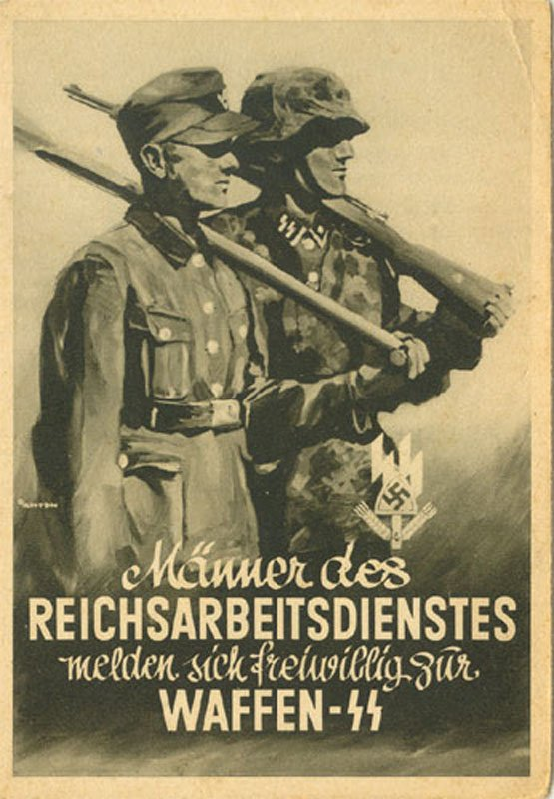
Hitler’s economic aims
Reduce unemployment
Rearm (both to try to kick-start the economy and for ideological reasons)
Autarky (making the German economy a self sufficient system) Why might this be a priority?
Help for the Mittelstand (German lower middle classes, Farmers and Small shopkeepers)
Aryanisation of the Jewish owned firms by destroying them or taking them over.

Slide 3
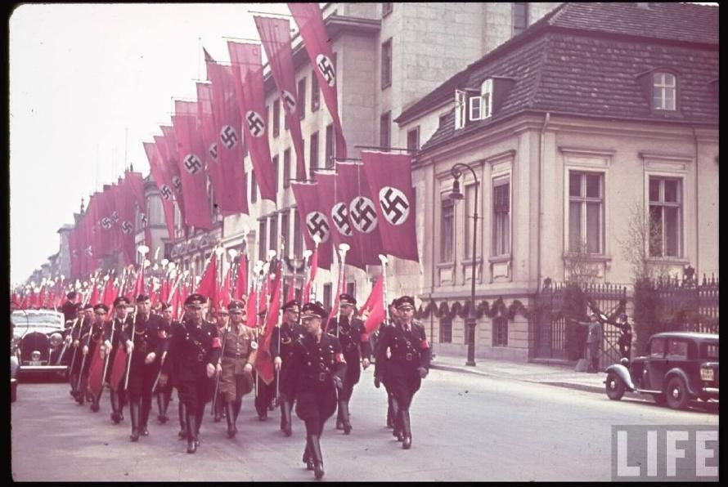
The Nazi economy can be divided into 3 broad sections
Recovery:1933 – 36
Rearmament: 1936 – 39
War: 1939 – 45 (covered in the next topic)

Slide 4
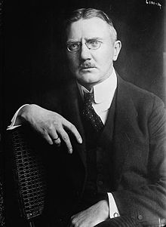
Recovery 1933 – 1936 Hjalmar Schacht and the New Plan
Schacht was appointed president of the Reichsbank in March 1933 and minister of economics in 1934.
He had been involved in the creation of the Rentenmark after hyperinflation in 1923. This is a good example of the Nazis being forced to work with the traditional elites in their early policies.
Schacht supported public works programmes like the building of the autobahns and tried to regulate imports signing new deals with the Balkan states.

Slide 5
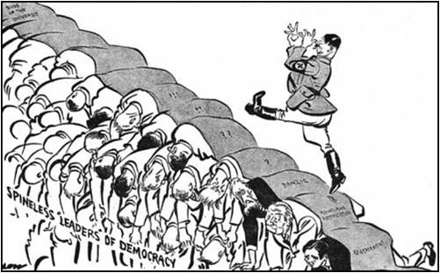
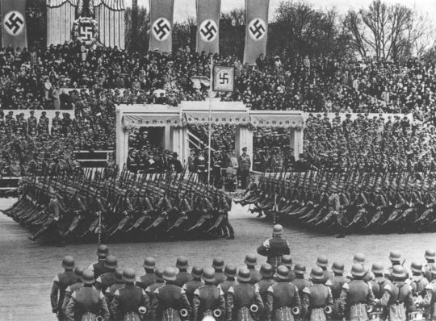
Rearmament 1936 - 1939
By 1936 Schacht was becoming increasingly concerned by the distortion to the economy caused by rearmament. This was increasing the need for imports of a number of raw materials, and reducing the focus on exporting German goods.
Hitler became impatient with him and put Goering in charge of the new 4 Year Plan for rearmament. This gave priority to rearmament, but also to making Germany self sufficient in food and industrial production.

Slide 6
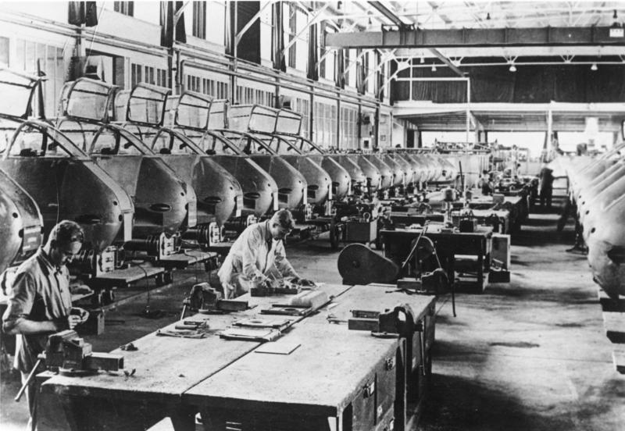
Task:
Use the sources on page 214 & 215 to note down evidence that the German economy was improving. Who gained from this?
Then note down evidence suggesting weakness in the economy.

Slide 7
How far can German economic policy be considered a success in the years 1933 - 39?
Success | Failure

Slide 8
Pairs
Louis and Lucy
Ellie and Dan
Conor and Alice
Luke and Kai
Matti and Fletcher
Livi and Sophie (Russell)
Bella and Ben (Shorrock)
Ben (Spanton) and Alexandra
Olvier and Sophie (Ralling)

Slide 9
How far can German economic policy be considered a success in the years 1933 – 1939? Task: Remember PEEL
In pairs take your point and write a paragraph for the essay using your notes from Hine and Hinton and pages 25 & 26 in the booklet. Make sure your paragraph includes the following:
Point: The key point you are making.
Evidence: Historical detail that supports this.
Evaluation/Explanation: Why this is important/relevant, what this shows etc.
Link: Link back to the question. How does this show success or failure (this can be incorporated into the evaluation but you must do it)
When finished email your paragraph to the pair who are doing the introduction.

Slide 10
Task: Activity on page 26 of the booklet. Your homework is to finish this and answer the questions on page 37 of the booklet. Reading is on Godalming online

