Slide 1
From your homework…
How were workers, peasants, women and youth affected by the war?
Were any groups more or less affected than others? Why?
How does this add to your understanding of the success of Nazi social policies?

Slide 2
The Impact of War on the Home Front
Know how the war impacted different groups in German society
Identify reasons why the regime was able to keep Germany fighting until the end
Evaluate the extent to which German morale was weakened

Slide 3
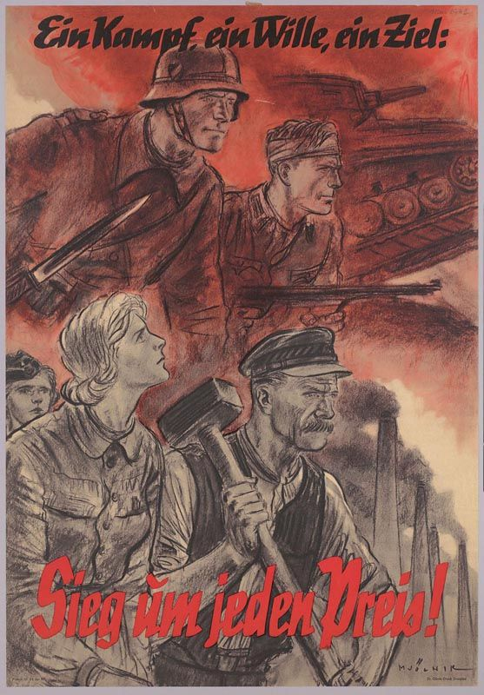
Morale on the home front
Hitler thought that WW1 was lost because the German people gave up the will to fight.
Wartime propaganda aimed to mobilise the German people and sustain morale.
The German people did not welcome war in 1939 but Hitler’s early successes seemed to confirm the belief that he was a military genius.

Slide 4
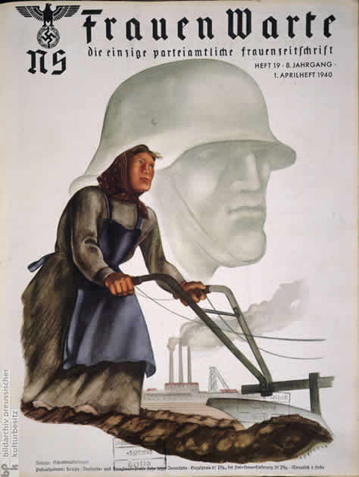
Rationing
Rationing from 1939 of food, clothes, cigarettes, and basics e.g. soap; food consumption fell by 25% 1939-41 and furniture and clothing sales fell by 40% and 25%
No chronic shortages until 1944 – by this point there was a very short supply of food, clothes and shoes.

Slide 5
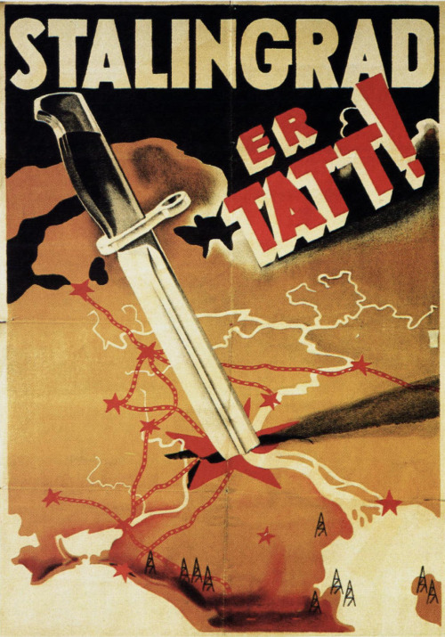
Impact of military events
Invasion of Russia 1941 removed hopes of a short war
German defeats at El Alamein (Nov 42) and Stalingrad (Jan 43) resulted in heightened cynicism and dwindling faith in the regime evident in SD reports.
Letters from soldiers at the front painted a different picture from official reports about the war’s progress published by the Propaganda Ministry.
Party membership fell & ‘defeatism’ was made a criminal offence.

Slide 6
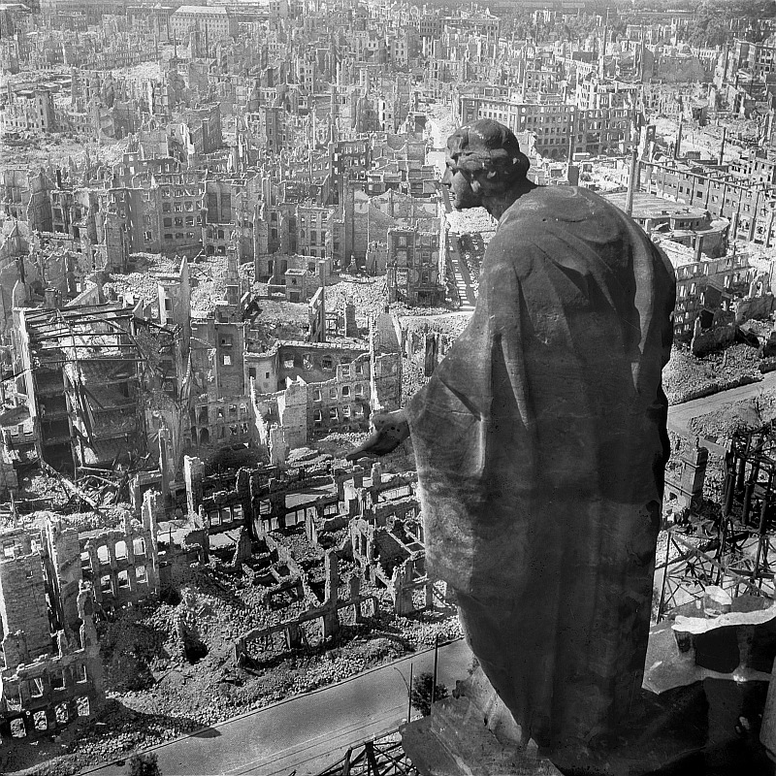
Impact of Allied bombing
400,000 Germans were killed plus 60,000 foreign workers and POWs
3.6 million homes were destroyed
Hamburg raid in July 43 resulted in mass panic and criticism of Hitler. This raid plus the raid on Dresden, Feb 45 resulted in the deaths of 75,000 civilians.
Fear of the advancing Red Army by autumn 1944 and despair at the failure of V-1 pilotless bombs and V-2 long-range rocket.
But there was no real sign of a collapse in morale (as per the Blitz)

Slide 7
However…
Goebbels became the public face and voice of the Nazi regime, delivering a famous speech on 18 February 1943 at the Berlin Sportpalast in response to the surrender of Stalingrad, rallying the people for ‘total war’.
Cinema was used to distract people from the realities of the war.
‘Active resistance’ failed to topple Nazism.
The vast majority of people remained loyal to Hitler.

Slide 8
Why was the Nazi regime able to keep the Germans fighting until the end?

Slide 9
Homework

