Slide 1
How successfully was the German economy mobilised for war?
Understand the problems faced by the German economy by 1941
Be able to explain how successfully Speer tackled the problems in the German economy

Slide 2
Problems in the German economy, 1939
No coherent overall plan for the allocation of resources.
Shortages, bottlenecks, duplication and waste.
Rivalry between the main branches of the armed forces.
Lack of standardisation, with different branches of the armed forces using different equipment.

Slide 3
Task
Using Layton p.235-237, answer the questions on p.7 of your booklet.

Slide 4
Albert Speer
Succeeded Fritz Todt as Armaments Minister from 1942
A close friend of Hitler and his personal architect!
Implemented a programme of ‘industrial self-responsibility’
A Central Planning Board was established in April 1942, supported by a number of committees representing different areas of the economy.

Slide 5
Task
Use Hite and Hinton p.416-417 to complete the table on p.8

Slide 6
Homework
For WEDNESDAY 27th
Complete the table on Speer (p.8)
For FRIDAY 29th
2 conclusions:
How successful was Speer in improving the German economy?
To what extent did the Allied bombing campaigns have a significant effect on Germany’s economy?
Use p.9-10 of your booklet.

Slide 7
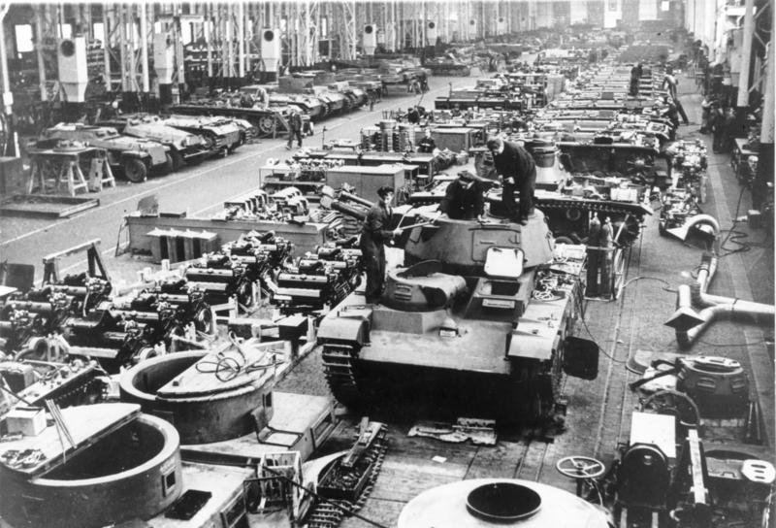
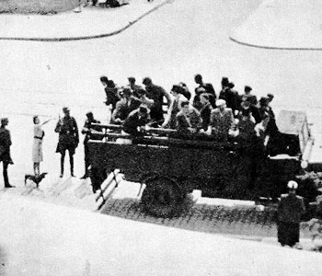
Success
Ammunition production increased by 97%
Tank Production rose by 25%
Total Arms up 59%
Heavy use of foreign workforce and forced labour to plug the gaps in the German workforce
Germany devoted a Higher % of GNP than all nations other than the US

Slide 8
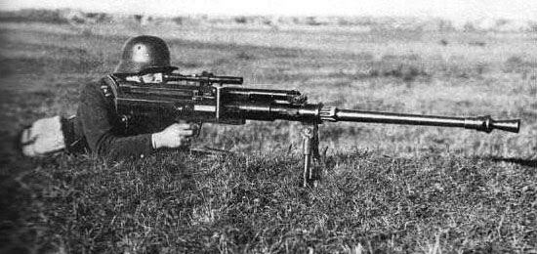
However…
Serious shortages in Vital raw materials was only partly addressed
Germany was unprepared by the 4 year plan for the global scale of WW2
Lack of skilled labour and goods forced Germany to import and spend more than it received
From 1940 – 1943 even Britain was able to out-produce Germany
Germany only started to mobilise full potential after Stalingrad and by this time many would argue the war had already turned against them.
Territories occupied by the 3rd reich were more plundered than exploited with real economic efficiency.

Slide 9
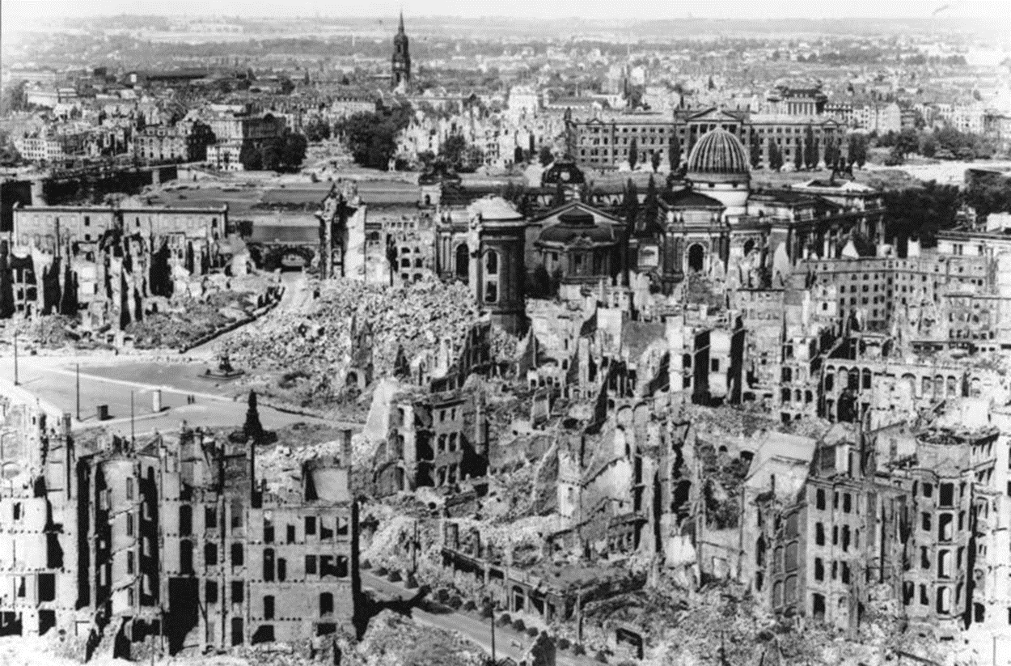
How effective was the Allied bombing of Germany?

Slide 10
Remember Speer?
Richard Overy says he achieved a ‘production miracle’.
His actions resulted in a great increase in output at a time when Germany was enduring a massive Allied bombing campaign targeted at its industry.

Slide 11
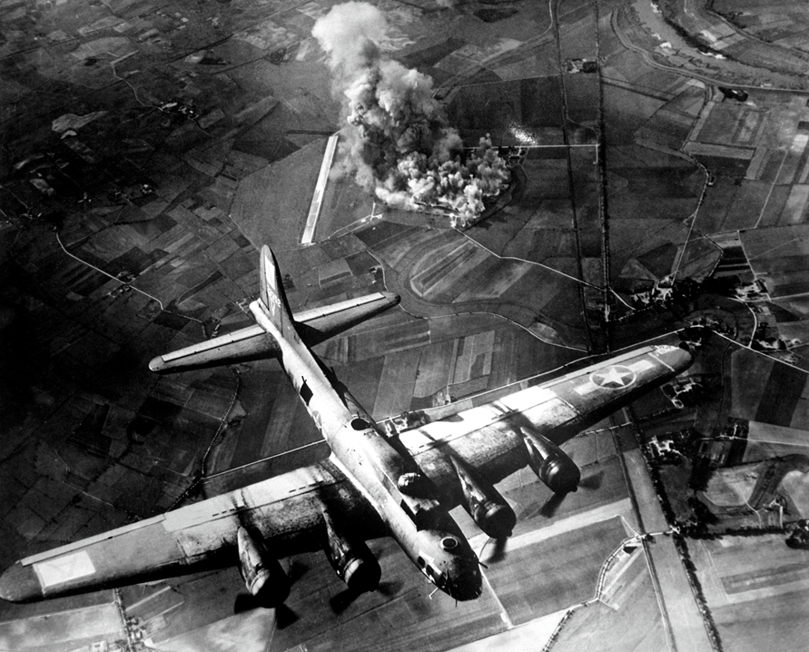
Strategic bombing, 1940 onwards
‘Strategic bombing’ ranges from bombing of specific industrial targets to blanket bombing of cities to terrorise the population.
A way to hit Germany directly.
It could aid USSR – bombing diverted German resources from the eastern front
It could damage the German economy
Simultaneously bombing could damage civilian morale

Slide 12
Some facts and evaluation of the bombing campaign.
Allied bombing diverted German resources to anti aircraft weapons and fighter planes relieving the pressure on allied ground forces.
However over the course of the war the British lost 8325 bombers and around 55,000 men.
Despite bombing German arms production trebled in the years 1941 – 1944
Around 635000 German civilians died as a result of the bombing campaign.

Slide 13
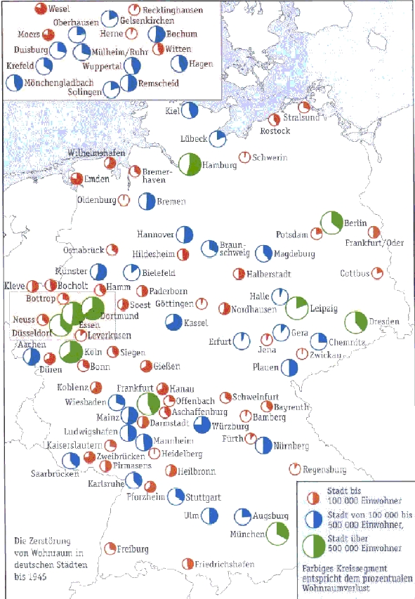
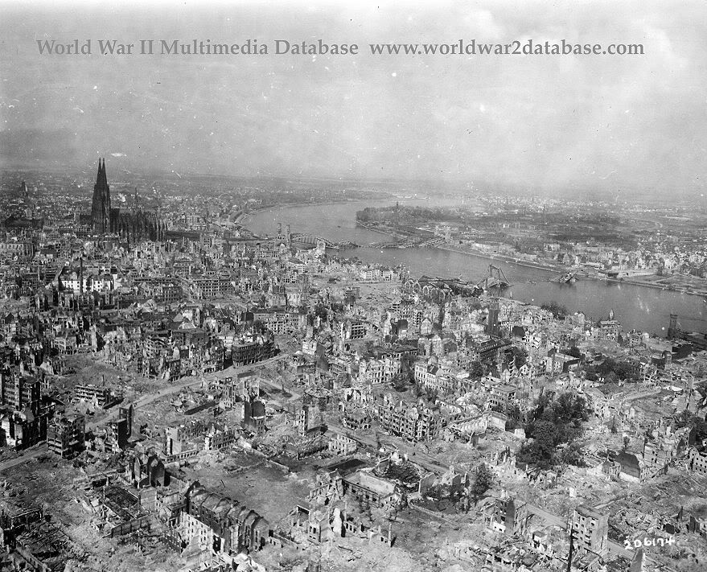
Percentage of buildings destroyed by the Allied bombing
Source: http://www2.needham.k12.ma.us

Slide 14
Task
Answer the questions on British bombing strategy in WW2.

Slide 15
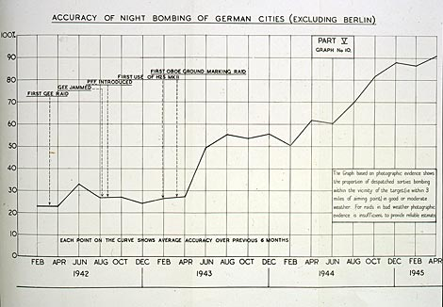
Source: www.nationalarchives.gov.uk

Slide 16
The impact on the German economy
Synthetic oil industry halted in autumn–winter 1944
Steel production dropped by 80%
Railway system had been disabled by end 1944
Chemical industry badly damaged, reducing output of explosives by half.
Disrupted production; the German Armaments Ministry concluded that in 1944 35% fewer tanks & 31% fewer aircraft had been produced as a result of bombing.
Anti-aircraft guns accounted for a third of all German artillery production.

Slide 17
However…
Bombing, especially daytime precision bombing, was incredibly inaccurate especially in the early years: only 3% of bombs fell within 5 miles of their target – hence the move from area rather than precision bombing.
Despite the bombing, German arms production trebled 1941-4. German arms production peaked in August 1944.
But Overy argues that if it had not been for Allied bombing, the German economy might well have outproduced the USSR and UK together, such were the improvements made by Speer.

Slide 18
homework
For MONDAY please can you ensure you have finished watching the video & answered all the questions
For FRIDAY 5th Feb add notes to the spider diagram on p.18 (or you can create your own mind map if you need more space) using Layton p.249-251. This can be accessed on GOL through the library page.

