Slide 1
Why was Germany divided in 1949?
Understand the significance of the Berlin Blockade
Use a range of sources to evaluate the reasons for Germany’s division in 1949 and the responsibility of the USSR and the west.

Slide 2
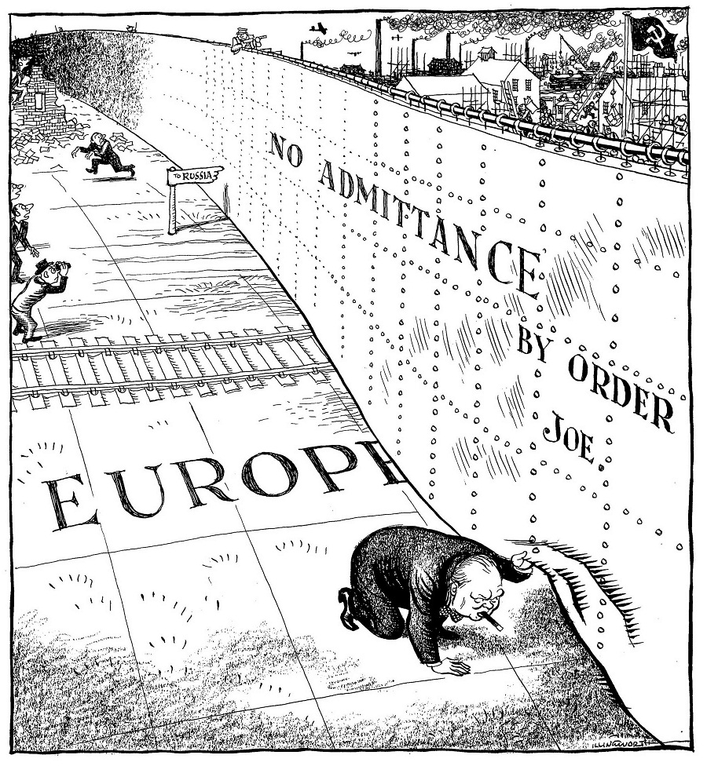
Emergence of the Cold War
Churchill: the ‘Iron Curtain’ speech
Communist expansion in south-eastern Europe led to the Truman Doctrine and ‘containment’
This was accompanied by the Marshall Plan or Marshall Aid.

Slide 3
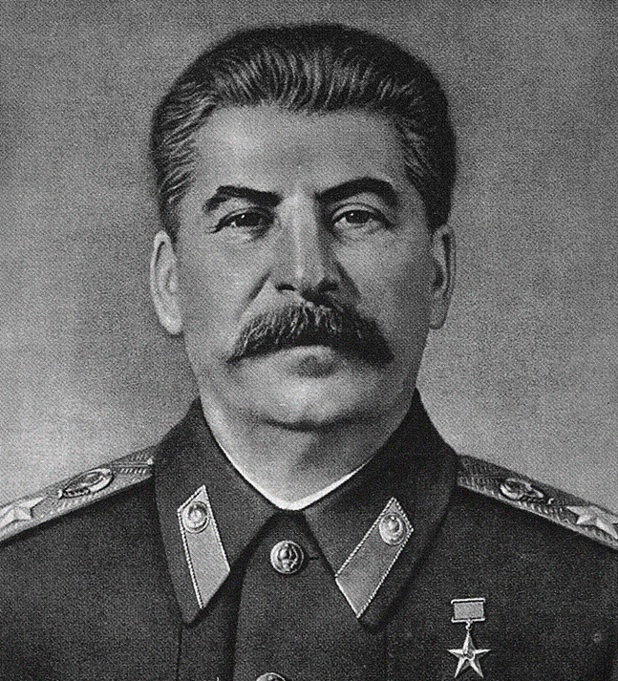
Stalin’s attitude towards Germany
Wanted Germany to be demilitarised & politically neutral
2/3 of German territory and ¾ of its population would be in the western zones and he feared a capitalist West Germany could be used as a launchpad for a US attack on the USSR in a 3rd world war.

Slide 4
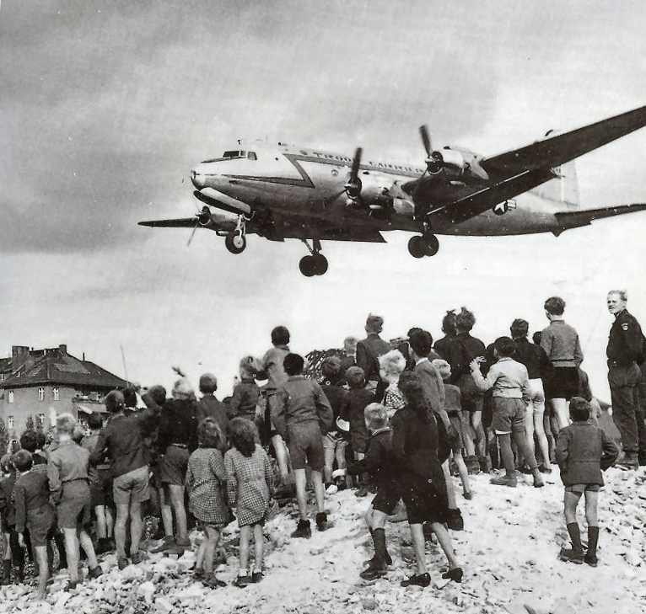
The Berlin Blockade
1948: western zones reformed the currency & within months there were signs that Germany was recovering.
Stalin could do nothing about the reformation of the western zones or currency but he could stamp his authority on Berlin
The city was blockaded, cutting off the 2 million strong West Berlin population from western help

Slide 5
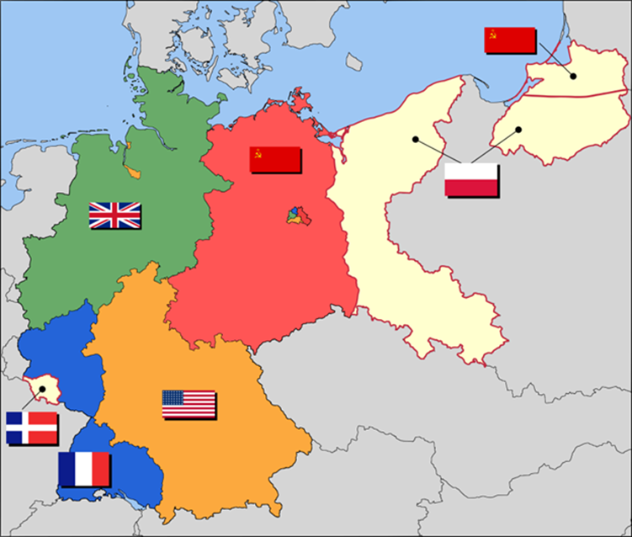

Slide 6
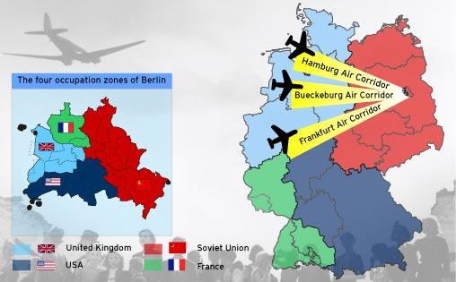
The Berlin Airlift
Truman wanted Berlin to be a symbol of freedom behind the ‘Iron Curtain’ and ordered an airlift
For ten months West Berlin was supplied by a constant stream of aeroplanes bringing in everything from food and clothing to oil and building materials – although there were still enormous shortages.
By May 1949 Stalin had reopened communications.

Slide 7
The significance of the Berlin Blockade
It was one of the first major international crises of the Cold War.
It demonstrated the deepening divisions between the western allies and the Soviet Union: it nearly ended in war.
It brought humiliation to the Soviets.
It resulted in the formal separation of Germany into 2 states, remaining like this for over 40 years.
It resulted in animosities between Germans and the western allies decreasing.

Slide 8
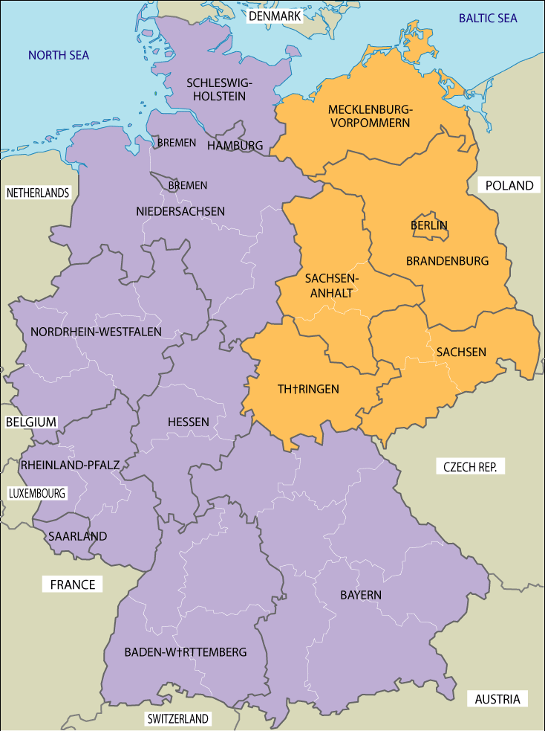
Creation of West and East Germany
In May 1949, the Federal Republic of Germany (FRG – West Germany) came into existence. The new capital was Bonn, a small provincial town on the Rhine and the first government was formed under Konrad Adenauer (CDU).
In October 1949, the German Democratic Republic (GDR – East Germany) was formed in what had been the Soviet zone of occupation. The president of the new state was the communist Wilhelm Pieck and the prime minister was Otto Grotewohl.

