Slide 1
What are the key principles behind Communist economic policy?

Slide 2
What were the consequences of East German economic policy?
Aims:
Understand East German economic policy with regards to agriculture and industry
Be able to explain the impact these policies had on the economy

Slide 3
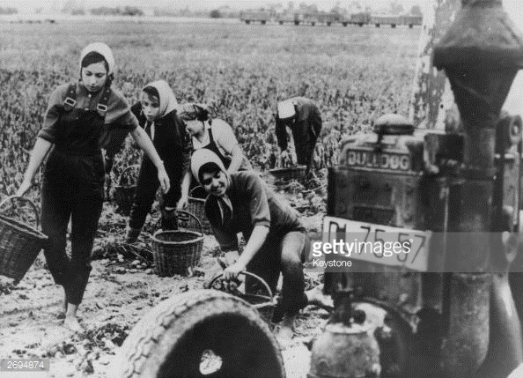
Agriculture
Confiscation of landed estates over 100 hectares – given to landless labourers and refugees
From 1952 forcible collectivisation began
In the Second Five-Year Plan EG accelerated this and by 1961 collective farms accounted for 90% of agricultural products
It was economically inefficient and unpopular
There were shortages of all but the most basic foodstuffs and EG had to import grain to feed livestock.
Farmers started to emigrate & collectivisation contributed to 1953 unrest

Slide 4
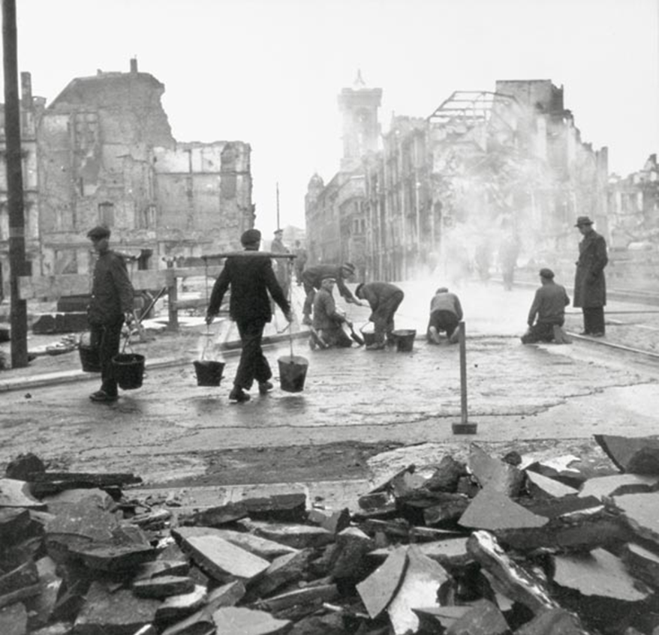
Industry
East Germany was crippled by the Soviet policy of reparations 1945-49.
In Berlin 80% of industrial machinery was removed and overall the USSR extracted about 23% of GNP for reparations
Ulbricht’s policy was rigidly Stalinist: 80% of industry was nationalised and 60% of investment was in iron, steel, mining or energy; only 2% was devoted to consumer goods.
Emphasis on quantity rather than quality
Five Year Plans beginning in 1951 introduced centralised state planning, stressing high production quotas and increased labour productivity
The policies provoked unrest in 1953

Slide 5
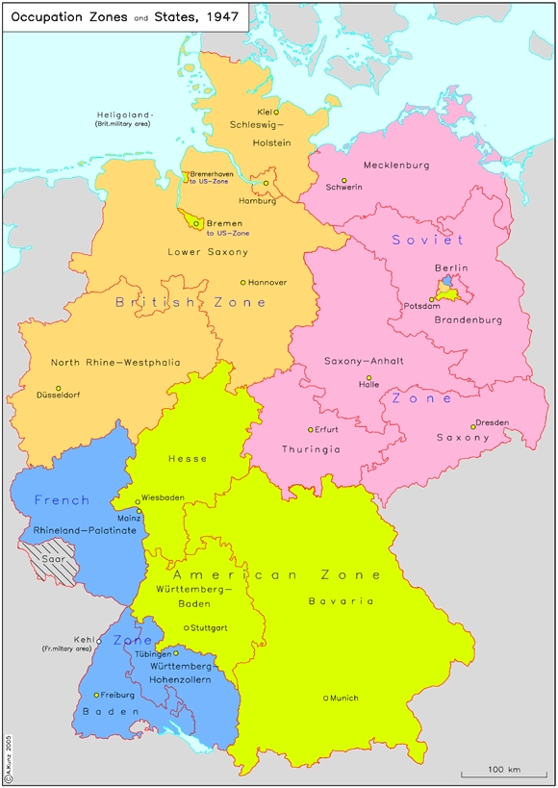
Emigration and the ‘Brain Drain’
3 million East Germans (1/6 of the GDR’s population) emigrated to the West 1949-61
Most were businessmen or skilled professionals e.g. engineers, doctors, teachers (Neulehrer) and most were young (50% were under 25)
The direct cost of manpower losses was estimated at $7 billion to $9 billion.
Most people emigrated through Berlin as the inner border was closed, leading eventually to the building of the Berlin Wall in 1961.

Slide 6
The 1953 Workers’ Uprising
Using p.9 of the booklet,
Why did the unrest break out?
Why was Ulbricht so shaken by it?
Why nevertheless did he survive?
Why did such unrest not happen again?

Slide 7
Homework
Pp12-13: read the bullet points & give a mark out of 10 to the extent to which the GDR was a “workers’ paradise”. Write a conclusion on this, incorporating at least 3 points on each side.

