Slide 1
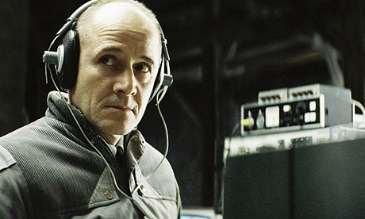
‘The Lives of Others’
What type of state was East Germany?
Can you identify any similarities between East Germany and Nazi Germany from this clip?

Slide 2
How did East Germany develop, 1949-1961?
Aims:
to gain an overview of the East German state & understand what it was like in terms of politics, the economy and repression
to understand how the East German state controlled the population

Slide 3
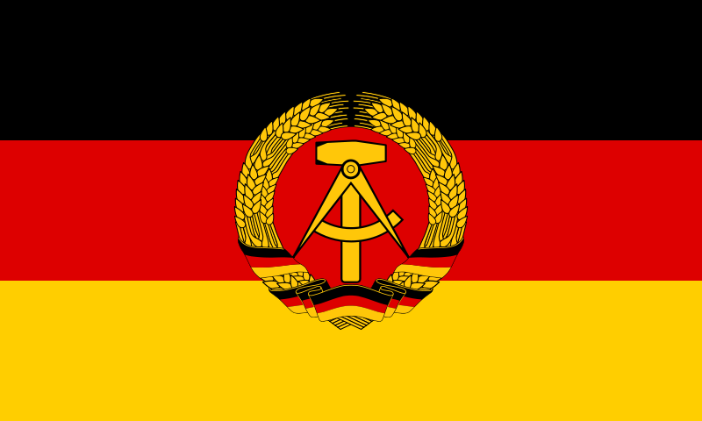
The GDR (East Germany), 1949-1961
Stalin did not want Germany to be divided
He waited until the creation of West Germany in May 1949 before officially setting up East Germany, the German Democratic Republic in October 1949
The GDR lasted 41 years before being absorbed in 1990 into the Federal Republic’s system
The GDR was led by Walter Ulbricht, 1949-71 & Erich Honecker, 1971-1989

Slide 4
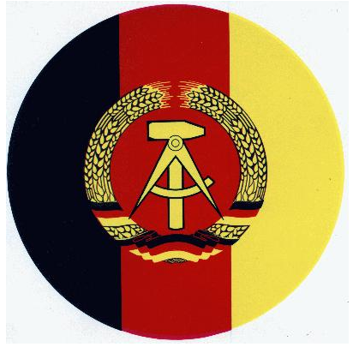
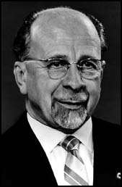
Politics in the GDR
A one party state: with only officially approved candidates able to run in elections.
Ulbricht and Honecker controlled the country as General Secretary of the Party
Centralised system of government as opposed to the federal system used under the Kaiser, the Weimar Republic & the Federal Republic

Slide 5
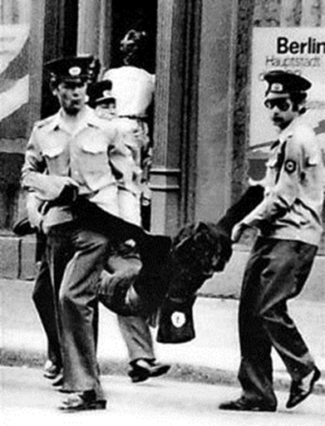
Use of Repression
Police states: The GDR’s Stasi were similar to Stalin’s NKVD and Hitler’s Gestapo. The population was spied upon to detect and suppress political opponents.
The communists used former Nazi camps like Buchenwald to imprison political opponents.
The regime was repressive rather than brutal.

Slide 6
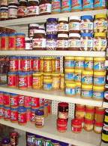
The economy
Modelled on Communist ideology
State control of industry to ensure priority was given to heavy industry & the needs of the Army at the expense of consumer goods.

Slide 7
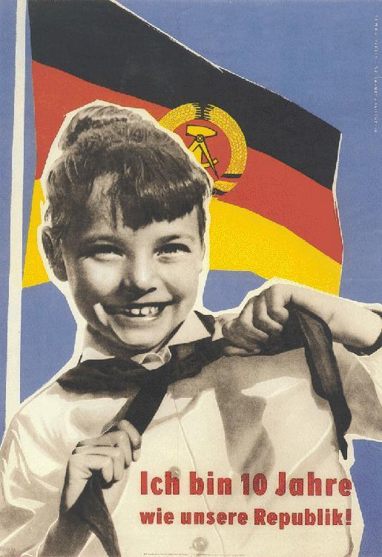
Youth indoctrination & religion
The Communist FDJ was comparable with the Hitler Youth
The regime was suspicious of the churches, which were almost the only organisations independent of state control.

Slide 8
Germany After Stalin
Answer the questions on the video.
Cold War: After Stalin 4 mins 20 seconds

Slide 9
East German social policy
In pairs, fill in the Social Policy Grid. Think of what the Nazis did - Communist methods were often similar.

Slide 10
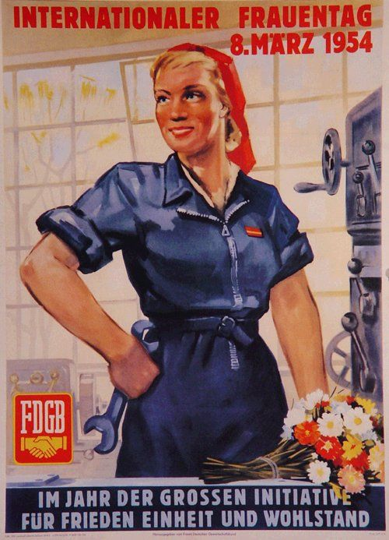
The GDR has an acute shortage of labour because of the war & emigration: what can be done to enable more women to work?
Maternity care
Work-based nurseries
After-school childcare

Slide 11
To encourage mass participation in official organisations like the FDGB (Communist labour organisation, a bit like the Nazi DAF) & the Democratic Women’s League of Germany (DFD)
Virtually every worker was a member of the FDGB
Organise subsidised holidays & other leisure activities
Organisations to promote cultural pursuits or sporting activities.

Slide 12
To encourage young people to see the USSR as their friends
German-Soviet Friendship Society sought to teach the population that they had been ‘liberated’ rather than conquered by the USSR
Schoolchildren could win prizes for writing essays praising the USSR

Slide 13
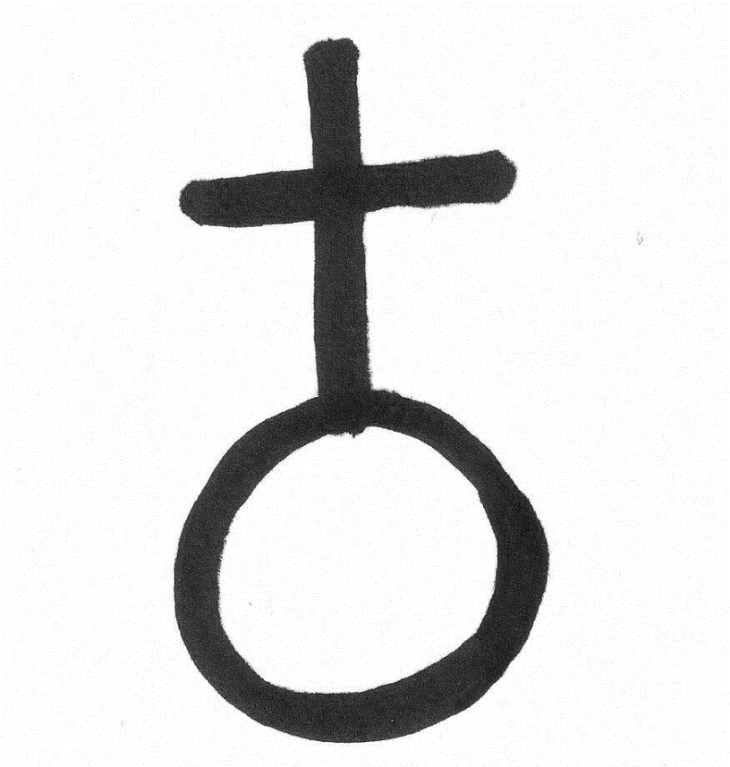
To reduce the influence of religion on young people
Religious instruction removed from the school curriculum in 1946
Repression of Christian youth groups: in 1952-53 they waged a campaign against the ‘Junge Gemeinde’ (Young Community), a Protestant youth group
Students showing a religious commitment were prevented from taking the Abitur or going to university.
Impose the Jugendweihe, designed to replace confirmation and declaring allegiance to communism.

Slide 14
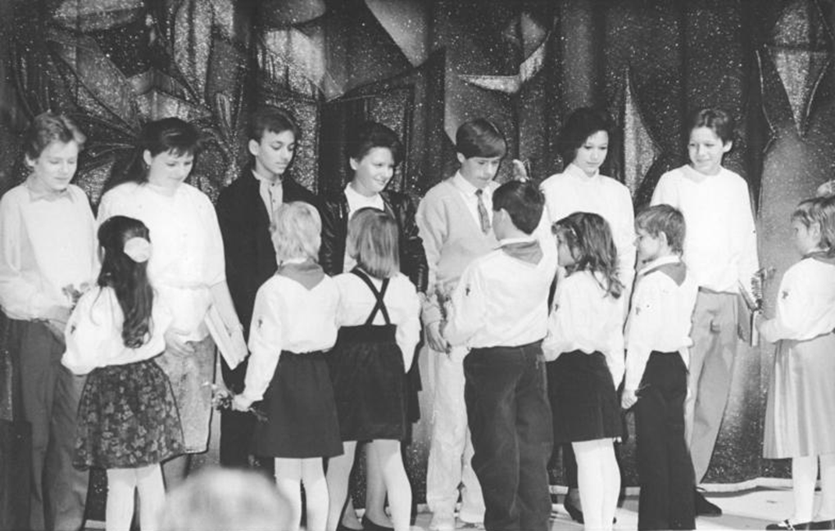
To ensure that young people take the Jugendweihe (a ceremony involving an oath of allegiance to the SED)
Discriminate against those who refused to take it, denying them access to higher education and professional careers

Slide 15
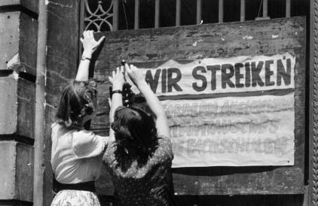
To improve the educational & career prospects of working class as opposed to middle class young people
Spend more money on education
Expand pre-school education
‘Twin’ schools with local factories so that students could gain experience of industrial work and identify themselves as working class
Scholarships and opportunities for adult education to allow more working class people go to university
Young people from middle class families were discriminated against

Slide 16
To ensure that teachers teach Communist ideas after years of Nazism
Sack teachers with a Nazi past
Replace with young new teachers (Neulehrer)

Slide 17
To encourage young people to join Communist youth groups like the FDJ & to regard Communists as heroes
School-based activities, outings and camps, emphasis on physical fitness, community service and practical training
Young Pioneers (ages 6-14) named after Ernst Thalmann, a KPD leader murdered by the Nazis
Young people taught about Communist resistance to the Nazis.
Discriminated against those who were not a member of FDJ in terms of educational and career progression

Slide 18
Using the notes in the booklet (p.5-7) bullet point answers to these questions:
To what extent did the East German regime benefit ordinary Germans?
How successful was the East German regime in controlling the population?

Slide 19
Homework
1. Using the notes in the booklet (p.5-7) bullet point answers to these:
To what extent did the East German regime benefit ordinary Germans?
How successful was the East German regime in controlling the population?
2. Watch the documentary on the Berlin Wall and answer the questions on p.14-15 (no.6763 - ‘Cold War: the Wall 1958-63)

