Slide 1
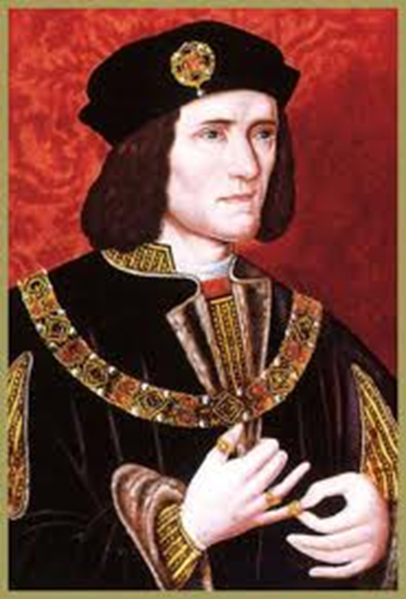
Reasons Why Richard III lost the throne (or reasons why Henry Tudor won)

Slide 2
Past questions
It was the weaknesses of Edward IV’s reign rather than the personal ambitions of Richard III which led to the usurpation of the crown in 1483.”How far do you agree with his statement in explaining the events of 1483?
Why was Richard III’s reign so short lived? (June 2011)
Was Richard responsible for his own insecurity? (Jan 2009)
How far was the unpopularity of Richard III responsible for the success of Henry Tudor’s challenge in 1485? (June 2009)
How accurate is it to say that Henry Tudor was able to seize the crown primarily because of Richard III’s inability to secure the support of the great nobles of England?
How far do you agree Richard was responsible for his own downfall (last year)
Why was Edward able to overcome the challenges to his reign in 1471 yet Richard unable to do so in 1485 (2013)

Slide 3
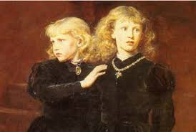
1. Richard lll’s claim to the throne was never generally accepted.
Edward V was only 12 years old in 1483 and it was easy for Richard to keep him and his brother in the Tower of London and to seize the throne. Richard claimed that they were illegitimate because their father had been precontracted to marry Eleanor Butler and so was not free to marry their mother Elizabeth Woodville. If this argument were accepted it would mean that Richard himself was the rightful heir of Edward lV. Most people did not believe this story.

Slide 4
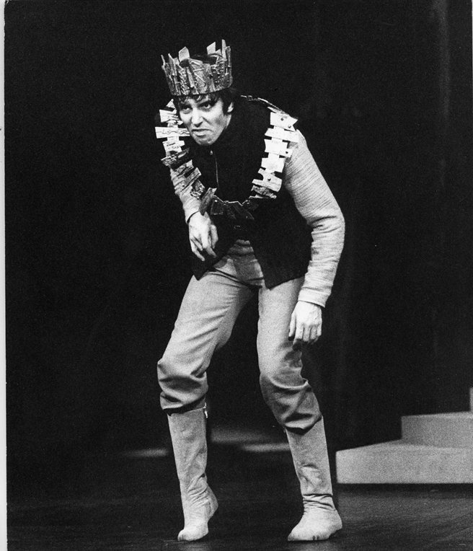
2. Richard lll had an evil reputation.
He executed his own former supporters and relatives of Edward V. Lord Hastings, Earl Rivers, Sir Thomas Grey and the Duke of Buckingham all died without a trial.
He was considered by many to be a usurper and in addition he was suspected of murdering his two young nephews.

Slide 5
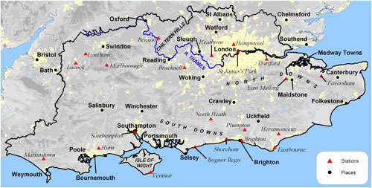
Richard lll was unpopular in the South.
He spent most of his life, up to 1483, in the North. Most of his supporters were therefore from the midlands and the North and the southerners’ resentment of this was shown by the fact that rebellion broke out in every county south of London in the autumn of 1483. Richard retaliated by giving land and power to his northern supporters in the South. This made him even more unpopular.
As far as we know no southern nobles fought for Richard at Bosworth.

Slide 6
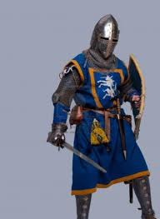
Richard lll was not supported by the nobility.
Richard is supposed to have been very popular in the North yet the two most powerful northern families, The Stanleys and the Percies failed to support him at Bosworth.
At a decisive point in the battle Sir William Stanley intervened on Henry Tudor’s side.
Buckingham’s rebellion.

Slide 7
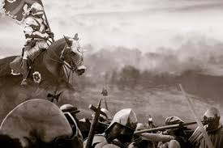
Richard lll’s strategic errors on the battlefield.
What were these?

Slide 8
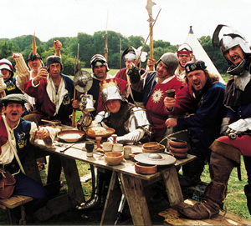
Legacy of the Wars of the Roses.
After 30 years of civil conflict fewer than half of the English nobility and gentry were prepared to commit themselves to either side. Respect and loyalty to the monarch had declined since the 1450s. The crown was weak and could not command the loyalty of the nobility. There had been frequent changes of monarch in recent years.

Slide 9
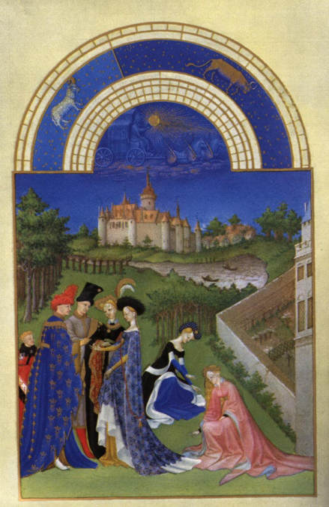
Henry Tudor had French support.
Charles Vlll of France gave Henry the money and the army he needed to invade England in 1485. Henry attracted little English support before Bosworth as most nobles refused to commit themselves until they knew who had won so his army was mainly French.

Slide 10
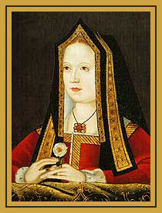
Richards actions taking the throne had split the Yorkists
Henry VII had promised to marry Elizabeth of York, the daughter of Edward lV, once he was king. Other Yorkists joined him.

