Slide 1
Revision session 1, causes of instability in England 1445 – 1455
Stage 1 1445 – 1450
Stage 2 1450 - 1455
Aims:
Identify the issues which were causing political instability in England.
Evaluate the significance of these.

Slide 2
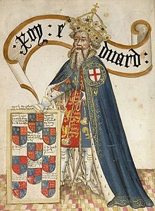
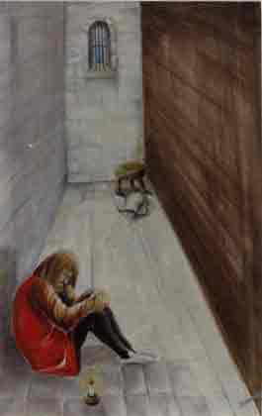
The legacy of the Lancastrian usurpation of the throne
Edward III had too many sons leaving too many with a claim to the throne
Did Henry IV’s usurpation of the throne create long term problems for the stability of the monarchy? Discuss in pairs evidence for and against.

Slide 3
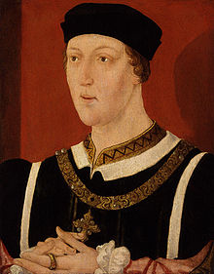
The fact that Henry VI had taken the throne as a child
Henry V’s death left Henry VI on the throne aged only 9 months old. This could well have been a problem.
However his uncles ruled well, Bedford maintained the French lands up until his death in 1435 and Gloucester’s council was unchallenged in England during Henry’s childhood.
You could argue this was the most successful part of Henry’s reign.

Slide 4
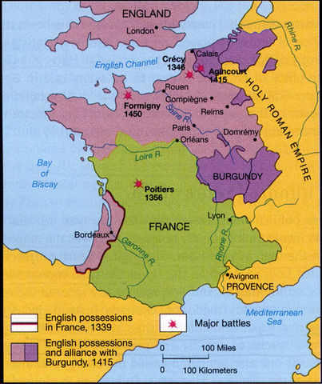
Events in France
In 1435 Burgundy swapped sides putting pressure on the English
By the 1440s commanders were beginning to go unpaid and crown lands were having to be sold to support the war. (York ended up being owed huge sums by the crown.)
York was appointed Lieutenant in France (commander) but was overlooked and failed campaigns were led by Somerset which caused resentment.
By 1444 the English were ready for peace. Marriage was agreed between Henry and Margaret of Anjou. In return Maine and Anjou were handed back to the French (causing more English resentment.
England broke the truce in 1449 and the French captured Normandy in 1450.

Slide 5
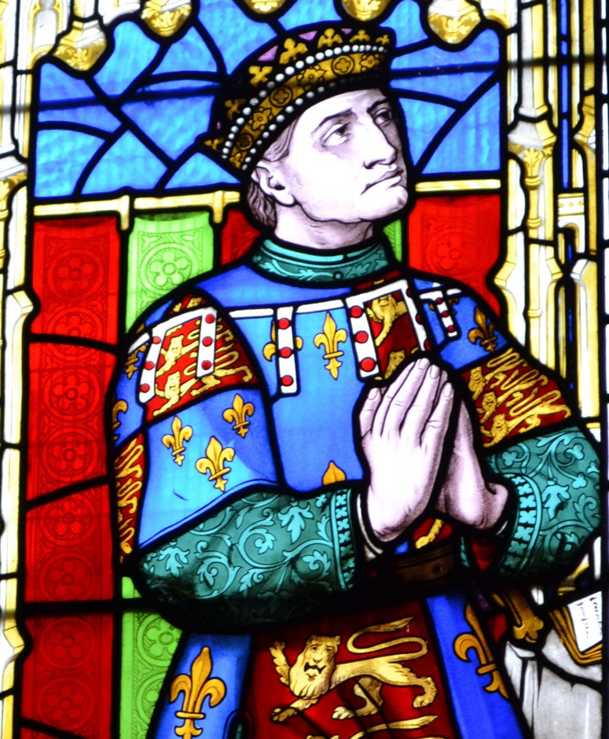
The alienation of Richard Duke of York
York was replaced as Commander in France in 1445 and sent to Ireland (He refused to go until 1447)
Therefore he could only watch as the English lost Normandy in 1450
Also Somerset's expenditure in France was repaid but York’s was not.

Slide 6
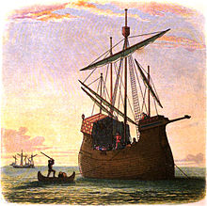
Henrys Favourites
Henry favoured Suffolk and Somerset over York.
Suffolk was promoted to Duke a position usually only reserved for the royal family
Henry rewarded these men with money and more importantly land which reduced the income of the Crown

Slide 7
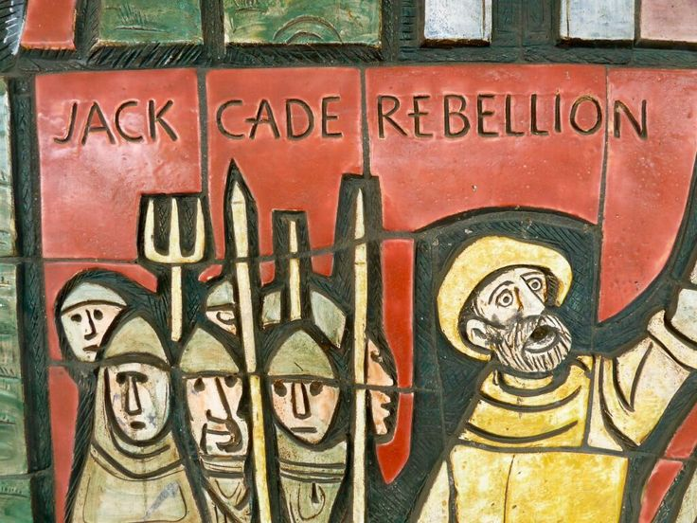
Result: Cades Rebellion
Look at the source in the workbook on Cades rebellion. What reasons does this give for the rebellion. Using own knowledge and provenance assess how useful this is as evidence for the causes.

Slide 8
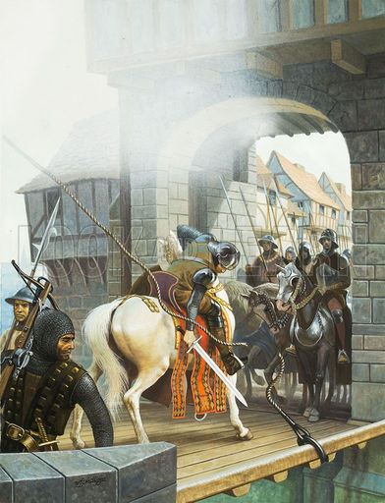
1450 – 55 causes of St Albans
After Cades rebellion. York had returned from Ireland, supposedly to help restore order to the kingdom but he had not been asked to do so by the king.
He probably was trying to clear his name after Cades rebels had used it.
It is also possible he wanted to be repaid the debts he was owed by the crown.
He also seems to have wanted to claim his position on the kings council over Somerset.

Slide 9
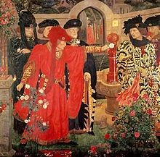
York’s first attempted Coup
York was unsuccessful in gathering support but returned to his castle at Ludlow rather than Ireland.
He turned down the opportunity to join the king’s council in 1451 and in 1452 raised armed support and marched on London
York was confronted by the king’s men at Dartford. The kings army included Buckingham, Salisbury and Warwick so York backed down.

Slide 10
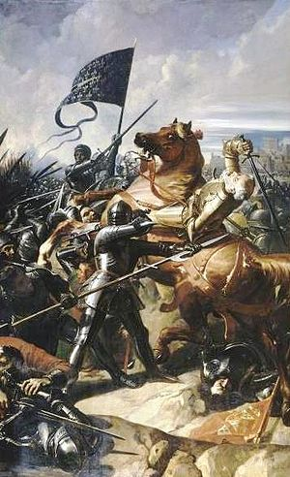
Loss of Gascony
On 17th July 1453 the English suffered a catastrophic defeat at the Battle of Castillon losing the province of Gascony.
Henry promptly had a mental breakdown losing all ability to interact with the world around him

Slide 11
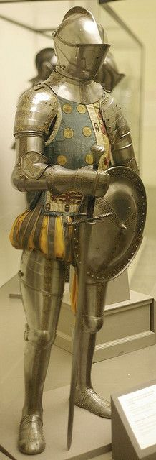
Instability in the regions
At the same time law and order had been breaking down in the provinces.
The feud over land in the North between the Neville and Percy family had been escalating for some time and had now escalated to open fighting.
Henry and his council did nothing to stop this so the Nevilles turned to York. This gave York more military support.

Slide 12
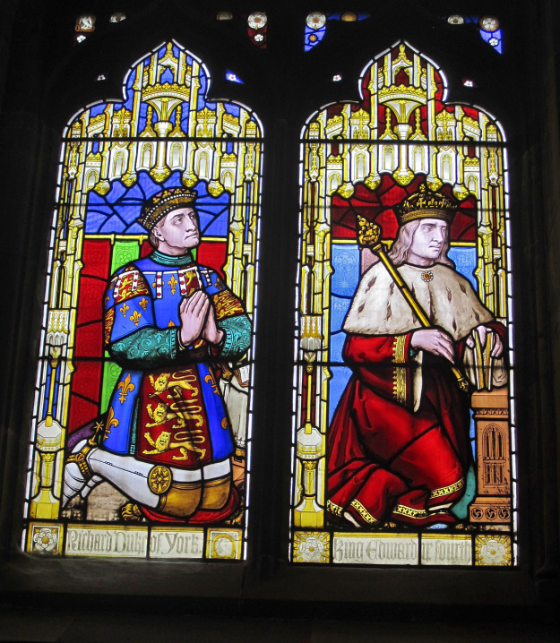
Henry has a mental breakdown and York assumes power
Henry’s breakdown in 1453 meant they now needed someone to act in his name.
York was appointed the protector of the kingdom. Henry’s illness had finally given York the status he craved.

Slide 13
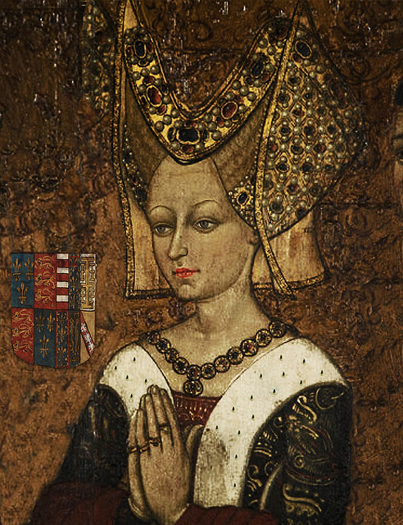
York Somerset Feud
On 13th October 1453, Edward of Lancaster was born. As York was no longer Heir he felt his position threatened and promptly sent Somerset to the tower.
Margaret of Anjou attempted to take power on the basis that she was the queen but the nobility supported York. However this is a sign of the later feud to come.

Slide 14
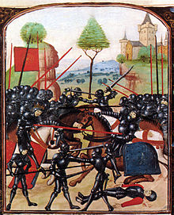
Henry recovers and Somerset is released
Henry recovered his senses at Christmas 1454 and by 1455 York was no longer protector. In February 1455 Somerset was released from the tower.
Why was the situation now so dangerous for both York and Somerset?

Slide 15
Battle of St Albans
York and the Nevilles now feared they were going to be attained so assembled their forces.
They met Henry, Somerset and the Percy forces at St Albans
It was the first Yorkist victory, Somerset and the Earl of Northumberland (Percy) were killed.

Slide 16
Rank the factors causing the wars of the roses into long and short term
The legacy of the Lancastrian usurpation
The loss of France
Henry’s financial problems
Henry’s mental illness
Margaret of Anjou
Richard Duke of York’s ambition
The Duke of Somerset
The Neville – Percy feud
Overmighty subjects

