Slide 1

Balloon debate
Need to prepare 4 separate and different arguments for your particular cause of the Wars of the Roses
Each round one cause will be ‘voted out’
The final team will be the winner
Weakness of Henry VI
Loss of French territory
Ambition and alienation of Richard Duke of York
Over mighty subjects and feuds between them

Slide 2
Recap from last week
Who won and who died at the battle of St Albans?
What happened to Henry within 2 weeks of the battle?
What was the impact of this on York?
What was the impact on Margaret and what did she now do?
Give some examples of how this simmering feud was leading to a breakdown in law and order in England
What was Loveday? How realistic was this as an attempt to bring about peace?

Slide 3
Recap from last week
1: What can we learn from Margaret from sources D, E and F
2: Does the fact that source D is a piece of propaganda mean that it is not useful as a source on this period?
3 Do the sources show that Margaret helped to cause the conflict? Fill in the table to help you reach this decision

Slide 4
Source | Evidence in support | Evidence against | Reliability | Mark out of 10
D
E
F

Slide 5
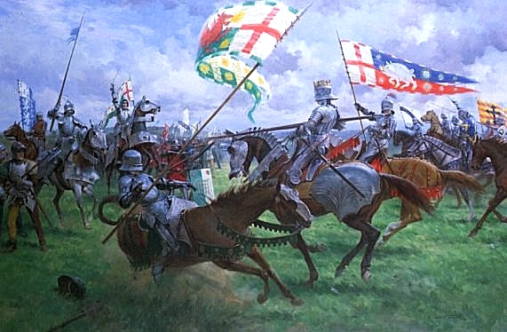
The battles
We will revisit at a later date

Slide 6
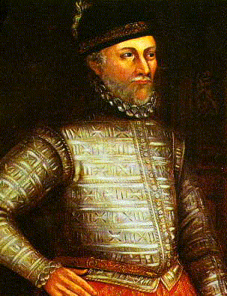
Warwick’s CV
Create a CV for Warwick, using page 70 of textbook

Slide 7

The Act of Accord
Complete activity on page 10 of your booklet
Why would the Act of Accord satisfy neither side? Discuss in pairs

Slide 8
The Battle of Wakefield: War of the Roses: A bloody crown (1:00 – 1:10)
Questions on page 11 of booklet

Slide 9
Wakefield and 2nd St Albans
Two big victories for Yorkists
Whole towns swapped side
Yorkists appear to be dominant

Slide 10
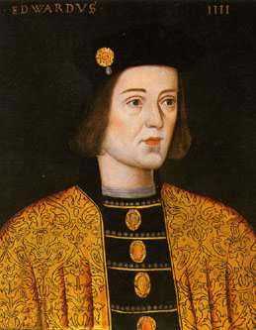
Edward IV
Richard’s son
Wins a battle at Mortimer’s Cross
Proclaims himself King Edward IV with support of the Lords
Uses the details of the Act of Accord to declare himself King – despite Henry still being alive

Slide 11
The downfall of the Lancastrians start 1:10 – 1:27:30
Questions on page 12-13 of booklet

Slide 12
Homework
Complete source activity

