Slide 1
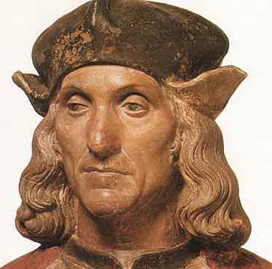
Keeping your crown
Henry VII died in April 1509 aged 52 to some extent worn out by the dangers and decisions of his reign. He had kept his crown and passed it on to his son. Did you do well as Henry? Check your decisions against the information below. You start with four crowns but unfortunately correct decisions do not add to your total, you just don’t lose one. See how many you have left at the end.

Slide 2
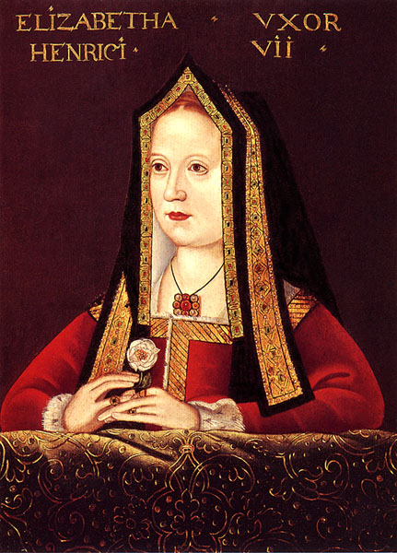
1. Marriage
You have already promised to marry Edward lV’s daughter, Elizabeth, to win the support of Yorkists who opposed Richard lll. However, English kings usually marry foreign princesses to cement diplomatic links. Edward lV’s marriage to an Englishwoman created rivalries and jealousies.
Will you marry…..

Slide 3
Elizabeth of York, uniting the families of York and Lancaster and reducing the chances of internal opposition?
A French princess? France gave you aid in 1485 and might give powerful support against English rebels.
A Spanish princess to warn France you will not be easily dominated?

Slide 4
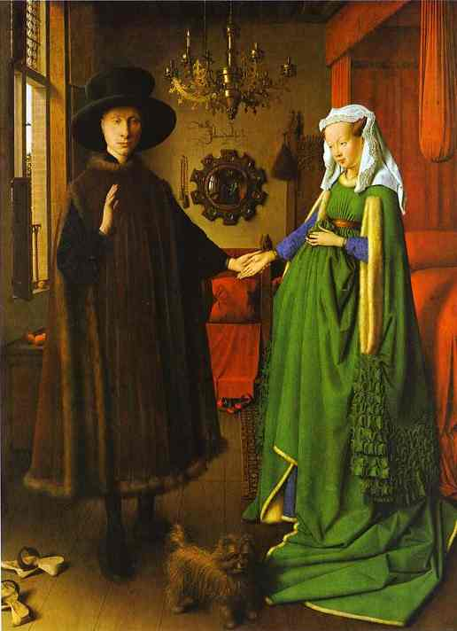
Marriage
A: This was Henry’s decision honouring his earlier promise. This was the best way to reduce potential rebelliousness.
B: Potentially helpful but it means going back on a promise and you might be portrayed as a French puppet. (lose one crown)
C: No practical benefit while repeating the problems of B. (lose two crowns)

Slide 5
2. Who will be your advisers?
Will you
Make a clean sweep of the council and leading administrators, replacing them with men who were in exile with you?
Replace those closest to Richard lll with your men but keep the majority of councillors?
Make a clean sweep of the council and leading administrators, replacing them with your loyalists and give extensive lands and rewards to your supporters to ensure their loyalty?

Slide 6
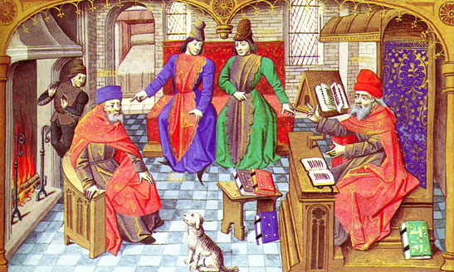
Councillors
A: You need experienced men if the administration is to work efficiently and this option would leave you very short of officials. Anyway most administrators have survived changes of dynasty. (lose one crown)
B: Good choice – you keep the basis for efficient government while removing the discontented. Henry’s choice.
C: All the problems of A while giving away money and land. You need to build your strength. (lose two crowns)

Slide 7
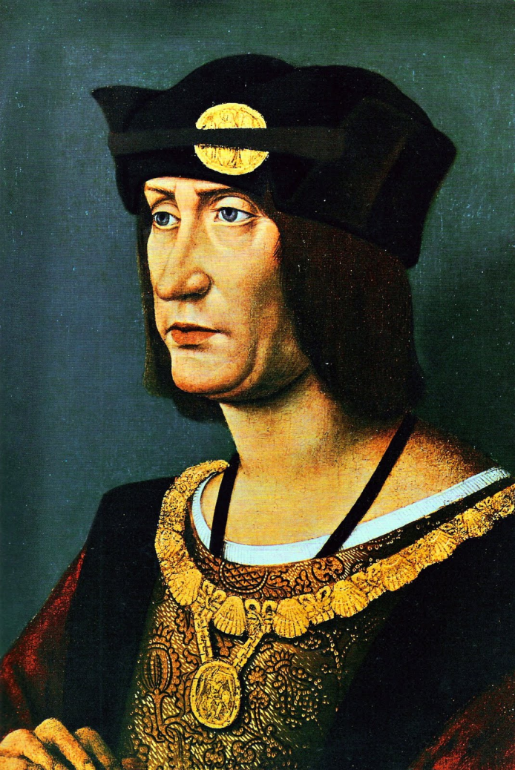
3. Foreign Policy
The French helped you in 1485 but as King of England, you claim to be King of France. The most successful kings have been warriors but French kings helped to destabilise Edward lV and Richard lll.
What will be your policy towards France?

Slide 8
Do you…
Restate your claim to France and plan an invasion which will unite the nobility behind you?
Sign a short term truce with France, omitting any reference to your claim to France?
Sign a peace treaty, giving up your claim to France in return for a French promise to support you against any rebels?

Slide 9
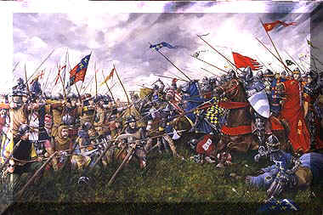
Foreign Policy
A: Attractive option but very expensive – seeking heavy taxes will not win friends. France might also support Yorkist claimants against you. (lose 1 crown)
B: Sensible option, using the link established in 1485 but not appearing to bow down to France either. Not creating French anger Henry’s action.
C: Disastrous will encourage French aggression against you and will provide excellent propaganda for your enemies. (lose 3 crowns)

Slide 10
4. The Earls of Warwick and Lincoln
Both are nephews of Edward lV and Richard lll. Warwick has the better claim to the throne but is still a child. Lincoln is in his 20s.
Should you

Slide 11
Imprison both to prevent them becoming involved in rebellions?
Imprison Warwick but allow Lincoln to join the council to show that he is supporting you?
Free both but keep watch for their involvement in plots?

Slide 12
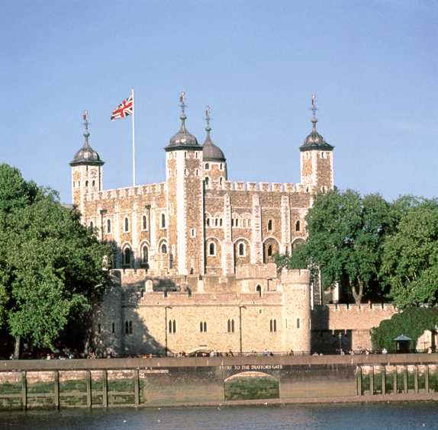
The Earls of Warwick and Lincoln
A: A harsh but sensible option having the fewest dangers.
B: Henry’s choice, very logical but a risk in relation to Lincoln. In 1487 Lincoln joined a rebellion. (lose 1 crown)
C: Dangerous option – Warwick might be the figurehead for a rebellion. Even someone pretending to be Warwick was a danger in 1487. (lose 2 crowns)

Slide 13
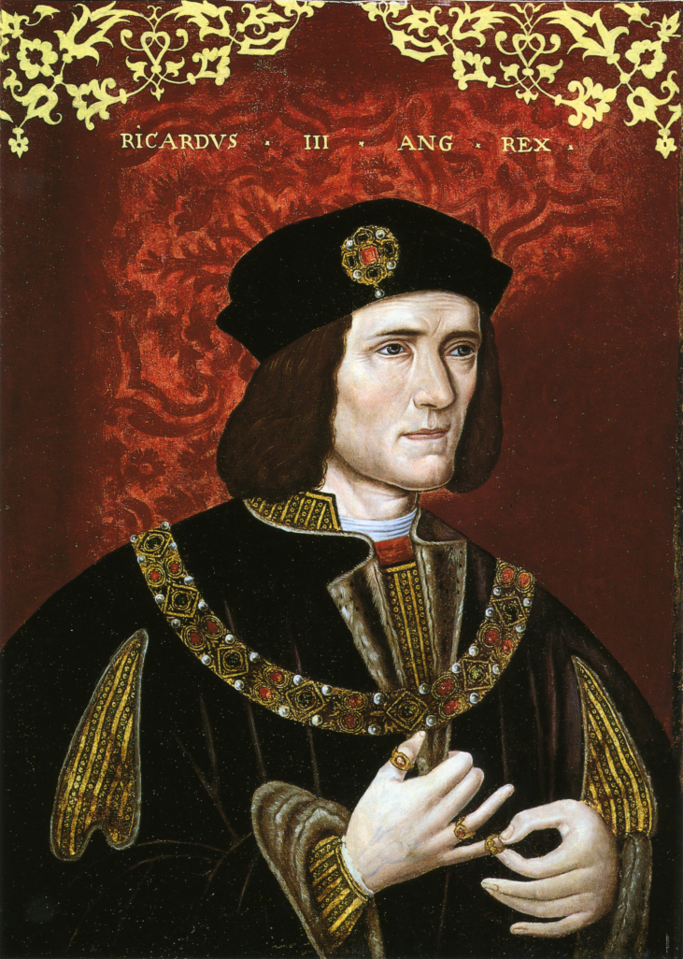
5. Controlling the North
Richard lll had been popular in the North, especially in the city of York. Many northern lords and gentry had been well rewarded by Richard and might join a rebellion.
Should you

Slide 14
Visit York quickly to establish your presence as king and ensure that local lords know that they will be held responsible for any trouble?
Stay safe in the South, leaving the government of the North to the local lords as this will not provoke them to rebellion?
Appoint a southern lord as governor of the North, with orders to deal savagely with any trouble.

Slide 15
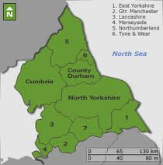
Controlling the North
A: Henry’s choice although it came close to disaster when Ricardians tried to attack him in York. At least he was demonstrating his power and position as king.
B: Abdication by another name! people want a strong king not another Henry VI who left everything to others. (lose 3 crown)
C: Half a good idea. Several years later Henry did appoint Surrey to head the council of the North, but an over harsh response would have stirred the revolt you want to avoid. (lose 1 crown)

Slide 16
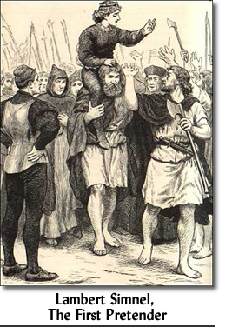
6. Rebellion, 1487
In Ireland a boy has been crowned King of England. His supporters say he is one of Edward lV’s nephews. They plan to invade England with a mercenary army and take the throne.
Should you:

Slide 17
Imprison potential Yorkist supporters, such as Lincoln, to prevent the rebellion winning influential support?
March immediately to the North-West, the most likely landing area, summoning your lords to raise troops and meet you there?
Await more detailed news while ordering your lords to muster their men in the Midlands?

Slide 18
Rebellion 1487
A: Good plan. Henry wasn’t quick enough and Lincoln fled to head the rebellion. Weeks of worry followed although Henry’s victory at the Battle of Stoke was easier than expected.
B: What if they didn’t join you or joined the rebels? You would be isolated and lacking support. (lose 2 crowns)
C: Another sensible move. Henry did this – a pity he didn’t link this to option A.

Slide 19
7. France and Brittany
French forces have invaded the independent Duchy of Brittany. French control would give them the whole coastline facing England.
Should you

Slide 20
Ignore the French moves because it is too dangerous to act while England is still unsettled after the rebellion?
Use the army that put down the rebellion to invade Brittany to protect its independence?
Seek European allies to pressure France into withdrawing from Brittany and encourage English volunteers to fight ‘unofficially’ in Brittany?

Slide 21
France and Brittany
A: A signal to the king of France that he can do whatever he wishes. Not the action of a strong king. (lose 1 crown)
B: A dangerous gamble, leaving the country, even if you can raise taxes and cope with the ensuing hostility. Too much on top of the rebellion. (lose 1 crown)
C: A reaction without risking immediate over-commitment. Henry’s choice.

Slide 22
8. Earl of Surrey
Thomas Howard, Earl of Surrey, fought for Richard lll at Bosworth. He was imprisoned but refused the chance to escape and join the 1487 rebellion. He is a capable and experienced nobleman.
Should you

Slide 23
Keep him in prison to show your harshness to opponents and potential rebels?
Release him and make him responsible for keeping peace in the North, where he has no lands and supporters and therefore no power of his own?
Restore him to his family lands in East Anglia where his influence should ensure law and order?

Slide 24
Earl of Surrey
A: The Safest route but not a good use of a capable man. His support for you would be useful.
B: Henry’s action, calculated to make the best use of Surrey with the smallest risk.
C: Too much of a risk if Surrey does not prove to be loyal (lose 1 crown)

Slide 25
Conclusions
How well did you do? However well or badly you did as the king the real purpose of this game was to introduce you to some of the key issues and events of Henry’s reign and the problems he had to deal with.
Can you answer these questions:
1: What were the main concerns of Henry VII as King?
2: What have you learned about Henry himself?
3: Why do you think he survived?
4: What questions do you now want to ask about his reign?

