Slide 1
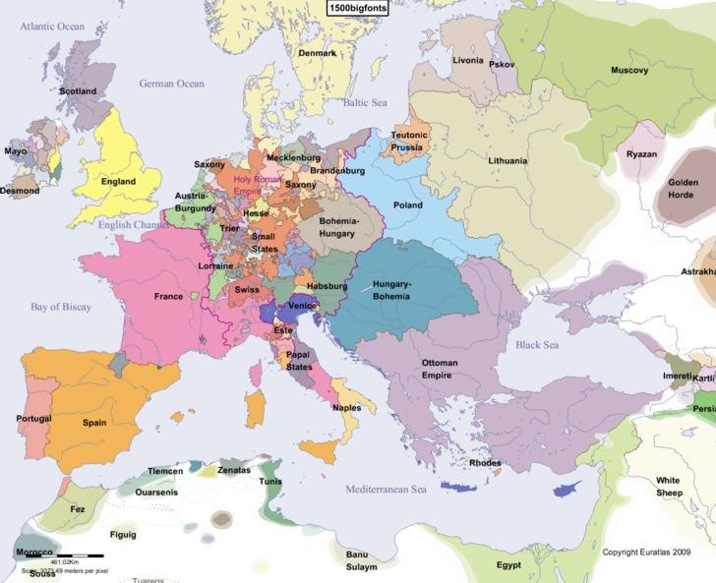

Slide 2
Foreign policy
If you were in Henry VII’s position which countries would you prioritise in your foreign policy?
Who are potential threats and who are potential allies?
Research the leaders of the following countries: Spain, Scotland, Burgundy, Holy Roman Empire and France. Mark them on the map.
What are his three main aims going to be?

Slide 3
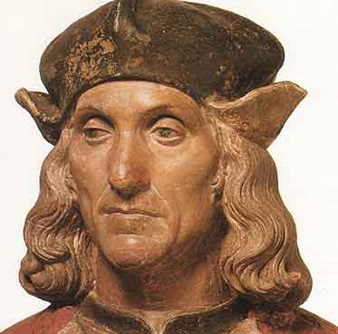
Henry VII’s foreign policy
Henry had 3 main aims at the start of his reign.
To maintain peace in England.
To avoid war.
To gain allies.

Slide 4
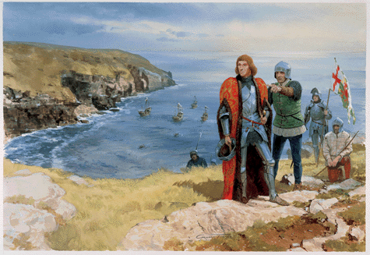
Henry’s motives
The reason he pursued a largely non-interventionist policy was because he had little choice. War was expensive and dangerous, peace was cheaper and gave him a chance to consolidate his power in England.
As a usurper Henry was very vulnerable and many of Europe's rulers did not expect him to last long.

Slide 5
1485 – 1488: First Steps
France: while England’s traditional enemy, France had ties with the Lancastrians and had helped Henry gain the throne. Henry negotiated a one year truce which was then extended for a further 3 years
Scotland: In July 1486 Henry succeeded in persuading James III to sign a three year truce. This truce survived James III assassination in 1488.
Brittany : A long term treaty was signed in 1486 which was more of a commercial relationship.
Why are these sensible first steps?

Slide 6
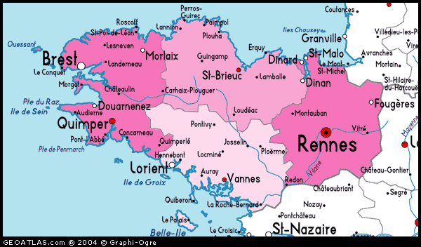
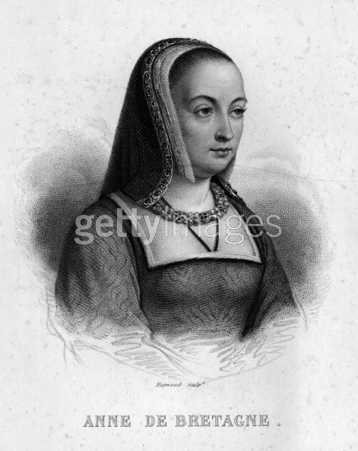
Brittany 1489 - 1492
In 1488 Duke Francis of Brittany had died and left the 12 year old Anne as his heir.
The French King Charles VIII claimed custody of Anne.

Slide 7
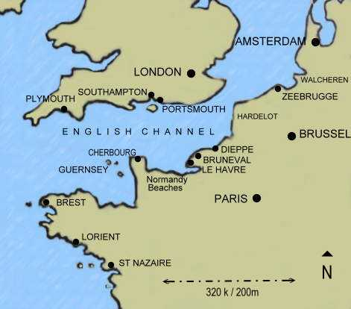
Why do you think Henry would not have wanted the French to have control of Brittany?

Slide 8
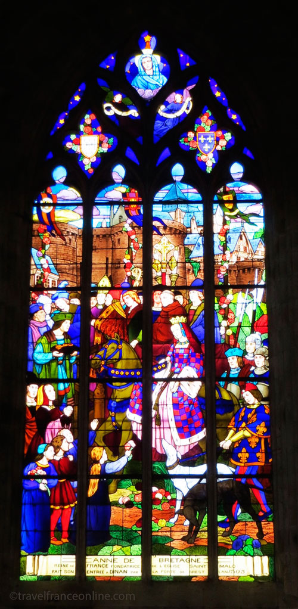
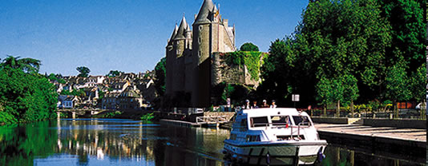
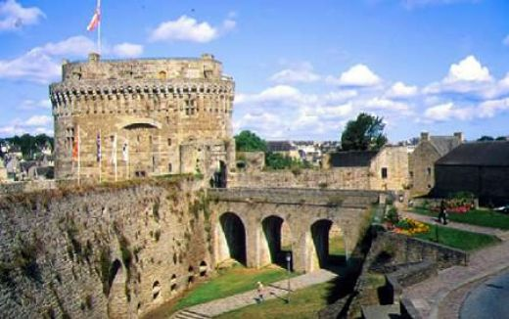
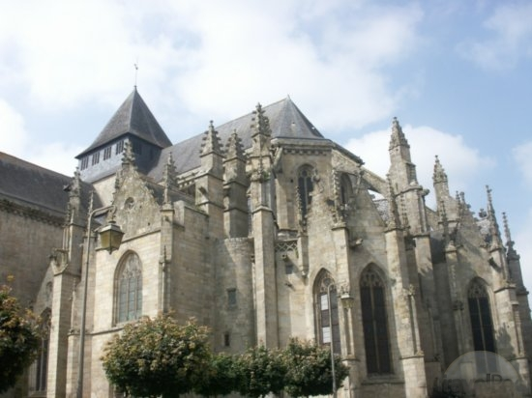
Henry with the support of Ferdinand of Spain and Maximilian, the Holy Roman emperor, sent 6000 men to support Brittany. Unfortunately this was too little too late and when the Spanish troops withdrew so did Henry. Anne married Charles in 1491 spelling the end of Brittany's independence.

Slide 9
France and the treaty of Etaples 1492
Henrys intervention in Brittany had angered the French and in retaliation they supported Warbeck’s claim to the throne. Henry had to respond to this.
Henry did not want war and could not afford it but he had to convince the French he was serious. He landed in Calais with an army of 26000 men hoping the French would back down. He timed this landing for November which some historians see as a signal to Charles that he was willing to negotiate.

Slide 10
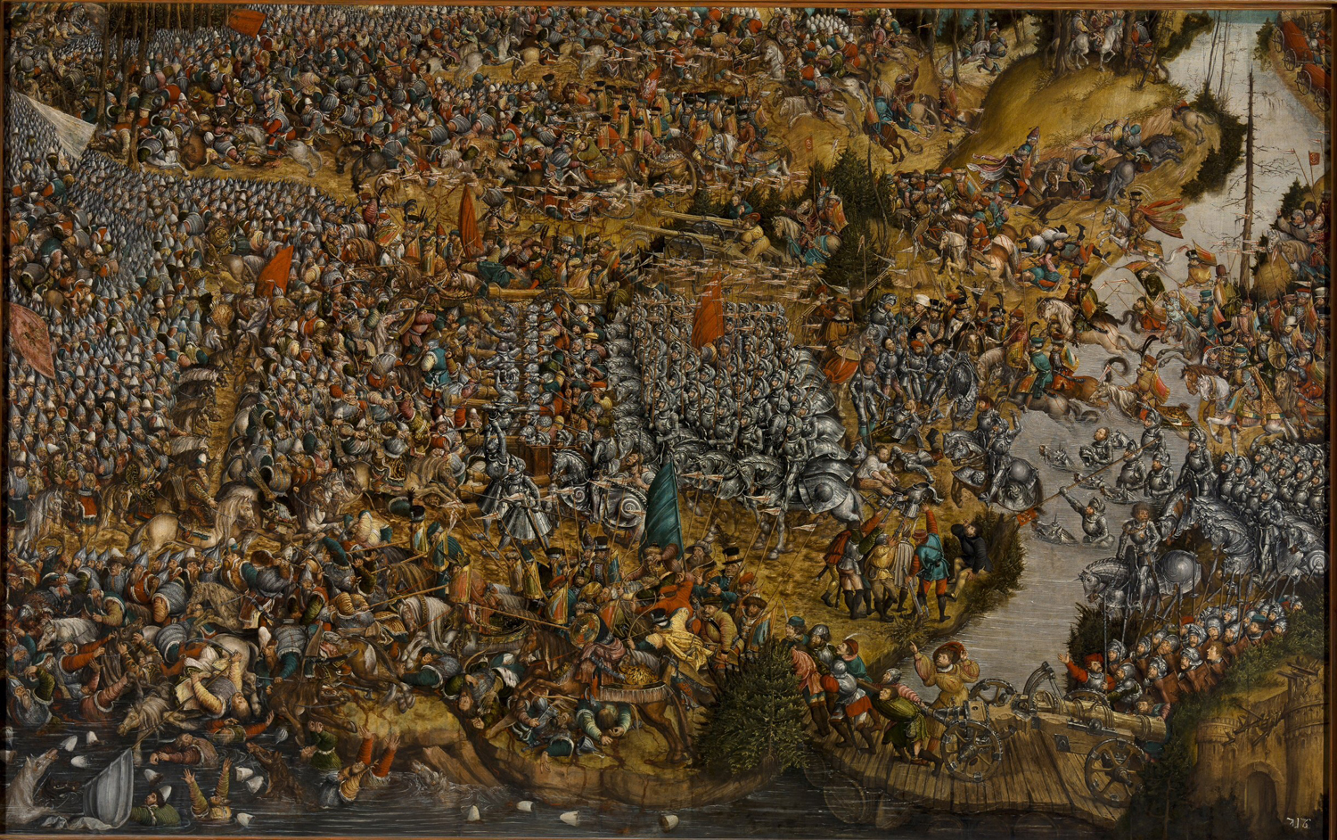
He also knew that by this point Charles was distracted with the Italian wars

Slide 11
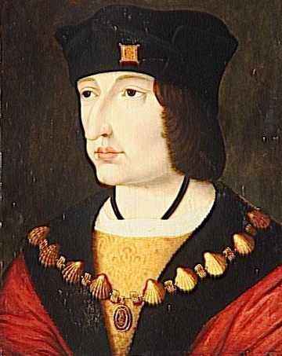
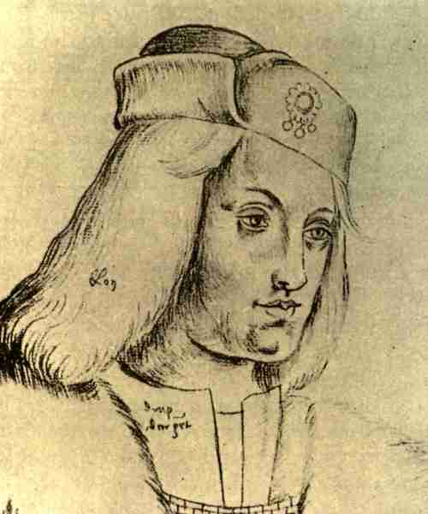
His bluff worked and Charles backed down. Henry managed to negotiate the following:
The French would give no further aid to English rebels, particularly Warbeck.
They would pay the cost of Getting Henry’s army back to England.
They would pay the arrears of the money owed to Edward IV at the treaty of Picqugny back in 1475.

Slide 12
Read pages 3-4 – answer questions on page 5
How was Henry’s involvement in France different from that of his predecessors?
List the successes and failures of the campaign.
Was the outcome brought about by the successes of Henry’s policies or by circumstances?
What do these events tell us about Henry’s skills and objectives in foreign policy?

Slide 13
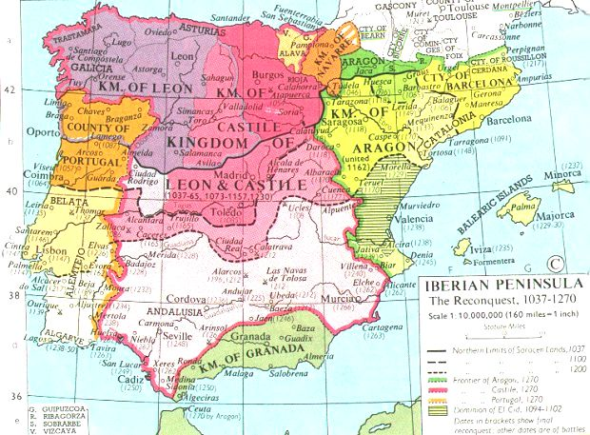
Spain

Slide 14
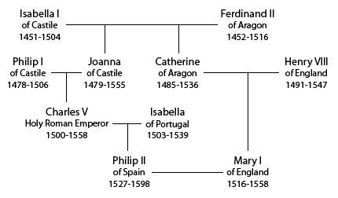

Slide 15
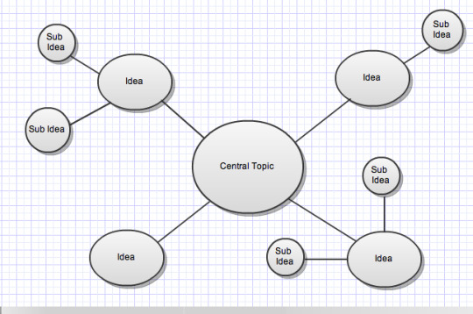
Spain
Create a spider diagram on page 7 of your booklet, using pages 6 and 7 of the booklet, on why the treaty of Medina del Campo was a success for Henry VII

Slide 16
Spain
Henry spotted a useful ally in Ferdinand
The Treaty of Medina Del Campo was signed in 1489 this agreed:
1 Spain would not support pretenders to the English throne
2 They would act together against France in Brittany
3 Improved trade
4 Henry’s eldest son Arthur would marry Ferdinand & Isabella’s oldest daughter Catherine when they were old enough.

Slide 17
Spain
Create a spider diagram on page 7 of your booklet, using pages 6 and 7 of the booklet, on why the treaty of Medina del Campo was a success for Henry VII

Slide 18
Timeline – add Spain and France to your timeline – remember to colour code

Slide 19
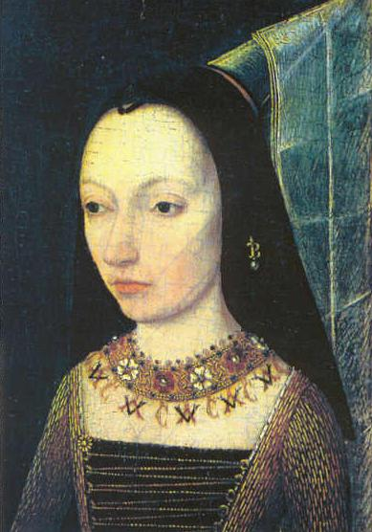
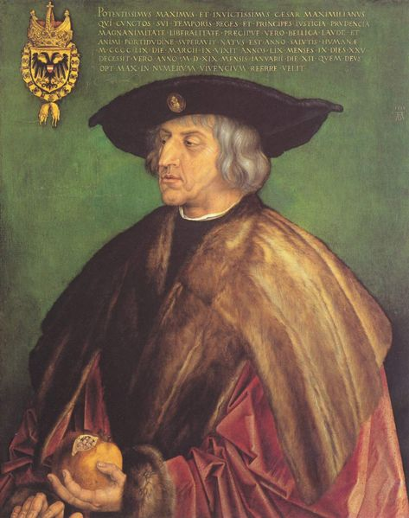
Burgundy
Traditionally England’s Ally Burgundy had close ties with the house of York and with London merchants.
Margaret of Burgundy (Edward IV and Richard III sister) saw Henry as a usurper and was determined to destroy him. 1486 they harboured Lovell and 1487 Lincoln.
Traditional historians see Margaret of Burgundy’s hatred of Henry as main reason for this but Burgundian interests were also at stake as they were worried about Henry’s connection to France.
It is worth noting that Henry’s relationship with Burgundy improved in the later years of his reign.

Slide 20
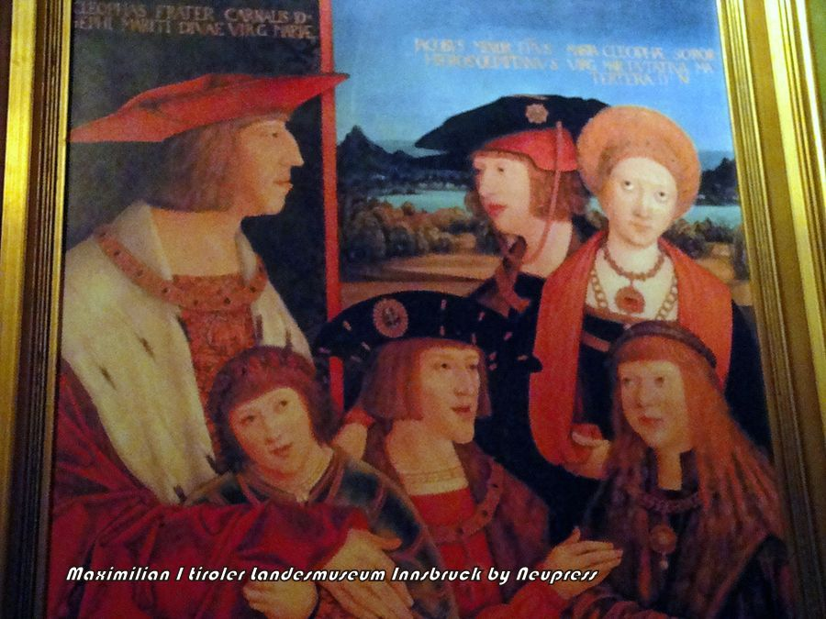

Slide 21
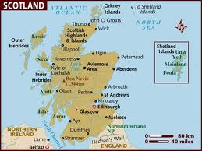
Scotland

