Slide 1
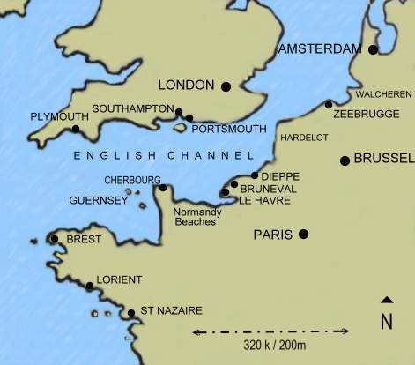
France & Brittany
How was Henry’s involvement in France different from that of his predecessors?
List the successes and failures of the campaign.
Was the outcome brought about by the successes of Henry’s policies or by circumstances?
What do these events tell us about Henry’s skills and objectives in foreign policy?

Slide 2
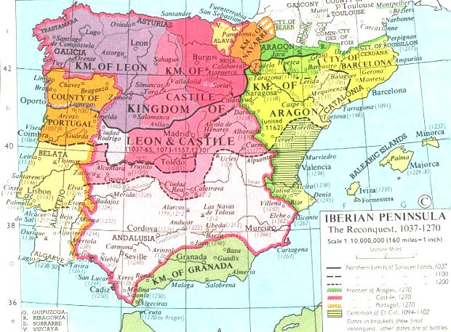
Spain

Slide 3
Spain
Henry spotted a useful ally in Ferdinand
The Treaty of Medina Del Campo was signed in 1489 this agreed:
1 Spain would not support pretenders to the English throne
2 They would act together against France in Brittany
3 Improved trade
4 Henry’s eldest son Arthur would marry Ferdinand & Isabella’s oldest daughter Catherine when they were old enough.

Slide 4
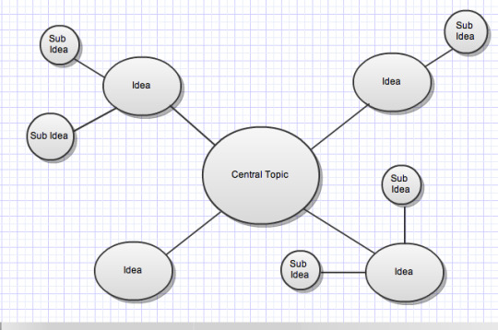
Spain
Create a spider diagram on page 7 of your booklet, using pages 6 and 7 of the booklet, on why the treaty of Medina del Campo was a success for Henry VII

Slide 5
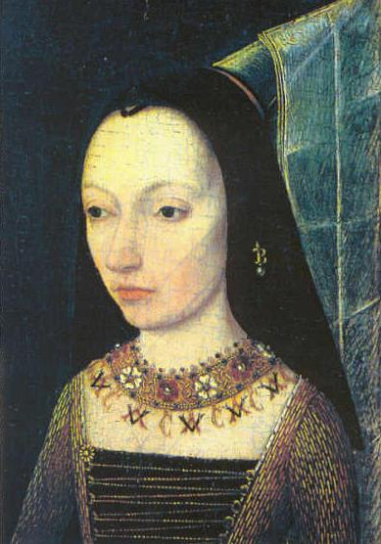
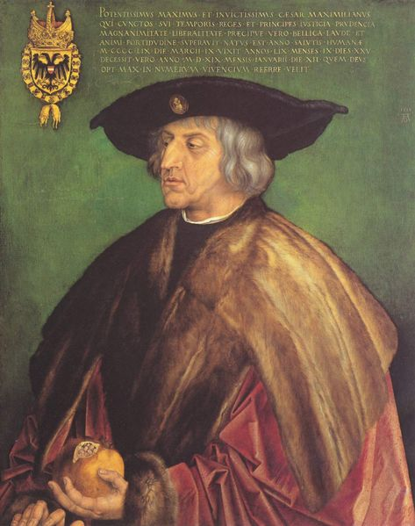
Burgundy
Traditionally England’s Ally Burgundy had close ties with the house of York and with London merchants.
Margaret of Burgundy (Edward IV and Richard III sister) saw Henry as a usurper and was determined to destroy him. 1486 they harboured Lovell and 1487 Lincoln.
Traditional historians see Margaret of Burgundy’s hatred of Henry as main reason for this but Burgundian interests were also at stake as they were worried about Henry’s connection to France.
It is worth noting that Henry’s relationship with Burgundy improved in the later years of his reign.

Slide 6
Burgundy
What do you understand by the term trade embargo?
What does the fact that henry imposed an embargo tell us about his priorities?
When and why did the embargo come to an end?

Slide 7

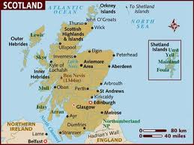
Scotland
Traditionally rivals – however neither Henry VII nor James III wanted trouble, so a three year truce was initially agreed
In 1488 James III was assassinated and replaced by the 15 year old James IV. James and his advisors were hostile to England

Slide 8
Scotland
James IV initially supports Warbeck
In 1496 James IV launched a massive border raid into England with Warbeck, but it achieved nothing as there was no support
By Autumn of 1497 James IV was willing to make peace and they made the Truce of Ayton
This was followed by the ‘Treaty of Perpetual Peace’ in 1502

Slide 9
Scotland
These treaties were a great achievement for Henry – there had been no significant treaty with Scotland since 1328
Henry married his daughter Margaret to James IV in 1503
However Scottish friendship and alliance with France remained – which was always seen as a potential threat to England

Slide 10
Scotland
Why was Scotland seen as a threat by Henry?
Why was 1496 such a difficult year for Henry?
What was the significance of the Truce of Ayton? Consider Henry VII’s foreign policy aims.
What was the significance of the marriage alliance between James IV and Margaret? (Again consider Henry’s foreign policy aims).

Slide 11
DESCRIPTION OF HENRY VII’S FOREIGN POLICY | EVIDENCE FOR | EVIDENCE AGAINST
Cautious/wary | Didn’t wage many wars (no long term ones) Tried to avoid provoking other countries as much as possible – didn’t claim the throne of France when he took the English throne Spent time and money trying to get hold of Warbeck. | When he sends an army of 26,000 men to France, to try to force them into a position when they will negotiate
Defensive | Trade embargo rather than invasion with Burgundy Marriages and peace treaties as a whole showed his defensive mind set | Invades France to force a positive position in negotiations
Pragmatic Practical/sensible | Doesn’t retaliate with war to the Scottish border raid Marriage of Margaret to James IV | Treaty of Windsor and alienating Ferdinand in the final years
Realistic | Didn’t try to regain the French land that had been lost. Treaty Etaples – accepts that he is going to lose Brittany, but sees the pension as at least he’s getting something out of it. | He believed he could make peace with everyone and not have them turn on him – actually by the end of his life most of his foreign policy ends up at least partially failing. England ends up isolated.
Forward thinking/ Strategically sound | Sending volunteers to Brittany – to try to stop it from going to France Treaties and marriages were thinking long term | Alienated Ferdinand in the final years and was excluded from international relations at Cambrai in 1508
Unambitious | Accepts the loss of Burgundy Never remarries after loss of Elizabeth | Tries to ransom France for a pension Alliance with Spain – very ambitious
Opportunistic | Treaty of Windsor – when bad weather makes Philip of Burgundy land, he negotiates a treaty with him. James IV being unmarried, marries Margaret | Could have intervened a lot more than he did, e.g. in Italy, or France or Brittanny
INSERT YOUR OWN DESCRIPTION HERE! Secure | Constantly trying to make peace with everyone | Nearly collapsed at the end of his reign.

Slide 12

Complete your timeline

Slide 13
Homework – finish your timeline and bring to next lesson to hand in

