Slide 1
Recap – finances. What happened with each of these – were they successful?
Changes to management of crown lands
Changes to management of customs revenue
The King’s Prerogative rights (as well as his extraordinary rights)
Which of the reforms was most important?

Slide 2
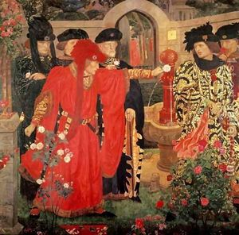
Law and order
What was the situation under Henry VI with regards to law and order?
What other factors might have had a negative impact on law and order in the UK during the Wars of the Roses?
Why was it important that Edward IV fix this?

Slide 3
Law and order under Edward IV
Read pages 108-110
Create an argument for the side you have been assigned, that Edward either did or didn’t improve law and order in England
You will be matched up with someone from the other side, so be ready to describe to them your view

Slide 4
Homework
Read the sources on page 25 and 26 of your booklet and answer questions on page 26

Slide 5
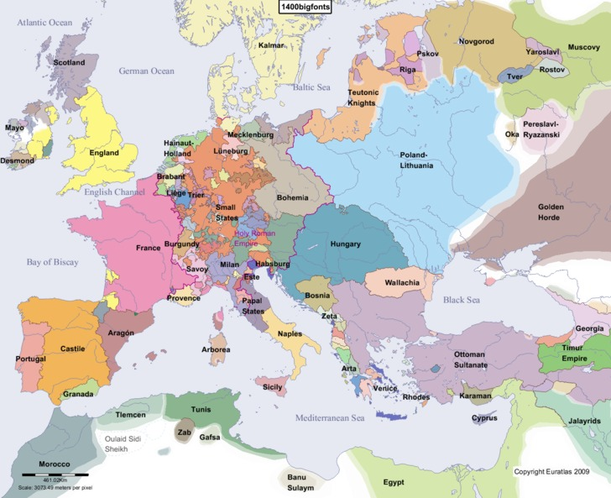
Foreign Policy
When Edward became king in 1461 what would his immediate priorities for foreign policy have been? Discuss in pairs for 2 minutes.
Which countries should he have been particularly interested in?

Slide 6
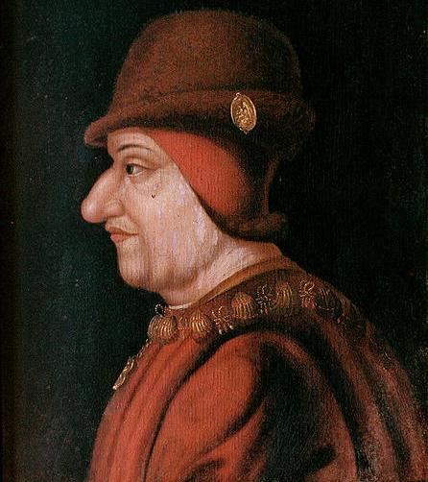
The Problems France and Scotland
Scotland and France were generally aligned in their dislike of England
In the early 1460s the Scots half-heartedly supported Henry and Margaret. They supported Margarets attempted invasion of 1463 but fled alongside her army when confronted by the Earl of Warwick’s forces.
By the end of 1463 Louis and the Scots had abandoned action against England

Slide 7
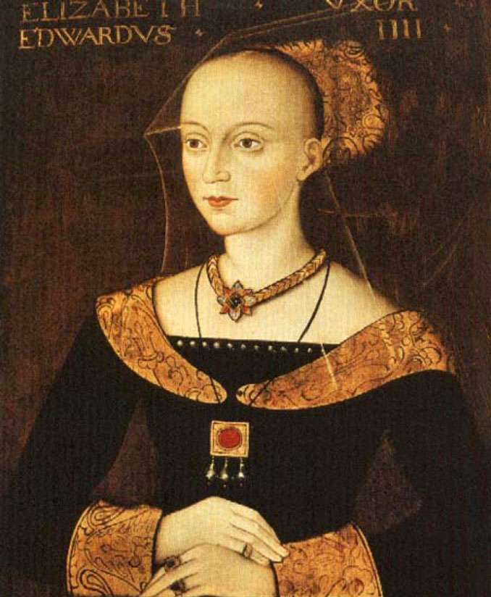
Foreign alliances
Warwick was negotiating a French match for Edward by 1464 but this was dashed by his marriage to Elizabeth Woodville.
As Edwards security on the throne grew so too did the willingness of others to make treaties with him. Treaties were made with Castile, Aragon, Denmark, Naples and the Holy Roman Empire.
Mark these on your map. How does this link to French hostility.

Slide 8
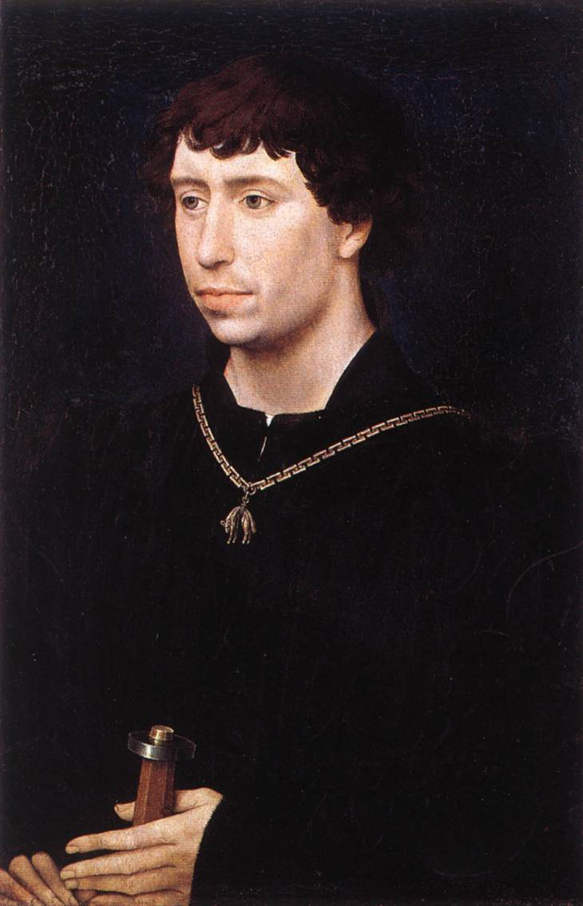
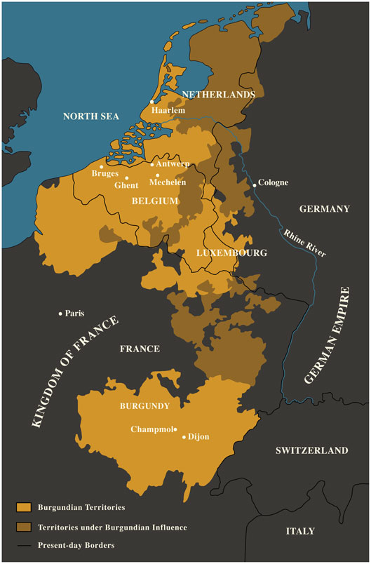
From 1466 – 67 Both France and Burgundy were trying to ally with England against each other.
Warwick favoured France but Edward chose Burgundy due to the trade links and traditional alliance with the country. The following year Edwards sister Margaret married the Duke of Burgundy Charles the Bold.
The counter side to this was French anger. They supported an attack by Jasper Tudor in West Wales. This was dealt with by Edward’s supporters
Far more dangerously though Louis then brought Margaret and Warwick together and played a role in the readeption.

Slide 9
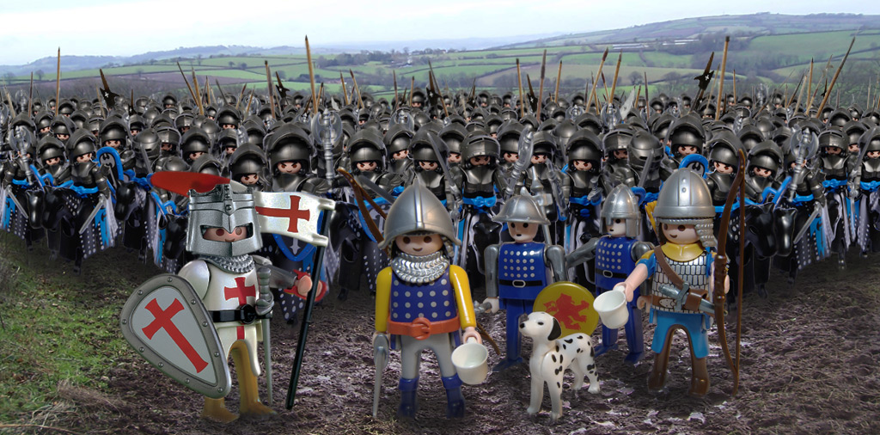
1471 – 1483 Foreign Policy in Edward’s Second Reign
In his second reign Edward was more aggressively anti-French.
Read pages 111 and 113
In pairs write a speech from either the point of view of Edward or Louis saying why the Treaty of Picquigny has been a success for your side.

Slide 10
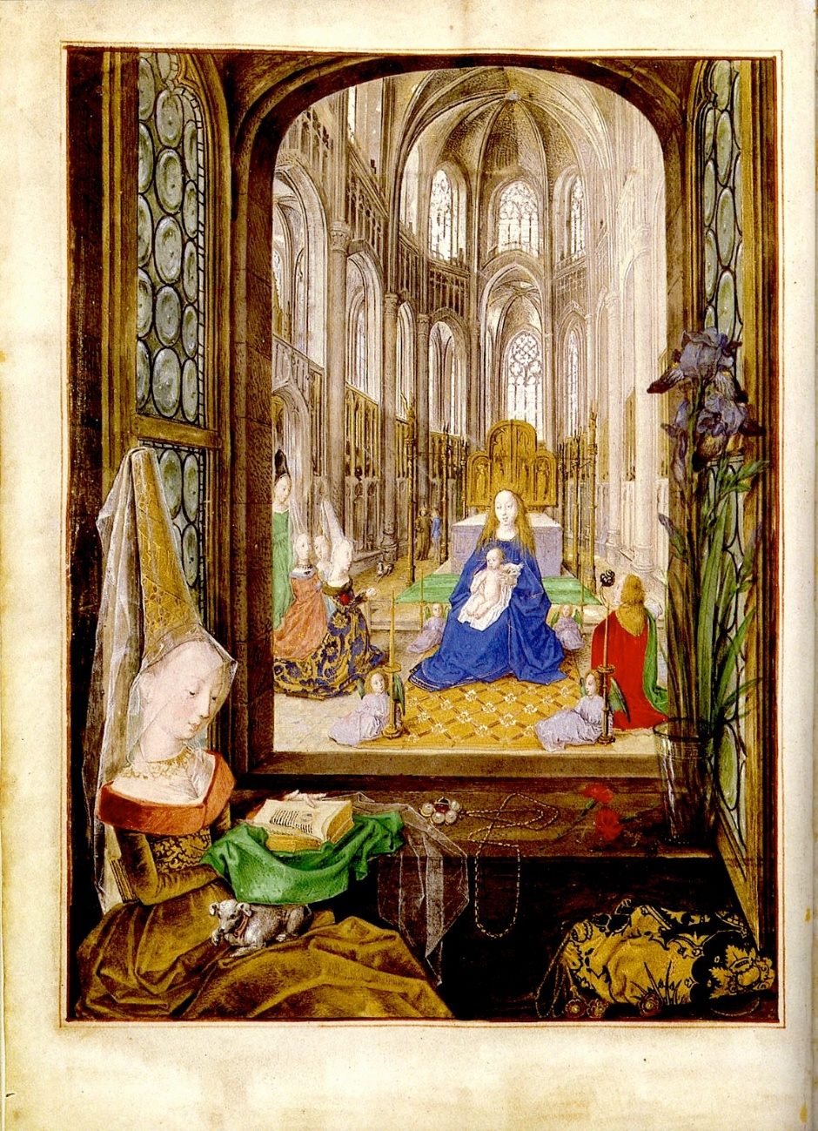
Burgundy after 1475
In 1477 Charles the Bold of Burgundy died.
This left a vulnerable situation in Burgundy which Louis took advantage of. In 1482 the two countries signed the Treaty of Arras and Louis stopped paying the Pension to Edward as he no longer feared an Anglo-Burgundian move against him.

Slide 11
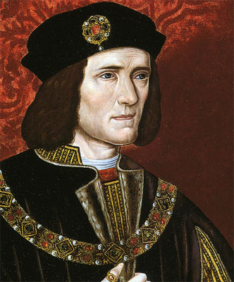
Scotland
In 1480 the Scots had started to raid England again stirred up by Louis.
The Duke of Gloucester retaliated for this and attacked Scotland in 1482. He captured the James III and Edinburgh but eventually had to withdraw due to a lack of support.
Nevertheless he recaptured Berwick upon Tweed from the Scots on his way back south.

