Slide 1
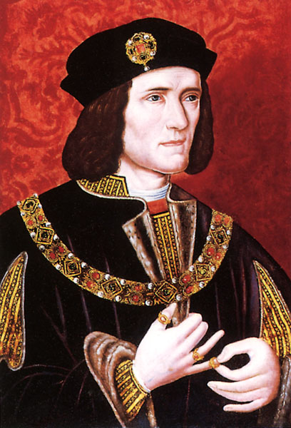
Richard, Duke of Gloucester becomes Richard III

Slide 2
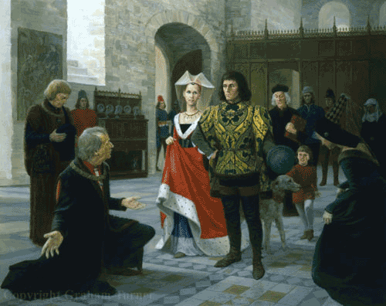
April 1483 – Richard heard that his brother had unexpectedly died.
Richard had been named Lord Protector in his brother's will, but the Woodvilles planned to bypass this by crowning the boy immediately. A Woodville controlled king was seen as a threat to Gloucester, and he immediately headed south.

Slide 3
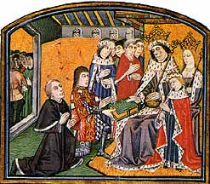
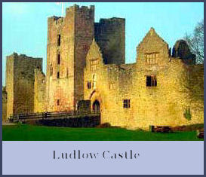
Edward V was being trained on the Welsh border and living in Ludlow
On the death of his father on 9 April, 1483, the new King journeyed to his capital with his maternal uncle, Anthony Woodville, appointed his governor, his half-brother Sir Richard Grey and a small retinue.
His progress was interrupted at Stony Stratford by his paternal uncle Richard, Duke of Gloucester and his distant cousin, Henry Stafford, Duke of Buckingham.
Woodville, Grey and others of the king's escort were sent to Richard's power base in the north.
Edward, objected, but was humiliatingly powerless.
Anthony Woodville and Richard Grey, despite reassurance to the contrary, were later executed on Richard's orders.

Slide 4
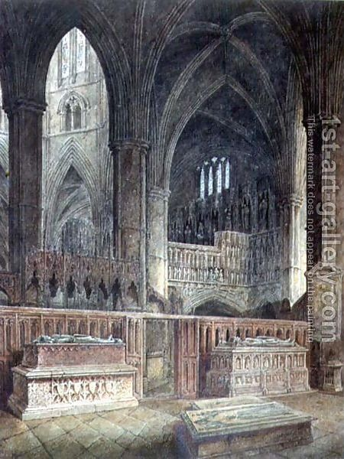
Elizabeth and her children took sanctuary in Westminster Abbey
Elizabeth had planned for her son to be crowned on 5th May, but Richard announced the coronatino would be on the 26th June. Edward is place in the tower – the customary home of king’s awaiting coronation.

Slide 5
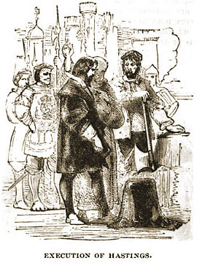
The plot thickens
The council met and a date for Edward V's coronation was agreed, 22 June. It is not known when Gloucester decided he would usurp the throne, but for the next few weeks the council worked harmoniously, and appeared to have no qualms about Gloucester's power, or the future of Edward V.
On 13 June, however, Gloucester's intentions became clear, when he had Hastings taken from a council meeting and executed without trial. Hastings could command a large number of retainers if needed, and his loyalties to Edward IV and his children were without question. His removal was vital for Gloucester's usurpation.
Gloucester's reason for the execution was that he had discovered a plot against him. Also implicated in this were Archbishop John Rotherham, Bishop John Morton and Thomas, Lord Stanley, who were arrested.

Slide 6
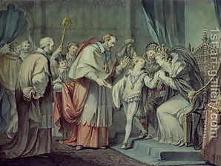
Edward’s younger brother is taken to the Tower
Richard (age 10), younger son of Edward IV and Elizabeth Woodville lived in court . He went to sanctuary when his mother did and stayed there until 16 June 1483 when Richard, Duke of Gloucester and protector with the help of the Archbishop of Canterbury convinced her he'd be safe in the Royal apartments with his brother Edward

Slide 7
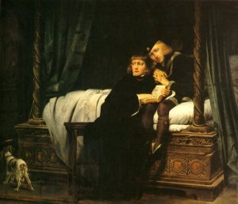
The Princes are disinherited
On 26 June 1483, all of Elizabeth's children were bastardized after Bishop Stillington's revelation that Edward IV had a precontract with Eleanor Butler predating his marriage to Elizabeth Woodville.
Then, precontracts were as binding as marriages. Neither boy could inherit the throne.
They were moved to the Garden Tower as Richard III took up residence with his wife, Anne in the royal apartments awaiting his coronation.

Slide 8
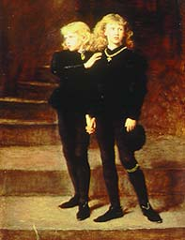
What happened to the boys?
The boys were reportedly seen playing on the Tower grounds throughout the summer, long after Richard had left on his progression through England. Some reported they had disappeared as early as June that year, while others claim to have seen them into February of the next year, but the consensus is they disappeared sometime in September, 1483. Richard III's wardrobe account has an expense for Edward's clothes to wear while attending Richard's coronation 6 July 1483. Richard's own son was north in Middleham during the coronation, so the clothes could only have been for the now bastardized prince. It is unknown whether Edward was actually in the coronation party

Slide 9
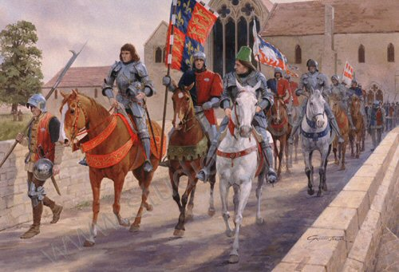
Royal procession
Aiming to rule as rightful king and not as a usurper, he continued with Edward IV's policies and personnel - with the obvious exceptions of those he had killed in seizing the crown.
Richard had to win over his new subjects, so - two weeks after his coronation - he set off on a grand tour to meet them. This was quite successful, and he had good grounds for optimism by the time he reached York.

Slide 10
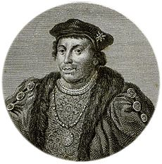
Plots
Richard stayed there in some comfort. Still, there had been problems - there had been a plot to free Edward V and his brother from the Tower and another to smuggle their sisters out of sanctuary to another country. Still, these mattered little, and Buckingham was put in charge of an investigation into the plots.

Slide 11
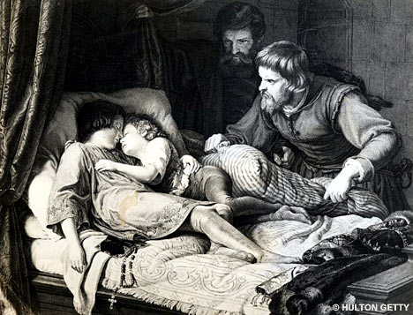
Buckingham switches sides
Buckingham's motives in these events are disputed. His antipathy to Edward IV and his children probably arose from two causes. One was his dislike for their mutual Woodville in-laws, whom Edward greatly favoured. Another was his interest in the the Bohun estate which Buckingham claimed should have been devolved to him.
Richard III promised to settle the estate on and after he did award the other half of the Bohun estate to Buckingham, but it was conditional on the approval of Parliament.
Historians disagree on whether this condition was in fact a way for Richard to appear to keep his promise while actually breaking it, but this may have been a motivation for Buckingham to turn against Richard.
According to a manuscript discovered in the early 1980s, the Princes were murdered "be [by] the vise" of the Duke of Buckingham.
Buckingham can be said to have had motivation to kill the Princes, being a Lancastrian contender for the throne with a viable claim potentially equivalent to that of Henry Tudor, depending on one's view of the legitimacy of the Tudor branch of the House of Lancaster. According to this perspective, if Buckingham killed the Princes and blamed Richard, he could foment a Lancastrian rebellion.

Slide 12
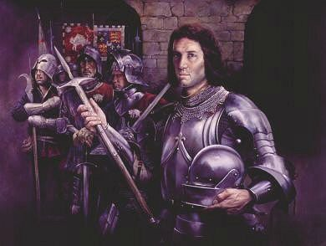
Buckingham’s rebellion
In the space of a few months, Richard survived the defections of servants from within the royal household, leading gentry figures from regional centres throughout the south of England, and of former confidants such as Henry Stafford, Duke of Buckingham, all of whom had helped to secure the successful seizure of the throne only a few months earlier -in June 1483. The rebels failed in their attempts to replace Richard as king, yet the response of the crown in re-establishing control over the south, and Richard's failure to eliminate Henry Tudor's development as a rival claimant to the throne, ensured that the crushing of the rebellion only heralded deeper dynastic and security problems for the Ricardian regime.

