Slide 1
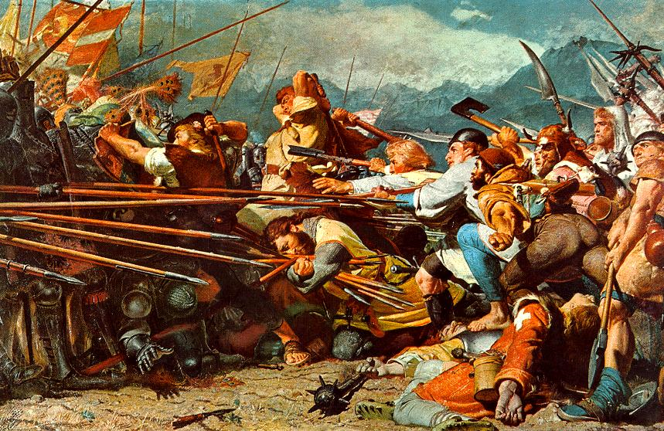
Why did France go to war in April 1792?

Slide 2
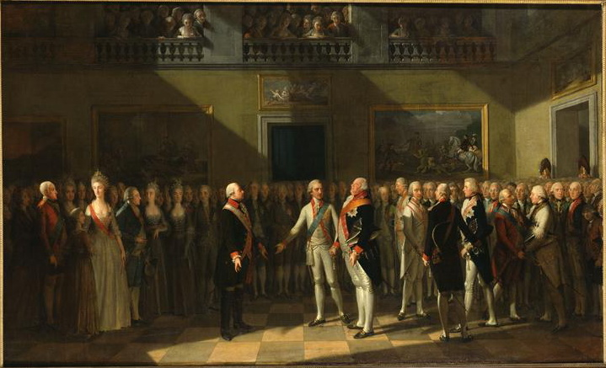
Declaration of Pillnitz
Revolution or religion?
Work through the questions on the sheet
Notes:
Villagers protested that the Deputies were trying to change their religion.

Slide 3
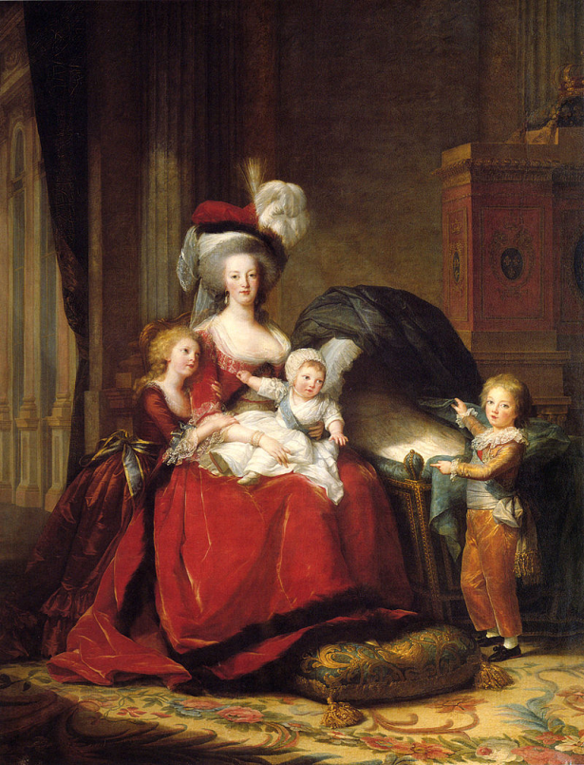
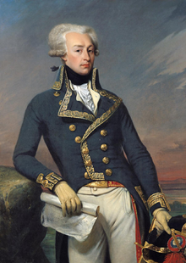
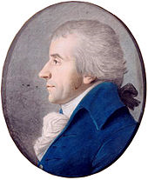
Support for war in France

Slide 4
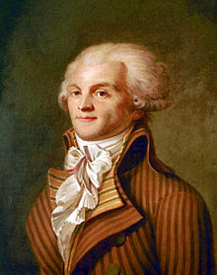
Robespierre’s opposition
Robespierre said that the real enemies to the state were not abroad and that they should concentrate on securing the revolution at home.
He also said, “no one loves armed missionaries.

Slide 5
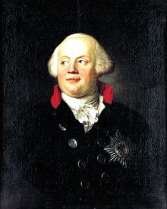
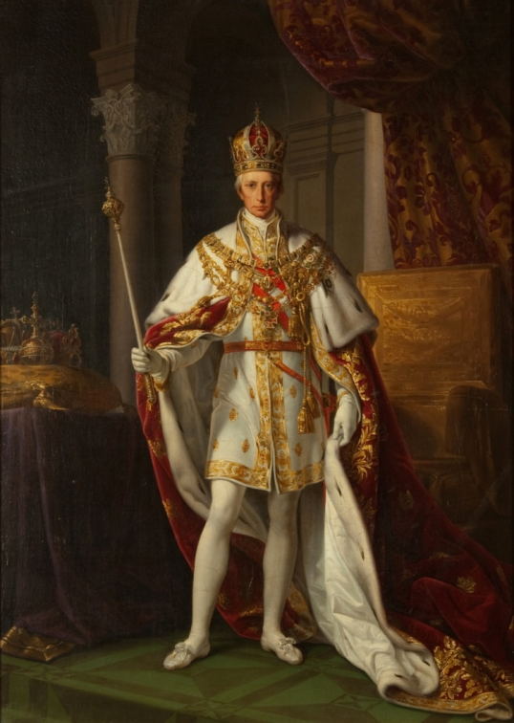
Blunder - assumed France was weak
.
Frederick Wilhelm II painted by Anton Graff, c. 1792 King of Prussia
Francis II new emperor of Austria

Slide 6
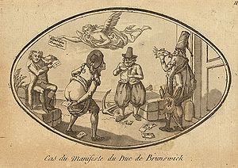
Brunswick manifesto
August 1792
Prussia and Austria declare they will destroy Paris if the royal family is harmed.
Incites riots. The Tuilleries is attacked and the royal family are imprisoned in the Temple.
This begins the radical phase of the revolution.

Slide 7
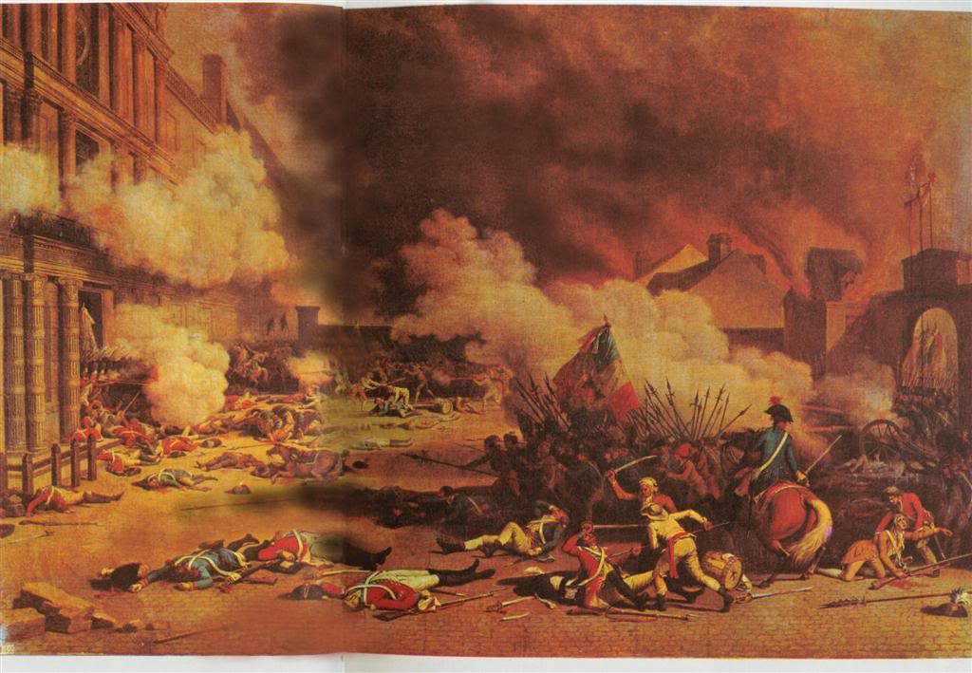
10th August thousands of sans culottes, fédéres and National Guards attacked the royal palace. By the end of the day Paris was controlled by the insurrectionist Commune.

Slide 8
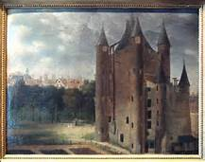
Proclamation of a republic
10th August Louis and his family were deposed and imprisoned by the insurrectionist commune. Power was now shared between the Legislative Assembly, the Commune who controlled Paris and a new body created by them both, the Provisional Executive Council which was dominated by Danton.

Slide 9
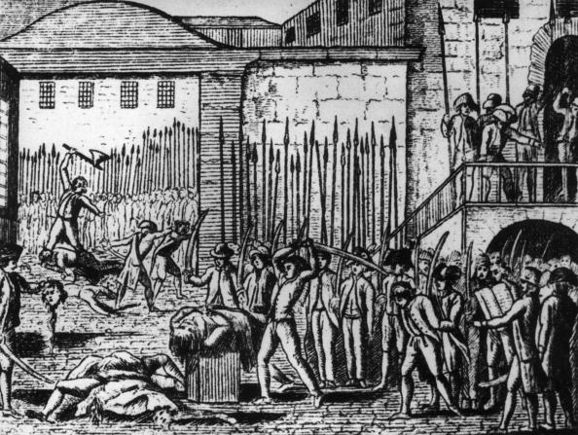
September massacres
When the fortress of Verdun fell people in Paris panicked. Next day crowds surrounded a tumbrel of prisoners on its way to prison and murdered them. Over the next five days up to 1300 prisoners were hacked or beaten to death.

Slide 10
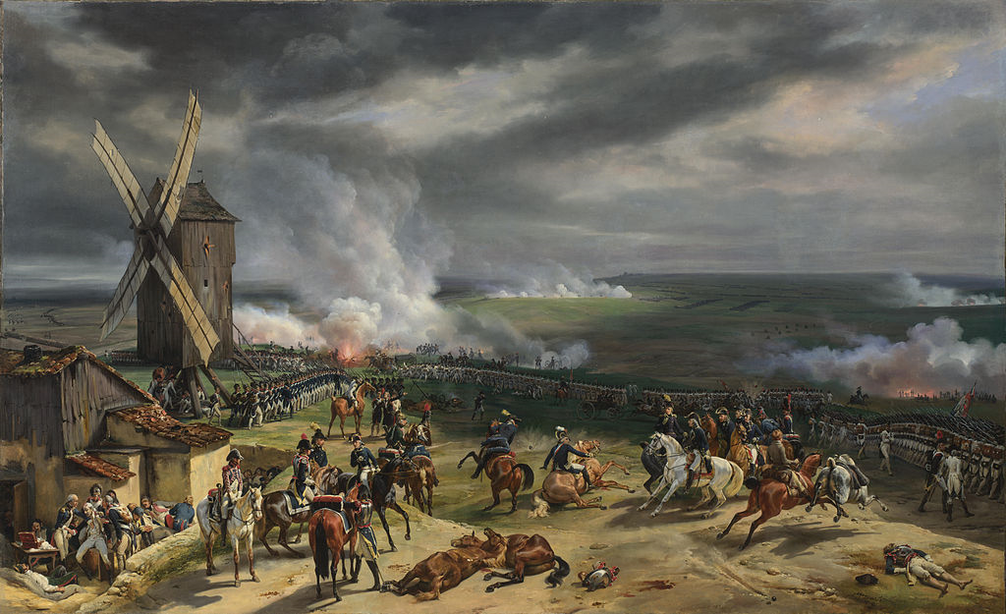
The battle of Valmy – decisive victory for the Revolutionary army

Slide 11
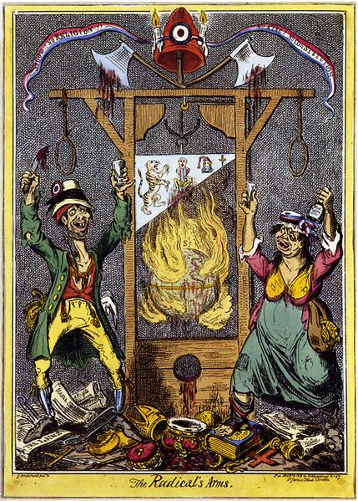
The Terror
The events of the first revolutionary war significantly contributed to The Terror – but there were other factors as well

Slide 12
The Terror
Create a timeline of the events of the Terror, using pages 17 and 18 in the booklet

Slide 13
The Terror
Four main reasons:
The war
Rivalry between the different political clubs/factions
The growing fear in France
The problems with the economy

Slide 14
The Terror
In your group you need to look at your assigned cause
Explain it’s contribution to the terror
It’s significance
The war
Rivalry between the different political clubs/factions
The growing fear in France
The problems with the economy

Slide 15
The Terror
Create a pie diagram of the four main reasons, with a share of the pie proportional to how significant it’s role was in causing the Terror:
The war
Rivalry between the different political clubs/factions
The growing fear in France
The problems with the economy

Slide 16
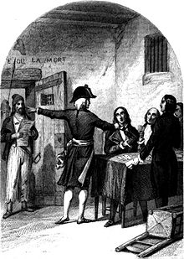
Why were the Girondins overthrown?

Slide 17
Death of Marat
Read page 19 in your booklet

Slide 18
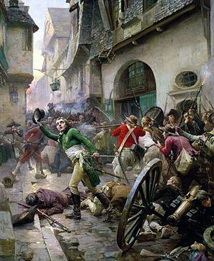
Revolt of the Vendee
Why did violence break out?
Pages 94-95 in textbook

Slide 19
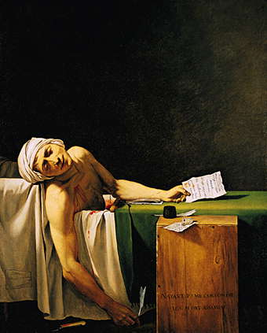
How do these two events demonstrate the situation during the Terror?

