Slide 1
Consolidation
Government – Did the Directory achieve anything?

Slide 2
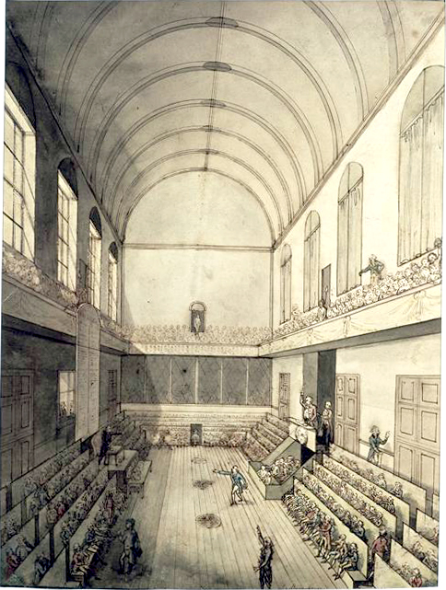
Changing the Constitution again
The National Convention had met for the first time in 1792. It replaced the Legislative Assembly which created it in order to draw up a new republican constitution . Their first act was to put the king on trial and execute him on January 21st 1793.
In April they went to war against an alliance of European monarchies and fears of counter revolution and treason produced the “TERROR”.

Slide 3
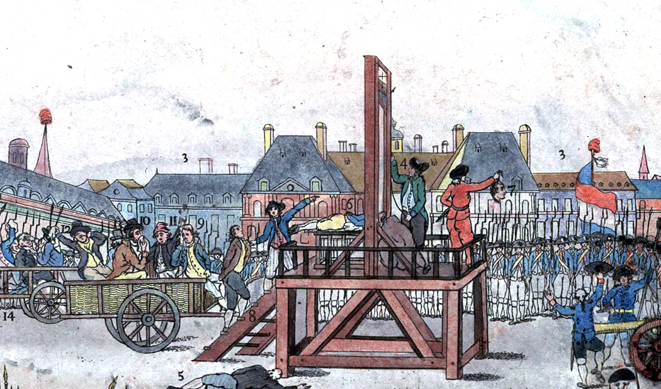
THERMIDOREANS
The men who overthrew Robespierre moved to end the Terror. Within a month the Law of 22 Prairial (which had made guilty verdicts likely) was repealed.

Slide 4
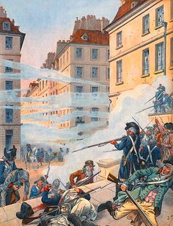
Royalist Resurgence
Following the fall of Robespierre in July 1794 the National Convention had to deal with a royalist resurgence.
The Convention so feared that royalists would gain power that when it came to ratifying a new constitution they passed a Two Thirds Law requiring that only one third of the seats in the first election of the new government would be open to new members.
"

Slide 5
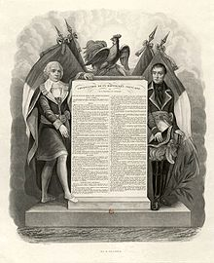
Another constitution! Year III or 1795
The Thermidorians wanted to create a new constitution
Two main reasons for this:
In order to guarantee the main features of the revolution of 1789, such as the freedom of the individual
They also wanted to ensure that a dictatorship, like that of the CPS, would be impossible.
They established a legislature I n 2 chambers and an executive that was to be a Directory of Five who would hold office for five years. This was the period of the Directorate.

Slide 6
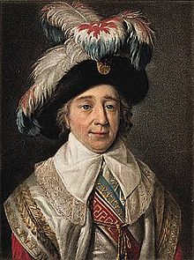
The Directory
A total of thirteen men served as Directors between 1795 and 1797 but just one for the entire time. This was Paul Barras, an ex noble and army officer responsible for the brutal suppression of counter-revolution in Marseilles and the capture of Toulon. As a Director he gained a reputation for corruption and immorality.
The five Directors could hold office for 5 years, but one, chosen by lot, had to retire each year and get replaced. They could not initiate or veto laws, they could not declare war and they had no control over the treasury.

Slide 7
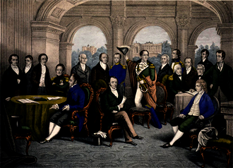
The Legislature
The law making body was divided into two chambers (a bicameral system)
The Council of Five hundred, all of whom had to be over 30 could initiate legislation.
It then got passed on to the Council of Ancients 250 men over 40 who could approve or object to bills, but could not introduce or change them.
Elections were to be held every year, when a third of the members retired.

Slide 8
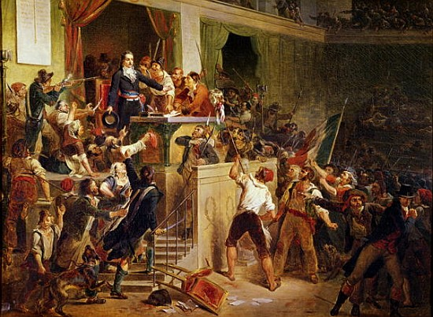
TRICKY START
The Economy
The economic problems the Directory faced were the same as previous regimes – inflation, a valueless currency and high food prices.
The Thermidoreans abolished the Maximum (price fixing) and moved back to a free market which caused rampant inflation.
Added to this was a bad winter.
Two major uprisings resulted:
Germinal and Prairial. The latter had to be put down by the army.

Slide 9
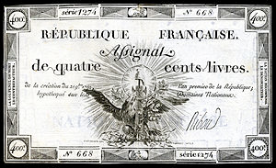
Money
The floor of the printing press collapsed under the weight of the new Assignats being printed.
Salaries paid to Directors were not paid in Assignats, but in goods.
In an attempt to solve inflation the Directory tried introducing a new paper currency. This was a complete failure.
Finally in February 1797 they returned to metal coins but there were not enough and deflation resulted.
Their failure made them unpopular with people at all social levels.

Slide 10
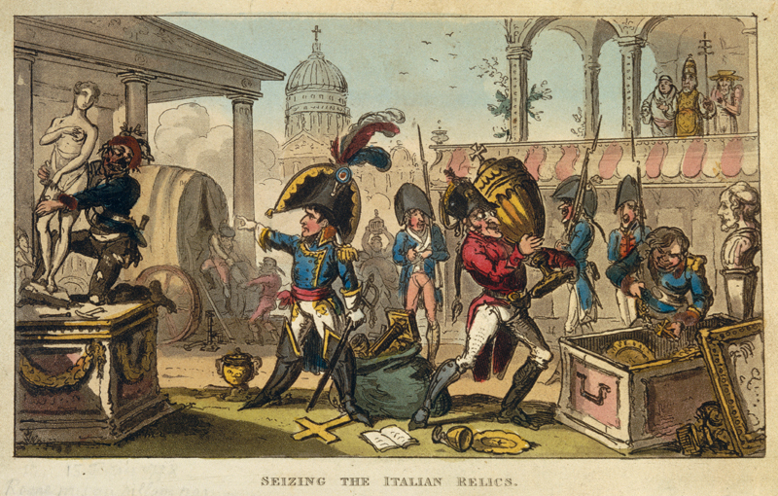
GOVERNMENT FINANCE
For government income the Directory relied upon the profits of war. Plunder taken by French armies.
On 15 May 1796 Bonaparte made the city of Milan pay a huge ransom.
This made the Directory even more dependant on the army.

Slide 11
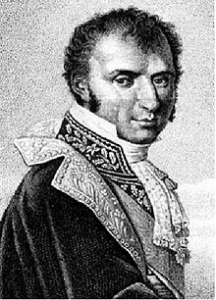
TAXATION
Better than relying on the army, the Finance Minister, Ramel reformed the tax system in 1798.
1. He introduced a tax on windows and doors which hit the rich hardest.
2. He reintroduced the Ancien Régime tax, the Octrois a tax on goods which was very unpopular.
He made tax collection more efficient.
This made government finances balanced at last, but also made them very unpopular and again reliant on the army.

Slide 12
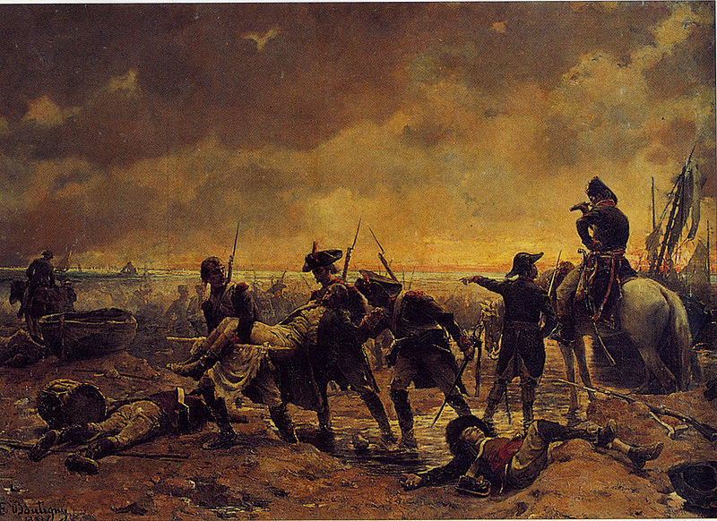
Resurgent royalists
Royalists had benefited from the amnesties that took place after Thermidor and some of the émigrés and non-swearing priests took the opportunity to return home.
When little Louis XVII died alone in his prison cell in June 1795 his uncle the Comte de Provence claimed the throne and issued the Verona Declaration promising to restore the ancient constitution.
An émigré landing was made supported by the British at Quiberon Bay.

Slide 13
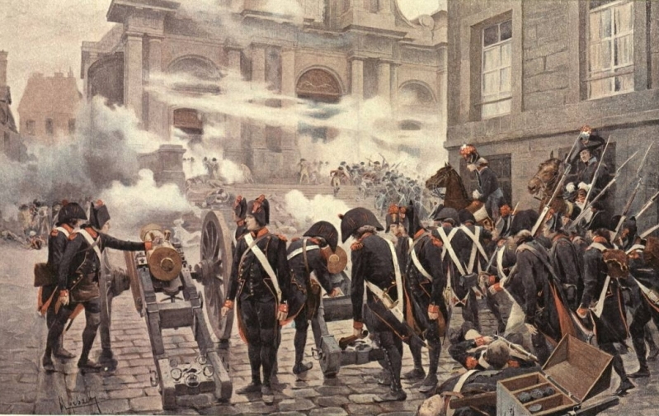
The VendĒmiare uprising
A crowd estimated to be as many as 25,000 tried to surround the National Convention, but was dispersed by Napoleon’s “whiff of gunshot”.

Slide 14
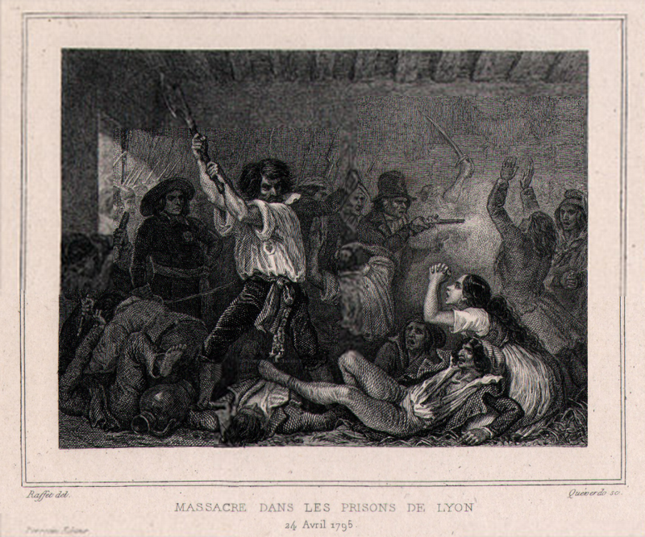
POLITICAL VIOLENCE
In the streets of Paris sans culottes, and Jacobins were attacked. The Jacobin club was closed.
In the south of France, in Lyons and the Rhone Valley where the Terror had been so brutal there were savage reprisals including prison massacres.
At least 2000 died in this White Terror in 1795.
With law and order failing this was another reason for the Directory to rely on the army.

Slide 15
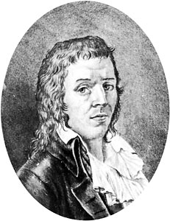
BABEUF PLOT 1796
On the left the Jacobins and the Sans Culottes were spent as a political force.
However, on the extreme left in 1796, a radical pamphleteer writing under the name of Grachus Babeuf wanted to bring down the Directory because it benefitted the wealthy.
He plotted in his conspiracy of equals that all property should be shared.
He received no support from the Sans culottes and little from former Jacobins, he was arrested in May 1796 and executed soon afterwards.

Slide 16
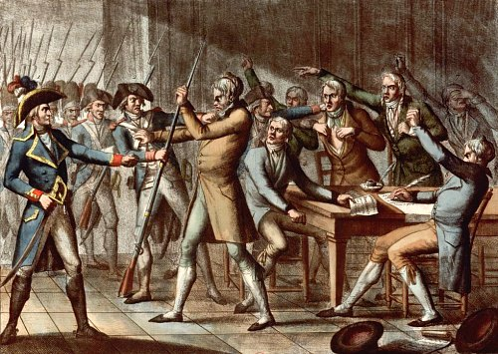
COUP OF FRUCTIDOR 1797
The elections of 1797 revealed that people were tired of war abroad and religious conflict at home and found the idea of a constitutional monarchy appealing thinking it would offer peace and stability.
Of the 216 ex members of the convention who sought re-election only 11 were returned. Monarchists won 180 of the 260 seats.
Napoleon sent General Augereau to Paris to support the republican Directors and on the night 3 – 4 September 1797 troops arrested 2 Directors and 53 deputies.
The army had ended parliamentary government.
Notes:
In breaking the Constitution the directors undermined their own standing and ultimately the legitimacy of the government.

Slide 17
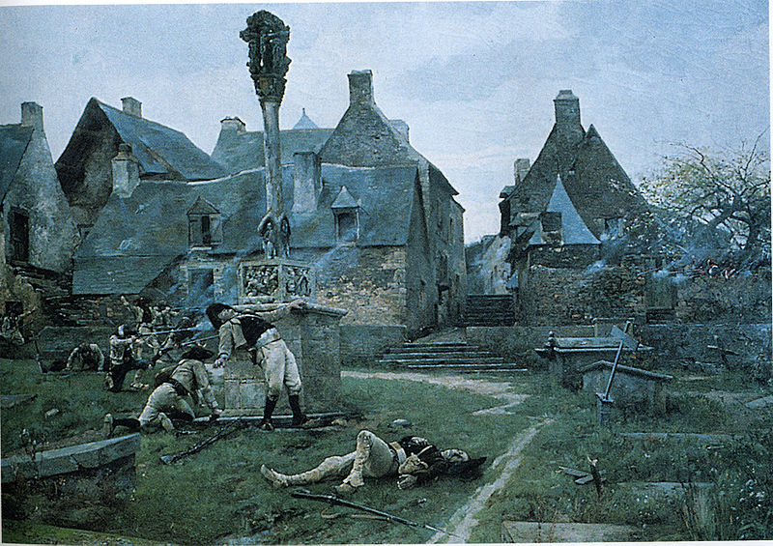
Internal revolt – the chouans
As well as dealing with politcal violence the Directory had to cope with internal revolt in Brittany and later Normandy where a movement known as the Chouans fought a guerrilla war attacking small groups of troops and killing local officials.
They seemed to have been suppressed but when the Jourdan Law reintroduced conscription Chounanism broke out again.

Slide 18
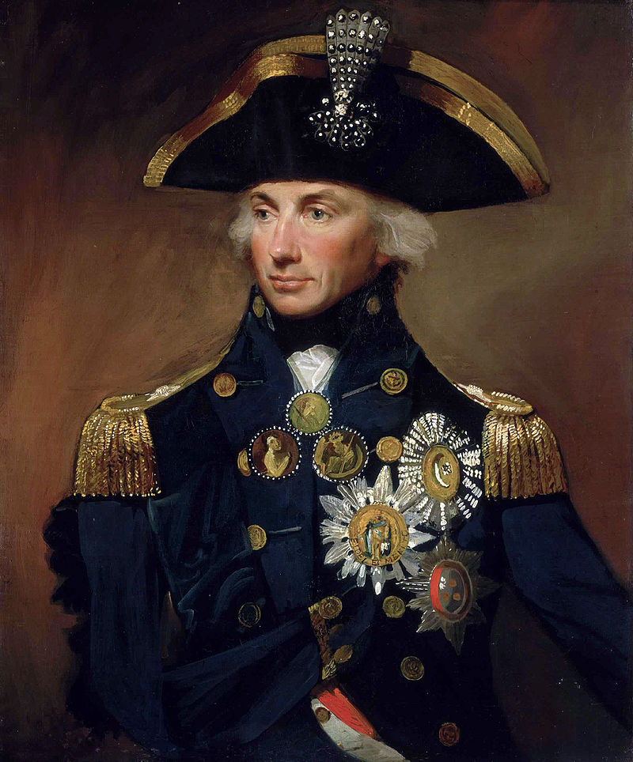
WAR
War became essential to the Directors because loot staved off bankruptcy.
In 1797 the Directory over reached itslef. Bonaparte set off with his army to attack British interests in Egypt. His military campaign was successful but he and his army were trapped in Egypt when Nelson sank the French navy in the Battle of the Nile.

Slide 19
Weakness of the 1795 constitution
The 1795 was based on a democracy of sorts. The franchise was based on a tax threshold, and this entitled 5.5 million adult males out of 8 million to vote and annual elections meant an unpopular government would soon be forced to face voters.
However, annual elections led to instability.
The ordinary voters only voted for Electors and Electors had to be rich so this system favoured the rich.
More seriously there was no mechanism to resolve the situation when the Directors disagreed with the Councils. It could be argued this was the reason for the Directors increasing disregard for the Constitution as they tried to maintain control of the Councils.

Slide 20
Essay
“Disillusionment with the Directory was the main reason why the coup of Brumaire was successful”? Assess this claim. (20)
How successful was the Directory? Complete the grid.
After you have completed your grid read the article by Michael Rapport on “The Rise of Napoleon” and prepare for an essay assessing whether Napoleon’s successful bid for power was due to failures by the Directory?

