Slide 1
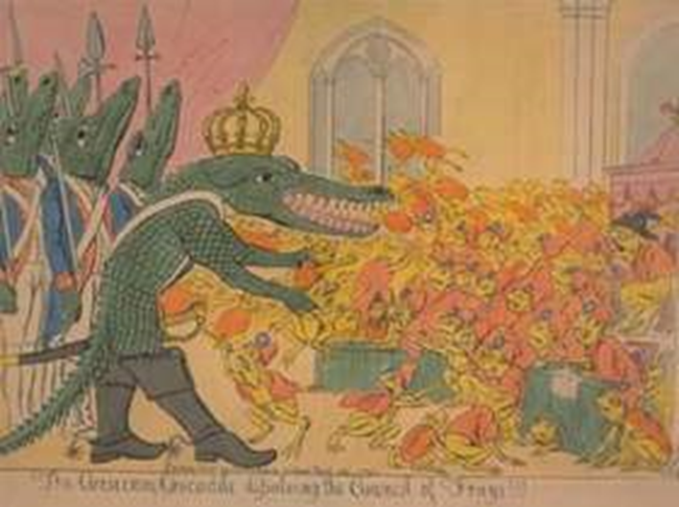
Topic 3 Napoleon Bonaparte to 1807 and the fall of the Directory

Slide 2
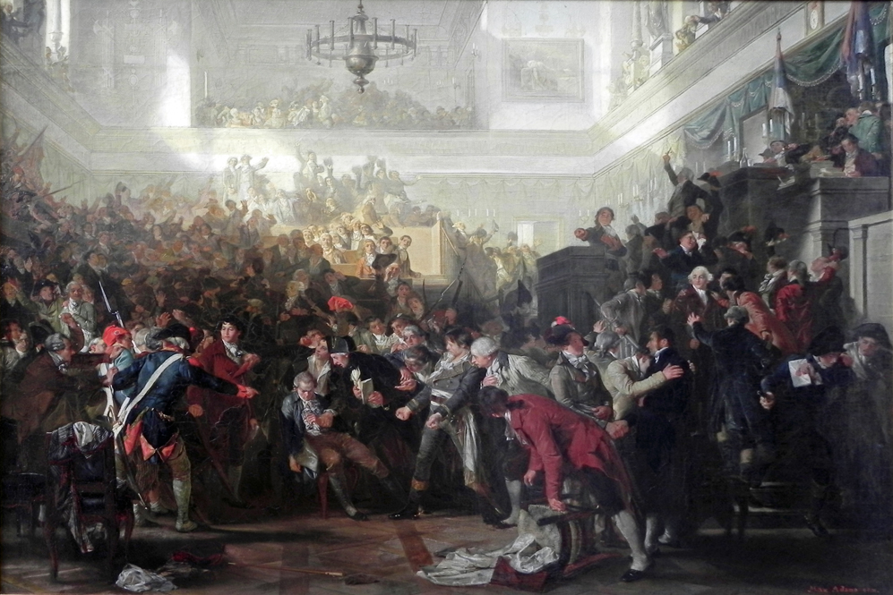
What were the weaknesses of the Thermidorians?
In its short 15-month life the Thermidorian regime was unpopular with most of the people.
It failed to address most of their grievances or improve their lives, and repeated several mistakes made by earlier governments.
They wanted to remove price controls to encourage a free market and this provoked Germinal and Prairial risings as food prices rocketed.
The constitution they created had many serious weaknesses.

Slide 3
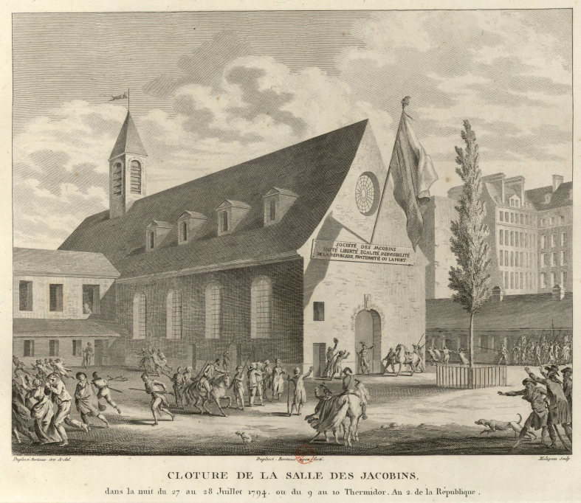
The white terror
The first year of the Thermidorian Convention was dubbed the White Terror, as those connected with the Jacobins or their government were harassed, attacked, driven into exile or murdered. Paris’ Jacobin club was shut down almost immediately and outlawed in November 1794.
Chouans revived guerrilla fighting against conscription.

Slide 4
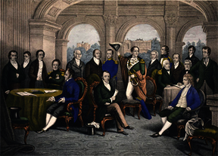
The Directory
The Directory placed power in the hands of the upper middle class and called for a two house legislature and an executive body of five men.
The system limited the power of the authorities through separation of powers.
Almost immediately it had to deal with royalists and the Verona Declaration.
In the Vendémiare uprising 25,000 royalists marched on the government. Napoleon resorted to the “whiff of grapeshot”.

Slide 5
• Why did the Directory fail?
Constant change – annual elections and failure to settle disputes.
Interfering with election results so that no one respected the constitution.
Use of the army to settle disputes.
Middle classes alienated by forced loans
War and Jourdan’s Law imposing conscription.
Coup d'état of Brumaire

Slide 6
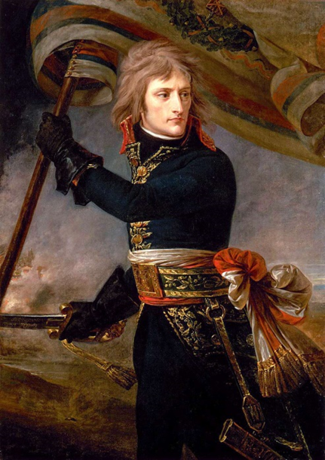
Bonaparte’s early life and character
A fiercely ambitious Corsican with enormous energy.
Could veer between frightening rages or great charm.
Understood how to promote himself.
Able soldier who based a lot of ideas on classical warfare.
Made his name at the siege of Toulon.
Showed himself prepared to fire on civilian rioters in the Vendémiaire uprising.

Slide 7
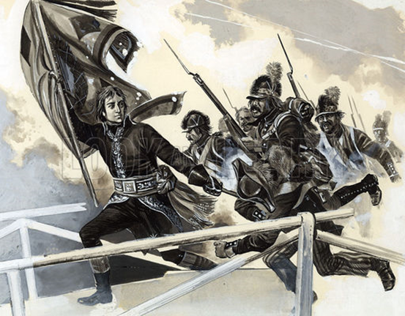
Why was Napoleon successful?
He was regarded by the French as the most successful general of the day.
There was general disillusionment with the Directory.
He was rescued by his brother Lucien.
He risked everything to win

Slide 8
What was achieved by Napoleon’s reforms

Slide 12
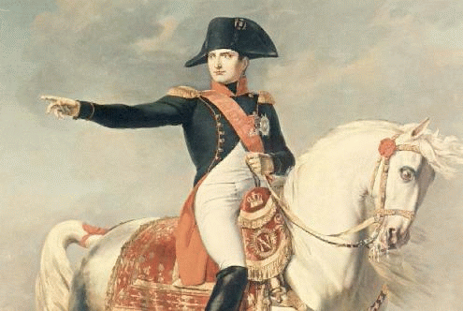
Reasons for military success 1799 - 1807
Inspiring leader
Great organiser
Great energy
Ruthless
Weakness and disunity of his enemies
Rapid mobility
Use of artillery
He could improvise brilliantly
Used mixed order tactics

Slide 13
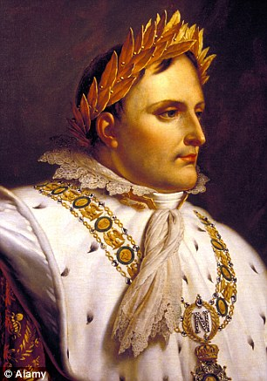
Why did Napoleon create the Empire
The empire that Napoleon created was the larges in Europe since Roman times.
Napoleon claimed he did this in order to protect revolutionary France and to take the revolutionary principles to oppressed people in Europe.
Some historians say he did it to enjoy power – and personal glory.
Others say it
worked for France.

Slide 14
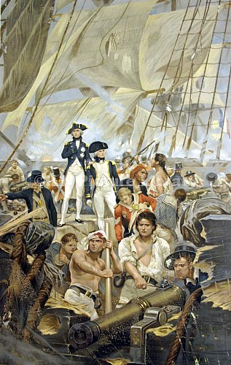
Explain Napoleon’s problems with England and his Continental Blockade
Napoleon did not understand naval warfare and he faced Nelson.
At the battle of Trafalgar in 1805 the French and Spanish fleet was destroyed.
This caused Napoleon to think of alternative methods of defeating Britain.
He thought that preventing them from trading would bring them to their knees.

