Slide 1
The causes of the French Revolution from 1774 and the events of 1789 – what you need to know:
The structure of the Ancien Régime
Qualities of Louis XVI as King of France
Financial problems and attempts by Turgot, Necker and Calonne to deal with them
The ideas of the Enlightenment and the impact of the American Revolution and the War of Independence
Social discontents
Economic problems from 1787
The Assembly of Notables and the political developments 1787–May 1789
The Estates General, events in Paris in 1789
The ‘Great Fear’
The October Days

Slide 2
This topic is an interpretation topic
This means you can get interpretation questions on it
But you can also get essay questions as well

Slide 3
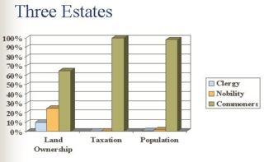
The structure of the Ancien Régime
Three Estates (with the King at the top):
1st Estate – Clergy
2nd Estate – Nobility
3rd Estate – the commoners (everyone else)
Clergy and nobility had most of the power
But the commoners had most of the taxation burden
This was a key source of anger amongst the Third Estate
This is very much a long term cause of the French Revolution

Slide 4
Qualities of Louis XVI as King of France
Intellectually quite bright – had a keen interest in a number of subjects
But was a weak character, who lacked the strength a King of France at this time needed.
Once he lost the initiative in the revolutionary period he was unable to regain it.
This can be seen as both a long term and a short term cause of the French Revolution.

Slide 5
Financial problems
Most taxes were indirect taxation.
Because of this, the French government often was in a position that it had to borrow money to cover it’s expenditure.
The French government had a large debt during the latter half of the 18th Century – which caused further problems
There was also a certain amount of corruption – due to the system of venality – when tax officials bought their position.
There was also a great inefficiency. A lot of sections of society had exemptions from having to pay taxation.
This is a key long term factor in the revolution

Slide 6
Attempts by Turgot, Necker and Calonne to deal with the financial problems
Turgot
Attempted to reform the tax system
Abolish some of the protection merchants had in the trade guilds
However this caused such levels of protest that Louis withdrew his support and Turgot left office
Necker
Avoided having to raise taxes by raising loans – this made him quite popular
But in the long run this caused more problems for France, by having more debt
Calonne
Tried, like Turgot, to reform the financial problems the monarchy of France had
But, like Turgot, he was blocked from doing this. In his case the Assembly of Notables rejected his suggestions

Slide 7
The ideas of the Enlightenment
The Enlightenment was an intellectual movement, that questioned and challenged many of the accepted elements of the Ancien Régime.
In France, known as philosophes. Three of the most famous were:
Montesquieu
Believed in a constitutional democracy – similar to what Britain had
He thought Parliament and the King would provide a check on each other
Rousseau
His focus was on the freedom of the people – that it should never be limited
He also emphasised that the sovereignty (power) of a country lay with the citizens of the country, not the monarchs.
Voltaire
Fought for the civil rights of the citizens – right to a fair trial, etc
Felt that the Ancien Régime was full of problems, at every level.
The American War of Independence meant that there was a country that was putting these ideas into practice.
All of this criticism can be seen as a long-term factor in the French Revolution, giving the ideas of what the alternative could be

Slide 8
Social discontent
Each of the different estates within French society had it’s own issues
First Estate (the Church)
Significant differences in wealth between the upper clergy and ordinary priests
From the other estates (particularly 3rd) there was resentment regarding the taxes that they had to pay to the church (tithes)
Second estate (the nobility)
Resentment against nobility because they didn’t have to pay direct taxation
The third estate also resented the feudal rights that existed
Third estate (the commoners)
Had very little political influence
Very large burden of taxation

Slide 9
Economic problems from 1787
There were two key economic problems in the final years before the revolution, both of which are key short term factors.
Bad harvests – there had been a number of bad harvests in the 1780s. There was a particularly bad one in 1788. This had a couple of impacts:
A lower demand for manufactured goods, because more income had to be spent on food
As well as an increase in the price of bread – something the poor were particularly impacted by
Economic crisis’ like this happened regularly – but this time they combined with the other more long term problems, to become a key short term factor in causing the revolution

Slide 10
How significant a factor was the personality of Louis XVI in the fall of the ancien regime?
Briefly plan the above question

Slide 11
Developments 1787-1789
The period between Louis first calling the Assembly of the Notables – the first key sign that Louis was losing control – and the calling of the Estates General in 1789 had a few key features:
Brienne replaces Calonne with the responsibility of trying to fix the financial difficulties facing France. He has the same issues that his predecessors had.
Brienne tries to use the parlements to pass the legislation, in particular the Parlement of Paris. They reject the legislation, the same as the Assembly of Notables had
There is a general increase in civil tensions in France
It culminates in August 1788, with the French government effectively declaring bankruptcy
Shortly before declaring bankruptcy Brienne, with Louis permission, calls the Estates General to meet on 1st May 1789

Slide 12
The Estates General
Hadn’t been called since 1614
This was the first real point that the bourgeoisie were getting involved in political agitation
The Third Estate had a number of issues, both with the government and with the way in which the Estates General worked.

Slide 13
The cahiers of the Estates-General
This was a list of grievances and wishes for reform all the Estates published.
Both of the first two estates (clergy and nobility) were quite liberal in their demands – requesting similar wishes to the 3rd estate
All three were against royal power and wanted the King to be restricted by the Estates General
The key area of disagreement between the Estates was around how voting should take place within the Estates:
By head (each person would get a vote) – this was favoured by the 3rd estate
By order (each estate votes separately) – this was favoured by the 1st and 2nd estate

Slide 14
Key events in Paris in 1789
Declaration of the National Assembly and the Tennis Court Oath
By luck, the Third Estate found they could not enter the hall – instead they met at an indoor tennis court nearby
They took an oath not to disperse until they had given France a constitution
They also made clear that they believed the King did not have the right to disperse them.
This is a key moment both because it shows how radical the deputies were getting, but also how power was slipping away from the King

Slide 15
Storming of the Bastille
Triggered by the continuing economic crisis in Paris – by 1789 a Parisian could be spending up to 88 per cent of his wages on bread
Louis had responded to the Tennis Court Oath by moving troops to outside Paris
This threatened and caused fear to many Parisians, who responded by storming the Bastille to claim weapons

Slide 16
Significance of the storming of the Bastille:
King had lost control of Paris
The Assembly was no longer under the threat of the King
Louis had to now share power
It was the first show of power of the sans-culottes
As a result, there was the first fleeing of some nobles from France

Slide 17
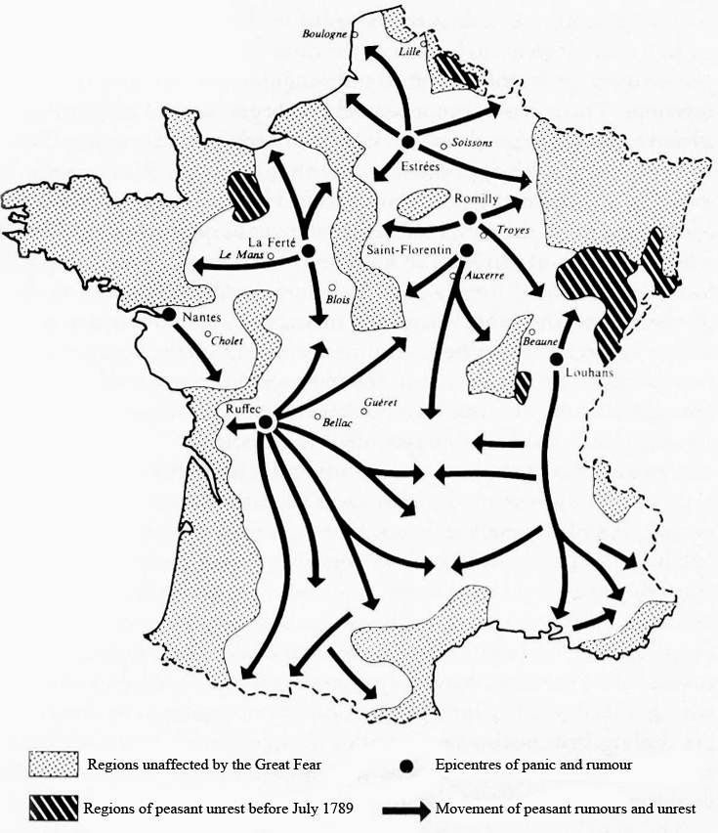
The Great Fear
Triggered by fears that landlords and nobility were hoarding grain, this resulted in general panic and unrest across the country
This was key as it showed the anger held by the peasantry in Paris was felt across all of France
Though, as the map shows, some areas were unaffected

Slide 18
Dismantling of the ancien regime – three key steps
August decrees – the abolishment of the feudal system. A few examples:
Tax privileges of the first two estates were abolished
Citizens to be taxed equally
Venality (buying a position) was outlawed
Declaration of the Rights of Man – the grounds of the constitution of France. Some highlights are:
All men are born free and equal
Power (sovereignty) rests with the people
Freedom of worship and speech
The nationalisation of Church land
Gave a lot of money to the government – that was in dire need
Also helped the equality of France – the church was one of the largest land owners in the country

Slide 19
The October Days
The King had refused to approve the Assembly’s decrees – which caused considerable tension
This combined with rumours of anti-revolutionary demonstrations at the King’s parties and, as per usual, rising bread prices
Between 6-7,000 women ,arched to Versailles to complain about the food shortage to the King
They forced the King to approve the August decrees and the Declaration of Rights
They also forced him to move to Paris

Slide 20
Significance of the October Days
Shows the power of the ordinary Parisians over the Assembly
King (and the Assembly) now felt imprisoned within Paris
A compromise with the King was going to be much harder to achieve from this point in
The King’s title is changed from ‘King of France’ to ‘King of the French’

Slide 21
Plan the following question
‘The most constant motive of popular insurrection during the Revolution, as in the 18th century as a whole, was the compelling need for cheap and plentiful bread and other essentials.’ Georges Rudé.
Evaluate the strengths and limitations of this interpretation, making reference to other interpretations that you have studied.

