Slide 1
Language and Power
The Theory

Slide 2
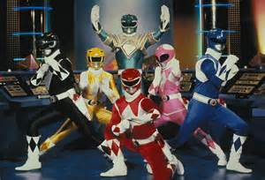
Wareing
Political = Legal e.g. Police, Judge, Barrister
Personal = Occupational e.g. Doctor, Teacher
Social Group = Friends and family, class

Slide 3
Instrumental vs. Influential
Instrumental = enforces authority imposed by the law, schools, exam boards…
Influential = persuasive power.

Slide 4
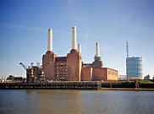
Power in and Behind Discourse
Power within discourse = features used to convey power
Power behind discourse = who? what? why?

Slide 5
Holmes
Managers favour mitigated imperatives.

Slide 6
Fairclough
Synthetic Personalisation = gives an audience, who are treated en masse, the impression of being considered as individuals.

Slide 7
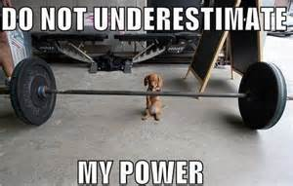
Morreal
Humour can be used as a powerful strategy.

Slide 8
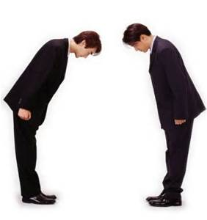
Face and Brown and Levinson
Face saving vs FTAs
Positive and negative politeness strategies.

Slide 9
Sapir-Whorf
Linguistic Determinism – language determines our thoughts.

