Slide 1
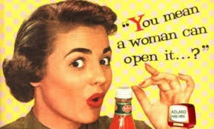
Stereotypes of Gender in the Media

Slide 2
Learning Objectives
To identify what gender stereotypes are
To apply understanding of gender stereotypes to representation of gender in media
To justify language choices for a men’s/women’s magazine article

Slide 3
What are gender stereotypes?
Stereotype - a widely held but fixed and oversimplified image or idea of a particular type of person or thing

Slide 4
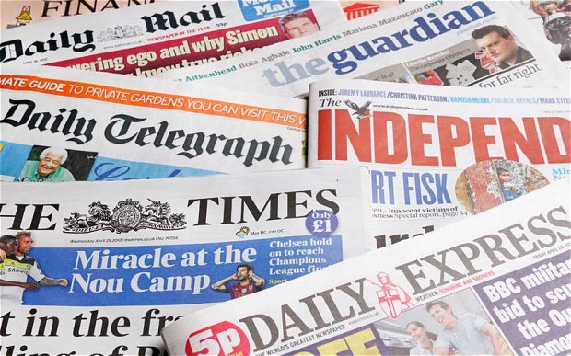
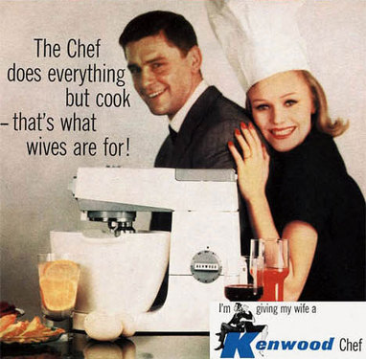
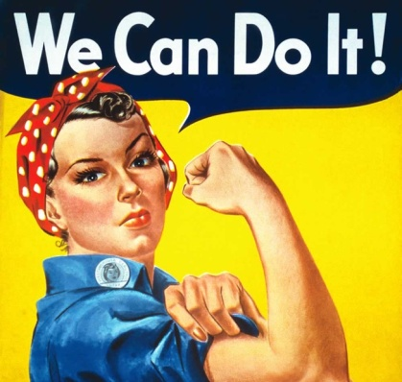
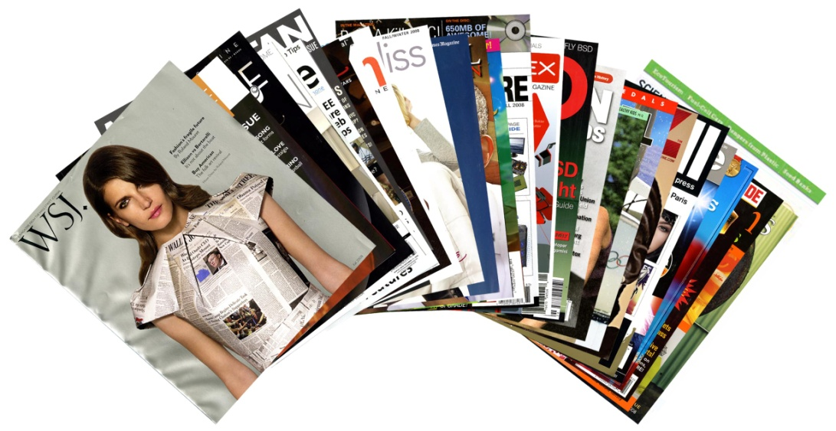
Media Carousel
How is gender represented?

Slide 5
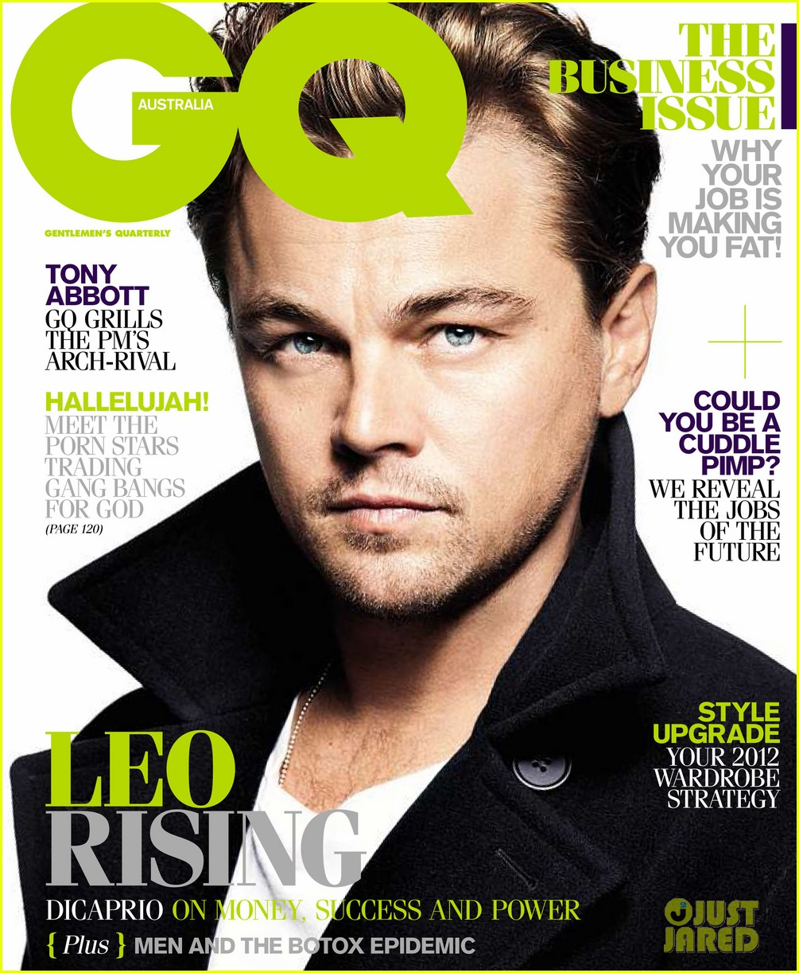
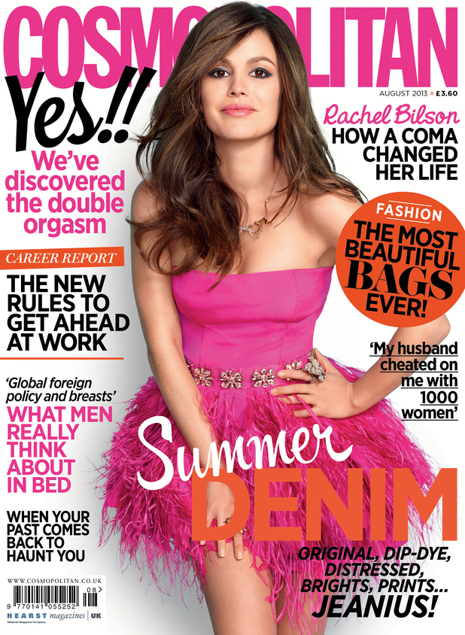
Write your own magazine article:
Write for a target, negotiated or critical audience
Justify your language choices
Preferred Reading – audiences respond to the product/message the way media producers want/expect them to
Negotiated Reading – audiences partially agree with the product/message
Oppositional Reading – audiences completely disagree with the product/message
(Stuart Hall – Audience Theory)

Slide 6
Homework
Bring in any text with ideas about how gender is represented based on the work covered this week.
Due: Next Lesson

