Slide 1
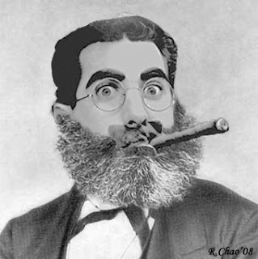
Marxism

Slide 2
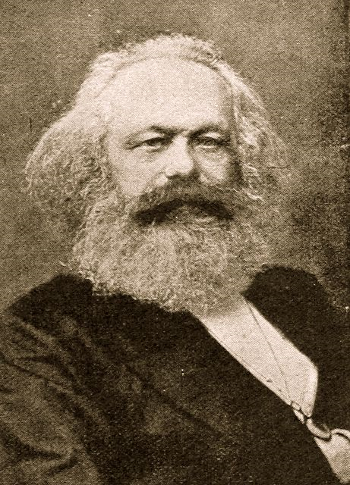
Karl Marx - 1818 -1883

Slide 3

Three best known published works:
The Communist Manifesto
Preface to the Contribution to the Critique of Political Economy (1859)
Das Kapital (1867)

Slide 4
Very generally….
The first publication Communist Manifesto (1848) argues that ‘the history of all hitherto existing societies is the history of class struggle’. That struggle is between The Bourgeois (dominant class who control and own the means of production) and the Proletariat (subordinate class: who don’t own and control the means of production).
At its purist form Marxism aims to revolutionise the concept of work through creating a classless society built on control and ownership of the means of production.

Slide 5
So what is the relevance to the study of English Literature?
'the mode of production of material life determines altogether the social, political, and intellectual life process. It is not the consciousness of men that determines their being, but on the contrary their social being, that determines their consciousness.' (Das Kapital)
Therefore…. the social situation of the author determines the types of characters that will develop, the political ideas displayed and the economical statements developed in the text. Literature itself is a social institution and has a specific ideological function, based on the background and ideology of the author.

Slide 6
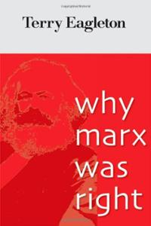
According to Eagleton:
“Marxist criticism is not merely a 'sociology of literature', concerned with how novels get published and whether they mention the working class. Its aim is to explain the literary work more fully; and this means a sensitive attention to its forms, styles and meanings. But it also means grasping those forms, styles and meanings as the product of a particular history”

Slide 7
To summarise, Marxism criticism has been used to:
assess of the political 'tendency' of a literary work
determine whether its social content or its literary form are 'progressive‘
analyse the class constructs demonstrated in the literature.

Slide 8
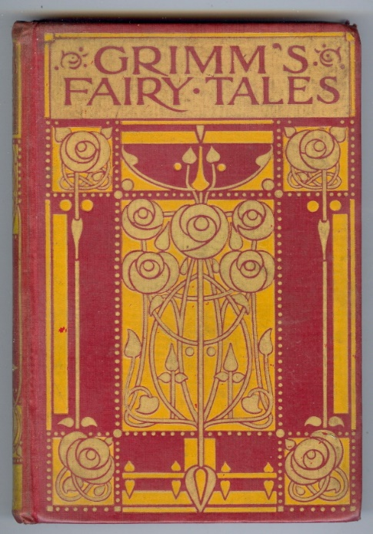
Illustrated in fairy tales which are….:
Populated with kings, queens, princes, princess, soldiers,
artisans, peasants, animals and supernatural creatures, and
rarely by members of the middle class.
With no machines and signs of industrialisation.
The main characters and concerns of a monarchical and feudal society are presented, and the focus is on class struggle and competition for power among the aristocrats themselves, and between the peasantry and aristocracy.
The central theme of fairy tales is that the Bourgeoisie oppress the Proletariat, reflecting and reinforcing Bourgeois ideals of class and gender,
However, while protagonists come from the lower social group, and they nearly always engage in a struggle with the rich and powerful, the final victory is rarely of an exploited class over a privileged class, but rather of one individual and their cunning over the stupidity of another individual. The shepherdess may become queen, but the rest of society remains untouched.

Slide 9
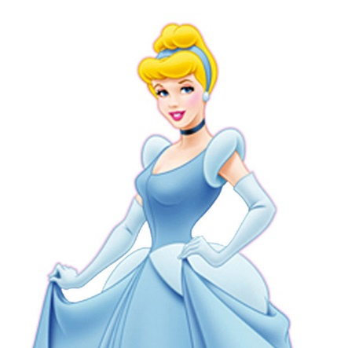
Cinderella Marxified…
There once lived a young womyn named Cinderella, whose natural birthmother had died when Cinderella was but a child. A few years after, her father married a widow with two older daughters. Cinderella's mother-of-step treated her very cruelly, and her sisters-of-step made her work very hard, as if she were their own personal unpaid laborer. One day an invitation arrived at their house.
The prince was celebrating his exploitation of the dispossessed and marginalized peasantry by throwing a fancy dress ball. Cinderella's sisters-of-step were very excited to be invited to the palace. They began to plan the expensive clothes they would use to alter and enslave their natural body images to emulate an unrealistic standard of feminine beauty. (It was especially unrealistic in their case, as they were differently visaged enough to stop a clock.) Her mother-of-step also planned to go to the ball, so Cinderella was working harder than a dog (an appropriate if unfortunately speciesist metaphor).
James Finn Garner, Politically Correct Fairy Tales, 1994

Slide 10
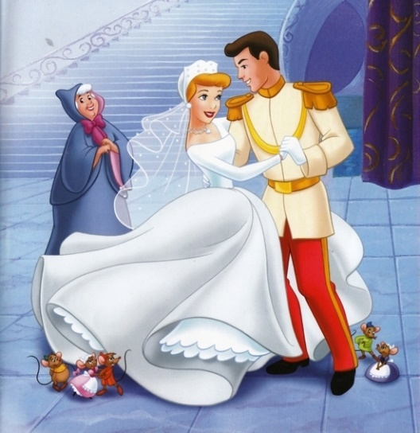
Development of the tale:
Cinderella is exploited by her rich relatives.
She exploits the mice, birds, and fairy godmother who help her for no pay.
Cinderella, her mother, the stepsisters and stepmother are representatives 'not of the category of woman, but of a particular social group.'” - Cristina Bacchilega. Class structure: Cinderella – the working class, oppressed by those who have stolen her rightful inheritance and turned her into a servant in her own home.
Step-Sisters – the middle class, represent the ambitious bourgeoisie trying unsuccessfully to marry up into the aristocracy.
The Prince – the upper-class, controlling the power of the kingdom, deciding who he shall marry. "
The prince chooses Cinderella because she represents herself as a member of the elite through her clothing. When she does not wear her finery, the prince does not recognise her. In the original fable, the animals gouge out the eyes of the step sisters and drive them out of town symbolizing the violent clashes between the rich and the poor.

Slide 11
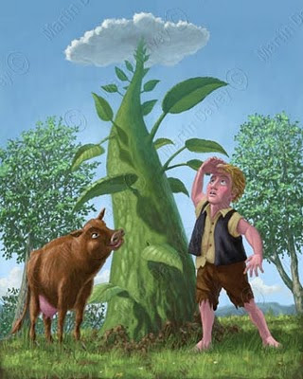
Your turn….
Once upon a time, on a little farm, there lived a
boy named Jack. He lived on the farm with his
mother, and they were excluded from the normal
circles of economic activity, trapped as they were
in a subordinate class, with no way to own and
to control the means of production. This cruel reality kept them in straits of direness, until one day Jack's mother told him to take the family cow into town and sell it for as much as he could, in an attempt to transcend their degraded state. Now, the prospect of easy wealth and mindless entertainment appealed to Jack's bourgeois sensibilities …

Slide 12

How relevant is Marxism to our current study of English Literature?

