Slide 1
“one of the most quintessentially American novels ever written”
“A permanent presence in American culture”
“A work of genius”
“A triumph of craftsmanship”
“Something new – something extraordinary”
“The most beautifully written of American novels”
“A masterpiece”
“The Great Gatsby is inexhaustible”
“A flawless novel”
“It is almost impossible to imagine contemporary American fiction without Jay Gatsby”

Slide 2
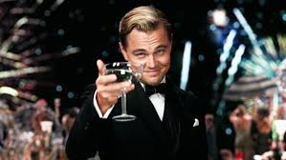
The Great Gatsby
Introduction to Narrative

Slide 3
The Saga of the Story v Plot v Narrative
Story: a series of real or fictitious events connected by a certain logic or chronology, and involving certain characters
Plot: the narration of this series of events – the way in which the events are told
The narrative: the method by which the narrator (or narrators) select, organise and present the events, (settings, time, characters, voices, points of view etc) and the author’s choice of narrator
According to The Glossary of Contemporary Literary Theory (ed. Jeremy Hawthorne, 2000)

Slide 4
Not forgetting the …
Narrator: “the linguistic function and not a person, which expresses itself in the language that constitutes the text” (Mieke Bal, 1985, 119)

Slide 5
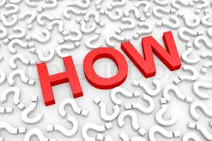
In other words:
Story: What?
Plot: How?

Slide 6
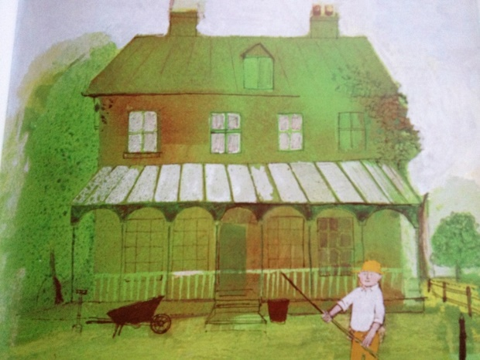
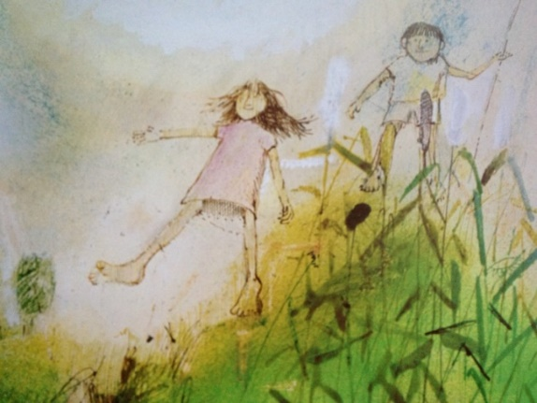
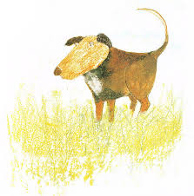
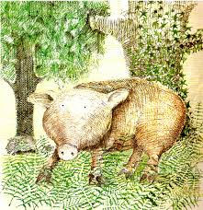
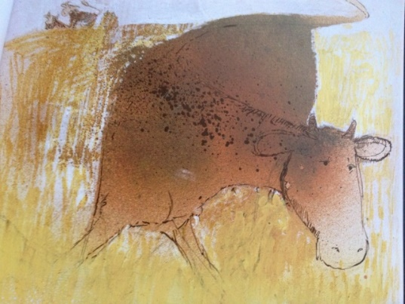
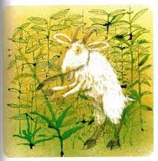
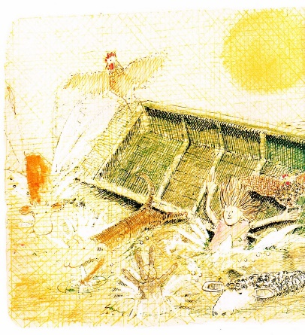
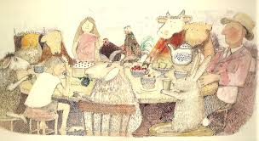
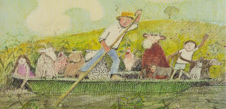

Slide 7
DO WE TRUST HIM?
No — Gatsby turned out all right at the end; it is what preyed on Gatsby, what foul dust floated in the wake of his dreams that temporarily closed out my interest in the abortive sorrows and short-winded elations of men.
My family have been prominent, well-to-do people in this Middle Western city for three generations. The Carraways are something of a clan, and we have a tradition that we’re descended from the Dukes of Buccleuch, but the actual founder of my line was my grandfather’s brother, who came here in fifty-one, sent a substitute to the Civil War, and started the wholesale hardware business that my father carries on to-day….
And so with the sunshine and the great bursts of leaves growing on the trees, just as things grow in fast movies, I had that familiar conviction that life was beginning over again with the summer.
There was so much to read, for one thing, and so much fine health to be pulled down out of the young breath-giving air. I bought a dozen volumes on banking and credit and investment securities, and they stood on my shelf in red and gold like new money from the mint, promising to unfold the shining secrets that only Midas and Morgan and Maecenas knew. And I had the high intention of reading many other books besides. I was rather literary in college — one year I wrote a series of very solemn and obvious editorials for the “Yale News.”— and now I was going to bring back all such things into my life and become again that most limited of all specialists, the “well-rounded man.” This isn’t just an epigram — life is much more successfully looked at from a single window, after all.
It was a matter of chance that I should have rented a house in one of the strangest communities in North America.

Slide 8
A few fancy (and not so fancy) terms to do with narrative :
First, (second) or third person narrator
“Ab initio” (meaning “from the start” in Latin): told from the beginning as opposed to “in medias res” (meaning “in the midst of things” in Latin)
Non linear narrative: a plot that doesn’t run chronologically
Flashback or analepsis: an interjected scene that takes the narrative back in time from the current point in the narrative. (With internal analepsis refering to an earlier point in the narrative, and external analepsis to a time before the narrative started)
Flashforward or prolepsis: reveals events that will occur in the future.
In medias res (meaning “in the midst of things" in Latin) is the literary and artistic technique of relating a story from the midpoint, rather than the beginning
Reliable or unreliable narrator (Do we believe everything the narrator tells us, or suspect that either deceit or obtuseness on his/her part requires us to see more than he or she does?)

