Slide 1
The Great Gatsby
Context

Slide 2
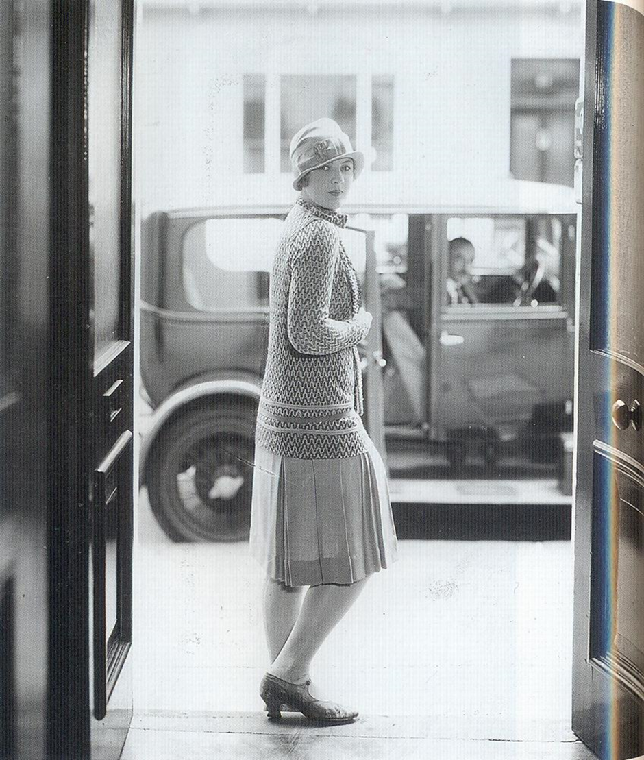

Slide 3
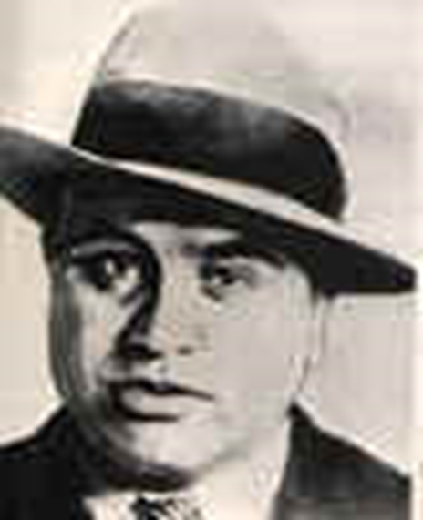

Slide 4
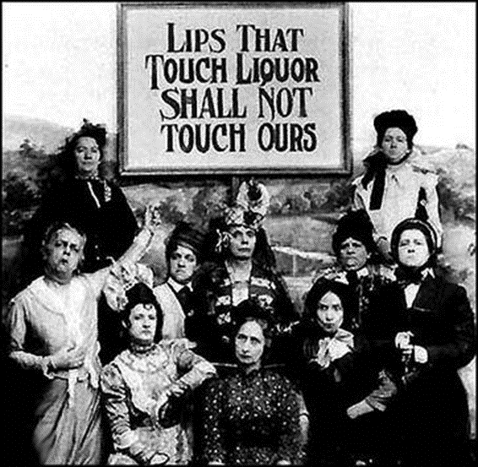

Slide 5
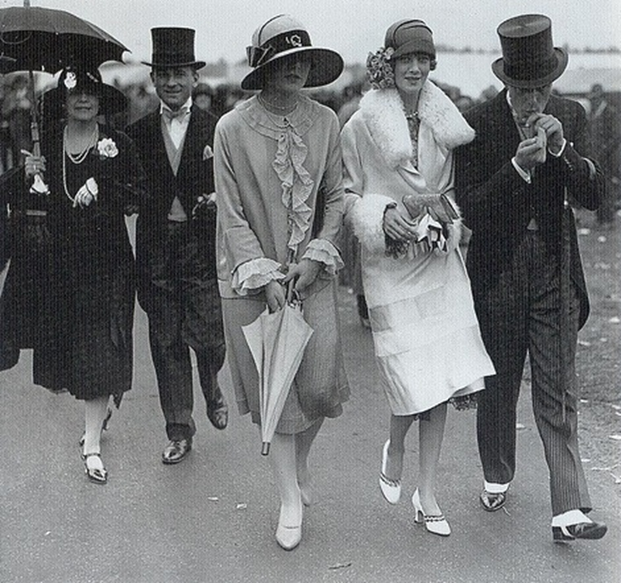

Slide 6
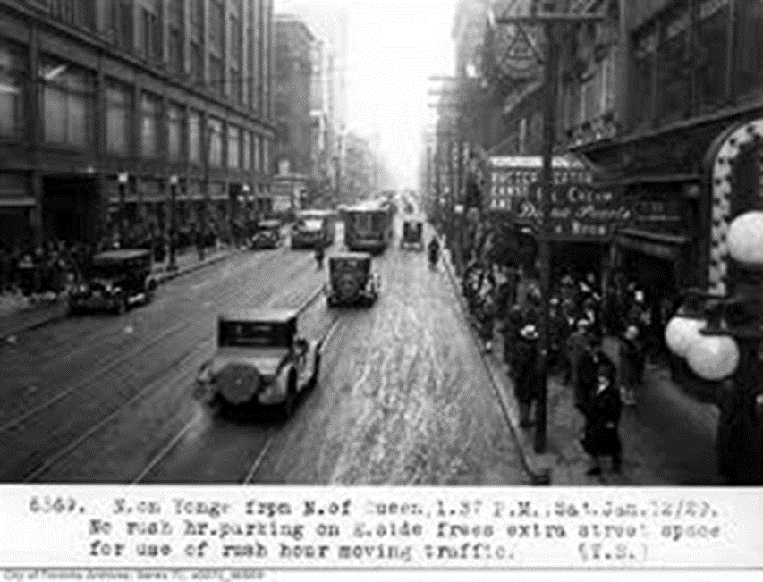

Slide 7
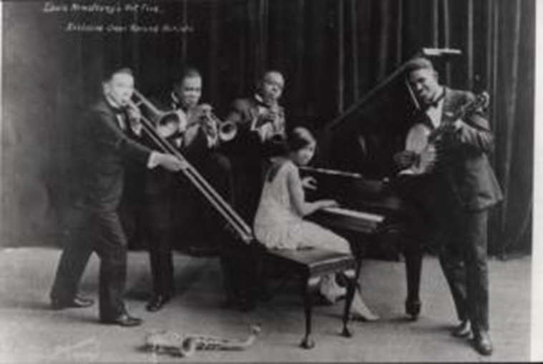

Slide 8
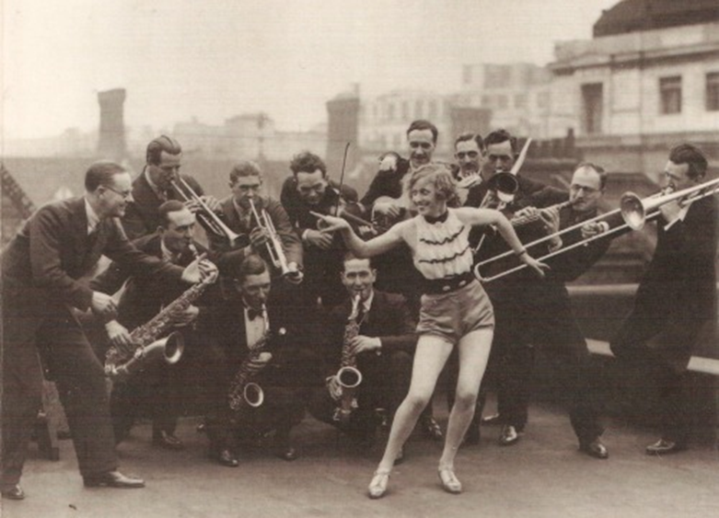

Slide 9
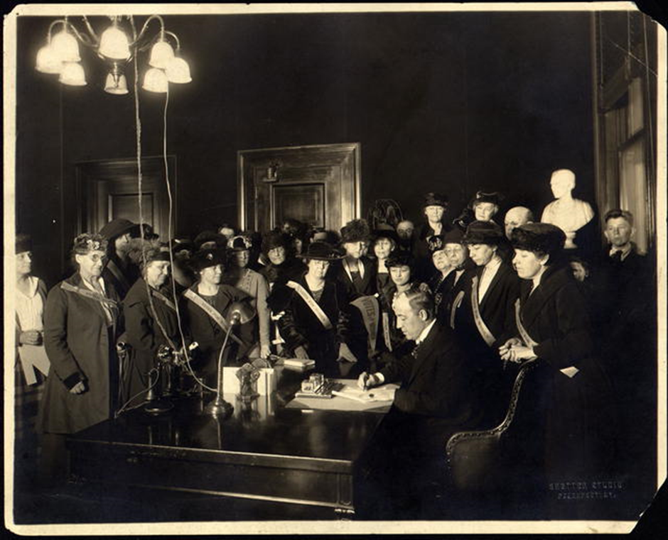

Slide 10
Some dates for you..
1896 – US Supreme Court upholds legality of segregation.
1905 – Anti black riot in Atlanta – 22 killed
1917 – US enters World War. 24% of homes have electicity
1918 – World War ends
1919 – 18th Amendment to the Constitution (prohibition)
1920 – Women get the vote in US. 8 million cars in the US.
1921 – Immigration controls introduced
1922 – TS Eliot’s The Waste Land published, 40 million film tickets sold each week in the US
1924 – Disney’s Alice in Wonderland released, Gershwin’s Rhaposody in Blue.
1925 - Warner Brothers make “Talkies”. The Great Gatsby is published.

Slide 11
Your task as a group
Read the extract you have in your group.
Summarise each paragraph in one sentence
Identify the three most interesting ideas contained in your extract
Give three examples of the relevance of the context outlined in your extract to The Great Gatsby
Make sure that everyone in the group takes notes

Slide 12
Where would you place the characters?
Masculine________________________________feminine
Positive___________________________________negative
Powerful____________________________________weak
Attractive_______________________________unattractive
Person___________________________________type

