Slide 1
Intrinsic or Extrinsic Approaches to Criticism

Slide 2
An Intrinsic Approach to Criticism
Interested in the form of the text, its structure and language
I A Richards (Practical Criticism) called this ‘the words on the page’
Subject them to close scrutiny
Read this poem and talk about it...

Slide 3
EARTH has not anything to show more fair: Dull would he be of soul who could pass by A sight so touching in its majesty: This City now doth like a garment wear The beauty of the morning; silent, bare, Ships, towers, domes, theatres, and temples lie Open unto the fields, and to the sky; All bright and glittering in the smokeless air. Never did sun more beautifully steep In his first splendour valley, rock, or hill; Ne'er saw I, never felt, a calm so deep! The river glideth at his own sweet will: Dear God! the very houses seem asleep; And all that mighty heart is lying still!

Slide 4
An Intrinsic Approach to Criticism
Interested in the form of the text, its structure and language
I A Richards (Practical Criticism) called this ‘the words on the page’
Subject them to close scrutiny
Using this intrinsic approach, interpret the two words ‘lying still’ at the end of the poem.

Slide 5
EARTH has not anything to show more fair: Dull would he be of soul who could pass by A sight so touching in its majesty: This City now doth like a garment wear The beauty of the morning; silent, bare, Ships, towers, domes, theatres, and temples lie Open unto the fields, and to the sky; All bright and glittering in the smokeless air. Never did sun more beautifully steep In his first splendour valley, rock, or hill; Ne'er saw I, never felt, a calm so deep! The river glideth at his own sweet will: Dear God! the very houses seem asleep; And all that mighty heart is lying still!

Slide 6
An Intrinsic Approach to Criticism
Interested in the form of the text, its structure and language
I A Richards (Practical Criticism) called this ‘the words on the page’
Subject them to close scrutiny
Given these pointers, how would you interpret the two words ‘lying still’ at the end of the poem
A sonnet has 14 lines. Petrarchan sonnets have an ABBAABBA octet, followed by a variety of different rhymes in the sestet. Shakespearian sonnets (dates 1564-1616) follow ABABCDCDEFEFGG

Slide 7
Composed Upon Westminster Bridge
EARTH has not anything to show more fair: Dull would he be of soul who could pass by A sight so touching in its majesty: This City now doth like a garment wear The beauty of the morning; silent, bare, Ships, towers, domes, theatres, and temples lie Open unto the fields, and to the sky; All bright and glittering in the smokeless air. Never did sun more beautifully steep In his first splendour valley, rock, or hill; Ne'er saw I, never felt, a calm so deep! The river glideth at his own sweet will: Dear God! the very houses seem asleep; And all that mighty heart is lying still!

Slide 8
Composed Upon Westminster Bridge
EARTH has not anything to show more fair: Dull would he be of soul who could pass by A sight so touching in its majesty: This City now doth like a garment wear The beauty of the morning; silent, bare, Ships, towers, domes, theatres, and temples lie Open unto the fields, and to the sky; All bright and glittering in the smokeless air. Never did sun more beautifully steep In his first splendour valley, rock, or hill; Ne'er saw I, never felt, a calm so deep! The river glideth at his own sweet will: Dear God! the very houses seem asleep; And all that mighty heart is lying still!
William Wordsworth, 1802

Slide 9
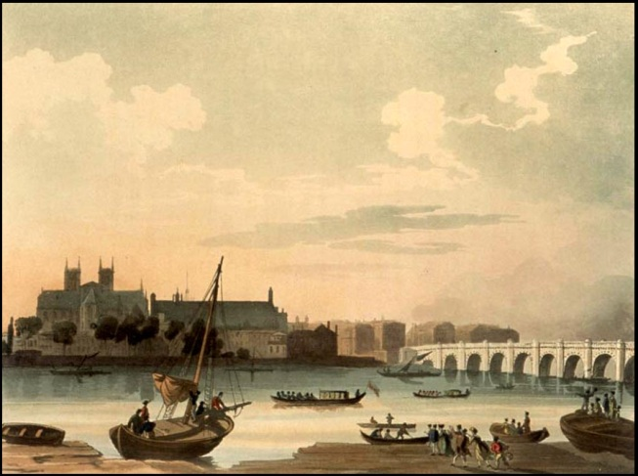
[...] we left London on Saturday morning at ¹⁄₂ past 5 or 6, the 31st July (I have forgot which) we mounted the Dover Coach at Charing Cross. It was a beautiful morning. The City, St pauls, with the River & a multitude of little Boats, made a most beautiful sight as we crossed Westminster Bridge. The houses were not overhung by their cloud of smoke & they were spread out endlessly, yet the sun shone so brightly with such a pure light that there was even something like the purity of one of nature's own grand Spectacles
Dorothy Wordsworth’s Journal
Westminster Bridge
in 1808

Slide 10
An Extrinsic Approach to Criticism
Interested in the world outside the poem, including the historical context
Would read a Shakespeare play in the light of historical events at the time of writing
Sometimes called historicist
Modern critical approaches, such as feminist and marxist approaches, are extrinsic

