Slide 1
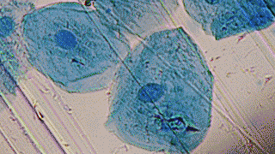
Biological Engineering and the Ethical Issues Involved

Slide 2
What is Biological Engineering?
Bioengineering is the application of engineering principles to biological systems.
This was first publicly introduced with Dolly the Sheep.
Stem Cell research.
“Biomedical Engineering is the application of engineering principles and design concepts to medicine and biology for healthcare purposes.”
^^Is it caring for everyone’s health?

Slide 3
Stem Cell Research
Embryonic stem cell research poses a moral dilemma. It forces us to choose between two moral principles:
The duty to prevent or alleviate suffering.
The duty to respect the value of human life.
Ishiguro challenges what we constitute as human and questions how much we value human life.

Slide 4
Is an isolated existence cruel if it’s all someone has ever known? For example in our society; battery farmed chickens. Child labour. Child soldiers in Somalia.

Slide 5
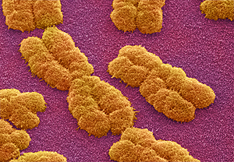
What makes us human?

Slide 6
Our humanity itself.
Empathy.
Creative thinking.
Originality.
Conscience.
The ability to love.
How much of this is exhibited in the Hailsham students behaviour and personalities?

Slide 7
We accept abortion, could we accept cloning?

Slide 8
This relatively normal idea actually encapsulates the whole concept behind Ishiguro’s novel. This idea that we as a society are able to give and take away life; like the way the students are clones made to have their organs harvested, abortion suggests that this concept of frivolously giving and taking away life is okay on a smaller scale.

Slide 9
THE END

