Slide 1
ORGAN DONATION
BELLA F & YOLLIE & BELLA R

Slide 2
What is Organ Donation?
Organ donation is the process of surgically removing an organ or tissue from one person (the organ donor, aka clones) and placing it into another person (the recipient, aka the normals).
QUOTE: CH7 pg 80, ‘Your lives are set out for you. You’ll become adults, then before you’re old, before you’re even middle aged, you’ll start to donate your organs. That’s what each of you was created to do.’

Slide 3
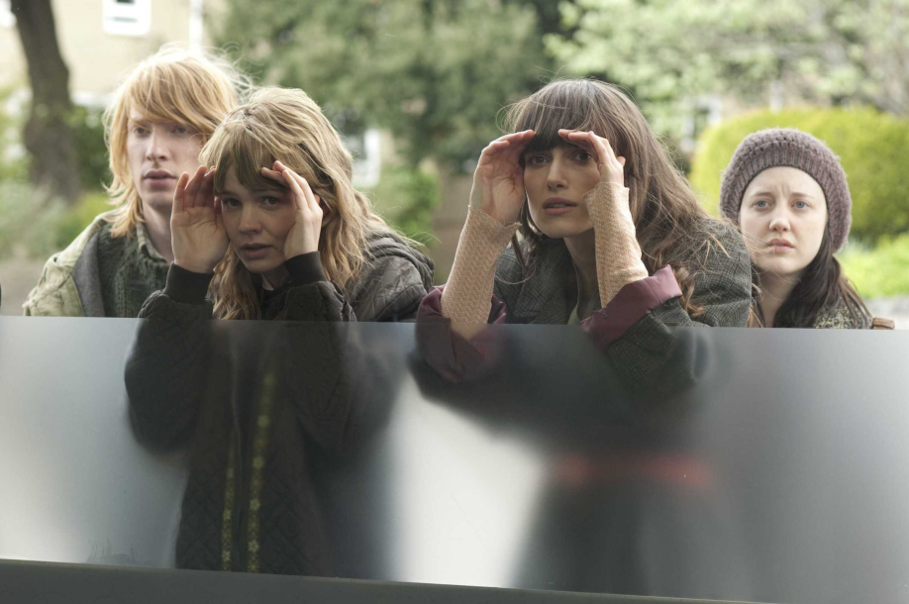
What is it’s effect on society?
People can choose to carry a donor card but donations are not obligatory for anybody. However the clones in Never Let Me Go are not given a choice because that is why they were created.
QUOTE: CH7 pg 80, ‘You were brought into this world for a purpose, and your futures, all of them, have been decided.’

Slide 4
Controversy of organ donation?
Very controversial issue as many people are very reluctant to give up their organs due to spiritual or religious beliefs. In the novel, God is only mentioned once by Kathy to Tommy as a joke so these beliefs would not apply to the clones.
QUOTE: CH7 pg 80 ‘If you’re to have decent lives, you have to know who you are and what lies ahead of you, every one of you.’

Slide 5
Links to Never Let Me Go
The clones talk about ‘unzipping’ as they are going to have their organs removed and the only way they can cope with the truth which they are unwilling to accept, is to make jokes about their prolonged deaths.
Society know about the donations, yet since they are better off do not mind that there are humans purely created for the harvesting of their organs, but they do not want to return to a world without the system due to its benefits eg. curing cancer.
The society in NLMG know about the clones and their donations. Moreover, they turn a blind eye to the clones and do not try to help them except a select few eg. Madame & Miss Lucy. They try to see them as not human so they do not feel as bad about what they are putting the clones through.

