Slide 1
Nature v Nurture
By Victoria, Bella and Jack

Slide 2
Definition- Genes or Environment?
The nature/nurture theory is a discussion to whether our characteristics are innate or are developed through environment.

Slide 3
Nature
The coding of genes in each cell in humans determines the different traits that we have, such as eye colour, hair colour, ear size, height, and other traits. However, it is still not known whether this affects aspects like personality, intelligence, sexual orientation, likes and dislikes are gene-coded in our DNA, too.
On the other hand, the behavioural genes are somewhat proven to exist when we take a look at fraternal twins. When fraternal twins are reared apart, they show the same similarities in behaviour and response as if they have been reared together.

Slide 4
Nurture
The nurture theory shows that the environmental factors are the real origins of our behaviour. It is possible to train a baby , to become any type of specialist . It is stated that they can be trained regardless of the child's potentialities, talents and race.
In the end, we are still left with the confusing question: Are we born this way, or do we behave according to our life experiences? The nature vs nurture debate goes on and on, but still, it is a fact that we have traits that are predetermined by our genes, but we can still choose who we want to be as we travel through our lifetime.

Slide 5
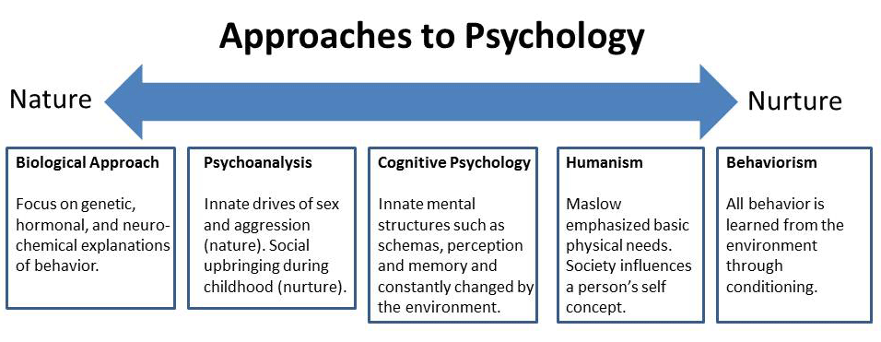
Effect On Society
The nature v nurture theory affects our approaches to psychology as it provides an observation of development of characteristics of people.

Slide 6
Links to ‘Never Let Me Go’
The clones have very distant relationships to their guardians, don’t know how to react to affection
‘she stood over me and hugged me, not in a sexy way…I just kept as still as possible’
The way in which they are brought up, hidden from emotions means that they have a different view on life from the rest of the world.

Slide 7
Links to ‘Never Let Me Go’
They want to find links from their nature to try and find who they were cloned from
‘are you looking through old porn mags for your ‘possible’
Due to her upbringing she is unable to understand her feelings sp therefore t

