Slide 1
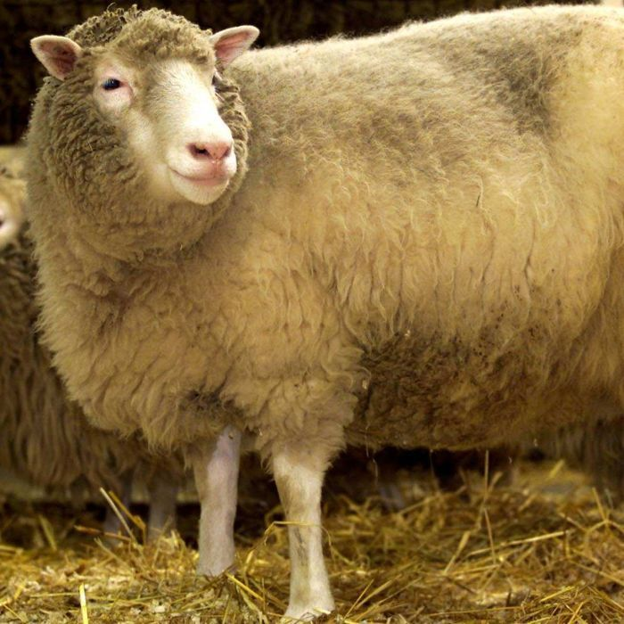
Cloning
Dolly The Sheep

Slide 2
What Is Cloning?
The term cloning describes a number of different processes that can be used to produce genetically identical copies of a biological entity. The copied material, which has the same genetic makeup as the original, is referred to as a clone.
Researchers have cloned a wide range of biological materials, including genes, cells, tissues and even entire organisms, such as a sheep.

Slide 3
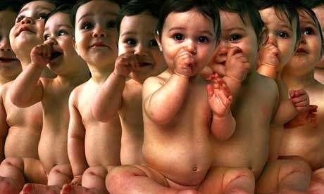
What Is Human Cloning?
Human cloning is the creation of a genetically identical copy of an existing, or previously existing, human being or growing cloned tissue from that individual.

Slide 4
Dolly The Sheep
Dolly was made at the University of Edinburgh at the Roslin institute Scotland. There was 277 previous attempts.
Dolly was born on the 5th July 1996 she was 6.6kg.
She produced normal offspring.
Sheep can live for 11/12 years, but Dolly only lived for 6 and ½ years.
Dolly suffered from arthritis in her leg joints and pulmonary adenomostosis (lung tumour).

Slide 5
Cloning Humans and Animals

Slide 6
Never Let Me Go Links
It was set in the 1990’s and during that time Dolly The Sheep was born and Ishiguro started to take notes about Dolly and the debates about the pros and cons of Cloning.
It was published in 2005, but two years before this George Bush said that “like most Americans, I believe human cloning is deeply troubling, and I strongly support efforts by congress to ban all human cloning. We must advance the promise and cause of medical science, including through ethical stem cells research, yet we must do so in ways that respect human dignity and help build a culture of life. I urge the Senate to act quickly on legislation banning all human cloning.

Slide 7
More Links To Never Let Me Go
Dolly the sheep died at 6 this was the age of her original.
The age of Dolly’s original when her adult cell was harvested to create Dolly was the age that Dolly died at.

Slide 8
What Can You Donate?
One donor can help several people as they can donate a number of organs, including:
kidneys
liver
heart
lungs
small bowel
pancreas
Tissues that can be donated include:
the cornea (the transparent layer at the front of the eye)
bone
skin
heart valves
tendons
cartilage

Slide 9
Current Laws
On January 14, 2001 the British Government passed The Human Fertilisation and Embryology (Research Purposes Regulations.
To amend the Human Fertilisation and Embryology Act 1990 by extending allowable reasons for embryo research and to permit research around stem cells and cell nuclear replacement, thus allowing therapeutic cloning.
However, on November 15, 2001, a pro-life group won a High Court legal case, which struck down the regulation and effectively left all forms of cloning unregulated in the UK. Their hope was that Parliament would fill this gap by passing prohibitive legislation. Parliament was quick to pass the Human Reproductive Cloning Act 2001 which explicitly prohibited reproductive cloning. The remaining gap with regard to therapeutic cloning was closed when the appeals courts reversed the previous decision of the High Court.
The first licence was granted on August 11, 2004 to researchers at the University of Newcastle to allow them to investigate treatments for diabetes, Parkinson’s disease and Alzheimer’s disease. The Human Fertilisation and Embryology Act2008, a major review of fertility legislation, repealed the 2001 Cloning Act by making amendments of similar effect to the 1990 Act. The 2008 Act also allows experiments on hybrid human-animal embryos

