Slide 1
Organ donation
Ellie, Erin and Ellie

Slide 2
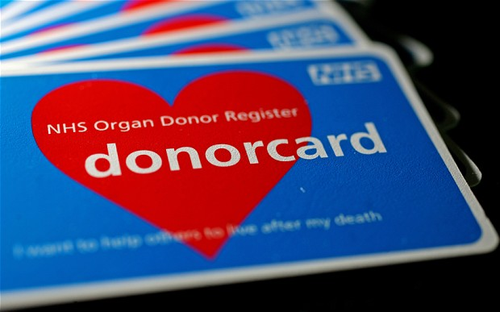
Organ donation context
What is a donation?
A donation is giving an organ or tissue to help someone who needs a transplant. Transplants can save or greatly enhance the lives of other people. But this relies on donors and their families agreeing to donate their organ or tissue.

Slide 3
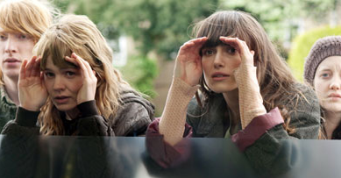
Organ donation context
Types of organ donations
There are two types of organ donations:
Living- Whilst you are still alive you can choose to donate a kidney, a small section of your liver, discarded bone from a hip or knee replacement and also your amniotic membrane (placenta).
Deceased- Deceased donors are most often individuals who die from accidents, heart attacks or strokes, and their next of kin consent to organ donation. The typical organ donor age range is from new born to 65 years or more.

Slide 4
Organ donation context
90% of people who say they support organ donations in opinion polls but less than 1/3 are registered donors
6848 people waiting for a transplant. 1734 people have received a transplant since the 1st of April 2015.
Some may be pro donation but think donating may upset their family.
You can only use organs and tissue from a donor with their consent or with their family’s consent after they die.

Slide 5
Organ Donation Context
Why people don’t donate:
Someone who believes in an afterlife are forfeiting their access to the afterlife and betraying their religion.
You cannot become a donor if you have HIV or cancer.
People don’t donate due to the taboo of death.

Slide 6
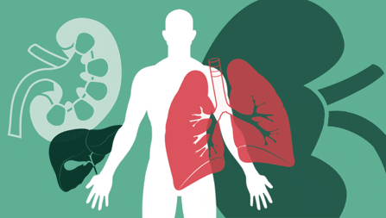
Organ donation context
Wales have on opt out option rather than opt in. This may link to Never Let Me Go as they do not have a choice. They are automatically signed up just like the welsh. However, the clones do not get the option to opt out.
A donation can help someone when their organs are not working properly and they need a transplant.
You can donate:
Kidneys
Heart
Liver
Lungs
Pancreas
Small bowel
Corneas
Tissue

Slide 7
Organ donation context
Linking it to Never Let Me Go:
In our society we give our own consent. We have the choice to donate or not. The clones are made to be donors. They don’t give any consent, they are forced.
In Never Let Me Go we never see the ones needing the organs. This would make you less sympathetic of the clones if they did. Never Let Me Go indicates the importance of having organ donors as these are the possible extremes that would take place if no one became a donor.
“it’s what we’re supposed to be doing” Ruth see’s donating as reaching her goal in life and fulfilling her purpose. They live to give their organs. In reality you give your organs without having to ‘complete.’ You still have a life before and after the donations. Or the donations take place when you’re deceased.

