Slide 1
Compositional Design

Slide 2
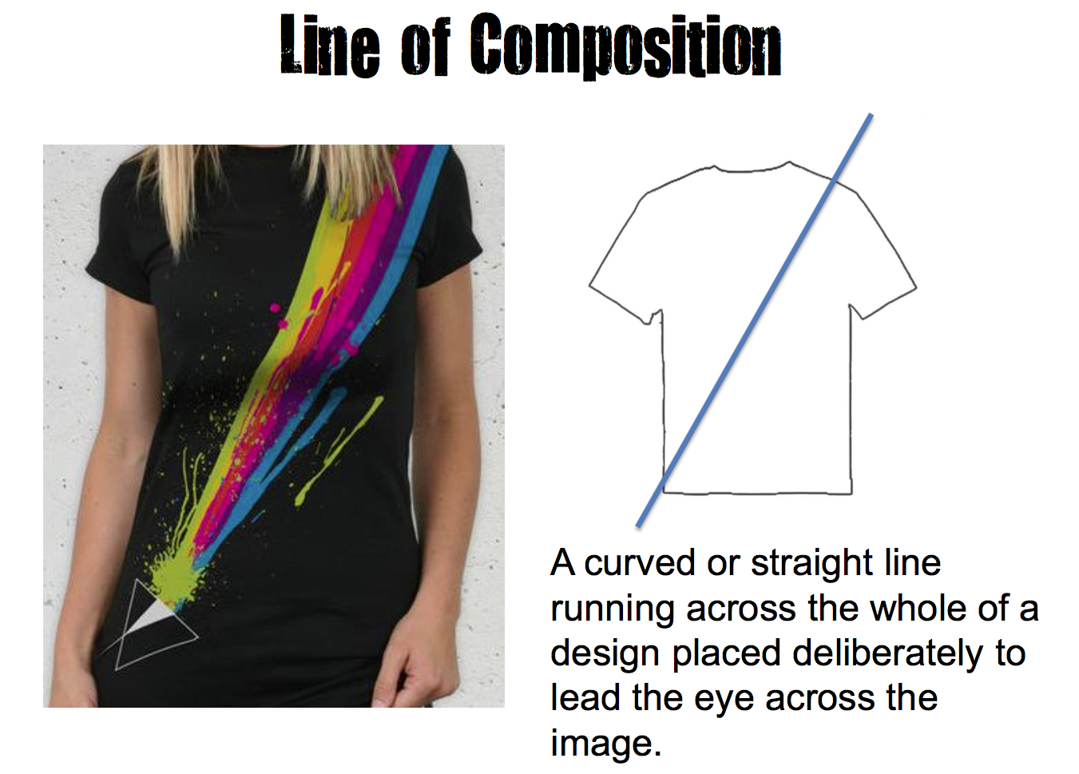

Slide 3
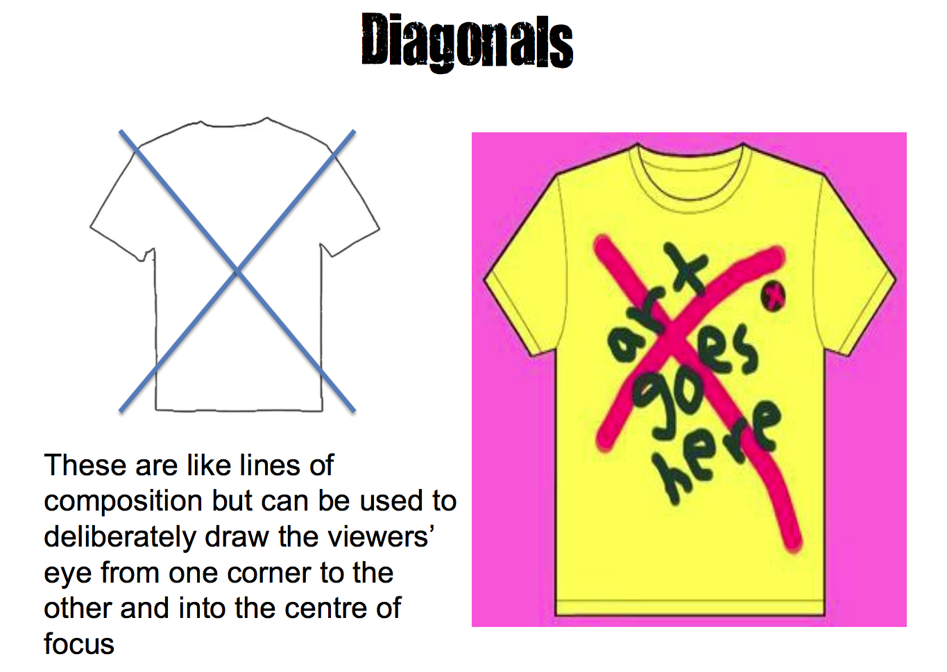

Slide 4
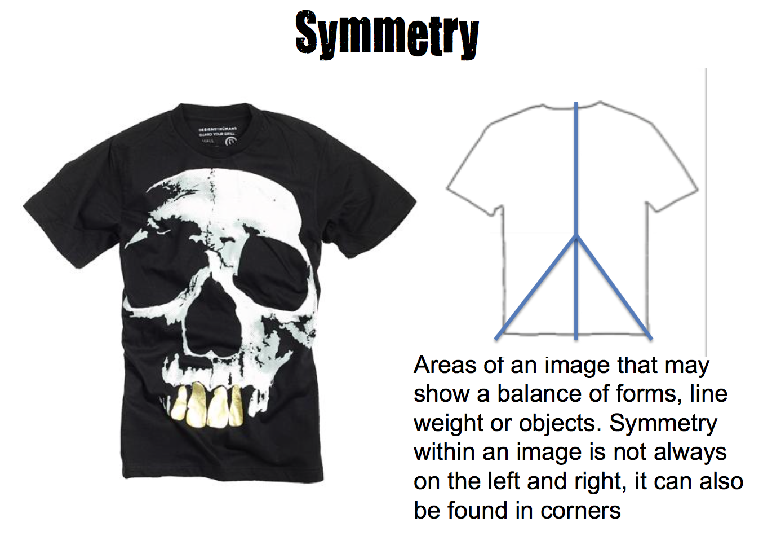

Slide 5
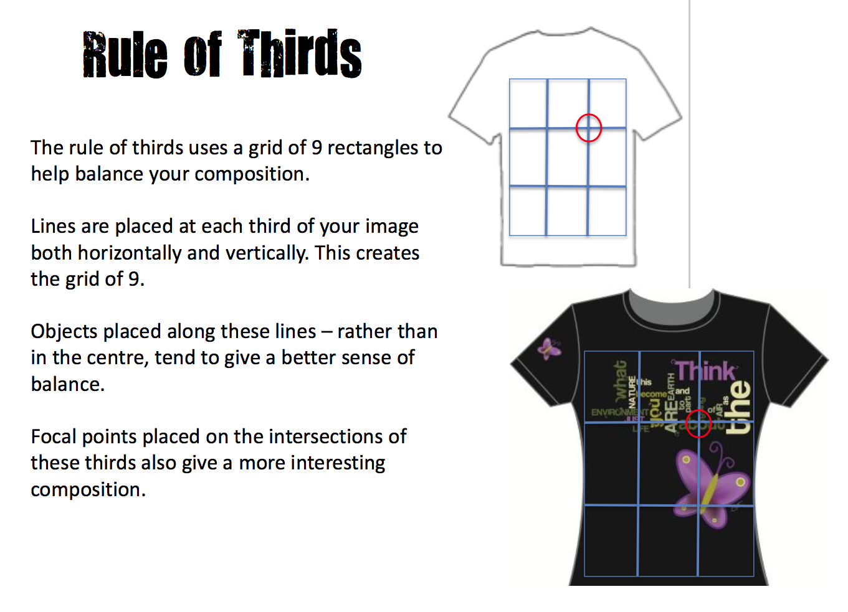

Slide 6
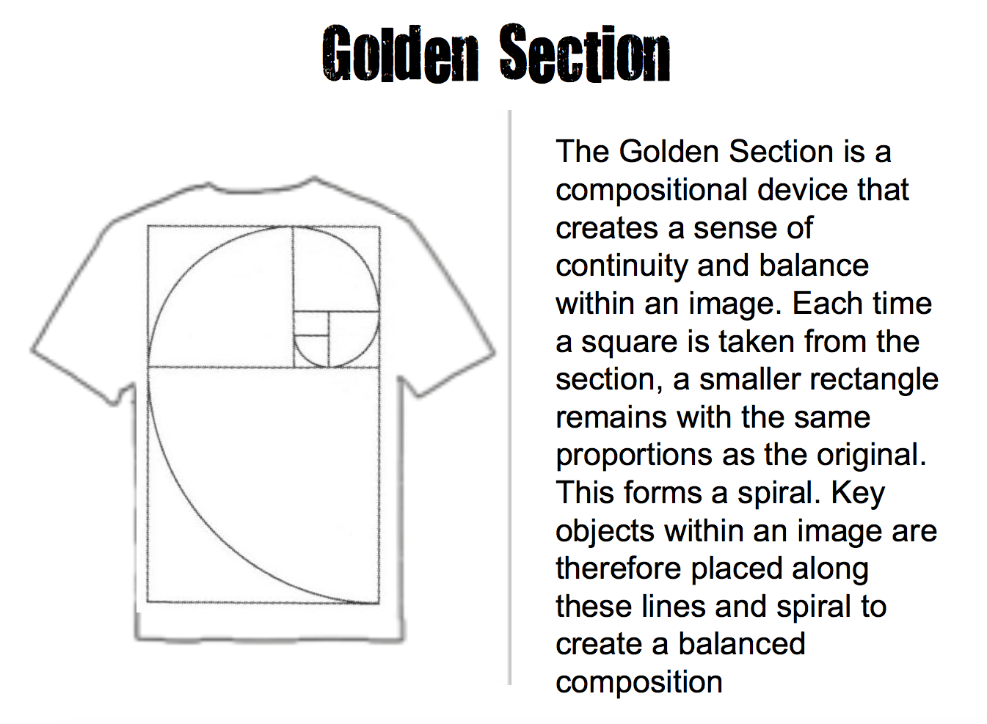

Slide 7




Slide 8
Other layout techniques to mention
Alignment/justification of text
Hierarchy

