Slide 1
Unit 3 - Customer Service
P1 continued - Presentation Skills

Slide 2
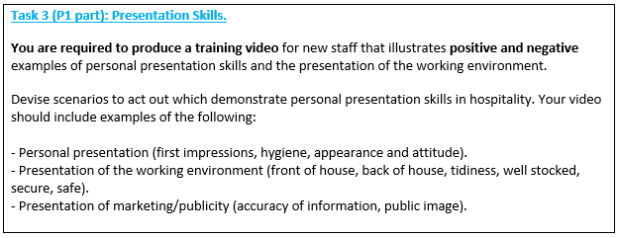
P1 Task 3

Slide 3
P1 Task 3 - Guidance
Devise TWO scenarios, that will allow you to demonstrate EXCELLENT and BAD examples of presentation skills.
Include:
A description of the scenario.
Scripts
An explanation of how and why the skills demonstrated are good/bad.

Slide 4
Read the following slides to help you understand the importance of personal presentation in hospitality.
Then look at the final slides (19/20) for instructions of how to write up your 2 scenarios.

Slide 5
Then…
When we are back in College, you will film your scenarios/training videos in groups of 3 or 4.

Slide 6
PERSONAL PRESENTATION.
1.APPEARANCE.
2.PERSONAL HYGIENE.
3.PERSONALITY.
4.ATTITUDE.
Along with the physical facilities and marketing
materials , the way staff present themselves to
customers can create a positive or negative
FIRST IMPRESSION.

Slide 7
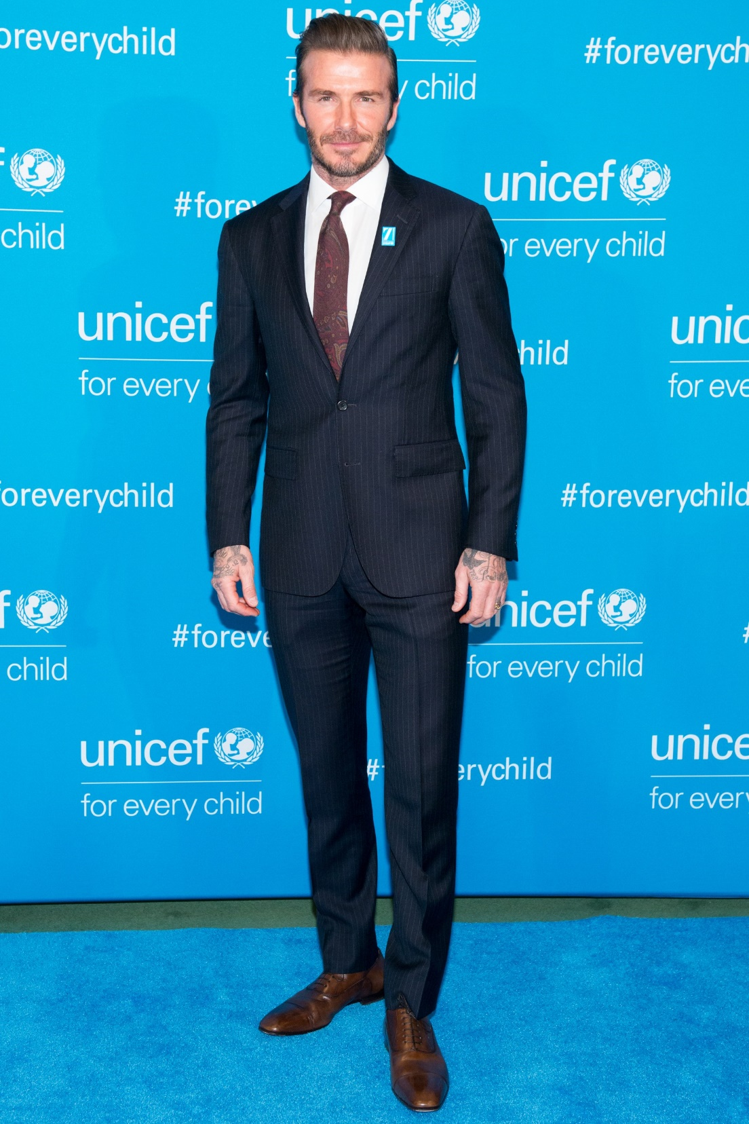

Slide 8
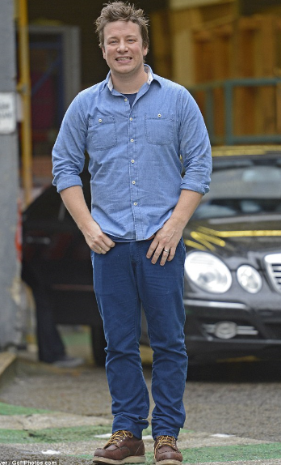

Slide 9
1. APPEARANCE.
Why do you think so many Hospitality organizations provide their staff with uniforms?
It helps create a positive first impression – How?
Staff can be recognized instantly as working for an organization.
Staff can be identified quickly for advice or assistance.
A member of staff’s job can be identified.
It helps create a professional image.

Slide 10
Dress and general appearance should suit the job, the organization and the customers expectations.
General appearance: Think about
Hair?
Jewelry?
Make Up?
Clean/Ironed uniform?
Tattoos?
Equal Opportunities?

Slide 11
Suggest the appropriate appearance for an employee in the following job roles:
Assistant Manager of a spa complex.
Kitchen Assistant.
Bar Tender.
Hotel Receptionist.

Slide 12
2. PERSONAL HYGIENE.
If a member of staff has poor personal hygiene, it can affect a
customer’s perception of the whole facility.
In hospitality, hygiene is essential because an organisation can be
closed down if hygiene levels are poor or if customers pick up
diseases caused by poor hygiene (through food & drink).
a) Hair.
Clean and tidy.
Kept out of face.
Tied back/ hats/ hair nets.
Clean shaven or beards and moustaches – trimmed.

Slide 13
b) Personal Freshness.
Bad breath.
Body odour (underarms and feet).
Smoke/other unpleasant smells on clothes.
c) Hands and Fingernails.
When on display, they should be clean.
Provision of wash basins/anti-bacterial hand wash.
d) Personal habits.
Picking nose, biting nails etc.
e) Consideration when ill/COVID.
Stopping the spread of germs.

Slide 14
3) PERSONALITY.
It is Important for employees to let their personality show through – Why?
Customers know they are dealing with human, not a robot.
Customers know staff see them as a real person and not just another customer.
Workers give customers the opportunity to make them feel a valued and necessary part of the organization.

Slide 15
Look at the following Hospitality jobs and discuss the specific types of personality that you think they would require:
Assistant Manager of a spa complex.
Kitchen Assistant.
Bar Tender.
Hotel Receptionist.
What personal skills/qualities do you feel are important for working in the Hospitality industry?

Slide 16
Examples of Personal Qualities:
Enthusiastic
Thoughtful
Individual
Pays Attention
Unflappable
Tolerant
Dependable
Thorough

Slide 17
4. Attitude
Attitude towards a customer is crucial as all customers are sensitive to the way staff feel about them.
A member of staff’s attitude will dictate how much they value their customers.
How can you describe someone’s attitude?
What can affect a staff member’s attitude?

Slide 18
ALSO CONSIDER:
Presentation of the Workplace
How the organisation looks/sounds/smells can have a massive impact on the first impression a customer forms.
Consider the following:
Tidiness?
Cleanliness?
Stock levels?
Security?
Health and Safety?
Marketing Materials? (Menus, price lists, posters etc., are they up to date? Clean? Accurate? Spelt correctly etc.)

Slide 19
Instructions, for each scenario (x2):
Remember, you are devising scenarios/scripts that will then be role played and filmed, in order to produce training videos for new staff.
1 BAD scenario – when filmed, this should demonstrate potential negative aspects of personal presentation of staff/the workplace. i.e. WHAT NOT TO DO.
1 EXCELLENT scenario – when filmed, this needs to show positive aspects of personal presentation of staff/the workplace (i.e. how things SHOULD be done).
Your scenarios should be representative of typical hospitality customer service situations e.g. A service in a restaurant, checking into a hotel etc.

Slide 20
What you need to produce for each scenario (1 Bad, 1 Excellent).
A written description of each scenario:
Where, when, who, why?
Describe the appearance of the member of staff (why is this good/bad?)
Describe the personal hygiene of the member of staff (why is this good/bad?)
Describe the personality of the member of staff (why is this good/bad?)
Describe the attitude of the member of staff (why is this good/bad?)
Describe the presentation of the environment/marketing materials (why is this good/bad?)
Then write out your scripts:
The script should show dialogue between the member of staff and customer(s).
Also include descriptions of what the member of staff is doing at appropriate points.
Each script should be 1-2 sides of A4. Once complete, please upload these to the appropriate area on GOL.

