Slide 1
Unit 3.1 – Task 4 (M1)
Explaining communication methods used in specific situations.

Slide 2
3.1 Task 4
Read through the following slideshow.
Follow the RED instructions on what to include in your leaflet.
You can choose the format of your leaflet (word/publisher etc.), but please make sure you include clear headings and relevant illustrations/screen shots to give it a professional feel.

Slide 3
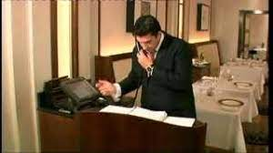
Leaflet Section 1: Taking a booking:
Leaflet: Write an introduction to this section that covers the following:
Why are bookings/reservations made? (Restaurants? Hotels? Leisure Facilities? Events?)
When are bookings made?
What information is essential…
For the business?
For the customer?
How are bookings made? Think about:
a) Face to face bookings
b) Bookings made over the telephone
c) E-mail/Online bookings

Slide 4
1a) Face to face booking:
Leaflet: Write a summary of the main considerations for staff (when they are taking face to face bookings) that covers the following:
Where and when are face to face bookings usually made?
What types of communication is commonly used?
Verbal? Non-verbal?
What information is usually communicated?
What should be done with the information received from the customer?
How can communication be used to meet specific customer requirements? (Think about what questions staff should ask customers).
What training would staff require to be able to take face-to-face bookings professionally/accurately?

Slide 5
1b) Telephone booking
Leaflet: Write a summary of the main considerations for staff (when they are taking telephone bookings) that covers the following:
Consider “telephone etiquette” (see Task 1a Posters).
What type of communication are commonly used during a telephone booking?
What information is usually communicated?
What should be done with the information received from the customer?
How can communication be used to meet specific customer requirements? (Think about what questions staff should ask customers).
What training would staff require to be able to take telephone bookings professionally/accurately?

Slide 6
1c) E-mail/Online booking
Leaflet: Write a summary of the main considerations for staff (when they are dealing with/monitoring e-mail/online bookings) that covers the following:
Research Online booking systems – look at the websites of different hospitality businesses…how can a customer make a reservation/booking? Include examples.
Do some businesses invite guests to email them?
What types of communication are commonly used in online/email communication?
What information is usually communicated?
What should be done with the information received from the customer?
How can communication be used to meet specific customer requirements? (Think about what information the system should ask a customer when they are booking online).
What training would staff require to be able to manage online bookings?

Slide 7
Bookings - Summary
Leaflet: What can staff do to EXCEED customer requirements when communicating during taking a booking?

Slide 8
Leaflet Section 2:Dealing with a complaint
Leaflet: Read through slides 7-12, then…
Add a section to your leaflet that explains the communication that should be used by staff
during the receiving of a customer complaint,
processing a complaint,
responding to a complaint.
It is important that you GIVE REASONS for how staff should deal with complaints (and for the communication that they should use).
Again, think of face-to-face, telephone, written options.
It’s vital to follow the organisation’s complaints procedure – why?
Is Training Important?
If a complaint is handled well, a good relationship can be established and the customer may return in the future.

Slide 9
Complaint research:
A happy customer will tell 4 other people about good service they receive.
A dissatisfied customer will tell at least 15 people about bad service they receive.
94% of customers who receive bad service do not complain, but simply walk away and don’t return.
Most organisations lose between 45-50% of their customers every 5 years through bad handling of complaints.
Replacing lost customers costs 5 times as much as retaining existing ones.

Slide 10
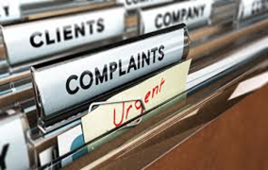
Organisations that actively encourage customers to complain can increase customer retention by 10%.
WHY?
Actually responding to a complaint can boost chances of retaining that customer by up to 75% and if the customer is very satisfied, there is a 95% chance they will return.
(Source – Estoban Kolsky)
https://www.youtube.com/watch?v=NsErCieYmxE
https://www.skillcast.com/blog/tips-handling-customer-complaints

Slide 11
Example of how to handle guest complaints:
1. Listen with concern and empathy.
2. Isolate the guest if possible, so that other guests won't overhear.
3. Stay calm. Don't argue with the guest.
4. Be aware of the guest's self-esteem. Show a personal interest in the problem, try to use the guest name frequently.
5. Give the guest your undivided attention. Concentrate on the problem, no on placing blame. Do NOT Insult the guest.
6. Take notes. Writing down the key facts saves time if someone else must get involved. Also, Guests tends to slow down when they see the front desk agent trying to write down the issue.
7. Tell the guest what can be the best done. Offer choices. Don't promise the impossible, and don't exceed your authority.
8. Set an approximate time for completion of corrective actions. Be specific, but do not underestimate the amount of time it will take to resolve the problem.
9. Monitor the progress of the corrective action.
10.Follow up. Even if the complaint was resolved by someone else, Contact the guest to ensure that the problem was resolved satisfactory (using appropriate communication method).

Slide 12
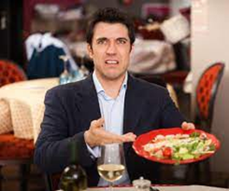
Types of complainers/awkward customers.
The aggressive complainer.
The passive complainer.
The constructive (or professional) complainer.
The rude/obnoxious customer.
The over-demanding customer.
The angry customer.

Slide 13
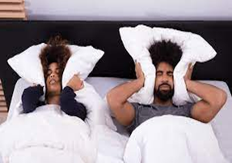
Also consider…
The seething but silent individual.
The “nothing’s ever going to be right for this person” customer.
The constant critic.
The non-stop talker.
The weirdo.
The indecisive customer.
The drunk.
The argumentative complainer.
https://www.youtube.com/watch?v=gKRNRz6VK_k

Slide 14
Dealing With Complaints - Summary
Leaflet: What can staff do to EXCEED customer requirements when communicating during customer complaints?

Slide 15
Leaflet Section 3: When a customer has specific needs
For your leaflet, add a section that explains the considerations that staff should make when communicating with 3 specific customer types.
Examples of specific needs?
Physical?
Mental?
Hidden?
Communication to be used when dealing with specific customers?
Consider verbal/non-verbal, listening, written, electronic communication and how these need to be ADAPTED to meet different needs.

Slide 16
Specific Needs - Summary
Leaflet: What can staff do to EXCEED customer requirements when communicating with customers who have specific needs?

