Slide 1
Godalming College History Department AS History
Welcome to Godalming College and to the History Department
Jonathan Sparshott

Slide 2
Introduction to the Course
In your AS year at college you will study two units, one British and one non-British
Each unit is worth 50% of your overall AS level
AS History
Unit 1; England 1485-1558: the Early Tudors | Unit 2; Democracy and Dictatorships in Germany 1919-1963

Slide 3
Introduction to the Course
All AS students will take the Unit 1 and Unit 2 AS exams at the end of their first year.
Your time will be divided equally between the Unit 1 and Unit 2 courses – you will have three 45 minute lessons on each side of the course per week
This means a total of 4 hours 30 minutes of History each week
You will be taught each unit by a different teacher

Slide 4
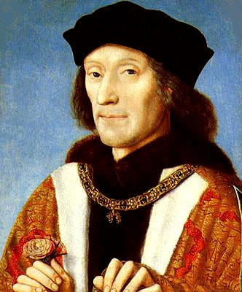
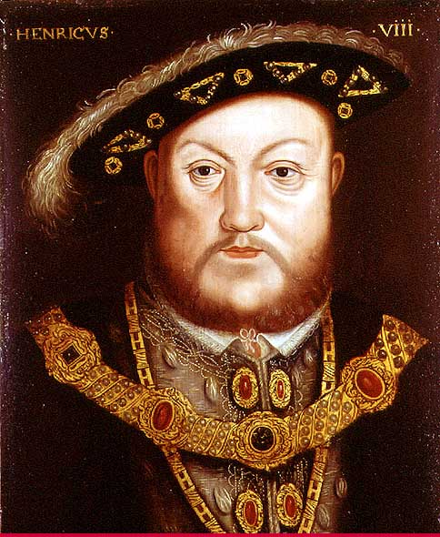
Introduction to the Course
Unit 1; England 1485-1558: The Early Tudors
The Unit 1 topic examines the changing nature and impact of one the most important ruling dynasties in English History – the Early Tudors
It combines detailed own knowledge of the period with the ability to analyse and use primary sources
In the Unit 1 exam you will answer questions from two sections
SECTION A: a 10 and a 20 mark question analysing a selection of three sources
SECTION B: one 20 mark own knowledge essay asking you to evaluate a key historical question within the period
Henry VII
1485-1509
Unit 1= 50 marks, 1 hour 30 minutes exam
Henry VIII
1509-1547

Slide 5
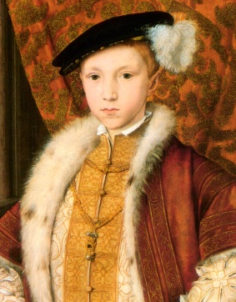
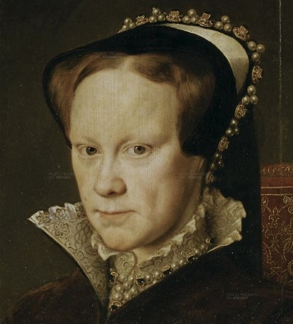
Introduction to the Course
Unit 1; England 1485-1558: The Early Tudors
The unit 1 Course will cover the following key areas:
The Government of Henry VII and the threats to his rule
Henry VIII’s Foreign Policy
Henry VIII and Wolsey
The reign of Henry VIII after 1529
Edward VI
1547-1553
Mary I
1553-1558

Slide 6
Introduction to the Course
Unit 1; England 1485-1558: The Early Tudors
The stability of the monarchy 1547-1558
Religious changes 1547-1558
Rebellion and Unrest 1547-1558
Edward VI
1547-1553
The above thee points make up what is called the ‘Enquiry Topic’. Here you will focus on the period 1547-1558 , known as the ‘Mid-Tudor Crisis’. It is also from this period that you will be given sources in the exam
Mary I
1553-1558

Slide 7
Today’s Aims:
-Investigate Henry VII’s claim to the throne
-Assess the strength of this claim
In pairs and using the work you were given during induction agree an answer to the following questions (make sure you know the name of the person you are working with):
Where did Henry VII’s claim to the throne come from?
How strong was this claim? (think carefully and make sure you explain you answer fully)
Henry VII
1485-1509

Slide 8
Today’s Aims:
-Investigate Henry VII’s claim to the throne
-Assess the strength of this claim
Join briefly with another pair to for a group of four and consider the following question:
What is the potential short-term and long-term significance Henry VII’s claim to the throne?
Henry VII
1485-1509
Short Term | Long Term

Slide 9
Homework
Watch the documentary on estream ‘War Walks – Bosworth’ which examines the final battle of the Wars of the Roses and the beginning of the Tudor Dynasty
As you watch this (28 minutes) record answers on p.3-5 of your workbook
Henry VII
1485-1509
DUE:

Slide 10
Reminders for next lesson
Organisation – make sure you have a folder ready to keep your notes as ordered as possible
Homework – If you are going to use a diary you will need one for the start of next week
On line resources – if you haven’t already, make sure you have logged on to Godalming Online and have located the correct History page – ‘AS History D&D U1’ – Resources will be uploaded throughout the term and you will need to stay up-to-date. Also make sure you can locate estream.
Emails – get in the habit of checking your college email account regularly. It will be the main way that teachers contact you

