Slide 1
Jonathan Sparshott
Welcome to Godalming College and the History and Politics Department

Slide 2
Introduction to the AS Course
In your AS Level you will study two units, one British and one non-British
Each is worth 50% of the overall AS Level
AS Level
Unit 1; England 1485-1558: the Early Tudors | Unit 2; Democracy and Dictatorships in Germany 1919-1963

Slide 3
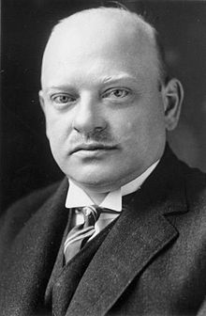
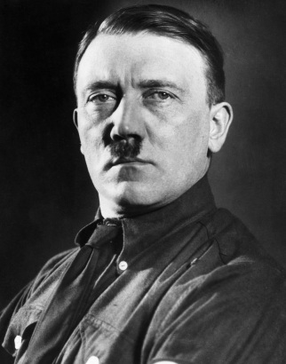
Introduction to the Course
Unit 2; Democracy and Dictatorships in Germany 1919-1963
The Unit 2 topic examines Germany between 1919 and 1963 looking at the turbulent changes it experienced following the First World War, the rise and rule of the Nazis, and how Germany emerged from the Second World War only to be divided and at the heart of the Cold War
It combines detailed own knowledge of the period with the ability to analyse and use historical interpretations
In the Unit 1 exam you will answer questions from two sections
SECTION A: one 30 mark own knowledge essay from a choice of two
SECTION B: a 20 mark answer based on a historical interpretation
Gustav Stresemann
Unit 1= 50 marks, 1 hour 30 minutes exam
Adolf Hitler

Slide 4
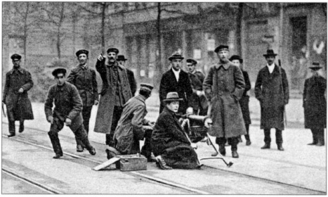
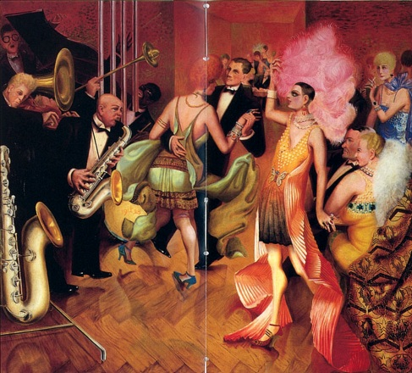
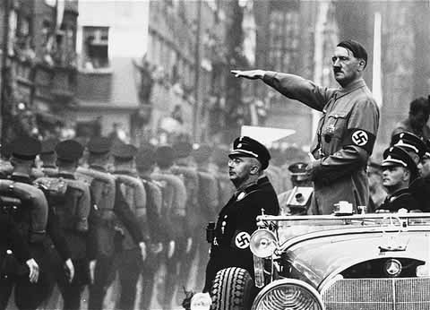
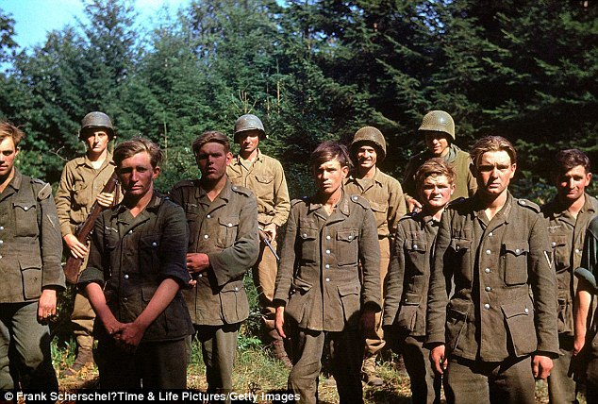
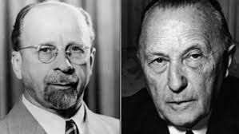
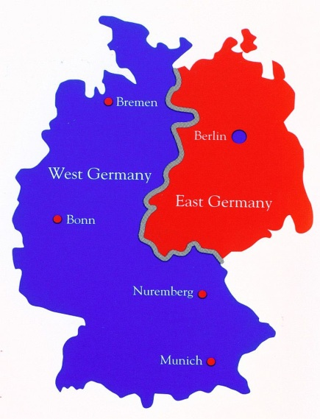
THE SYLLABUS IS IN 4 MAIN PARTS: 1. The establishment and development of the Weimar Republic 1919–33 2. The establishment of the Nazi Dictatorship and its domestic policies 1933–9 3. The impact of war and defeat on Germany 1939–49 4. Divided Germany: The Federal Republic and the DDR 1949–63

Slide 5
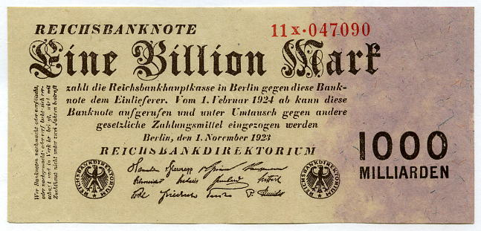
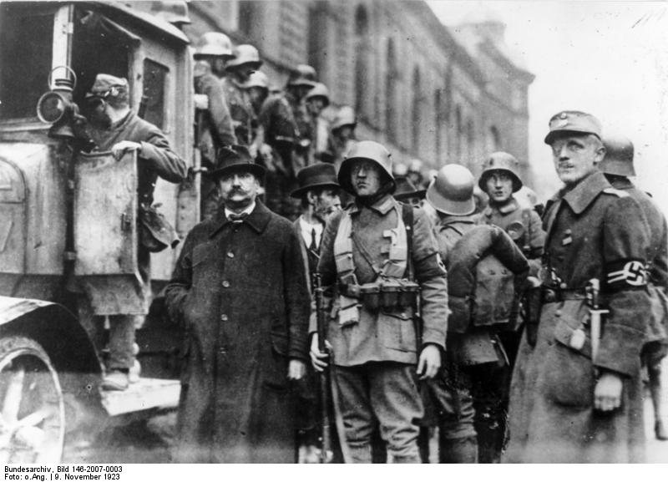
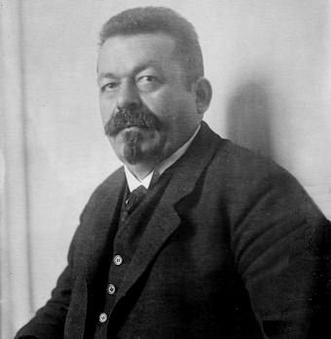
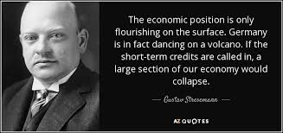
HOW DID THE WEIMAR REPUBLIC SURVIVE THE MANY CHALLENGES TO IT UP TO 1929?

Slide 6
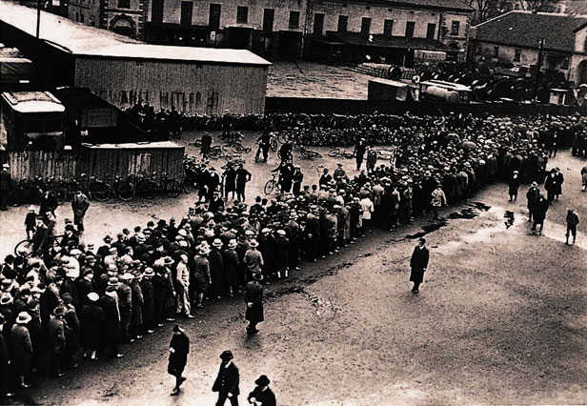
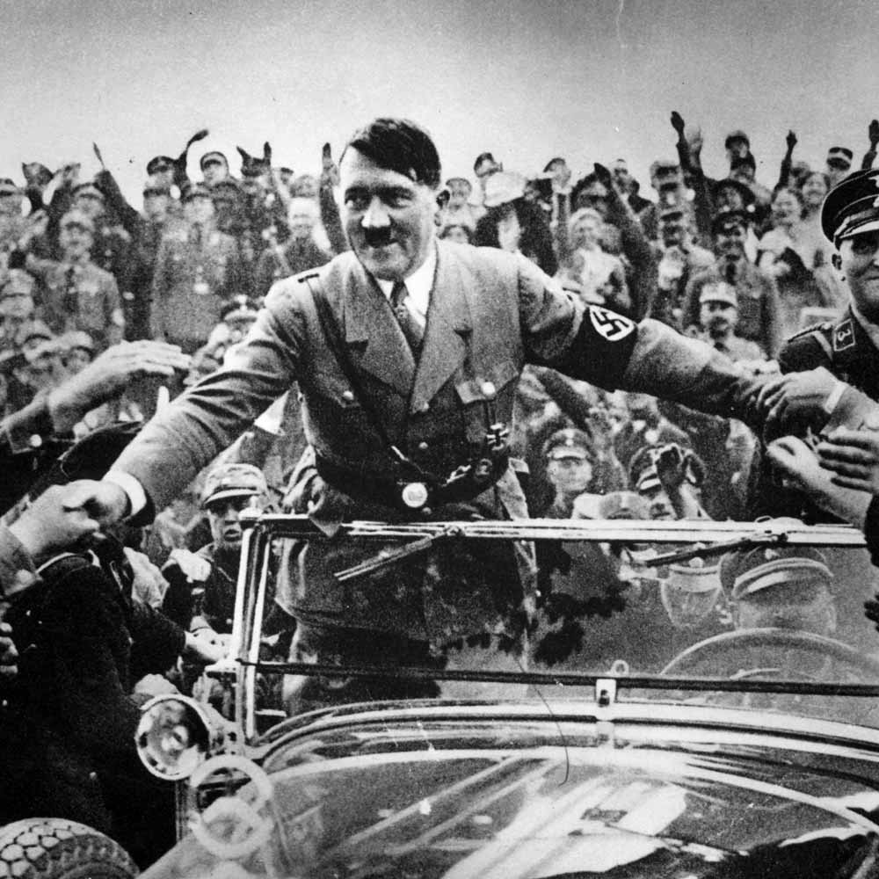
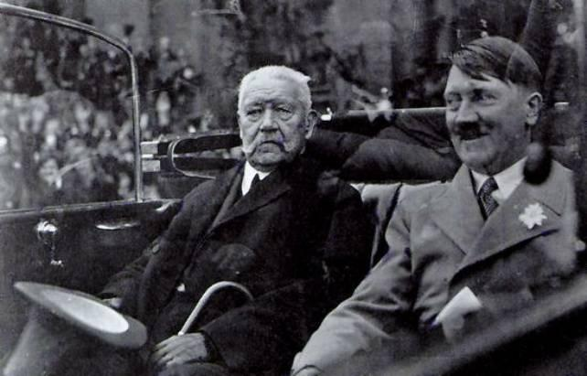
WHY NEVERTHELESS WAS HITLER ABLE TO COME TO POWER IN 1933?

Slide 7
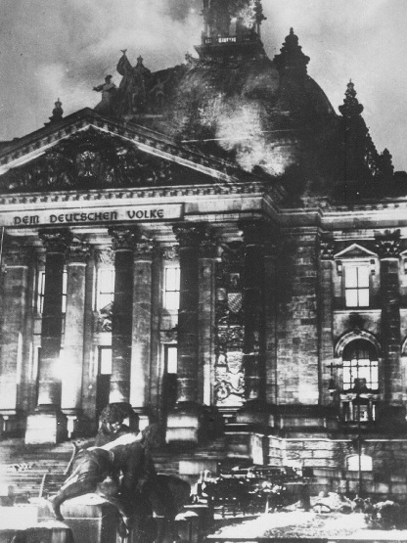
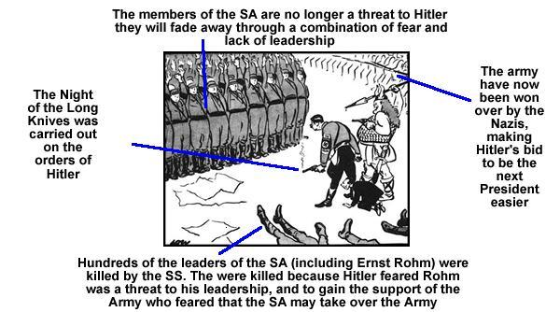
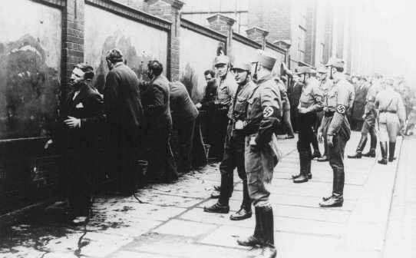
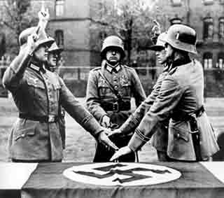
HOW DID HITLER MANAGE TO CREATE A NAZI DICTATORSHIP SO QUICKLY?

Slide 8
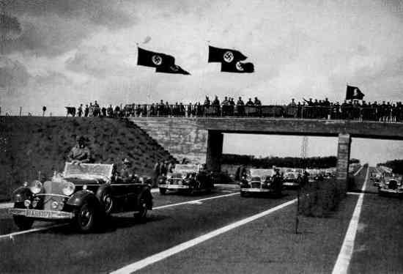
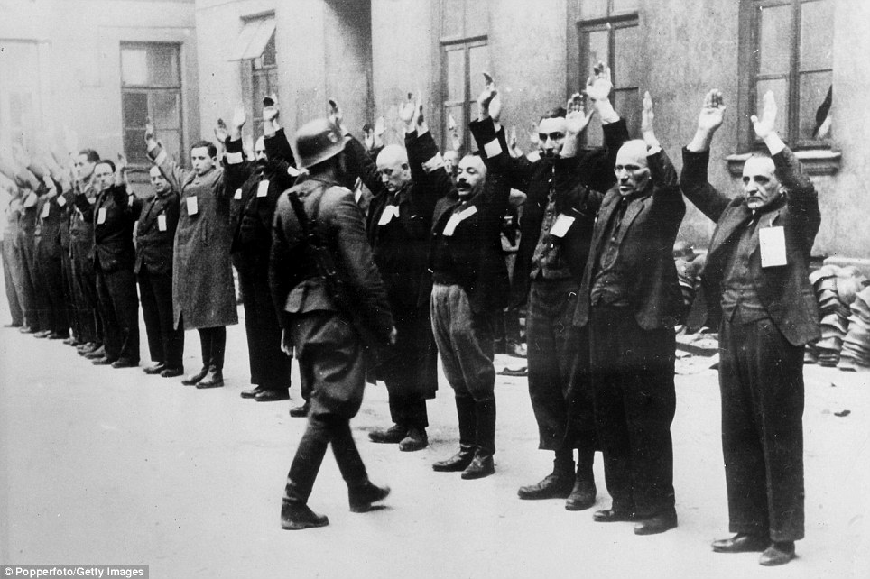
HOW DID THE NAZIS CONTROL GERMANY 1933-9?

Slide 9
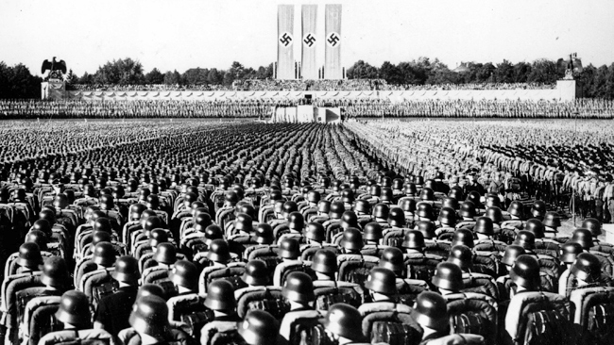
HOW SUCCESSFUL WAS NAZI ECONOMIC POLICY 1933-9?

Slide 10
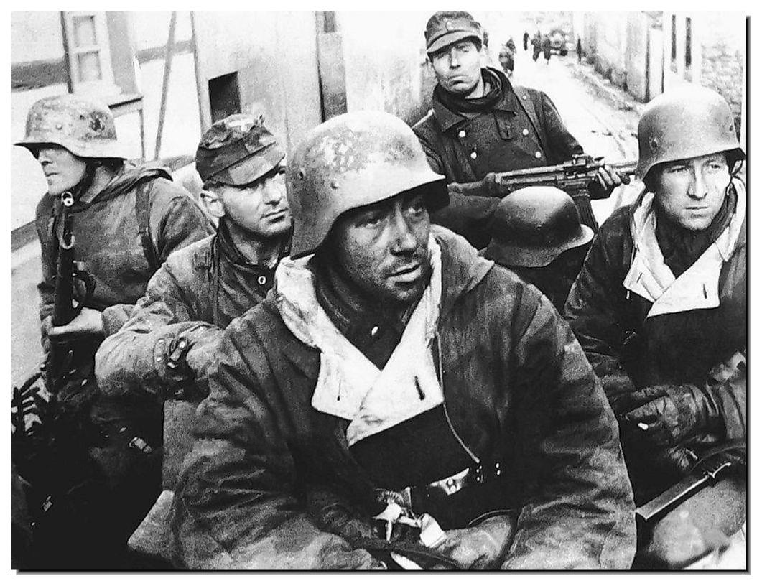
HOW DID THE NAZIS KEEP GERMANY FIGHTING TO THE END IN WW2?

Slide 11
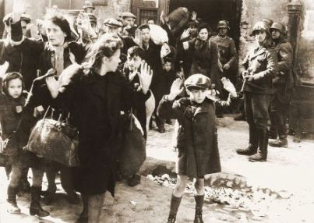
WHY DID THE HOLOCAUST HAPPEN?

Slide 12
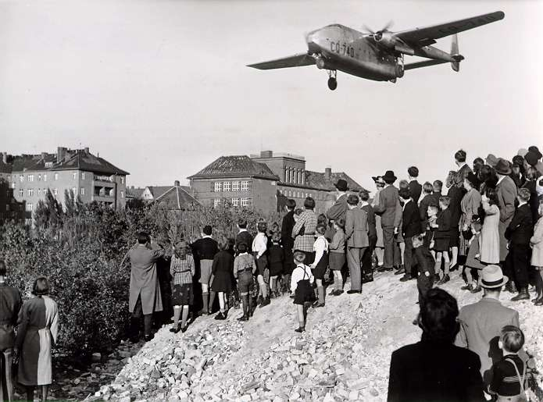
WHY WAS GERMANY DIVIDED IN 1949?

Slide 13
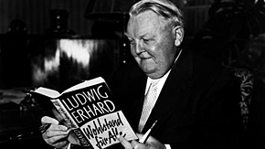
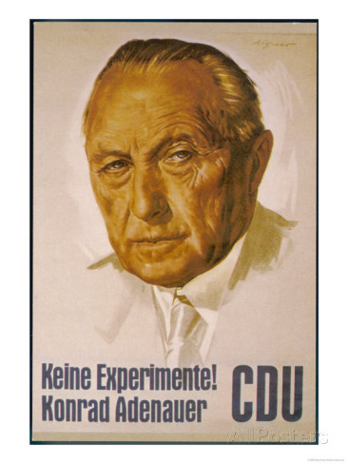
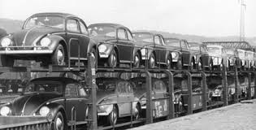
WHY WAS WEST GERMANY SO PROSPEROUS & SUCCESSFUL 1949-63?

Slide 14
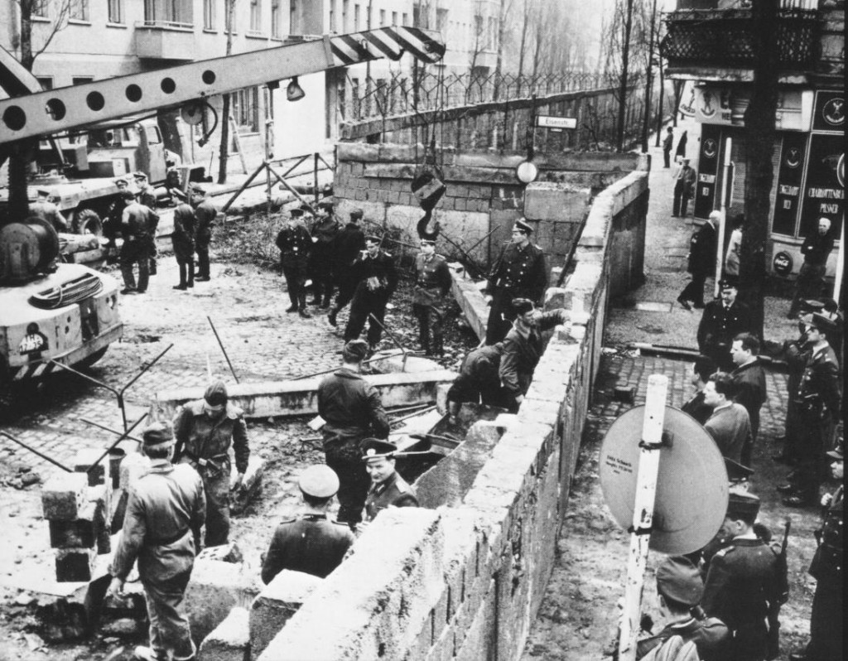
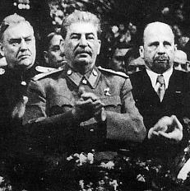
WHY WAS EAST GERMANY SUCH AN ECONOMIC FAILURE THAT THEY HAD TO BUILD THE BERLIN WALL?

Slide 15
ASSESSMENT
AS LEVEL EXAM 1 HOUR 30 MINUTES
SECTION A: 1 OF 2 ESSAY QUESTIONS (30 MARKS)
SECTION B: 1 COMPULSORY INTERPRETATION QUESTION (20 MARKS)

Slide 16
Todays Lesson
AIM: Review Induction work and introduce basic terms/geography
Take out the induction work you were given during enrolment and turn to the section on Germany
With the person next to you spend 5 minutes checking your answers to the map-based questions (make sure you know the name of the person you are working with)
Gustav Stresemann
HOMEWORK: Complete the summary activity on page 3 of your workbook
Adolf Hitler

