Slide 1
Grading Criteria
Unit 10 Learning Aim A
PASS 1 | MERIT 1 | DISTINCTION 1
Explain the narrative codes and conventions of a fictional genre film. | Compare the narrative and stylistic codes and conventions of fictional films of the same genre | Analyse the narrative and stylistic codes and conventions of different film genres using detailed examples to illustrate points.
PASS 2
Explain the stylistic codes and conventions of a fictional genre film with reference to its target audience.
Assignment Sheet

Slide 2
GENRE
UNIT 10 – FILM FICTION

Slide 3
DEFINITION
Genre is a way in which media texts are:
Organized
Categorised
Consumed

Slide 4
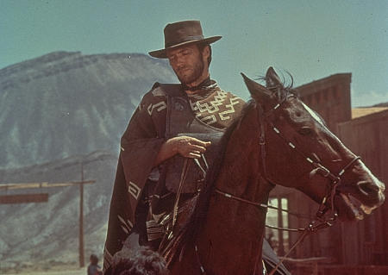

Slide 5
Western/Cowboy

Slide 6
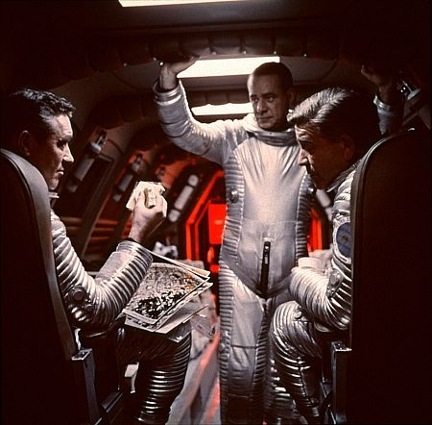

Slide 7
Sci-Fi

Slide 8
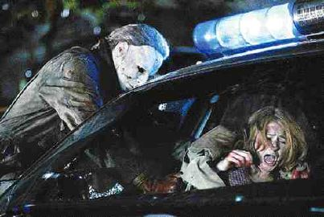

Slide 9
Horror

Slide 10
But how can we tell that these films are of a certain genre?

Slide 11
For each genre category there are specific visual and narrative expectations called codes and conventions.
CODES: (what you expect to see)
CONVENTIONS: (what you expect to happen)

Slide 12
CODES: (what you expect to see)
The opening credits (typography, title language)
Mise-en-scene (setting, lighting, costume, hair, make-up, props, posture, gesture and facial expressions)
Iconography (images/symbols which become associated/synonymous with a particular genre)

Slide 13
CONVENTIONS: (what you expect to happen)
Character types
Particular stars
A certain type of plot (conflict and resolution)
A particular type of resolution
Soundtrack (music, speech and sound effects)
A particular set of messages and values

Slide 14
Genre Tasks:
Identify codes and conventions of chosen genre
Find a scene and see if it matches
Find a scene which challenges codes and conventions

Slide 15
Task 1
Complete a codes and conventions ‘table’ for a genre of your choosing
Codes | Example
Opening credits (typography, title language)
Setting
Lighting
Costume
Props
Iconography
Conventions | Example
Character types
Particular stars
Plot
Resolution
Soundtrack
A particular message
Download from GoL

Slide 16
Genre Tasks:
Identify codes and conventions of chosen genre
Find a scene and see if it matches
Find a scene which ‘challenges’ codes and conventions

Slide 17
Genre and Audience
It has been said that audiences like genre, because of its reassurance and familiarity. Genre films have patterns and repetition.
Genre and Producers
Producers are said to like the concept of genre because they can exploit a winning formula and minimise risk taking. Producers/filmmakers can budget and plan to make and promote new products.

Slide 18
Sub-Genre
Genres evolve over time and are in a constant state of change.
Sub-genre is a sub-category within a particular genre
Action
Comedy

Slide 19
Hybrid
A fusion of more than one genre
A film that uses codes and conventions and contains the visual iconography of more than one genre
Romance
Comedy
Try and list as many sub-genres or hybrids as you can

Slide 20
Unit 10 LA A
Your comparative film analysis should include an analysis of the narrative and stylistic codes and conventions of fictional films from more than one genre.
Select two different film extracts from two different genres and use detailed examples of extracts from these films to illustrate your analysis and support your discussion.
Your analysis must draw conclusions relating to similarities and differences between your chosen extracts with reference to:
Formats and purposes
Generic conventions and characteristics
Narrative structures, including application of narrative models and theory and use of characterisation
Audience expectations and interpretation

Slide 21
Grading Criteria
Unit 10 Learning Aim A
PASS 1 | MERIT 1 | DISTINCTION 1
Explain the narrative codes and conventions of a fictional genre film. | Compare the narrative and stylistic codes and conventions of fictional films of the same genre | Analyse the narrative and stylistic codes and conventions of different film genres using detailed examples to illustrate points.
PASS 2
Explain the stylistic codes and conventions of a fictional genre film with reference to its target audience.
Assignment Sheet

Slide 22
What film extracts will you choose?
They must be:
2 different films
2 different types of extracts
2 different, easily recognisable genres
Easily identifiable codes and conventions

