Slide 1
AQA
    A Level
      Computer Science
      Paper 2
Function application
  Unit 12
  OOP and functional programming

Slide 2
Objectives
Understand what is meant by partial
function application
Know that a function takes only one argument which may itself be a function
Define and use higher-order functions, including map, filter and fold

Slide 3
First class objects
Review question from the previous lesson:
  What is a first-class object?

Slide 4
First-class objects
First-class objects (or values) are objects which may:
appear in expressions
be assigned to a variable
be assigned as arguments
be returned in function calls
So functions are first-class objects themselves

Slide 5
Function application
Consider a function
add3Integers x y z = x + y + z
The process of giving particular inputs to a function is called function application
  Thus, add3integers 2 4 5 represents the application of the function add3integers to the arguments 2, 4 and 5
  Although we would say that add3integers takes three arguments, in fact a function only ever takes one argument
  How does this work?

Slide 6
Function application
This function adds three numbers:
add3Integers x y z = x + y + z
Let’s see what actually happens. First, the type declaration would normally be written:
add3Integers :: integer →
integer → integer → integer
More accurately, it can be viewed as:
add3Integers :: integer →
(integer → (integer → integer))

Slide 7
One at a time
The type declaration could also be written as:
add3Integers :: integer → (integer →
(integer → integer))
What happens when you write:
add3Integers 2 4 5?

Slide 8
Working through
add3Integers :: integer → (integer →
(integer → integer))
  What happens when you write add3Integers 2 4 5 ?
  The function add3Integers is applied to the first argument 2, creating a function (shown in the outer blue parentheses above) that will add 2 to its arguments , which are 4 and 5
  Then the new function will be applied to its parameters to give a function that adds 6 onto its argument
  Finally, the new function will be applied to its only parameter 5 to give the output of 11

Slide 9
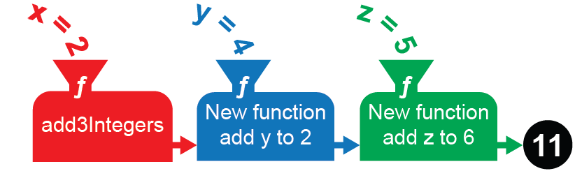
New functions
add3Integers :: integer → (integer → (integer → integer)
After applying the function to the first argument, 2, the output is a new function (shown in blue) that is applied to the second argument, 4
This produces a new function (shown in green) that is applied to the third argument, 5, adding it to 6 and returning the result, 11

Slide 10
Partial function application
You can use a cunning trick to exploit this idea
Start with an add function that takes two integers and returns their sum, like this:
add :: Integer → Integer → Integer
add x y = x + y
Remember that if we type add 6 4 Haskell will create a new function and do this in two stages,
(add 6) 4

Slide 11
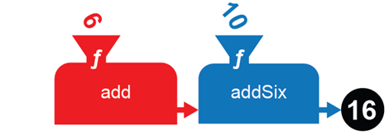
Partial function application
We can use this to simplify functions by fixing or binding an argument. In this case we can define a function addSix :: Integer -> Integer
addSix = add 6
  Then addSix 10 is the same as add 6 10
  This can be useful if we only want to pass partial arguments

Slide 12
An example
Here’s a good use for partial function application. We’ll define function times x y z = x * y * z
To find the volume of various designs for swimming pools with a fixed depth of 2.6m, define
poolVol l w = times 2.6 l w
  Then we can just use the length and width arguments, eg
poolVol 3 5

Slide 13

Worksheet 4
Do Task 1 on the worksheet

Slide 14
Higher-order functions
A function is higher-order if it takes a function as an argument or returns a function as a result, or does both.

Slide 15
The map function
Map is a higher-order function that takes a list and the function to be applied to the elements in the list as inputs, and returns a list made by applying the function to each element of the old list.
A list is a collection of elements which can be written in square brackets, e.g. [3, 7, 5, 9]

Slide 16
Applying map to a list
The function max x y is a built-in library function which returns the maximum of two numbers:
e.g. max 3 2 will return 3
We can partially apply max to get the maximum of a value and its argument. We then map that function, which has no name, to a list:
map (max 3)[1,2,3,4,5]
getting the result
[3, 3, 3, 4, 5]

Slide 17
Question
What would be returned by the following function?
Map (+5) [1,2,6]

Slide 18
Answer
What would be returned by the following function?
*Main> map (+5) [1,2,6]
[6,7,11]

Slide 19
Selecting with filter
filter is another higher-order function which takes a predicate (to define a Boolean condition) and a list
It returns the elements within the list that satisfy the Boolean condition
e.g. filter (>6)[2,5,6,8,9]
will return:
[8,9]

Slide 20
Selecting with filter
Question: what would these return?
Filter (== 5)[2,7,6,1,9]
Filter (== 5)[2,5,7,2,5]

Slide 21
Answer
*Main> filter (== 5)[2,7,6,1,9]
[]
*Main> filter (== 5)[2,5,7,2,5]
[5,5]

Slide 22
Home made filters
You can write your own predicate to be used
in the filter:
e.g. isEven n = n `mod` 2 == 0
(Note: You can write the built-in function mod as
mod n 2 but Haskell allows the alternative syntax shown above
Use the backward quote mark (`) to the left of the 1 key on the keyboard to surround the mod operator )

Slide 23
Worksheet 4
Do the questions in Task 2 of the worksheet

Slide 24
Fold (reduce) function
A fold (or reduce) function reduces a list to a single value, using recursion. For example, to sum all the elements of a list starting from the left, we write:
foldl (+) 0 [2, 3, 4, 5]
This will return the value 14. The initial value 0 is combined with the first element of the list, which is then recursively combined with the first element of the remaining list, and so on
  In effect, this is (((0 + 2) + 3) + 4) + 5

Slide 25
Two ways to fold: left, right…
foldl stands for fold left, i.e. the recursion starts with the leftmost value. foldr or fold right starts with the rightmost value. With operations like division, the order matters.
What will each of these return?
foldr (/) 100 [2,5]
foldl (/) 100 [2,5]

Slide 26
Two ways to fold Answer
What will each of these return?
foldr (/) 100 [2,5] … is 2/(5/100) = 40.0
foldl (/) 100 [2,5] … is (100/2)/5 = 10.0

Slide 27
Worksheet 4
Do the questions in Task 3 of the worksheet

Slide 28
Summary
Functions deal with one parameter at a time
A function taking several parameters actually takes only one parameter and returns a partially applied function each time until a value, rather than a function, is the result
E.g. add: integer-> (integer -> integer)
Higher-order functions take functions as input, output or both
Examples are: map, filter and fold (reduce)

