Slide 1
3.6 Organisms respond to changes in their internal and external environments

Slide 2
Specification
A stimulus is a change in the internal or external environment.
A receptor detects a stimulus.
A coordinator formulates a suitable response to a stimulus. An effector produces a response.
Receptors are specific to one type of stimulus.
Nerve cells pass electrical impulses along their length. A nerve impulse is specific to a target cell only because it releases a chemical messenger directly onto it, producing a response that is usually rapid, short-lived and localised.
In contrast, mammalian hormones stimulate their target cells via the blood system. They are specific to the tertiary structure of receptors on their target cells and produce responses that are usually slow, long-lasting and widespread.
Plants control their response using hormone-like growth substances.

Slide 3
3.6.1 Stimuli, both internal and external, are detected and lead to a response
Organisms increase their chance of survival by responding to changes in their environment.
In flowering plants, specific growth factors move from growing regions to other tissues, where they regulate growth in response to directional stimuli. The effect of different concentrations of indoleacetic acid (IAA) on cell elongation in the roots and shoots of flowering plants as an explanation of gravitropism and phototropism in flowering plants.
Taxes and kineses as simple responses that can maintain a mobile organism in a favourable environment.
The protective effect of a simple reflex, exemplified by a three neurone simple reflex. Details of spinal cord and dorsal and ventral roots are not required.

Slide 4
Organisms increase their chance of survival by responding to changes in their environment.
For the nervous system to carry out its function effectively it is dependent upon a continuous input of information from inside the body and from the environment. This input is detected by sensory receptors and relayed to effectors. That is, responses to all stimuli involve the reception of information and its transfer from the receptor to an effector via the nervous system.

Slide 5
Organisms increase their chance of survival by responding to changes in their environment.
Stimulus – a detectable change in the internal or external environment of an organism that leads to a response in the organism.

Slide 6
What is needed for control and co-ordination?
In order to respond to stimuli an organism needs:
A Receptor. Detects stimuli. Receptors are specific to one type of stimulus.
Receptors detect information from inside the body and from the surroundings.
A co-ordinator. Formulates a suitable response to a stimulus This could be at the molecular level, the brain or spinal cord (CNS), or a simple collection of cells.
An effector. Produces a response. This could be a muscle or a gland.

Slide 7
Communication methods in organisms
Hormones – relatively slow process, found in both plants and animals
Nervous system – more rapid means of communication found in animals

Slide 8
The sequence of events can be summarised as:
Stimulus receptor coordinator effector
response

Slide 9
Taxes
A taxis is a simple response whose direction is determined by the direction of the stimulus
Directional response to stimulus ie – moves toward (positive taxis) or away (negative taxis) from the stimulus

Slide 10
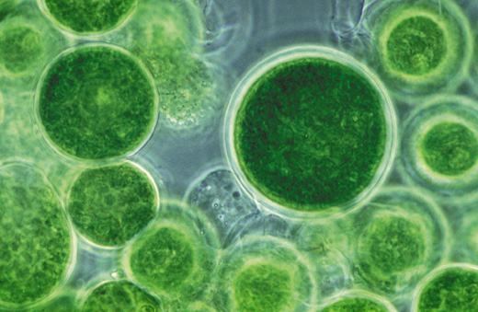
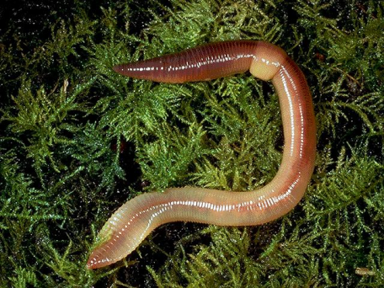
Examples of taxes
Single celled algae – As algae are photosynthetic they move towards light (positive phototaxis). This increases their chance of survival as they require light to manufacture their own food.
Earthworms – Move away from light (negative phototaxis). Helps them survive as this takes them into the soil, helping them conserve water, find food and avoid predators.

Slide 11
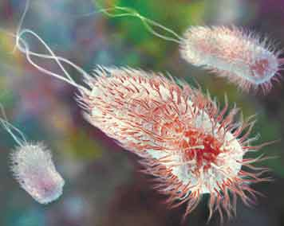
Examples of taxes
Some Bacteria –Move towards areas where glucose (there food) is more concentrated (positive chemotaxis) .

Slide 12
Kineses
A response when an organism does not move towards or away from a stimulus. Instead it changes the speed at which it moves and the rate at which it changes direction.
Non directional response to stimulus.
The more unfavourable the conditions the more rapidly the organism moves and changes direction more often.
This response enables the organism to return to favourable conditions more rapidly.

Slide 13
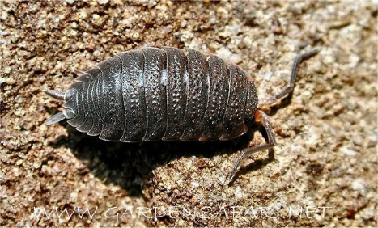
Examples of kinesis
Woodlice – lose water in dry conditions.
When in dry area – move more rapidly + change direction more often
When in damp area – move less rapidly + change direction less often.
This increases chance of organism moving into or staying in favourable conditions, preventing them drying out and increasing their chance of survival

Slide 14
Kineses vs Taxes
Bozeman https://www.youtube.com/watch?v=jSKkecFzD50
Taxes - enables a faster direct response to the stimulus but is only possible if the stimulus is directional
Kineses – A slower random response but allows a response to a stimulus that isn’t always directional eg temperature and humidity

Slide 15
Tropisms
A tropism is the growth of a plant in response to a directional stimulus.
The plant grows towards or away from the stimulus.
List some tropisms in plants.
Light - phototropic
Gravity - gravitropic
Water – hydrotropic
https://www.youtube.com/watch?v=pCFstSMvAMI

Slide 16
Plant growth factors
Exert their influence by affecting growth
Some plant growth factors affect the tissues that release them rather than acting on a distant target organ.
Indoleacetic acid (IAA) is a plant growth factor belonging to a group of sunstances called Auxins. IAA controls plant cell elongation.

Slide 17
Plant growth factors
https://www.youtube.com/watch?v=HR9KHW-e0pY

Slide 18
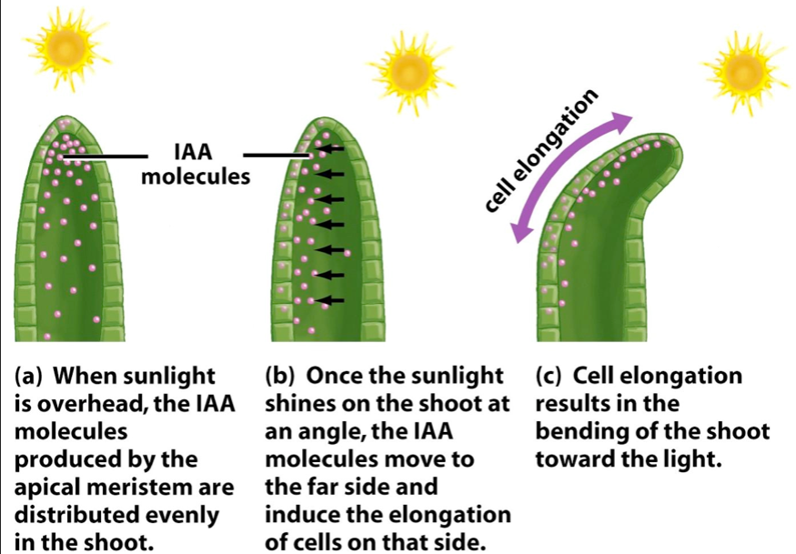
Phototropism in flowering plants
Cells in the tip of the shoot produce IAA, which is then transported down the shoot
The IAA is initially transported evenly throughout all regions as it begins to move down the shoot
Light causes the movement of IAA from the light side to the shaded side of the shoot

Slide 19
Phototropism in flowering plants
A greater concentration of IAA builds up on the shaded side of the shoot than on the light side
As IAA causes elongation of shoot cells and there is a greater concentration of IAA on the shades side of the shoot, the cells on this side elongate more
The shaded side of the shoot elongates faster than the light side, causing the shoot to bend towards the light.

Slide 20
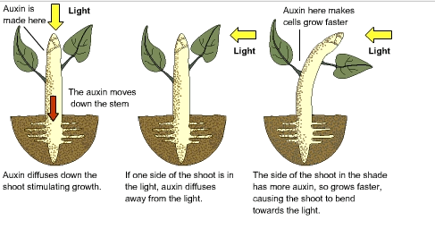
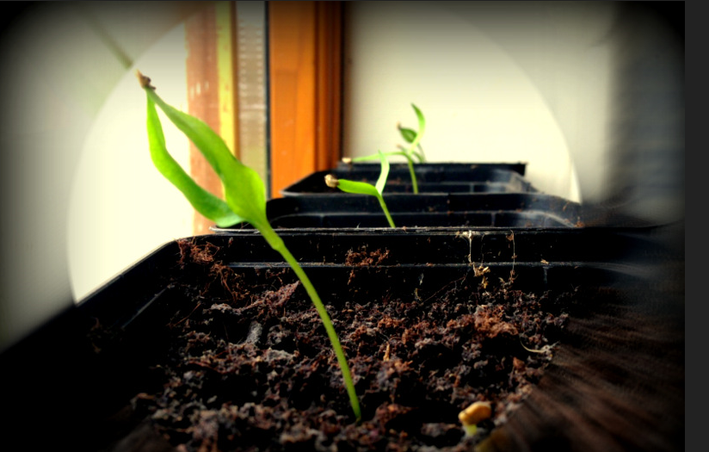

Slide 21
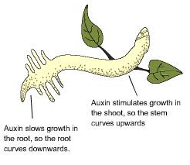
How would IAA affect roots?
High concentrations of IAA inhibits cell elongation in roots.
Therefore cell elongation is greater on the light side than the dark side so roots bend away from light.
Roots are negatively phototropic

Slide 22
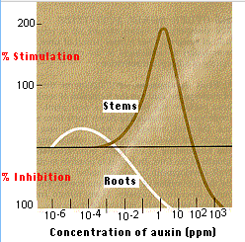

Slide 23
Gravitropism
Gravity leads to a change in the distribution of IAA carrier proteins that export IAA from cells

Slide 24
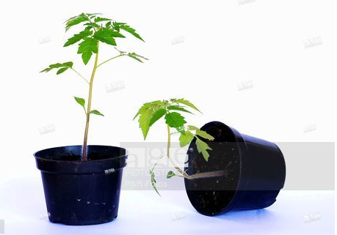
Gravitropism in flowering plants – roots https://www.youtube.com/watch?v=pi3P3uJOsN4
Cells in the tip of the root produce IAA, which is then transported along the root
The IAA is initially transported to all sides of the root
Gravity influences the movement of IAA from the upper to the lower side if the root
A greater concentration of IAA builds up on the lower side of the root than the upper side

Slide 25
Gravitropism in flowering plants - roots
As IAA inhibits the elongation of root cells and there is a greater concentration of IAA on the lower side, these cells elongate less than those on the upper side
This causes the root to bend downwards towards the force of gravity.

Slide 26
Gravitropism in flowering plants - shoots
The greater concentration of IAA on the lower side increases cell elongation so shoots grow upwards away from gravity

Slide 27
Role of IAA in elongation growth
IAA is produces in root and shoot tips. It is then transported in one direction away from the tip. IAA increases a plant cell’s plasticity (ability to stretch) of their cell walls. The response only occurs in young cell walls where cells are able to elongate. As the cells mature they develop greater rigidity so older parts of the root or shoot will not be able to respond.
The way in which IAA increases the plasticity of cells is called the acid growth hypothesis. Hydrogen ions are actively transported from the cytoplasm into the spaces in cell walls causing the cell walls to become more plastic allowing the cell to elongate by expansion.

Slide 28
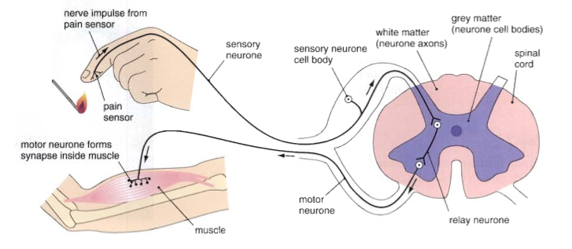
A reflex Arc
The simple reflex arc as the basis for protective, involuntary actions. It is the simplest type of nervous response to a stimulus

Slide 29
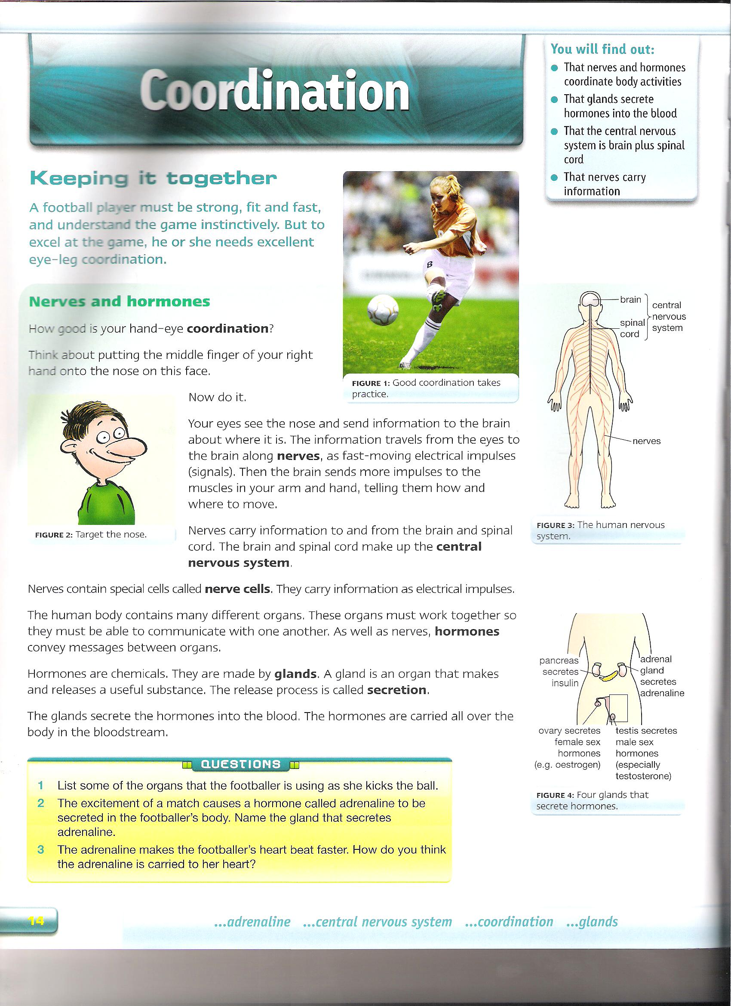
Nervous Organisation

Slide 30
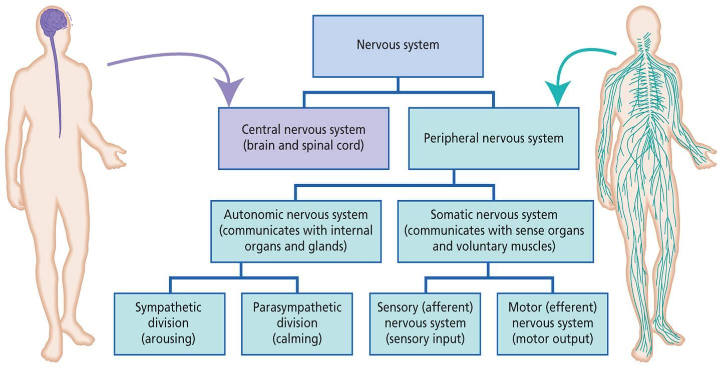
Crash course introduction to the nervous system
https://www.youtube.com/watch?v=x4PPZCLnVkA

Slide 31
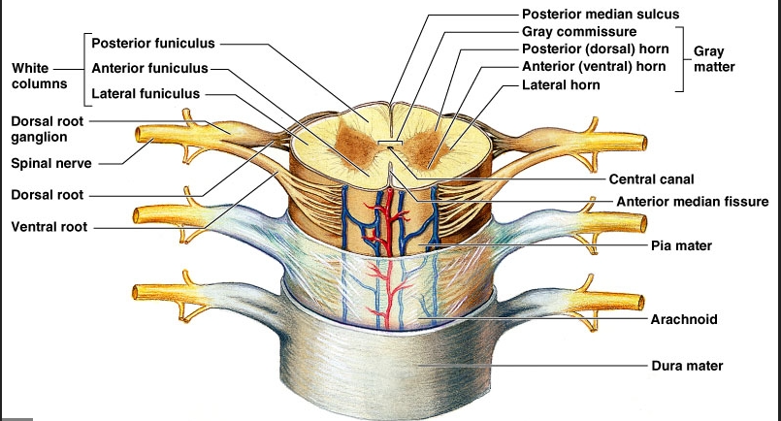
The Spinal cord
A column of nervous tissue that runs along the back and lies inside the vertebral column for protection. Emerging at intervals along the spinal cord are pairs of nerves.

Slide 32
Function of the Spinal cord
To relay impulses in and out of any particular point along the cord, and to relay impulses up and down the body, including to and from the brain.

Slide 33
Why are reflex arcs important?
BFY 338
An involuntary response that is very rapid.
It is not under the control of the brain.
It is protective and prevents damage to the body.

Slide 34
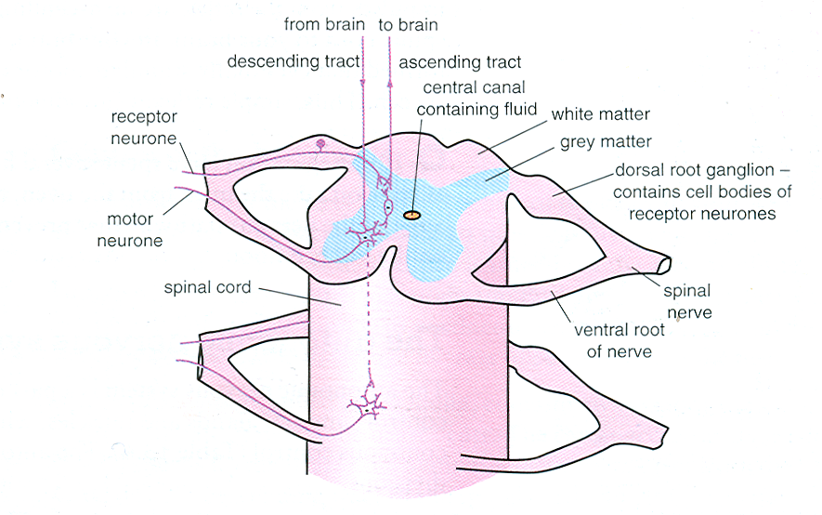
Label diagram in booklet

Slide 35
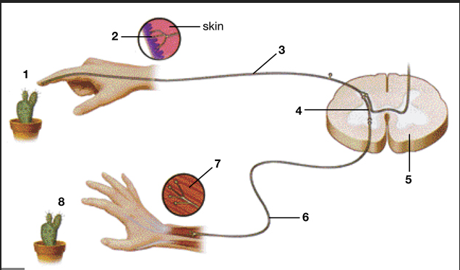
Stimulus
Receptor
Sensory neurone
Intermediate neurone
Spinal cord
Motor neurone
Effector
response

Slide 36
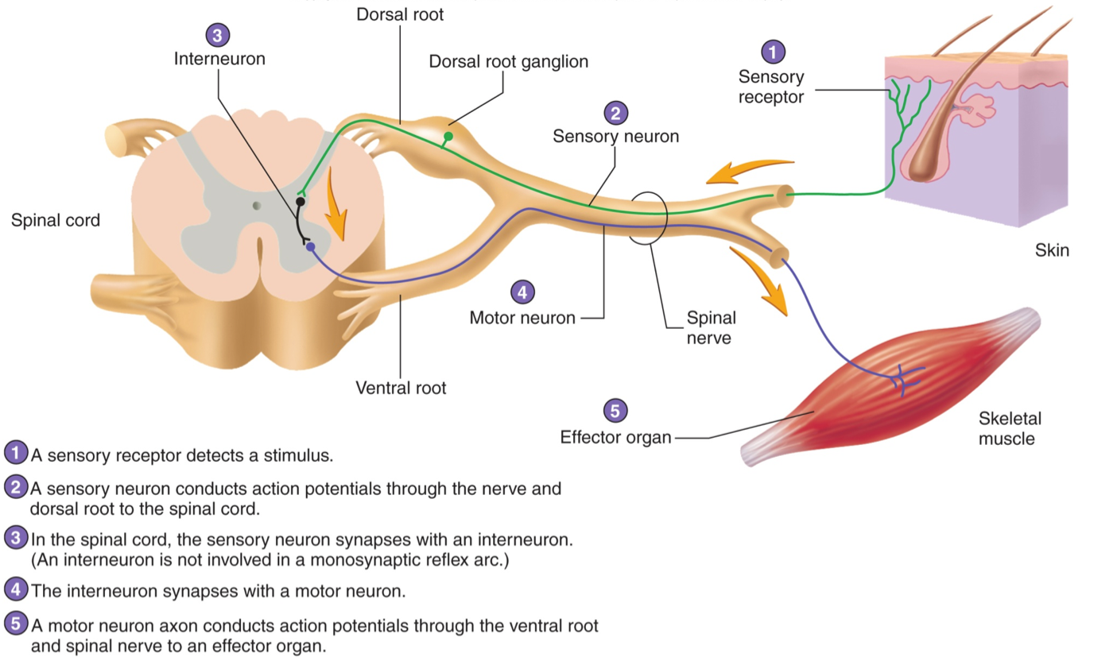

Slide 37
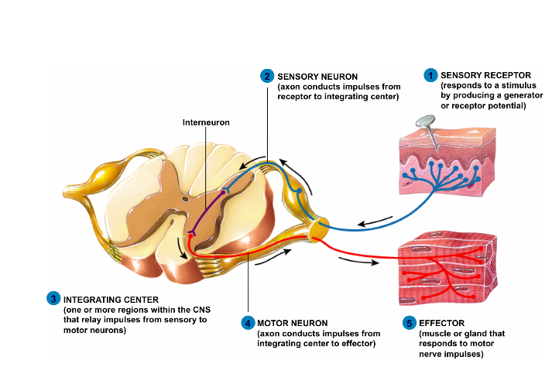
Sensory fibres of the peripheral system enter the cord via the dorsal routes. The cell bodies of the sensory fibres are found in the dorsal root ganglia which lie alongside the spinal cord. The motor fibres leave via the ventral routes.

Slide 38
Reflex arc animation
Reflex arcs
Make a flow chart naming all the structures involved in the reflex arc in response to hot surface and put them in the order of the direction of the impulse.

Slide 39
Reflex actions – eg. touching a hot object (complete the following)
If a hand touches a hot object a pain …………………………receptor…………. in the skin sends an action potential along a ……sensory …… neurone. This enters the spine through the …dorsal… root. The impulse is passed to a ……relay……….. neurone which lies totally within the …………grey matter…………… region of the spinal tissue. This in turn passes the impulse to a ……motor…… neurone which leaves the spine by way of the ……ventral……… root. It takes the impulse to a ……effector/muscle……. which will ……contract………………. so removing the arm from the source of pain.

Slide 40
The importance of reflex arcs
Involuntary so don’t need the brain to make a decision so the brain is left to carry out more complex responses and not overloaded.
Some impulses are still sent to the brain via ascending and descending tracts in the spinal cord. The brain may store this information or it may relate the information with sense data from, say, the eyes. As a result of receiving this extra information impulses may be sent from the brain to modify the response. Sometimes the response is over-ridden by the brain along inhibitory nerve fibres. (You don’t just drop an expensive, hot plate!)

Slide 41
The importance of reflex arcs
They protect the body from harm. They are effective from birth and do not need to be learnt
They are fast as neurone pathway is short with often one or two synapses (this is the slowest link in a neurone pathway)
As no decision making needed the action is rapid.

Slide 42
Sensory receptors
Ranges from specialised sensory cells, (such as those in the skin), to more complex sense organs such as the ear and eye.
Sensory receptors detect one form of energy and convert it into electrical energy. They are acting as
transducers. The electrical impulses travel along nerves and are called nerve impulses.
Some nerves bring information to the CNS and others take the information away.
There are a number of different types of receptors including thermoreceptors, which detect changes in temperature, photoreceptors which detect light, and chemoreceptors which detect chemicals.

Slide 43
Behaviour | Definition | Purpose | Example | Advantage
Taxes
Kinesis
Tropism
Reflex Arc

Slide 44
3.6.1.2 Receptors
AQA Specification
The Pacinian corpuscle should be used as an example of a receptor to illustrate that:
• receptors respond only to specific stimuli
• stimulation of a receptor leads to the establishment of a generator potential.
The basic structure of a Pacinian corpuscle.
Deformation of stretch-mediated sodium ion channels in a Pacinian corpuscle leads to the establishment of a generator potential.
The human retina in sufficient detail to show how differences in sensitivity to light, sensitivity to colour and visual acuity are explained by differences in the optical pigments of rods and cones and the connections rods and cones make in the optic nerve.

Slide 45
Pacinian corpuscle
A Pacinian corpuscle is a receptor which responds to changes in mechanical pressure.
It is specific to a single type of stimulus
It produces a generator potential by acting as a transducer

Slide 46
Sensory receptors acts as transducers
All stimuli involve a change in some form of energy. Eg heat, light, sound or mechanical energy. The receptor changes or transduces one form of energy into a nerve impulse known as a generator potential.

Slide 47
Pacinian corpuscle
The Pacinian corpuscle is a 1 mm diameter skin receptor which enables us to perceive mechanical stimuli such as pressure and vibration.
This is the receptor responsible for our awareness off smooth vs rough surfaces, shallow vs intense tactile sensation, etc.
They are found deep in the skin and are most abundant on the fingers, the soles of the feet and the external genitalia. They also occur in joints, ligaments and tendons.

Slide 48
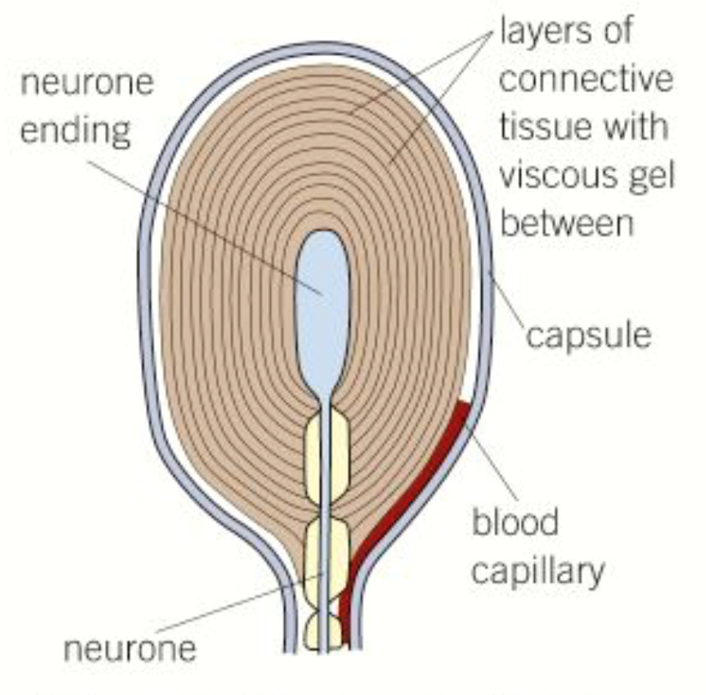
Pacinian corpuscle
A Pacinian corpuscle is a single sensory neurone in the centre of a layer of tissues, each separated by a gel.
Within the plasma membrane there are protein channels such as sodium channels.
The sodium channel is known as a stretch mediated sodium channel. It is named this way because it's permeability changes as it's shape changes.

Slide 49
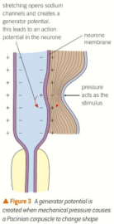
Pressure on the skin changed the shape of the Pacinian corpuscle.
This changes the shape of the pressure sensitive sodium channels in the membrane, making them open.
Sodium ions diffuse in through the channels leading to depolarisation of the membrane and thereby producing a generator potential.
The greater the pressure the more sodium channels open and the larger the generator potential.
If a threshold value is reached, an action potential occurs and nerve impulses travel along the sensory neurone.
The frequency of the impulse is related to the intensity of the stimulus

Slide 50
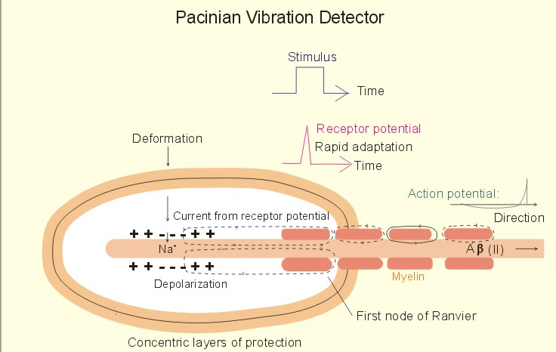

Slide 51
Receptors working together in the eye
Rods and Cones are the two main specialised eye photon receptors and differ in their distribution and sensitivity.
Rods are extremely sensitive in low light and can perceive as few as 6 photons, while cones sense more abundant light and therefore can identify different colours.

Slide 52
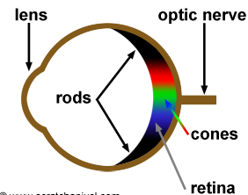
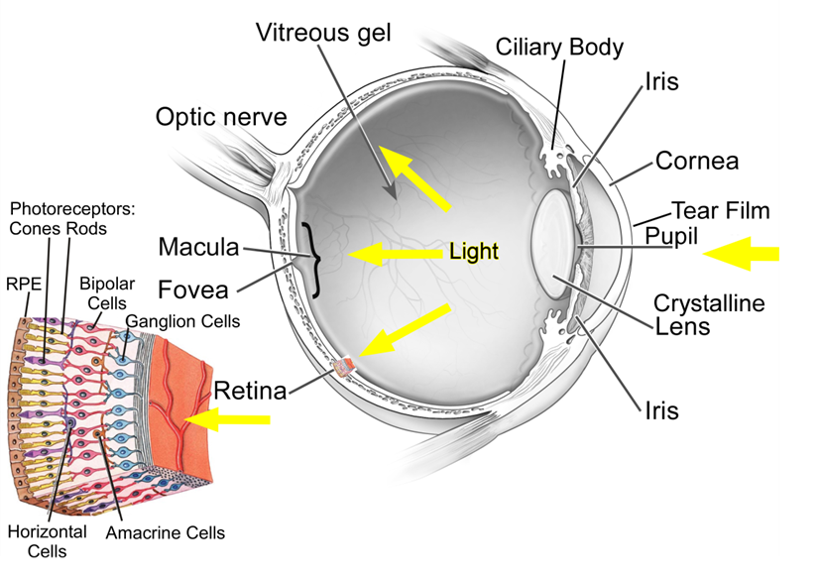
Rod cells are in greater number than cone cells
They are found in the periphery of the retina and are absent at the fovea
Cone cells are concentrated at the fovea
There is only one type of rod cell but three types of cone cells each responding to different wavelengths of light

Slide 53
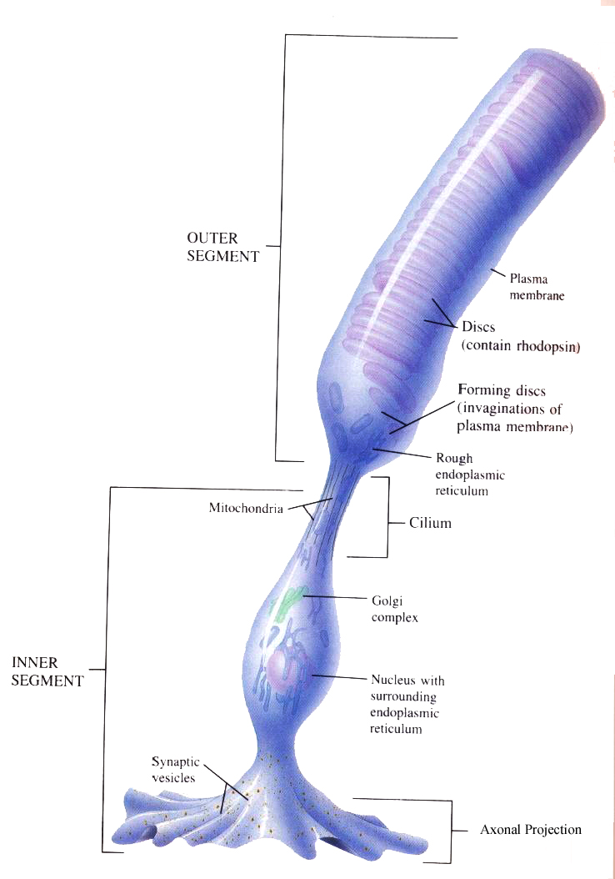
Rods
Rod cells are responsible for detecting light/dark. These cells cannot distinguish different wavelengths of light.
Rod cells are much more plentiful than cone cells.
They contain a pigment called rhodopsin. When light shines on this pigment, it is broken down in a process called bleaching which creates a generator potential that then stimulates an action potential that is detected in the brain.

Slide 54
Rods
There is a 3:1 ratio of rod cells: bipolar neurone because a threshold value has to be exceeded before a generator potential is made in bipolar neurone. With a 3:1 ratio this is more likely. This is called retinal convergence.
However, the rhodopsin is very sensitive to light, and is therefore best in dim conditions; since in brighter conditions it is broken down faster than it is reformed. This is why, in dim conditions we will see mainly in black and white

Slide 55
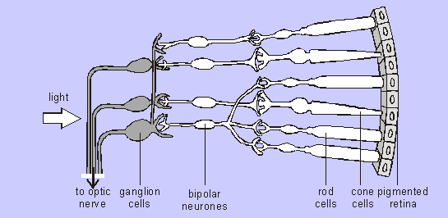
Many rods usually connected to one bipolar cell so even if many rods detect light only a single impulse will be sent to the brain.
This means that the brain cannot distinguish between separate sources of light that stimulated the Rod cells, so Rod cells give poor visual acuity (i.e. rods are not good at resolving fine detail).

Slide 56
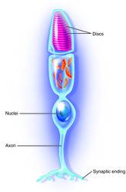
Cones
This cell has a different pigment called iodopsin.
There are 3 different types of iodopsin: sensitive to either red, blue or green wavelengths.
Therefore we have red sensitive, green sensitive and blue sensitive cones. We see different colours by the stimulation of different combinations of iodopsins. E.g red and green cones being stimulated = orange light
Each cone has its own bipolar neurone so they do not create generator potential when stimulated en masse.
They only respond to high light intensity which breaks down iodopsin. It is only then a generator potential is produced.

Slide 57
Cones
They only respond to high light intensity which breaks down iodopsin. It is only then a generator potential is produced.
As each cone cell is attached to a single bipolar cell if two cone cells are stimulated then the brain receives two separate impulses. The brain is therefore able to distinguish between the two separate sources of light and so is able to resolve two dots close together.
Cone cells give good visual acuity.

Slide 58
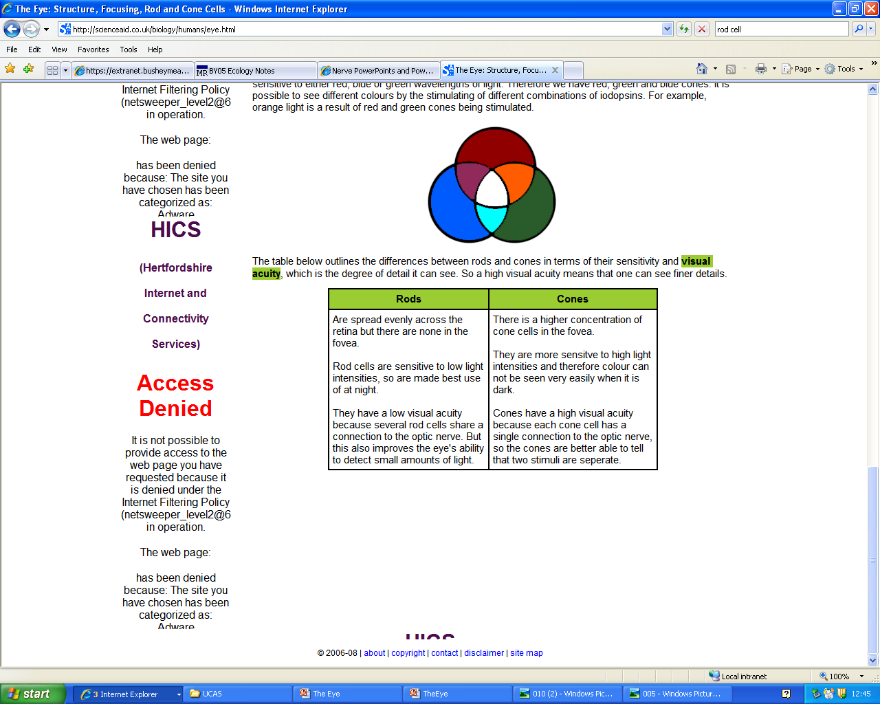
Rods vs Cones

Slide 59
3.6.1.3 Control of heartrate
AQA Specification
Myogenic stimulation of the heart and transmission of a subsequent wave of electrical activity.
The roles of the sinoatrial node (SAN), atrioventricular node (AVN) and Purkyne tissue in the bundle of His.
The roles and locations of chemoreceptors and pressure receptors and the roles of the autonomic nervous system and effectors in controlling heart rate.

Slide 60
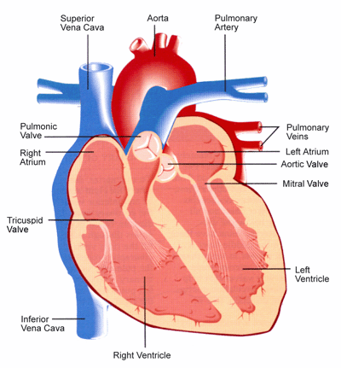
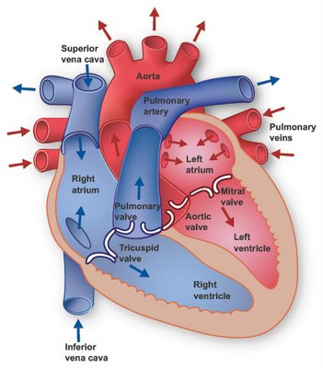
Learn to draw
and label
the diagram
right pulmonary artery
semi lunar
valve or
or semi lunar valve
or bicuspid valve or atrioventricular valve
atrioventricular
valve or
tendons attached to
papillary muscle
thick muscular wall
interventricular
septum
pericardium

Slide 61
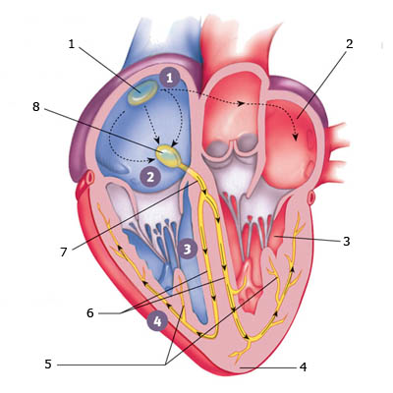
Electrical Activity in the Heart
Sinoatrial Node
Left Atrium
AtrioVentricular
node
Left Ventricle
Bundle of His
Left and Right
Bundle Branches
Apex
Purkinje Fibres
sinoatrial node
left atrium
left ventricle
apex
purkinje fibers
left and right bundle branches
bundle of his
atrioventricular node

Slide 62
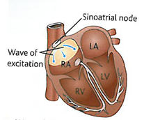
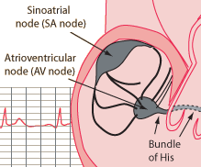
1. Electrical activity in the heart - SAN
It is essential that the sequence of muscle contraction and relaxation takes place in the right order
The sequence is controlled by a group of cardiac muscle cells called the sinoatrial node (SAN) near the top of the right atrium
Known as the natural pacemaker it sets the timing/rate/rhythm of all cardiac muscle cells
A wave of excitation is initiated at the SAN which passes over both of the atrial walls causing the atria to contract simultaneously

Slide 63
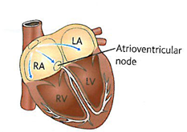
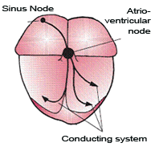
2. Electrical activity in the heart - AVN
The horizontal septum (atrioventricular septum) between the atria and the ventricles is non-conducting and so the wave of excitation cannot pass to the ventricles
The electrical impulse is received by the atrioventricular node (AVN).
This leads to a small delay so that the atria empty fully before the ventricles contract

Slide 64
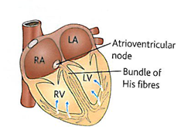
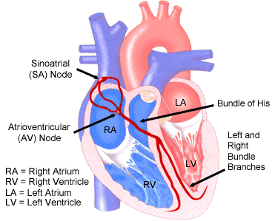
3. Electrical Activity in the heart - Bundle of His
From the AVN specialised fibres called the Purkinje tissue (which make up a structure called the bundle of His) conduct electrical impulses rapidly down the vertical septum between the ventricles (like a bottleneck)

Slide 65
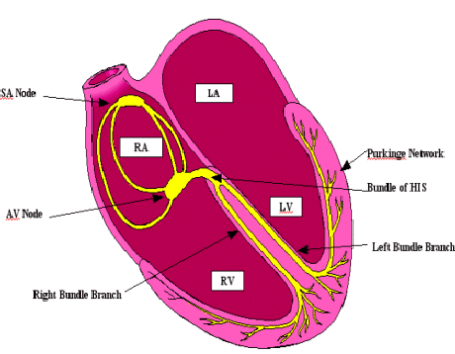
4. Electrical Activity - the Purkinje Fibres
From the Bundle of His the wave of excitation travels back up the ventricles through the Purkinje network of fibres through the ventricular muscle
This causes the ventricles to contract from the apex up
The contraction of the ventricles is therefore delayed after the atria
http://www.washingtonhra.com/16.html
://www.washingtonhra.com/resources/AV%252Bblock%252Banimation.gif&w=634&h=640&ei=xHpTT4CvNYbN0QXIiJzvCw&zoom=1&iact=hc&vpx=572&vpy=162&dur=5721&hovh=226&hovw=223&tx=98&ty=151&sig=108793582586417777891&page=1&tbnh=119&tbnw=118&start=0&ndsp=41&ved=1t:429,r:3,s:0

Slide 66
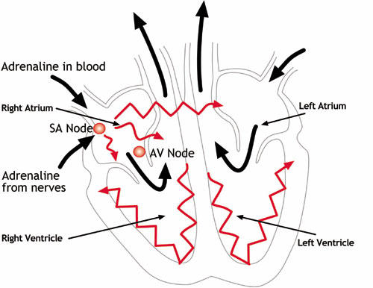
The SAN contains self excitable cells but heart rate can be modified by hormones or the nervous system

Slide 67
Fill in the gaps
The mammalian heart is made up of a special type of muscle called ------------------ muscle. This muscle has the ability to contract and relax without any stimulation and is therefore said to be -------------. The heart beat is initiated in an area of the right atrium called the -----------------------------------. The wave of excitation passes across both atria until it reaches an area of tissue called the --------------------. This in turn passes the wave to a group of fibres called the ---------------------------- and then the -------------------- ------------------- which transfer the wave to the tip of the ventricles. This causes the ventricles to ----------------- from the base upwards and forces blood to flow out of the heart through the aorta and the ------------------.
57

Slide 68
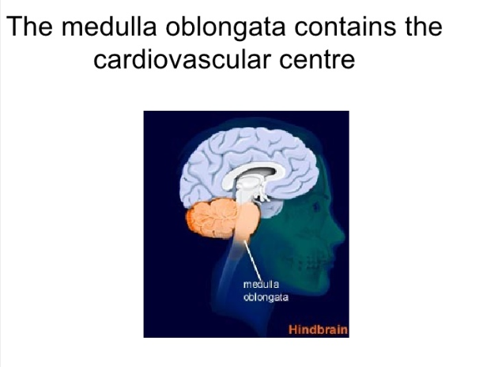
Modifying the resting heart rate

Slide 69
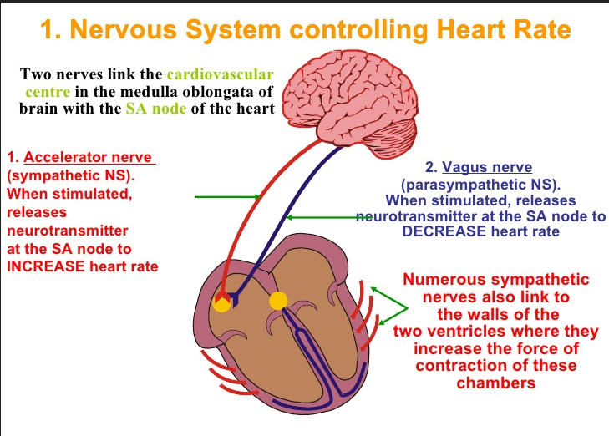
Which of these centres is simulated depends upon the nerve impulses they receive from two types of receptor, which respond to stimuli of either chemical or pressure changes in the blood.

Slide 70
Nervous system controlling the heart
When do you think the sympathetic nervous system is most dominant?
Stress and excitement
When do you think the parasympathetic nervous system is most dominant?
Rest and Sleep

Slide 71
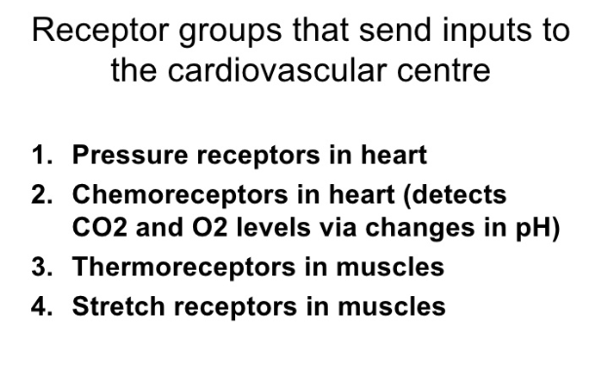

Slide 72
Control by Chemoreceptors
Chemoreceptors are found in the wall of carotid arteries (the arteries that serve the brain)
These are sensitive to pH in the blood
CO₂ levels will affect the pH of the blood
Exercise will increase CO₂ levels

Slide 73
CO₂ levels increase so pH of the blood is ______________
Chemoreceptors in wall of carotid arteries and the aorta detect the change and send an impulse to the ______________________
This centre _______________ impulses sent to SAN via sympathetic nervous system
Rate of production of excitation wave increased
Heart rate is _______________
Blood flow increased so CO₂ removed by lungs
pH of blood returns to normal
Chemoreceptors in wall of carotid arteries and the aorta detect the change
Frequency of nerve impulses to medulla oblongata ________________
Heart rate ________________

Slide 74
Control by pressure receptors
Pressure receptors are found in the wall of carotid arteries and the aorta. They respond to changes in blood pressure.
When blood pressure is high:
Pressure receptors transmit more impulses to the centre in the medulla oblongata that decreases heart rate .
The centre sends impulses via the parasympathetic nervous system to the SAN which leads to a decrease in heart rate

Slide 75
Control by pressure receptors
When blood pressure is low:
Pressure receptors transmit more impulses to the centre in the medulla oblongata that increases heart rate .
The centre sends impulses via the sympathetic nervous system to the SAN which leads to a increase in heart rate
http://highered.mheducation.com/sites/0072507470/student_view0/chapter21/animation__baroreceptor_reflex_control_of_blood_pressure.html

Slide 76
