Slide 1
Captain scott
And his diary/expedition

Slide 2
Background info:
Born on 6th June 1868 in England
Died 29th March 1912 Antarctica
Occupation: Navy officer and Antarctica explorer
Awards: RGS Patron's Gold Medal (1904), Vega Medal (1905), Cullum Geographical Medal (1906)
Parent(s): John Edward Scott, Hannah Scott
Spouse(s): Kathleen Bruce

Slide 3
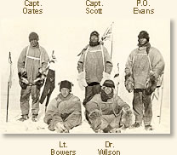
Colleagues:
Lawrence Oates
17th March 1880 – 17th March 1912
Edward Wilson
Henry Bowers
Evans

Slide 4
The expedition:
Set off from Wales in October 1911
They took ponies, dogs and sledges
By mid December the ponies and dogs teams turned back
By Jan 1912, only 5 remained; Scott, Wilson, Oates, Bowers and Evans
On 17 January, they reached the pole, only to find that a Norwegian party led by Roald Amundsen, had beaten them there
They started the 1,500 km journey back
By March, Oates was suffering from severe frostbite and, knowing he was holding back his companions, walked out into the freezing conditions never to be seen again
Eight months later, a search party found the tent, the bodies and Scott's diary

