Slide 1
3.6.1.3 Control of heartrate
AQA Specification
Myogenic stimulation of the heart and transmission of a subsequent wave of electrical activity.
The roles of the sinoatrial node (SAN), atrioventricular node (AVN) and Purkyne tissue in the bundle of His.
The roles and locations of chemoreceptors and pressure receptors and the roles of the autonomic nervous system and effectors in controlling heart rate.

Slide 2
How is the nervous system organized?

Slide 3
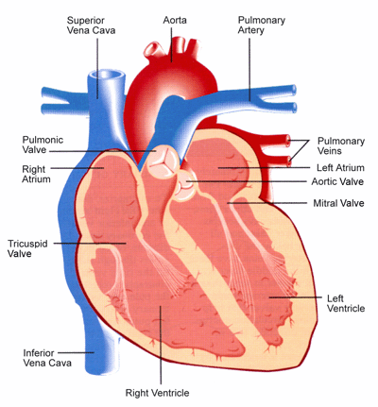
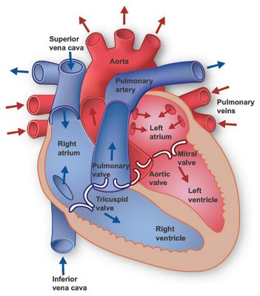
Learn to draw
and label
the diagram
right pulmonary artery
semi lunar
valve or
or semi lunar valve
or bicuspid valve or atrioventricular valve
atrioventricular
valve or
tendons attached to
papillary muscle
thick muscular wall
interventricular
septum
pericardium

Slide 4
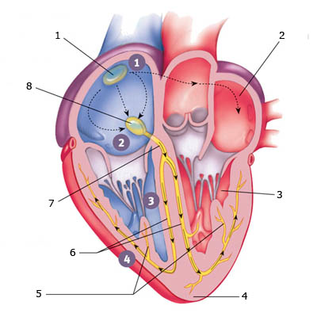
Electrical Activity in the Heart
Sinoatrial Node
Left Atrium
AtrioVentricular
node
Left Ventricle
Bundle of His
Left and Right
Bundle Branches
Apex
Purkinje Fibres
sinoatrial node left atrium left ventricle apex purkinje fibers left and right bundle branches bundle of his atrioventricular node

Slide 5
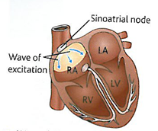
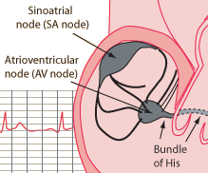
1. Electrical activity in the heart - SAN
It is essential that the sequence of muscle contraction and relaxation takes place in the right order
The sequence is controlled by a group of cardiac muscle cells called the sinoatrial node (SAN) near the top of the right atrium
Known as the natural pacemaker it sets the timing/rate/rhythm of all cardiac muscle cells
A wave of excitation is initiated at the SAN which passes over both of the atrial walls causing the atria to contract simultaneously

Slide 6
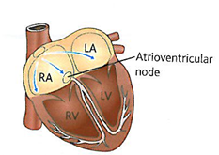
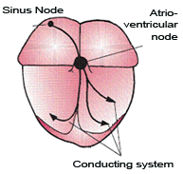
2. Electrical activity in the heart - AVN
The horizontal septum (atrioventricular septum) between the atria and the ventricles is non-conducting and so the wave of excitation cannot pass to the ventricles
The electrical impulse is received by the atrioventricular node (AVN).
This leads to a small delay so that the atria empty fully before the ventricles contract

Slide 7
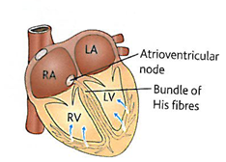
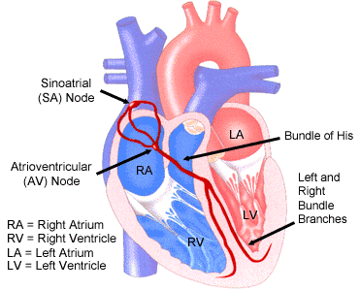
3. Electrical Activity in the heart - Bundle of His
From the AVN specialised fibres called the Purkinje tissue (which make up a structure called the bundle of His) conduct electrical impulses rapidly down the vertical septum between the ventricles (like a bottleneck)

Slide 8
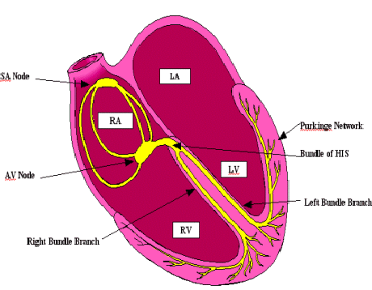
4. Electrical Activity - the Purkinje Fibres
From the Bundle of His the wave of excitation travels back up the ventricles through the Purkinje network of fibres through the ventricular muscle
This causes the ventricles to contract from the apex up
The contraction of the ventricles is therefore delayed after the atria
http://www.washingtonhra.com/16.html
://www.washingtonhra.com/resources/AV%252Bblock%252Banimation.gif&w=634&h=640&ei=xHpTT4CvNYbN0QXIiJzvCw&zoom=1&iact=hc&vpx=572&vpy=162&dur=5721&hovh=226&hovw=223&tx=98&ty=151&sig=108793582586417777891&page=1&tbnh=119&tbnw=118&start=0&ndsp=41&ved=1t:429,r:3,s:0

Slide 9
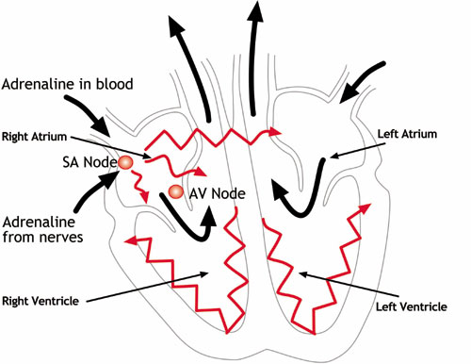
The SAN contains self excitable cells but heart rate can be modified by hormones or the nervous system

Slide 10
Fill in the gaps
The mammalian heart is made up of a special type of muscle called ------------------ muscle. This muscle has the ability to contract and relax without any stimulation and is therefore said to be -------------. The heart beat is initiated in an area of the right atrium called the -----------------------------------. The wave of excitation passes across both atria until it reaches an area of tissue called the --------------------. This in turn passes the wave to a group of fibres called the ---------------------------- and then the -------------------- ------------------- which transfer the wave to the tip of the ventricles. This causes the ventricles to ----------------- from the base upwards and forces blood to flow out of the heart through the aorta and the ------------------.
57

Slide 11
Modifying the resting heart rate

Slide 12
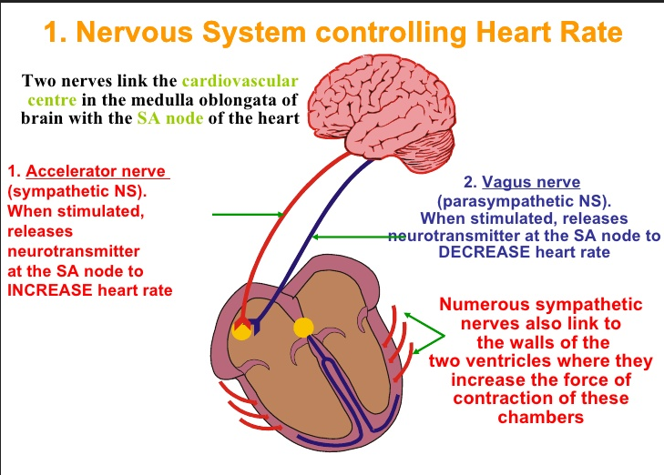
Which of these centres is simulated depends upon the nerve impulses they receive from two types of receptor, which respond to stimuli of either chemical or pressure changes in the blood.

Slide 13
Nervous system controlling the heart
When do you think the sympathetic nervous system is most dominant?
Stress and excitement
When do you think the parasympathetic nervous system is most dominant?
Rest and Sleep

Slide 14
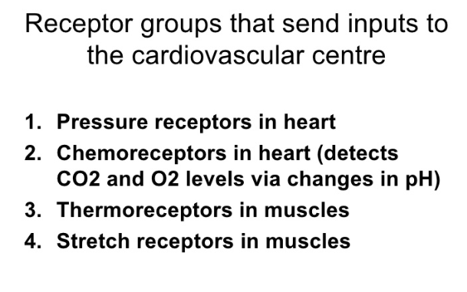

Slide 15
Control by Chemoreceptors
Chemoreceptors are found in the wall of carotid arteries (the arteries that serve the brain)
These are sensitive to pH in the blood
CO₂ levels will affect the pH of the blood
Exercise will increase CO₂ levels

Slide 16
CO₂ levels increase so pH of the blood is ______________
Chemoreceptors in wall of carotid arteries and the aorta detect the change and send an impulse to the ______________________
This centre _______________ impulses sent to SAN via sympathetic nervous system
Rate of production of excitation wave increased
Heart rate is _______________
Blood flow increased so CO₂ removed by lungs
pH of blood returns to normal
Chemoreceptors in wall of carotid arteries and the aorta detect the change
Frequency of nerve impulses to medulla oblongata ________________
Heart rate ________________

Slide 17
CO₂ levels increase so pH of the blood is lowered
Chemoreceptors in wall of carotid arteries and the aorta detect the change and send an impulse to the medulla oblongata
This centre increases impulses sent to SAN via sympathetic nervous system
Rate of production of excitation wave increased
Heart rate is increased
Blood flow increased so CO₂ removed by lungs
pH of blood returns to normal
Chemoreceptors in wall of carotid arteries and the aorta detect the change
Frequency of nerve impulses to medulla oblongata decreased
Heart rate decreased

Slide 18
Control by pressure receptors
Pressure receptors are found in the wall of carotid arteries and the aorta. They respond to changes in blood pressure.
When blood pressure is high:
Pressure receptors transmit more impulses to the centre in the medulla oblongata that decreases heart rate .
The centre sends impulses via the parasympathetic nervous system to the SAN which leads to a decrease in heart rate

Slide 19
Control by pressure receptors
When blood pressure is low:
Pressure receptors transmit more impulses to the centre in the medulla oblongata that increases heart rate .
The centre sends impulses via the sympathetic nervous system to the SAN which leads to a increase in heart rate
http://highered.mheducation.com/sites/0072507470/student_view0/chapter21/animation__baroreceptor_reflex_control_of_blood_pressure.html

Slide 20
