Slide 1
3.6 Organisms respond to changes in their internal and external environments

Slide 2
Specification
A stimulus is a change in the internal or external environment.
A receptor detects a stimulus.
A coordinator formulates a suitable response to a stimulus. An effector produces a response.
Receptors are specific to one type of stimulus.
Nerve cells pass electrical impulses along their length. A nerve impulse is specific to a target cell only because it releases a chemical messenger directly onto it, producing a response that is usually rapid, short-lived and localised.
In contrast, mammalian hormones stimulate their target cells via the blood system. They are specific to the tertiary structure of receptors on their target cells and produce responses that are usually slow, long-lasting and widespread.
Plants control their response using hormone-like growth substances.

Slide 3
Receptors working together in the eye
Rods and Cones are the two main specialised eye photon receptors and differ in their distribution and sensitivity.
Rods are extremely sensitive in low light and can perceive as few as 6 photons, while cones sense more abundant light and therefore can identify different colours.

Slide 4
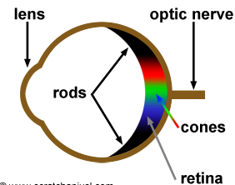
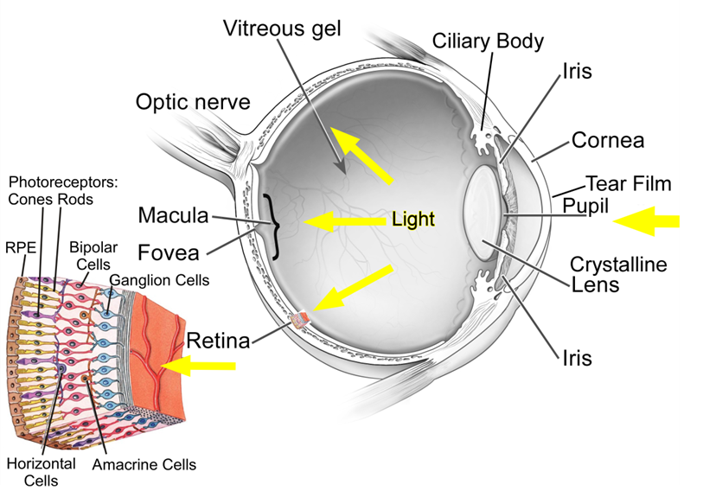
Rod cells are in greater number than cone cells
They are found in the periphery of the retina and are absent at the fovea
Cone cells are concentrated at the fovea
There is only one type of rod cell but three types of cone cells each responding to different wavelengths of light

Slide 5
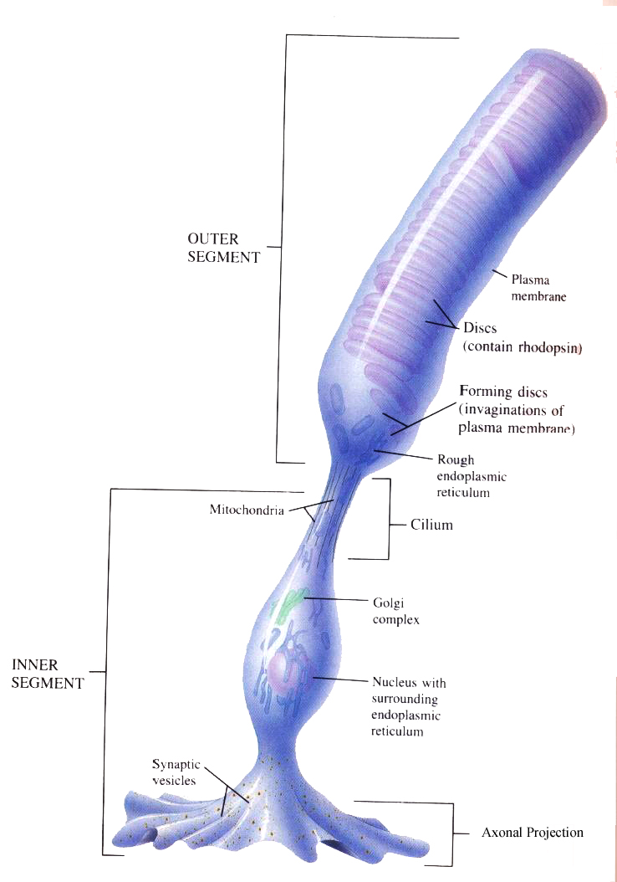
Rods
Rod cells are responsible for detecting light/dark. These cells cannot distinguish different wavelengths of light.
Rod cells are much more plentiful than cone cells.
They contain a pigment called rhodopsin. When light shines on this pigment, it is broken down in a process called bleaching which creates a generator potential that then stimulates an action potential that is detected in the brain.

Slide 6
Rods
There is a 3:1 ratio of rod cells: bipolar neurone because a threshold value has to be exceeded before a generator potential is made in bipolar neurone. With a 3:1 ratio this is more likely. This is called retinal convergence.
However, the rhodopsin is very sensitive to light, and is therefore best in dim conditions; since in brighter conditions it is broken down faster than it is reformed. This is why, in dim conditions we will see mainly in black and white

Slide 7
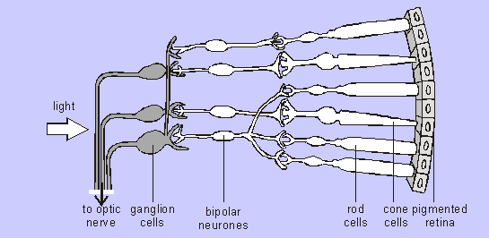
Many rods usually connected to one bipolar cell so even if many rods detect light only a single impulse will be sent to the brain.
This means that the brain cannot distinguish between separate sources of light that stimulated the Rod cells, so Rod cells give poor visual acuity (i.e. rods are not good at resolving fine detail).

Slide 8
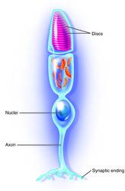
Cones
This cell has a different pigment called iodopsin.
There are 3 different types of iodopsin : sensitive to either red, blue or green wavelengths.
Therefore we have red sensitive, green sensitive and blue sensitive cones. We see different colours by the stimulation of different combinations of iodopsins. E.g red sensitive and green sensitive cones being stimulated = orange light
Each cone has its own bipolar neurone so they do not create generator potential when stimulated en masse.

Slide 9
Cones
They only respond to high light intensity which breaks down iodopsin. It is only then a generator potential is produced.
As each cone cell is attached to a single bipolar cell if two cone cells are stimulated then the brain receives two separate impulses. The brain is therefore able to distinguish between the two separate sources of light and so is able to resolve two dots close together.
Cone cells give good visual acuity.

Slide 10
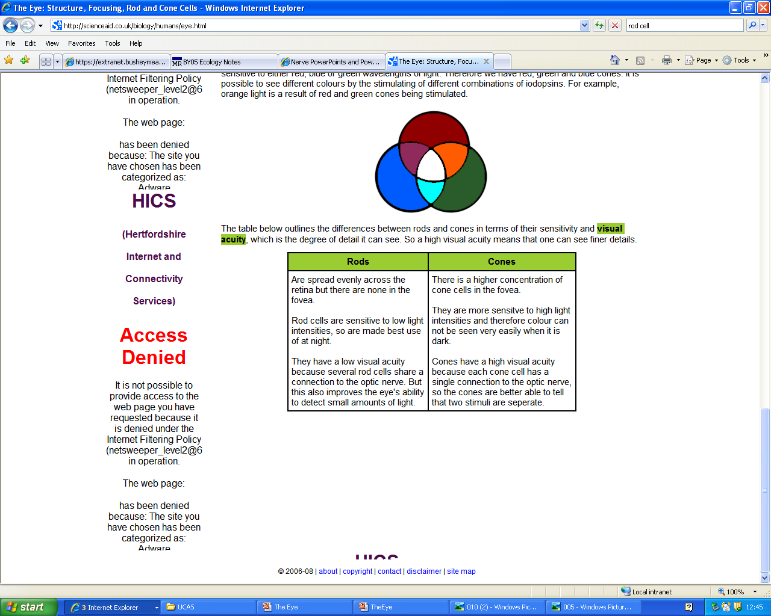
Rods vs Cones

