Slide 1
3.6 Organisms respond to changes in their internal and external environments

Slide 2
Specification
A stimulus is a change in the internal or external environment.
A receptor detects a stimulus.
A coordinator formulates a suitable response to a stimulus. An effector produces a response.
Receptors are specific to one type of stimulus.
Nerve cells pass electrical impulses along their length. A nerve impulse is specific to a target cell only because it releases a chemical messenger directly onto it, producing a response that is usually rapid, short-lived and localised.
In contrast, mammalian hormones stimulate their target cells via the blood system. They are specific to the tertiary structure of receptors on their target cells and produce responses that are usually slow, long-lasting and widespread.
Plants control their response using hormone-like growth substances.

Slide 3
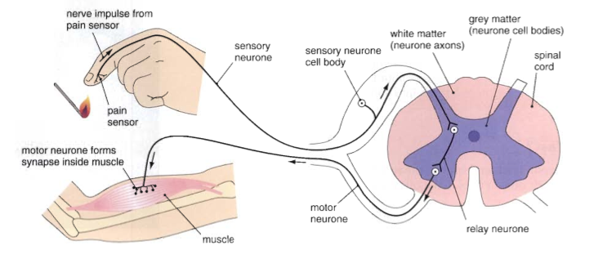
A reflex Arc
The simple reflex arc as the basis for protective, involuntary actions. It is the simplest type of nervous response to a stimulus

Slide 4
Nervous Organisation

Slide 5
How is the nervous system organized?

Slide 6
Crash course introduction to the nervous system
https://www.youtube.com/watch?v=x4PPZCLnVkA

Slide 7
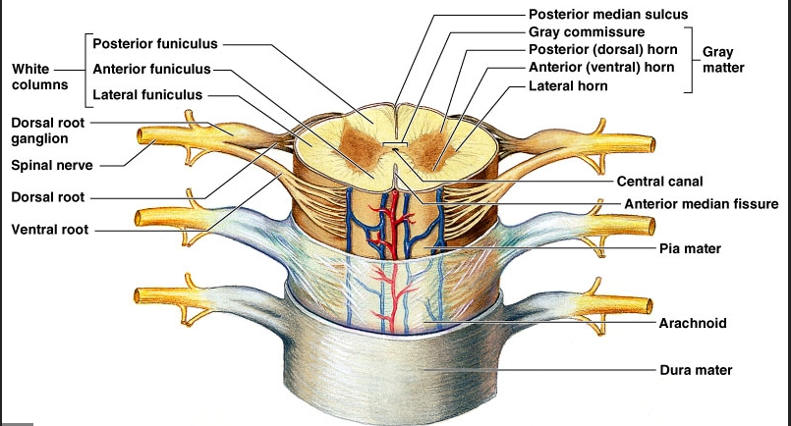
The Spinal cord
A column of nervous tissue that runs along the back and lies inside the vertebral column for protection. Emerging at intervals along the spinal cord are pairs of nerves.

Slide 8
Function of the Spinal cord
To relay impulses in and out of any particular point along the cord, and to relay impulses up and down the body, including to and from the brain.

Slide 9
Why are reflex arcs important?
BFY 338
An involuntary response that is very rapid.
It is not under the control of the brain.
It is protective and prevents damage to the body.

Slide 10
Label diagram in booklet

Slide 11
Stimulus
Receptor
Sensory neurone
Intermediate neurone
Spinal cord
Motor neurone
Effector
response

Slide 12
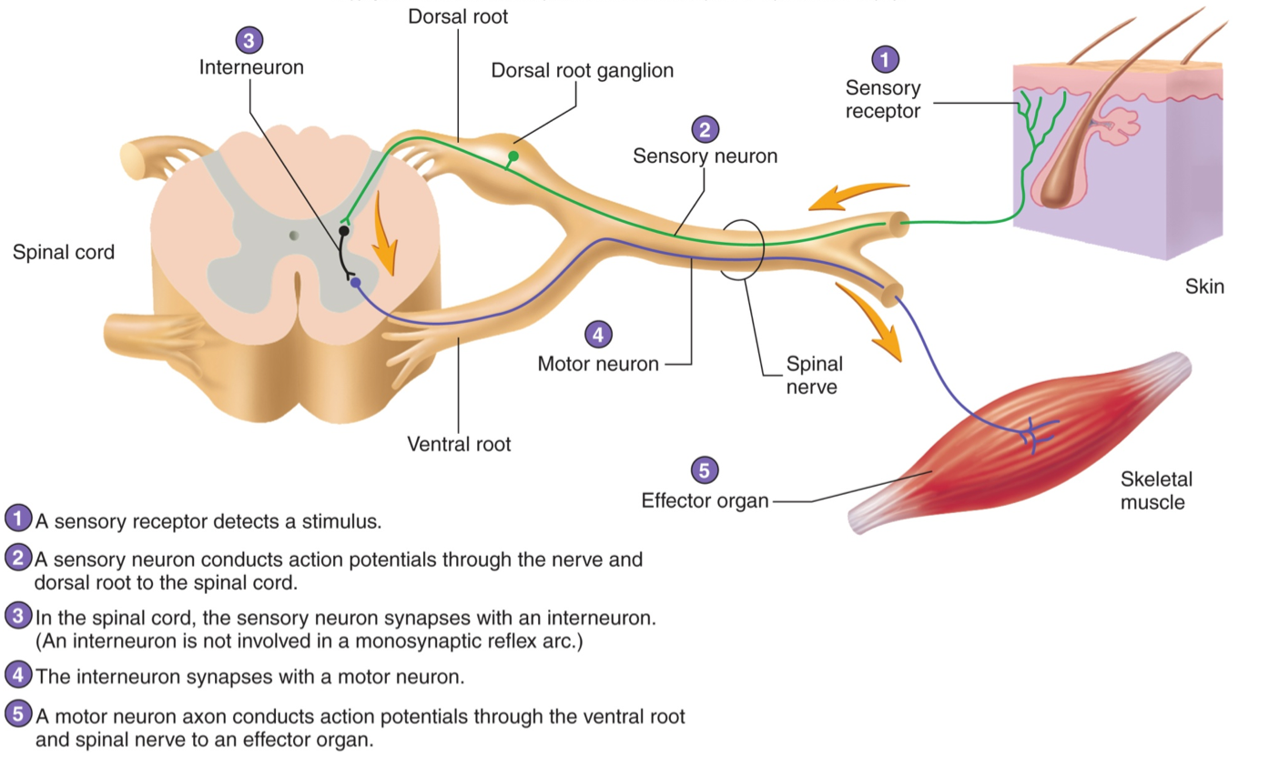

Slide 13
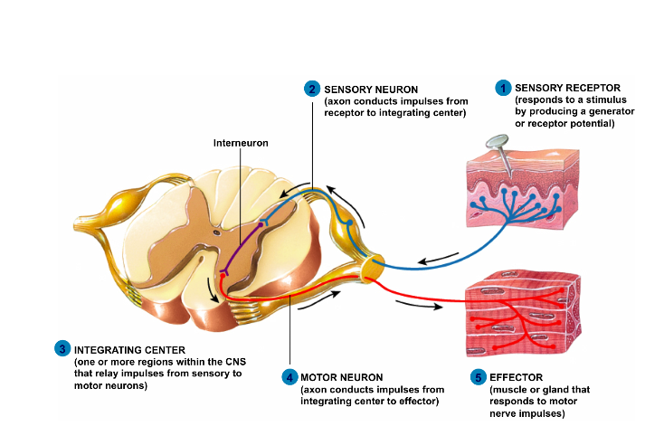
Sensory fibres of the peripheral system enter the cord via the dorsal routes. The cell bodies of the sensory fibres are found in the dorsal root ganglia which lie alongside the spinal cord. The motor fibres leave via the ventral routes.

Slide 14
Reflex arc animation
Reflex arcs
Make a flow chart naming all the structures involved in the reflex arc in response to hot surface and put them in the order of the direction of the impulse.

Slide 15
Stimulus – the hot surface.
Receptor – temperature and pain receptors in the skin which generate nerve impulses in the sensory neurone
Sensory neurone passes impulse to spinal cord.
Coordinator (intermediate neurone) links the sensory neurone to motor neurone in the spinal cord.
Motor neurone carries impulse from the spinal cord to an effector (muscle).
The effector –the muscle in the arm is stimulated to contract
Response - the hand is removed from surface.

Slide 16
Reflex actions – eg. touching a hot object (complete the following)
If a hand touches a hot object a pain …………………………receptor…………. in the skin sends an action potential along a ……sensory …… neurone. This enters the spine through the …dorsal… root. The impulse is passed to a ……relay……….. neurone which lies totally within the …………grey matter…………… region of the spinal tissue. This in turn passes the impulse to a ……motor…… neurone which leaves the spine by way of the ……ventral……… root. It takes the impulse to a ……effector/muscle……. which will ……contract………………. so removing the arm from the source of pain.

Slide 17
The importance of reflex arcs
Involuntary so don’t need the brain to make a decision so the brain is left to carry out more complex responses and not overloaded.
Some impulses are still sent to the brain via ascending and descending tracts in the spinal cord. The brain may store this information or it may relate the information with sense data from, say, the eyes. As a result of receiving this extra information impulses may be sent from the brain to modify the response. Sometimes the response is over-ridden by the brain along inhibitory nerve fibres. (You don’t just drop an expensive, hot plate!)

Slide 18
The importance of reflex arcs
They protect the body from harm. They are effective from birth and do not need to be learnt
They are fast as neurone pathway is short with often one or two synapses (this is the slowest link in a neurone pathway)
As no decision making needed the action is rapid.

Slide 19
Sensory receptors
Ranges from specialised sensory cells, (such as those in the skin), to more complex sense organs such as the ear and eye.
Sensory receptors detect one form of energy and convert it into electrical energy. They are acting as
transducers. The electrical impulses travel along nerves and are called nerve impulses.
Some nerves bring information to the CNS and others take the information away.
There are a number of different types of receptors including thermoreceptors, which detect changes in temperature, photoreceptors which detect light, and chemoreceptors which detect chemicals.

Slide 20
Behaviour | Definition | Purpose | Example | Advantage
Taxes
Kinesis
Tropism
Reflex Arc

