Slide 1
3.6 Organisms respond to changes in their internal and external environments

Slide 2
Specification
A stimulus is a change in the internal or external environment.
A receptor detects a stimulus.
A coordinator formulates a suitable response to a stimulus. An effector produces a response.
Receptors are specific to one type of stimulus.
Nerve cells pass electrical impulses along their length. A nerve impulse is specific to a target cell only because it releases a chemical messenger directly onto it, producing a response that is usually rapid, short-lived and localised.
In contrast, mammalian hormones stimulate their target cells via the blood system. They are specific to the tertiary structure of receptors on their target cells and produce responses that are usually slow, long-lasting and widespread.
Plants control their response using hormone-like growth substances.

Slide 3
3.6.1 Stimuli, both internal and external, are detected and lead to a response
Organisms increase their chance of survival by responding to changes in their environment.
In flowering plants, specific growth factors move from growing regions to other tissues, where they regulate growth in response to directional stimuli. The effect of different concentrations of indoleacetic acid (IAA) on cell elongation in the roots and shoots of flowering plants as an explanation of gravitropism and phototropism in flowering plants.
Taxes and kineses as simple responses that can maintain a mobile organism in a favourable environment.
The protective effect of a simple reflex, exemplified by a three neurone simple reflex. Details of spinal cord and dorsal and ventral roots are not required.

Slide 4
Organisms increase their chance of survival by responding to changes in their environment.
For the nervous system to carry out its function effectively it is dependent upon a continuous input of information from inside the body and from the environment. This input is detected by sensory receptors and relayed to effectors. That is, responses to all stimuli involve the reception of information and its transfer from the receptor to an effector via the nervous system.

Slide 5
Organisms increase their chance of survival by responding to changes in their environment.
Stimulus – a detectable change in the internal or external environment of an organism that leads to a response in the organism.

Slide 6
What is needed for control and co-ordination?
In order to respond to stimuli an organism needs:
A Receptor. Detects stimuli. Receptors are specific to one type of stimulus.
Receptors detect information from inside the body and from the surroundings.
A co-ordinator. Formulates a suitable response to a stimulus This could be at the molecular level, the brain or spinal cord (CNS), or a simple collection of cells.
An effector. Produces a response. This could be a muscle or a gland.

Slide 7
Communication methods in organisms
Hormones – relatively slow process, found in both plants and animals
Nervous system – more rapid means of communication found in animals

Slide 8
The sequence of events can be summarised as:
Stimulus receptor coordinator effector
response

Slide 9
Taxes
A taxis is a simple response whose direction is determined by the direction of the stimulus
Directional response to stimulus ie – moves toward (positive taxis) or away (negative taxis) from the stimulus

Slide 10
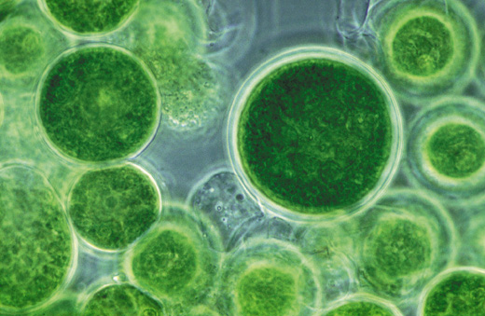
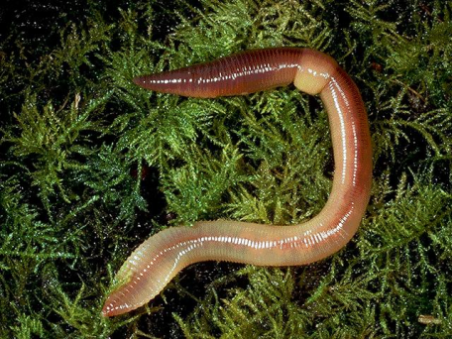
Examples of taxes
Single celled algae – As algae are photosynthetic they move towards light (positive phototaxis). This increases their chance of survival as they require light to manufacture their own food.
Earthworms – Move away from light (negative phototaxis). Helps them survive as this takes them into the soil, helping them conserve water, find food and avoid predators.

Slide 11
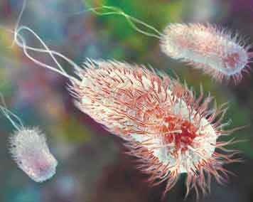
Examples of taxes
Some Bacteria –Move towards areas where glucose (there food) is more concentrated (positive chemotaxis) .

Slide 12
Kineses
A response when an organism does not move towards or away from a stimulus. Instead it changes the speed at which it moves and the rate at which it changes direction.
Non directional response to stimulus.
The more unfavourable the conditions the more rapidly the organism moves and changes direction more often.
This response enables the organism to return to favourable conditions more rapidly.

Slide 13
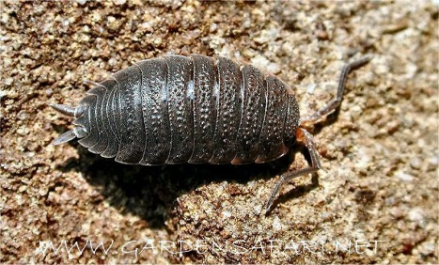
Examples of kinesis
Woodlice – lose water in dry conditions.
When in dry area – move more rapidly + change direction more often
When in damp area – move less rapidly + change direction less often.
This increases chance of organism moving into or staying in favourable conditions, preventing them drying out and increasing their chance of survival

Slide 14
Kineses vs Taxes Bozeman https://www.youtube.com/watch?v=jSKkecFzD50
Taxes - enables a faster direct response to the stimulus but is only possible if the stimulus is directional
Kineses – A slower random response but allows a response to a stimulus that isn’t always directional eg temperature and humidity

